Slide 1
Graphs

Slide 2
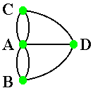
Introduction
Graphs are a collection of vertices and edges
  The solid circles are the vertices A, B, C and D
  The lines are the edges

Slide 3
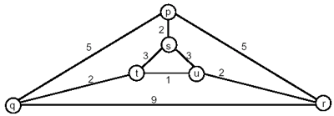
Weighted Graphs
We can also assign values to the edges (a cost related to connecting the two vertices together) and form a weighted graph

Slide 4
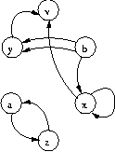
Directed Graph
There’s also a directed graph (sometimes called a digraph) that makes the edges one-way
  Since edges are only one-way, b has an edge to x, but x does not have an edge to b
As you can probably guess, you can have a weighted, directed graph as well

Slide 5
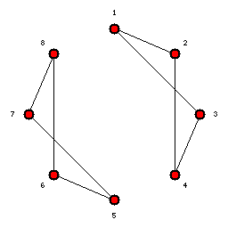
Terminology: Connected
A graph is said to be connected if there is a path from every vertex to every other vertex in the graph
If a graph is not connected, then we call it disconnected

Slide 6
Terminology: Path
A path is a list of vertices in which successive vertices are connected by edges in the graph. In this graph, one example path is
  A→B→D→A→C
A simple path is a path in which no vertex is repeated.
  Hence, A→B→D→A→C is not a simple path, but A→B→D→C is

Slide 7
Terminology: Cycle
A cycle is a path that is simple except that the first and last vertices are the same
In this graph, the path 7→5→6→8→7 is a cycle

Slide 8
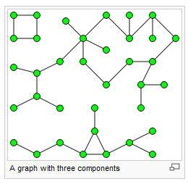
Terminology: Connected Component
A connected component or component is a maximal connected subgraph

Slide 9
Graph Representation
Adjacency Matrix
Adjacency List
Edge List
Adjacency Function

Slide 10
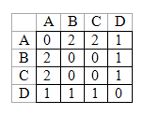
Adjacency Matrix
An adjacency matrix is simply an N x N matrix (where N is the number of vertices in the graph).
  Can store boolean (is there an edge?)
  Can store number (how many edges connect nodes)
  Can store weights (for weighted graph)

Slide 11
Adjacency List
The adjacency list simply keeps a linked list for each vertex that contains the vertices that are neighbors to it (that is, the list of vertices such that there exists an edge from the subject node to each of the vertices)
  A : B→C→D
  B : A→D
  C : A→D
  D : A→B→C

Slide 12
Motivation
Graphs are very useful for representing a large array of problems and for solving everyday “real world” problems, on which the contest loves to focus.
  Map intersections to vertices and roads to edges, and now you have a representation to help you route fire trucks to fires.
  Map a network of computers and routers to vertices, physical connections to edges, and you have a way to find the minimum number of hops between two given computers.
  Map a set of rooms that need water to vertices, all combinations of distances between pairs of rooms to the edges, and then you can determine the smallest amount of pipe needed to connect all the rooms together.
  Map the buildings on the UCF campus to vertices, the sidewalks between the buildings to vertices, and then you’ll be able to find the shortest walking distance from the Computer Science Building to any other building.
  Many, many others!

Slide 13
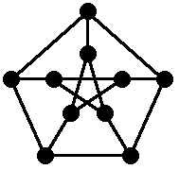
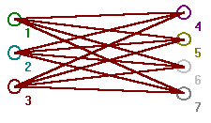

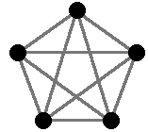
Testing

Slide 14
Algorithms
DFS
BFS
Two Coloring
Floyd-Warshall’s Algorithm (All Pairs Shortest Path)
Kruskal’s Algorithm (Minimum Spanning Tree)

Slide 15
Depth First Search
The name “Depth-First Search” comes from the fact that you search as deep as you can in the graph first
  We need an adjacency matrix and an array to keep track of whether we visited a given node yet
adj:array[1..N, 1..N] of Boolean
visited:array[1..N] of Boolean (initialized to all false)
DFS(node)
{
visited[node] = true;
if (node is target node) then
process accordingly
for I = 1 to N
{
if (adj[node][I]) and
(not visited[I]) then
DFS(I);
}
}

Slide 16
DFS Motivation
Most basic searching algorithm
Mazes
Path finding
Cycle detection

Slide 17
DFS Example
A
unexplored vertex
A
A
visited vertex
B
D
E
unexplored edge
discovery edge
C
back edge
A
A
B
D
E
B
D
E
C
C

Slide 18
DFS Example
A
A
B
D
E
B
D
E
C
C
A
A
B
D
E
B
D
E
C
C

Slide 19
Breadth First Search
The name “Breadth-First Search” comes from the idea that you search as wide as possible at each step
  Again, we need the adjacency list and visited array. We will also need a queue data structure
adj:array[1..N, 1..N] of Boolean
visited:array[1..N] of Boolean (initialized to all false)
BFS(node)
{
enqueue(node)
visited[node] = true
while (queue is not empty)
{
t = dequeue()
for I = 1 to N
{
if (adj[t][I]) and
(not visited[I]) then
enqueue(I)
visited[I] = true
}
}
}

Slide 20
BFS Motivation
Finding all connected components in a graph
Finding the shortest path between two nodes u and v (in an unweighted graph)
Testing a graph for bipartiteness

Slide 21
Example
L₀
unexplored vertex
A
A
A
visited vertex
L₁
B
C
D
unexplored edge
discovery edge
E
F
cross edge
L₀
L₀
A
A
L₁
L₁
B
C
D
B
C
D
E
F
E
F

Slide 22
Example (cont.)
L₀
L₀
A
A
L₁
L₁
B
C
D
B
C
D
L₂
E
F
E
F
L₀
L₀
A
A
L₁
L₁
B
C
D
B
C
D
L₂
L₂
E
F
E
F

Slide 23
Example (cont.)
L₀
L₀
A
A
L₁
L₁
B
C
D
B
C
D
L₂
L₂
E
F
E
F
L₀
A
L₁
B
C
D
L₂
E
F

Slide 24
Graph Coloring Problem
Goal: Assign colors to each vertex in a graph such that no two vertices that are connected by an edge are the same color.
The minimum number of colors necessary to complete a coloring for a particular graph is its chromatic number.

Slide 25
Two Color Problem
The two color problem is as follows: Given a graph, determine whether or not two colors suffices to color it.
There is a relatively quick solution to this problem.
However, no such solution for three colors exists. The three-color problem is NP-Complete, which, for now, is a way of saying that the problem is quite difficult.

Slide 26
Two Color Algorithm
Pick a start node arbitrarily and color it black.
Using, essentially a BFS, color all neighbors of this node white.
Continue the BFS, coloring all neighbors of black nodes white and all neighbors of white nodes black.
If a conflict ever arises, (you need to color a node already assigned a color the opposite color), answer NO!

Slide 27
Two Color Alg. Cont.
If all nodes are assigned a color, then clearly the answer is YES!
One trick: If the graph isn’t connected, you need to make sure and check all connected components. Thus, if the initial BFS doesn’t hit all nodes, then you must start another BFS from any uncolored node. Repeat until all nodes have been colored.

Slide 28
Floyd’s All Shortest Paths
This algorithm is known as “Floyd’s” and is based on dynamic programming. Basically, the idea of the algorithm is to construct a matrix that gives the length of the shortest path between each pair of nodes.
We’ll initialize this matrix to our adjacency matrix and then perform N iterations. After each iteration k, the matrix will give the length of the shortest paths between each pair of nodes that use only nodes numbered 1 to k.
At each iteration, the algorithm must check for each pair of nodes (i, j), whether or not there exists a path from i to j going through the node k that is better than the current shortest path using only nodes 1 to k-1.
After n iterations, the matrix will give the length of the shortest paths using any of the nodes, which is the result we want.

Slide 29
Floyd’s Algorithm
adj:array[1..N, 1..N] of Boolean
A:array[1..N, 1..N] of Boolean (A is our shortest path matrix)
Floyd()
{
A = adj;
For k=1 to N
{
for i=1 to N
{
for j=1 to N
A[i,j] = MIN(A[i,j], A[i,k]+A[k,j])
}
}
}
i
Uses only vertices numbered 1,…,k
(compute weight of this edge)
Uses only vertices
numbered 1,…,k-1
j
k
Uses only vertices
numbered 1,…,k-1

Slide 30
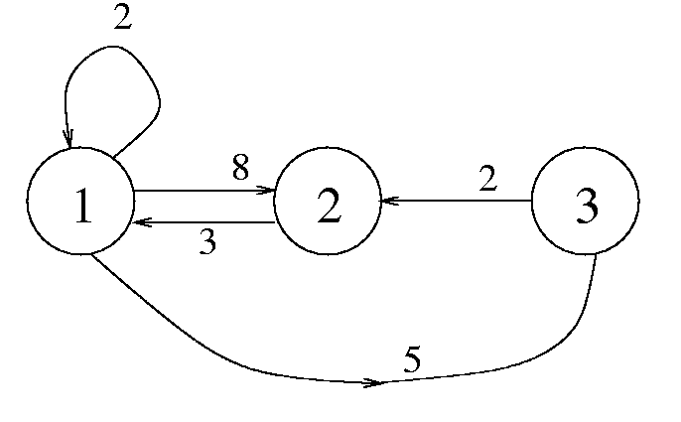
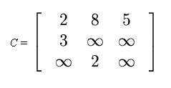
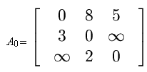
Floyd’s Example
Consider this graph with the adjacency matrix C
Be careful with self-loops
Need to zero out the diagonals
  But may be problem dependent!
So we’ll start with a modified adjacency matrix A₀

Slide 31
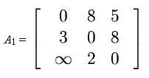
Floyd’s Example
Then we go through a loop where we update the shortest path from each node i to node j going through nodes 1 to k
So in step 1, we update each shortest path using only node 1
  A[i,j] = MIN(A[i,j], A[i,k]+A[k,j])
  A[2,3] = MIN(A[2,3], A[2,1]+A[1,3])
  A[2,3] = MIN(Inf, 3+5) = 8
  All others remain unchanged this loop through

Slide 32
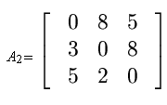
Floyd’s Example
Loop k=2
In step 2, we update each shortest path using only nodes 1 and 2
  A[i,j] = MIN(A[i,j], A[i,k]+A[k,j])
  A[3,1] = MIN(A[3,1], A[3,2]+A[2,1])
  A[3,1] = MIN(Inf, 2+3) = 5
  All others remain unchanged this loop through

Slide 33
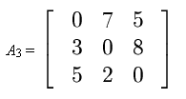
Floyd’s Example
Loop k=3
In step 3, we update each shortest path using only nodes 1, 2 and 3
  A[i,j] = MIN(A[i,j], A[i,k]+A[k,j])
  A[1,2] = MIN(A[1,2], A[1,3]+A[3,2])
  A[3,1] = MIN(8, 5+2) = 7
  All others remain unchanged this loop through

Slide 34
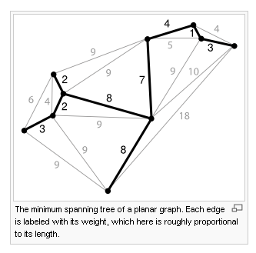
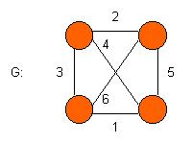
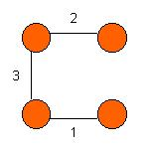
Minimum Spanning Tree
A subset of the edges that forms a tree that includes every vertex, where the total weight of all the edges in the tree is minimized
Motivation
  Connecting islands with cable
  Minimum sidewalks to connect buildings
  Many more!

Slide 35
MST Algorithms
Two algorithms
  Kruskal’s
    Adds edges that won’t cause a cycle (stop after n-1 edges)
  Prim’s
    Builds up a tree that includes all vertices (without cycles, obviously)

Slide 36
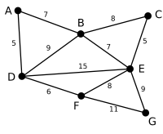
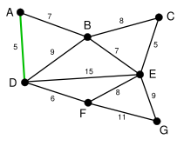
Kruskal’s Example
Here is our original graph
We’ll begin by finding the smallest edge
  Both AD and CE are the smallest (length 5)
  We’ll arbitrarily choose AD

Slide 37
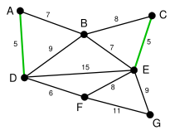
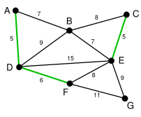
Kruskal’s Example
Then we consider the smallest edges left and find the one that won’t create a cycle
CE is of length 5 and won’t create a cycle
Then, DF (of length 6) is chosen in a similar fashion

Slide 38
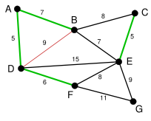
Kruskal’s Example
The process continues…
Both AB and BE are of length 7
We arbitrarily choose AB
Note that BD, if ever chosen, would create a cycle in our MST

Slide 39
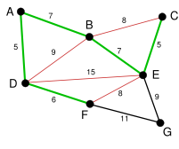
Kruskal’s Example
We then select BE (length 7) as our next edge since it does not create a cycle
Many more edges would now cause a cycle to be created if used later
  BC, DE and EF

Slide 40
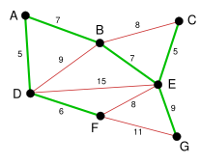
Kruskal’s Example
Finally, we will consider both BC and EF (of length 8) but they will be rejected as they would create cycles
So we consider BD and EG (of length 9)
  BD would create a cycle
  EG will not so we choose it

Slide 41
Kruskal’s Example
We’ve chosen n-1 edges so we’ve created our minimum spanning tree!

Slide 42
Summary
Graphs are useful for representing lots of different problems
  A major topic area for the ICPC
A variety of algorithms
  We’ve covered the most important today but there are others
  Get to know these algorithms very well!
  Watch the run-time

Slide 43
Thanks!
Thanks for images and other information to:
  Wikipedia
  Changhui (Charles) Yan
    http://www.cs.usu.edu/~cyan/CS5050/

