Slide 1
RAI Framework Project Design Considerations
SentinelOneX Security
AIML-510-01 — Responsible Application of AI
Workshop 3: Identifying & Managing Bias in AI
Aligned to NIST SP 1270 (March 2022)
Arun Kumar Vallala | Indiana Wesleyan University
Instructor: Armando V. Tauro, Ph.D. | June 17, 2026

Slide 2
Company Overview
SentinelOneX Security — Assignment 1.3
Cybersecurity AI company providing AI-powered threat detection, SOC automation, and vendor risk evaluation
Cybersecurity AI can directly impact customer systems and business operations
Our principles address threat response, customer trust, privacy protection, and operational decision-making
Organizational themes: fairness, accountability, transparency, privacy, reliability, and human oversight
AI Ethics Statement (Assignment 1.3)
Our AI systems will be designed and deployed to improve cybersecurity outcomes while respecting privacy, fairness, transparency, and human oversight. We commit to developing AI that is secure, reliable, explainable, and accountable. Human decision-makers will retain authority over critical security actions. We will continuously monitor AI systems for bias, performance degradation, and unintended consequences.
SentinelOneX Security | RAI Framework — Bias Design

Slide 3
AI Use Cases Under Consideration
Same use cases from Assignment 1.3
Use Case | Description | 1.3 Ethics Impact Area
AI Malware Detection Engine | ML model scores files and behaviors as malicious or benign for endpoint protection | Customer systems & operational decision-making
SOC Alert Triage & Prioritization | AI ranks incoming security alerts so analysts focus on highest-risk incidents first | Threat response & operational decision-making
Automated Incident Response Recommendations | AI suggests containment actions such as isolation, blocking, or escalation | Customer systems & threat response (human retains authority)
Third-Party Vendor AI Risk Assessment | AI evaluates external AI/security vendors for procurement and integration decisions | Customer trust, privacy protection, and accountability
SentinelOneX Security | RAI Framework — Bias Design

Slide 4
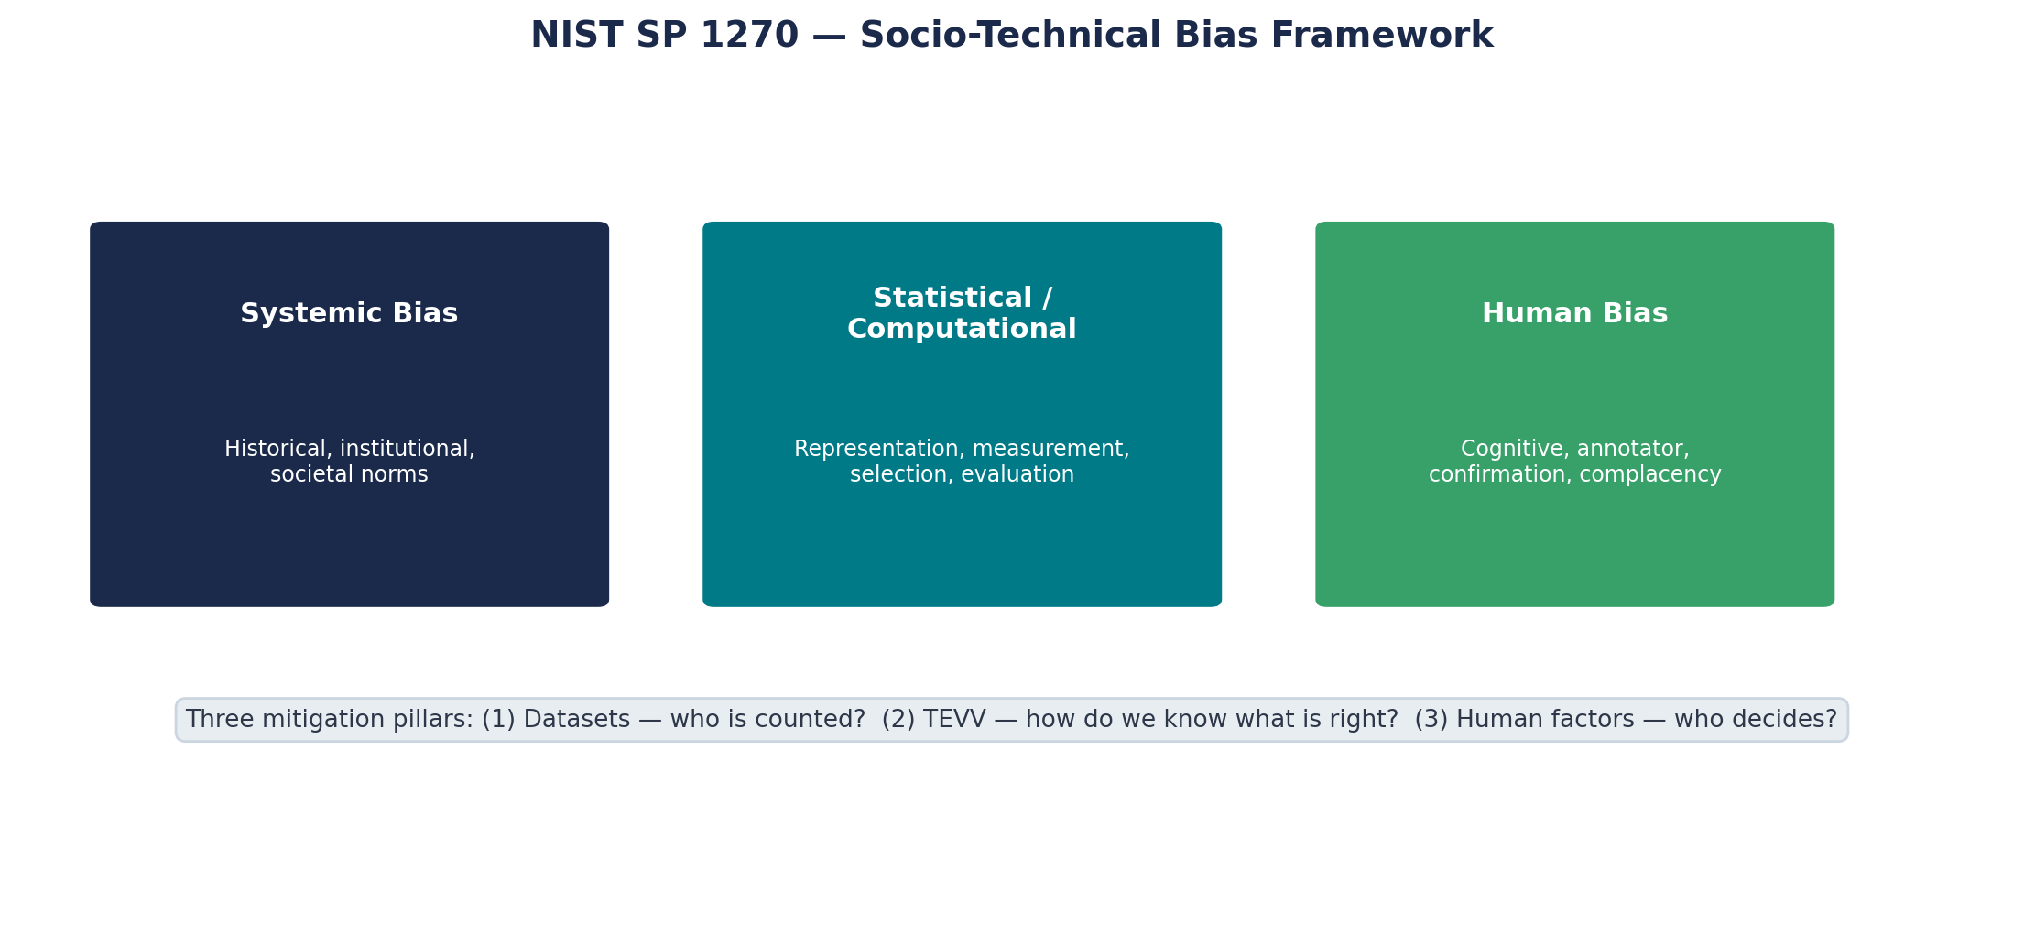
NIST SP 1270 Framework Context
Socio-technical approach — systemic, statistical/computational, and human bias (NIST Fig. 2)
Source: NIST SP 1270 — Towards a Standard for Identifying and Managing Bias in Artificial Intelligence (March 2022)
SentinelOneX Security | RAI Framework — Bias Design

Slide 5
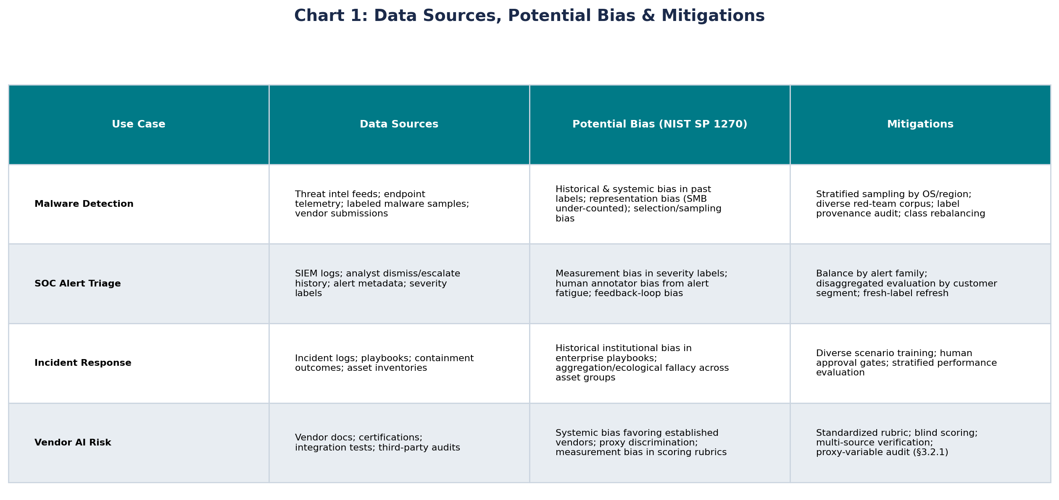
Chart: Data Sources, Bias & Mitigations
NIST §3.1 — dataset challenges: who is counted, and who is not?
SentinelOneX Security | RAI Framework — Bias Design

Slide 6
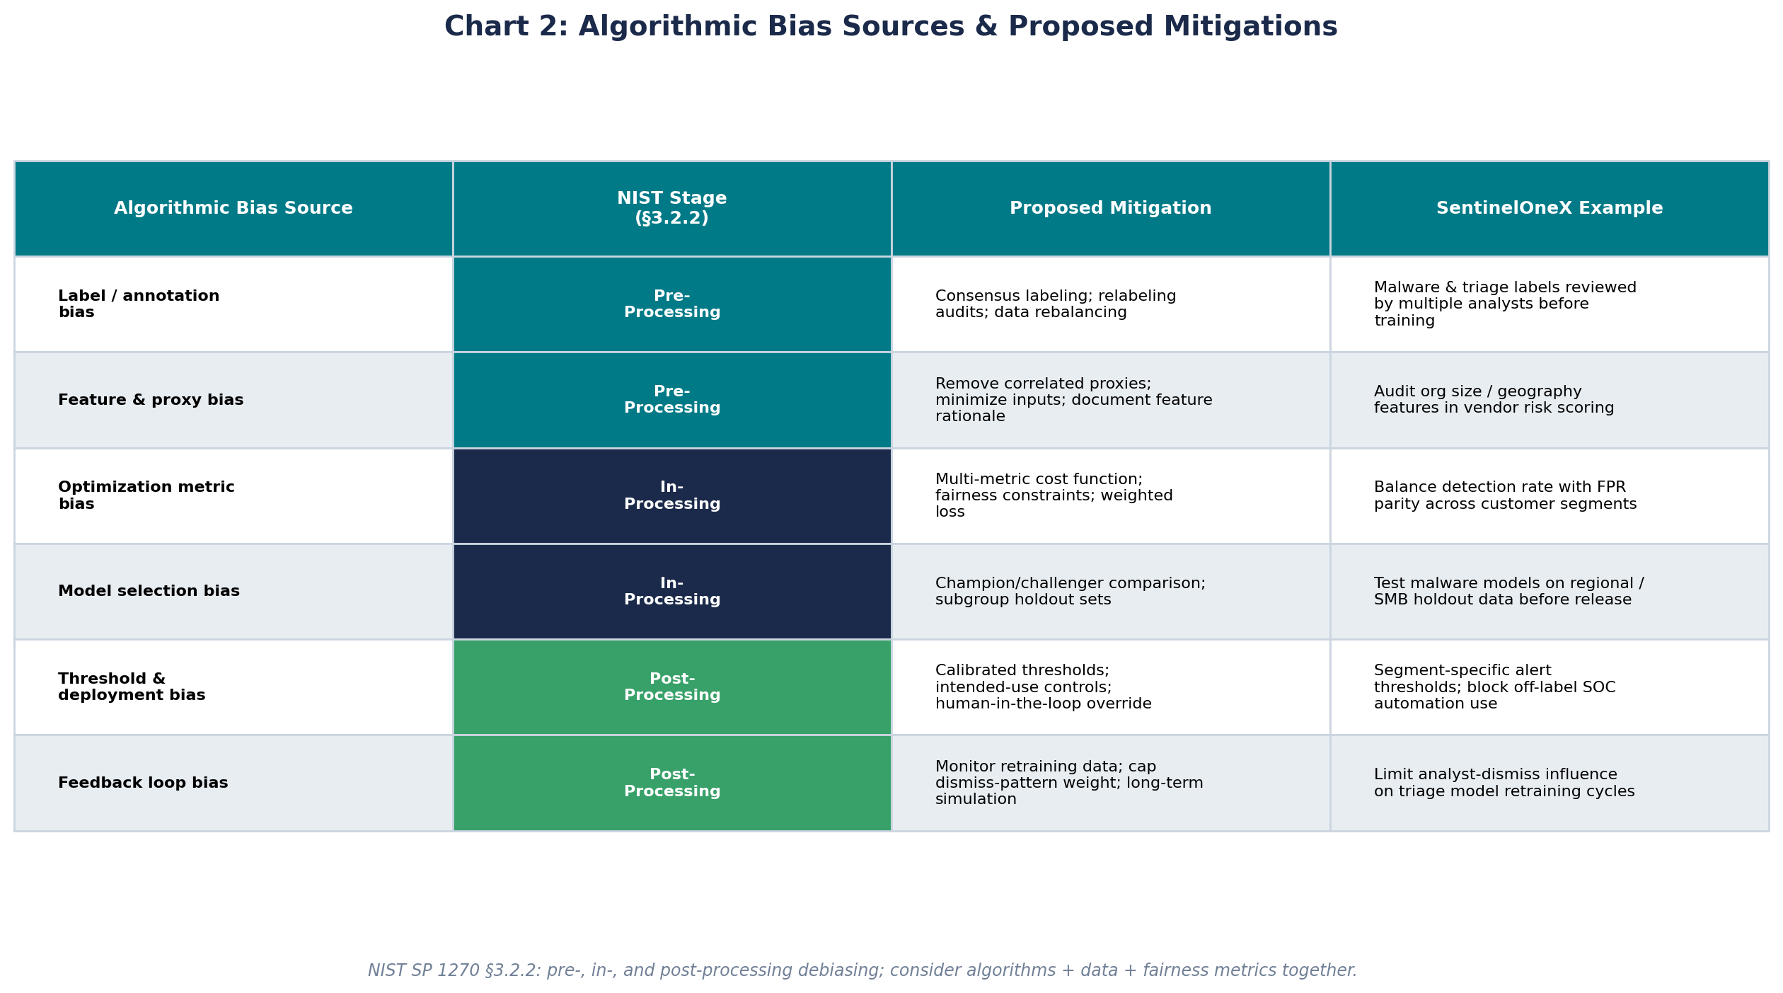
Chart: Algorithmic Bias Sources & Mitigations
NIST §3.2.2 — pre-processing, in-processing, and post-processing debiasing methods
SentinelOneX Security | RAI Framework — Bias Design

Slide 7
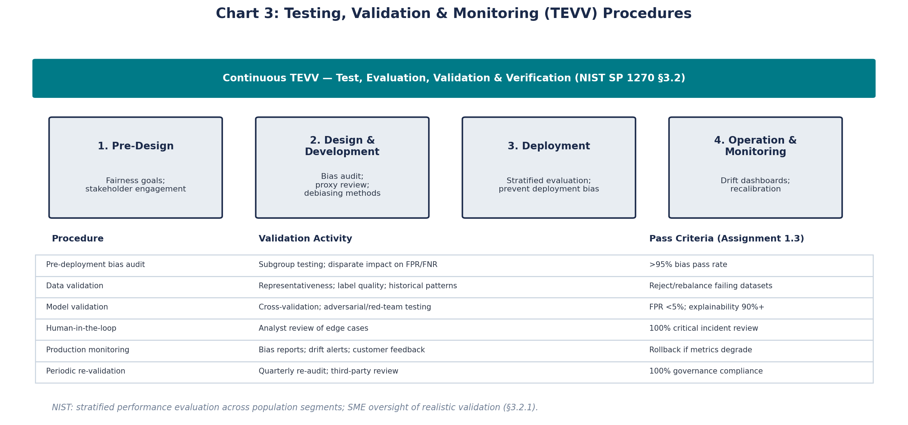
Chart: Testing, Validation & Monitoring
NIST §3.2 — TEVV continuous across the AI lifecycle (NIST Fig. 3)
Assignment 1.3 targets: Bias Testing >95% | FPR <5% | Human Review 100% critical | Explainability 90%+ | Governance 100%
SentinelOneX Security | RAI Framework — Bias Design

Slide 8
Tools, Processes & Engagement for AI Fairness Trust
NIST §3.3 — human factors and multi-stakeholder governance
AI Review Board with diverse membership for pre-release bias sign-off (multi-stakeholder approach, NIST §3.3.2)
Model cards documenting intended use, limitations, subgroup performance, and dataset fit (NIST §3.1.2)
Bias Impact Assessments at design stage — socio-technical analysis before development begins
Participatory design: SOC analysts and customers engaged before high-risk AI is built (NIST human-centered design guidance)
Customer and analyst feedback channels to report perceived unfair or unexplained AI decisions
Employee bias-awareness training for labelers, ML engineers, and SOC operators (Amazon recruiting case lesson)
External audit / red-team for independent fairness and adversarial testing annually
Transparent disclosures: which decisions use AI, what data is involved, how to request human review
Documented appeal / override process for automated containment or vendor scoring outcomes
Kill-switch and rollback if fairness metrics fail — human authority retained per Assignment 1.3 ethics statement
SentinelOneX Security | RAI Framework — Bias Design

Slide 9
Reflection
Difficulties and open questions from Workshop 3
NIST SP 1270 showed me that bias is not just a dataset problem — systemic and human factors matter as much as algorithms, which makes cybersecurity AI harder to govern.
The Amazon recruiting case and NIST's proxy-variable guidance (§3.2.1) raised a concern: org size or geography may correlate with threat patterns but using them as features could unfairly burden certain customer segments.
NIST emphasizes that fairness metrics can conflict — improving parity for one subgroup can harm another — and I am still unsure which metric SentinelOneX should prioritize in SOC triage.
The socio-technical lens from NIST challenged my assumption that >95% bias testing alone ensures fairness; statistical methods are necessary but not sufficient without stakeholder engagement.
Open question: How do we perform continuous TEVV across the full AI lifecycle without slowing incident response when adversaries exploit model blind spots?
SentinelOneX Security | RAI Framework — Bias Design

Slide 10
References
National Institute of Standards and Technology. (2022). Towards a Standard for Identifying and Managing Bias in Artificial Intelligence (NIST SP 1270). https://doi.org/10.6028/NIST.SP.1270
National Institute of Standards and Technology. (2023). AI Risk Management Framework 1.0.
Amazon AI recruiting tool case study — CAIO Time-Travel Simulation (Workshop 3).
Buolamwini, J., & Gebru, T. (2018). Gender Shades: Intersectional accuracy disparities in commercial gender classification.
SentinelOneX Security AI Ethics Statement — Assignment 1.3.
SentinelOneX Security | RAI Framework — Bias Design

