Slide 1
RAI Framework Project Design Considerations
SentinelOneX Security
AIML-510-01 — Responsible Application of AI
Workshop 4: Data Privacy, Protection & Regulatory Compliance
Arun Kumar Vallala | Indiana Wesleyan University
Instructor: Armando V. Tauro, Ph.D. | June 25, 2026

Slide 2
Company Overview
SentinelOneX Security — Assignment 1.3
Cybersecurity AI company providing AI-powered threat detection, SOC automation, and vendor risk evaluation
Cybersecurity AI can directly impact customer systems, business operations, and sensitive personal data
Organizational themes: fairness, accountability, transparency, privacy, reliability, and human oversight
Trust requires strong data privacy safeguards before customers share telemetry needed for personalized AI protection
AI Ethics Statement (Assignment 1.3)
Our AI systems will be designed and deployed to improve cybersecurity outcomes while respecting privacy, fairness, transparency, and human oversight. We commit to developing AI that is secure, reliable, explainable, and accountable. Human decision-makers will retain authority over critical security actions. We will continuously monitor AI systems for bias, performance degradation, and unintended consequences.
SentinelOneX Security | RAI Framework — Privacy & Compliance

Slide 3
AI Use Cases Under Consideration
Same use cases from Assignment 1.3
Use Case | Description | Privacy / Data Sensitivity
AI Malware Detection Engine | ML model scores files and behaviors as malicious or benign for endpoint protection | CRITICAL — endpoint telemetry may contain PII
SOC Alert Triage & Prioritization | AI ranks security alerts so analysts focus on highest-risk incidents | CRITICAL — logs contain identities and communications metadata
Automated Incident Response Recommendations | AI suggests containment actions such as isolation, blocking, or escalation | CRITICAL — forensic and account data; consequential automation
Third-Party Vendor AI Risk Assessment | AI evaluates external vendors for procurement and integration | HIGH — vendor confidential data; lower direct customer PII exposure
SentinelOneX Security | RAI Framework — Privacy & Compliance

Slide 4
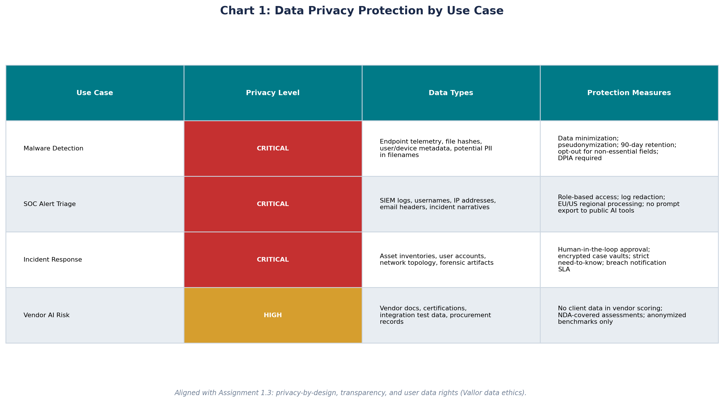
Chart: Data Privacy Protection by Use Case
Privacy level, data types, and protection measures
SentinelOneX Security | RAI Framework — Privacy & Compliance

Slide 5
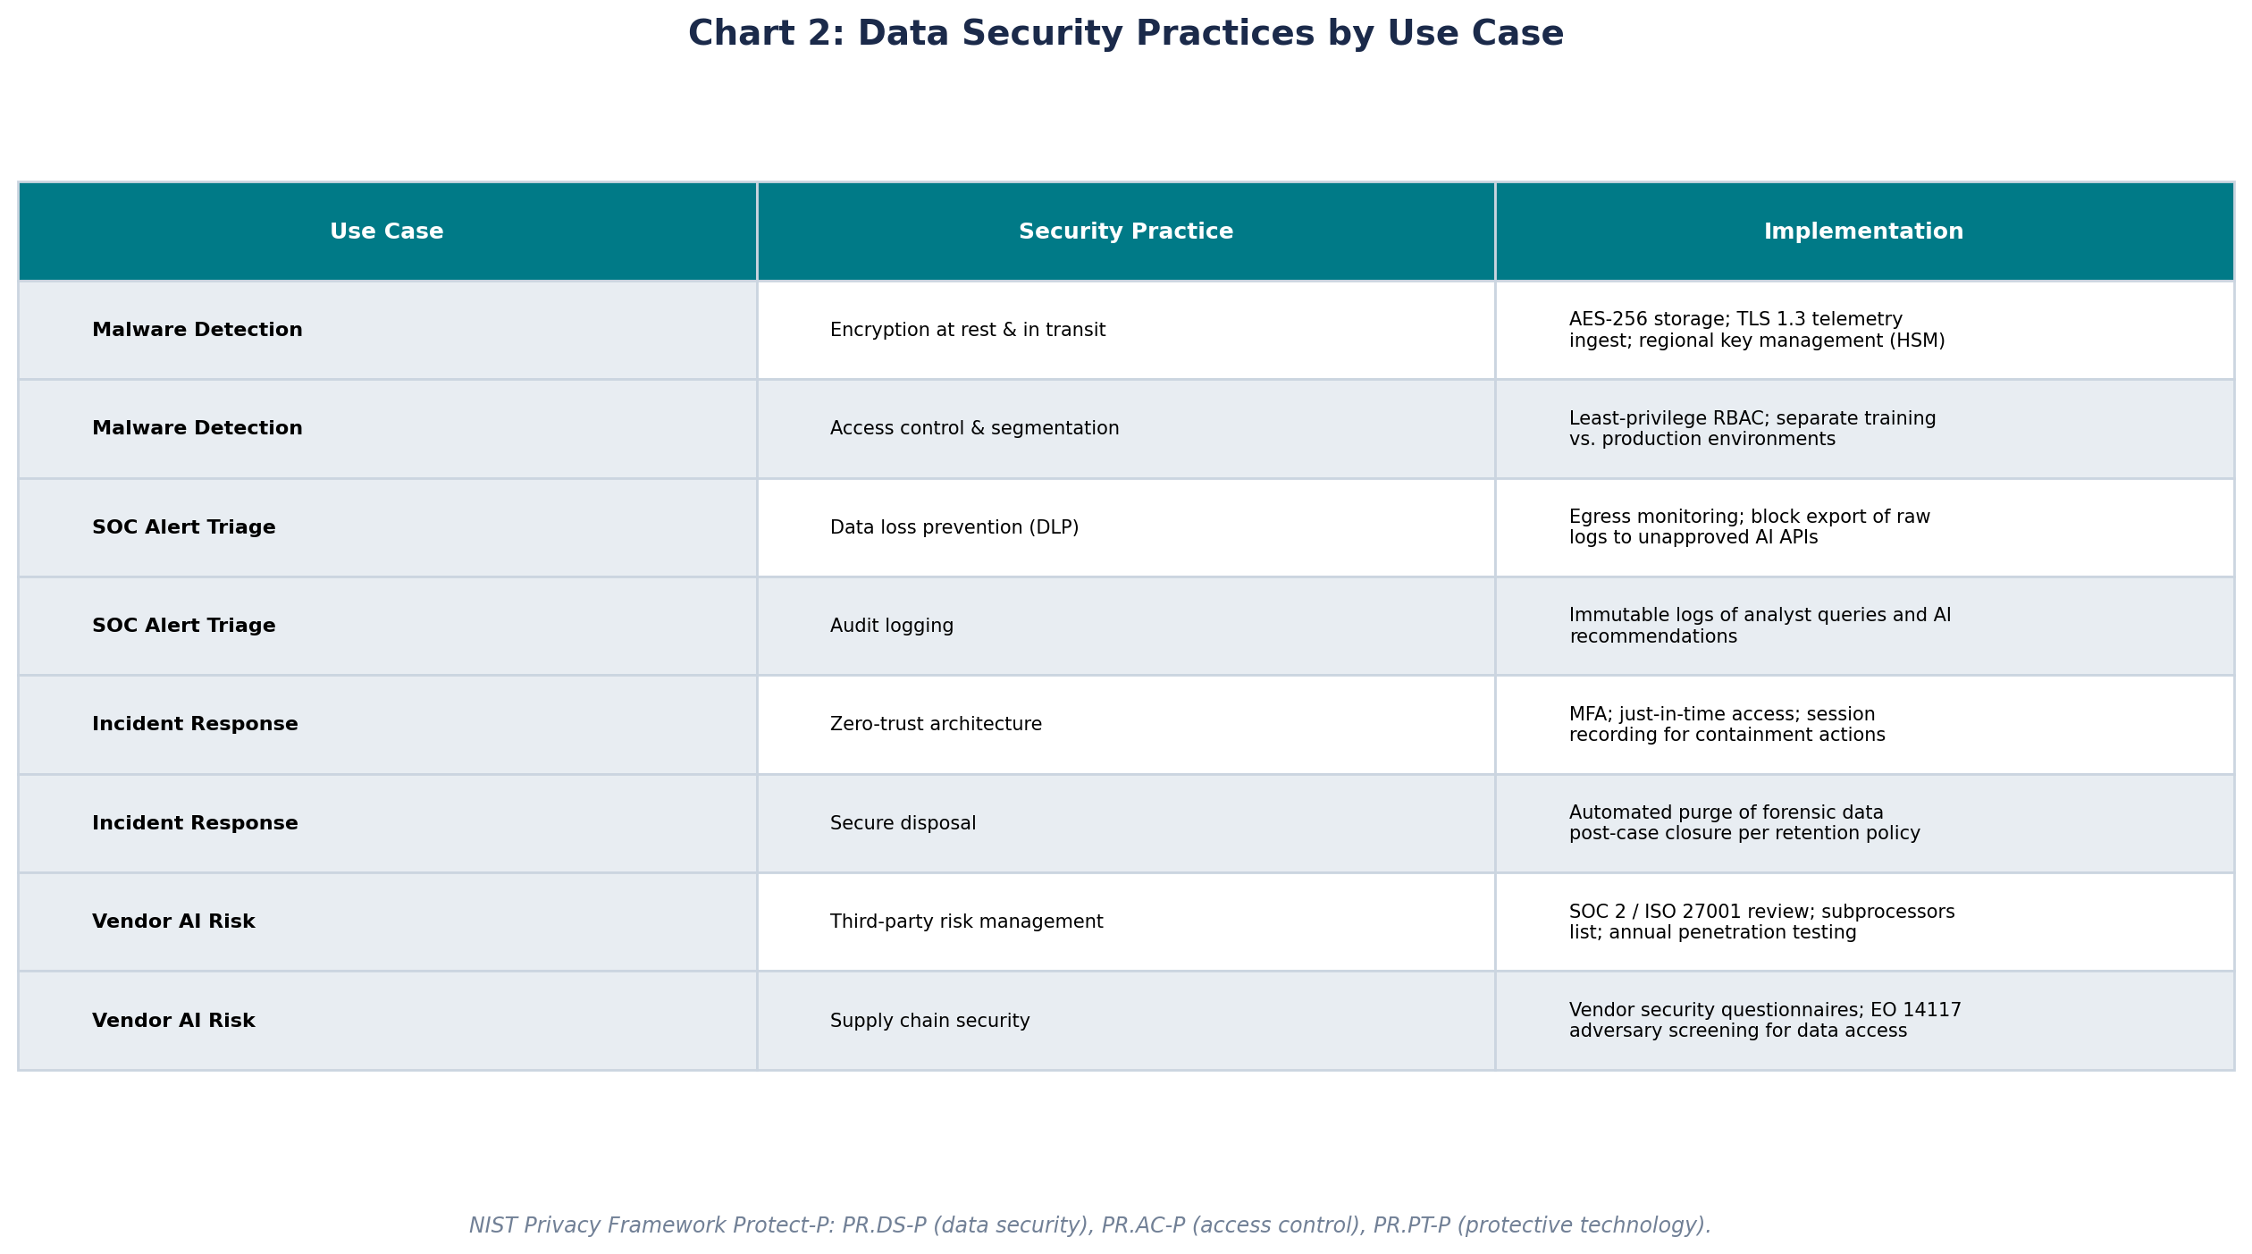
Chart: Data Security Practices by Use Case
NIST Protect-P aligned technical safeguards
SentinelOneX Security | RAI Framework — Privacy & Compliance

Slide 6
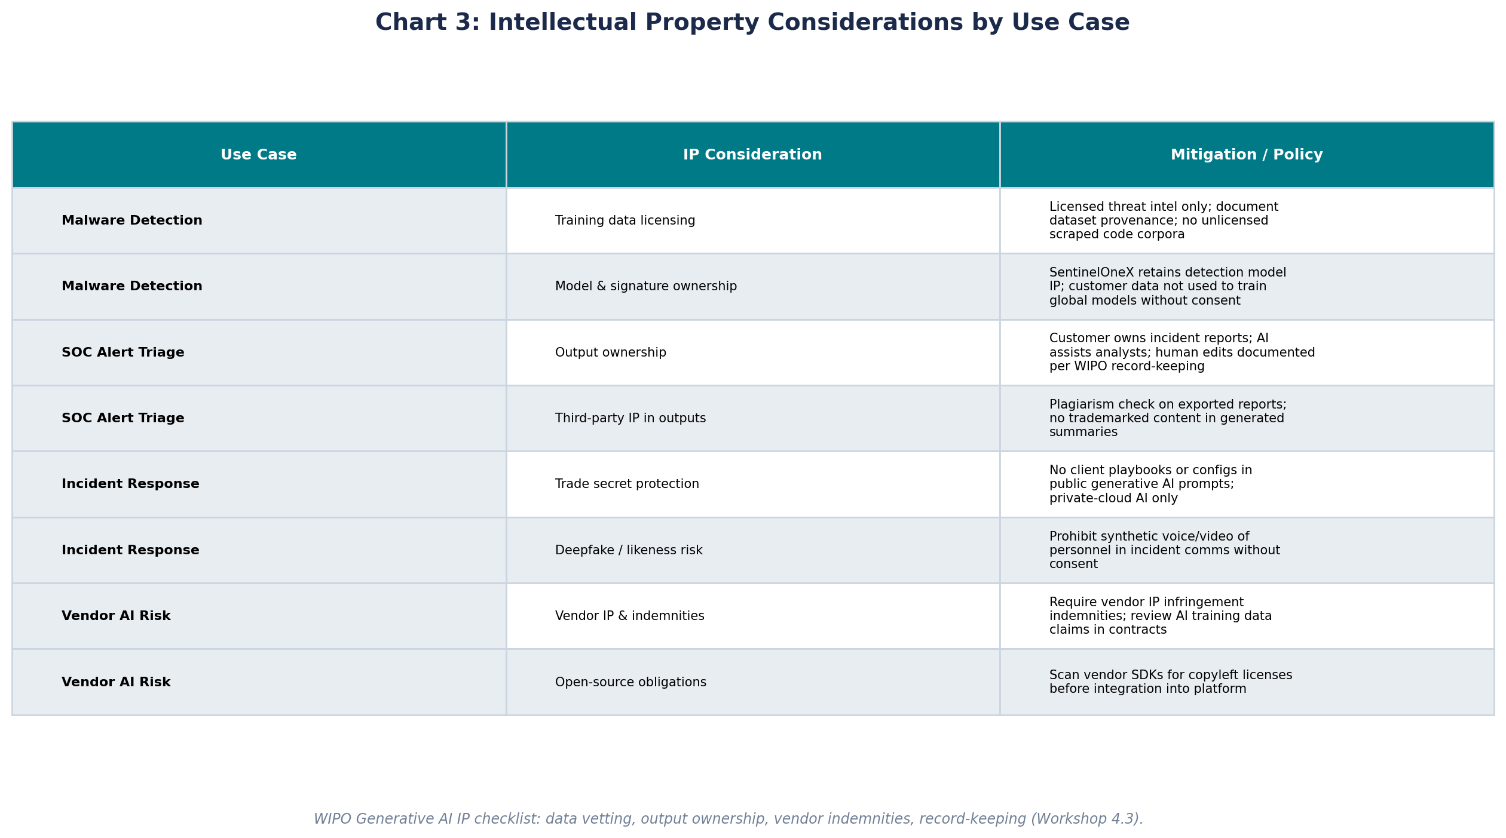
Chart: Intellectual Property Considerations
WIPO-informed IP governance per use case
SentinelOneX Security | RAI Framework — Privacy & Compliance

Slide 7
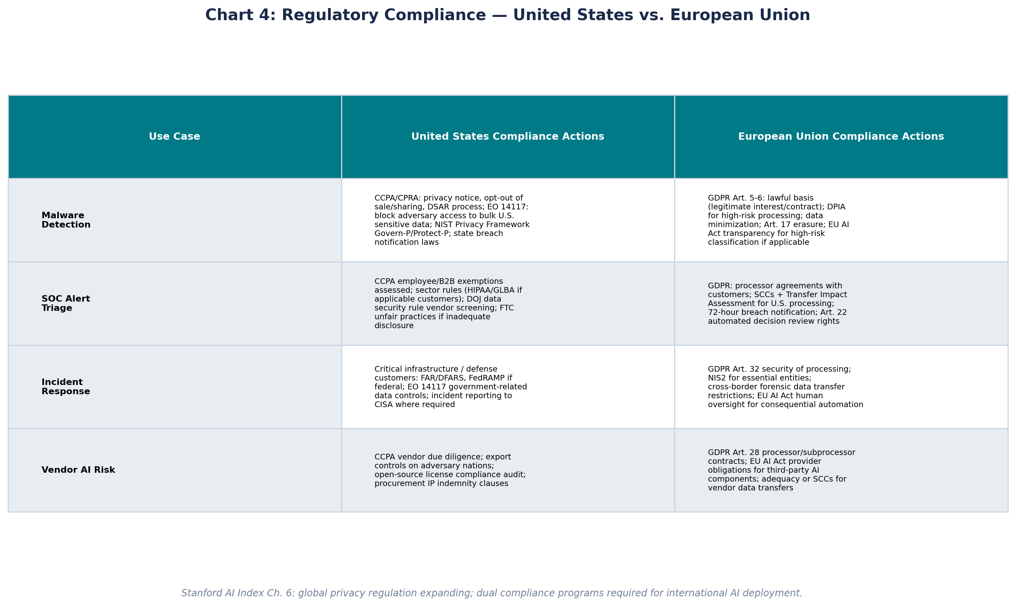
Chart: Regulatory Compliance — U.S. vs. EU
Required actions for United States and European Union compliance
U.S.: CCPA, EO 14117, NIST Privacy Framework | EU: GDPR, AI Act, Schrems II transfers
SentinelOneX Security | RAI Framework — Privacy & Compliance

Slide 8
Reflection
Difficulties and open questions from Workshop 4
Balancing personalized AI security with data minimization is harder than I expected — customers want better protection, but that requires more telemetry, which increases privacy risk.
The U.S. and EU frameworks do not align neatly: CCPA focuses on consumer rights, GDPR on lawful processing and transfers, and EO 14117 adds national security restrictions — I am still unsure how SentinelOneX maps all three for global SOC operations.
Shannon Vallor's data ethics emphasis on habit and character challenged me — technical controls alone cannot build trust if engineers treat customer data casually in daily practice.
The WIPO IP checklist from our NeuroCreate simulation applies even to cybersecurity AI: we must vet training data and avoid putting client secrets into vendor models, but the line between threat intelligence and personal data is often blurry.
Open question: How do we earn customer trust to share the data needed for personalized AI while proving — not just promising — that regional compliance (EU residency, U.S. adversary blocking) is enforced in our architecture?
SentinelOneX Security | RAI Framework — Privacy & Compliance

Slide 9
References
Maslej, N., et al. (2025). Artificial Intelligence Index Report 2025 (Chapter 6). Stanford HAI.
National Institute of Standards and Technology. (2020). NIST Privacy Framework, Version 1.0.
SentinelOneX Security AI Ethics Statement — Assignment 1.3.
Vallor, S. An Introduction to Data Ethics. Santa Clara University Markkula Center.
World Intellectual Property Organization. (2024). Generative AI: Navigating Intellectual Property.
Executive Order 14117 (2024). Preventing Access to Americans' Bulk Sensitive Personal Data.
SentinelOneX Security | RAI Framework — Privacy & Compliance

