Slide 1
RAI Framework Project Design Considerations
SentinelOneX Security | Workshop 5: Sustainment & Education
Arun Kumar Vallala | AIML-510-01 | June 2026

Slide 2
Company Overview
SentinelOneX Security — Assignment 1.3
Cybersecurity AI company: threat detection, SOC automation, vendor risk evaluation
AI accuracy drifts as threats evolve — sustainment and retraining are core responsibilities
Themes: fairness, accountability, transparency, privacy, reliability, human oversight
AI Ethics Statement (1.3): Improve cybersecurity outcomes while respecting privacy, fairness, transparency, and human oversight. Human decision-makers retain authority over critical security actions. Continuously monitor for bias, performance degradation, and unintended consequences.
SentinelOneX Security | RAI Framework — Lifecycle & Sustainment

Slide 3
AI Use Cases Under Consideration
Same use cases from Assignment 1.3
Use Case | Description | Sustainment Priority
AI Malware Detection Engine | ML scores files/behaviors as malicious or benign | HIGH — daily retraining as threat landscape shifts
SOC Alert Triage | AI ranks alerts for analyst prioritization | HIGH — monitor drift as alert patterns change
Incident Response Recommendations | AI suggests containment actions | CRITICAL — human-in-the-loop; scheduled validation
Vendor AI Risk Assessment | AI evaluates third-party vendors | MEDIUM — quarterly model refresh; policy updates
SentinelOneX Security | RAI Framework — Lifecycle & Sustainment

Slide 4
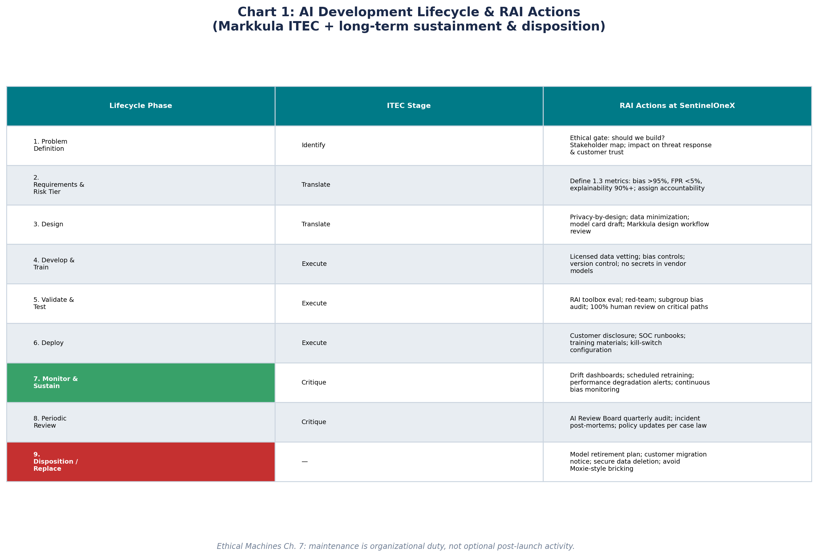
Chart: AI Lifecycle & RAI Actions
Markkula ITEC (Identify, Translate, Execute, Critique) + sustainment & disposition
SentinelOneX Security | RAI Framework — Lifecycle & Sustainment

Slide 5
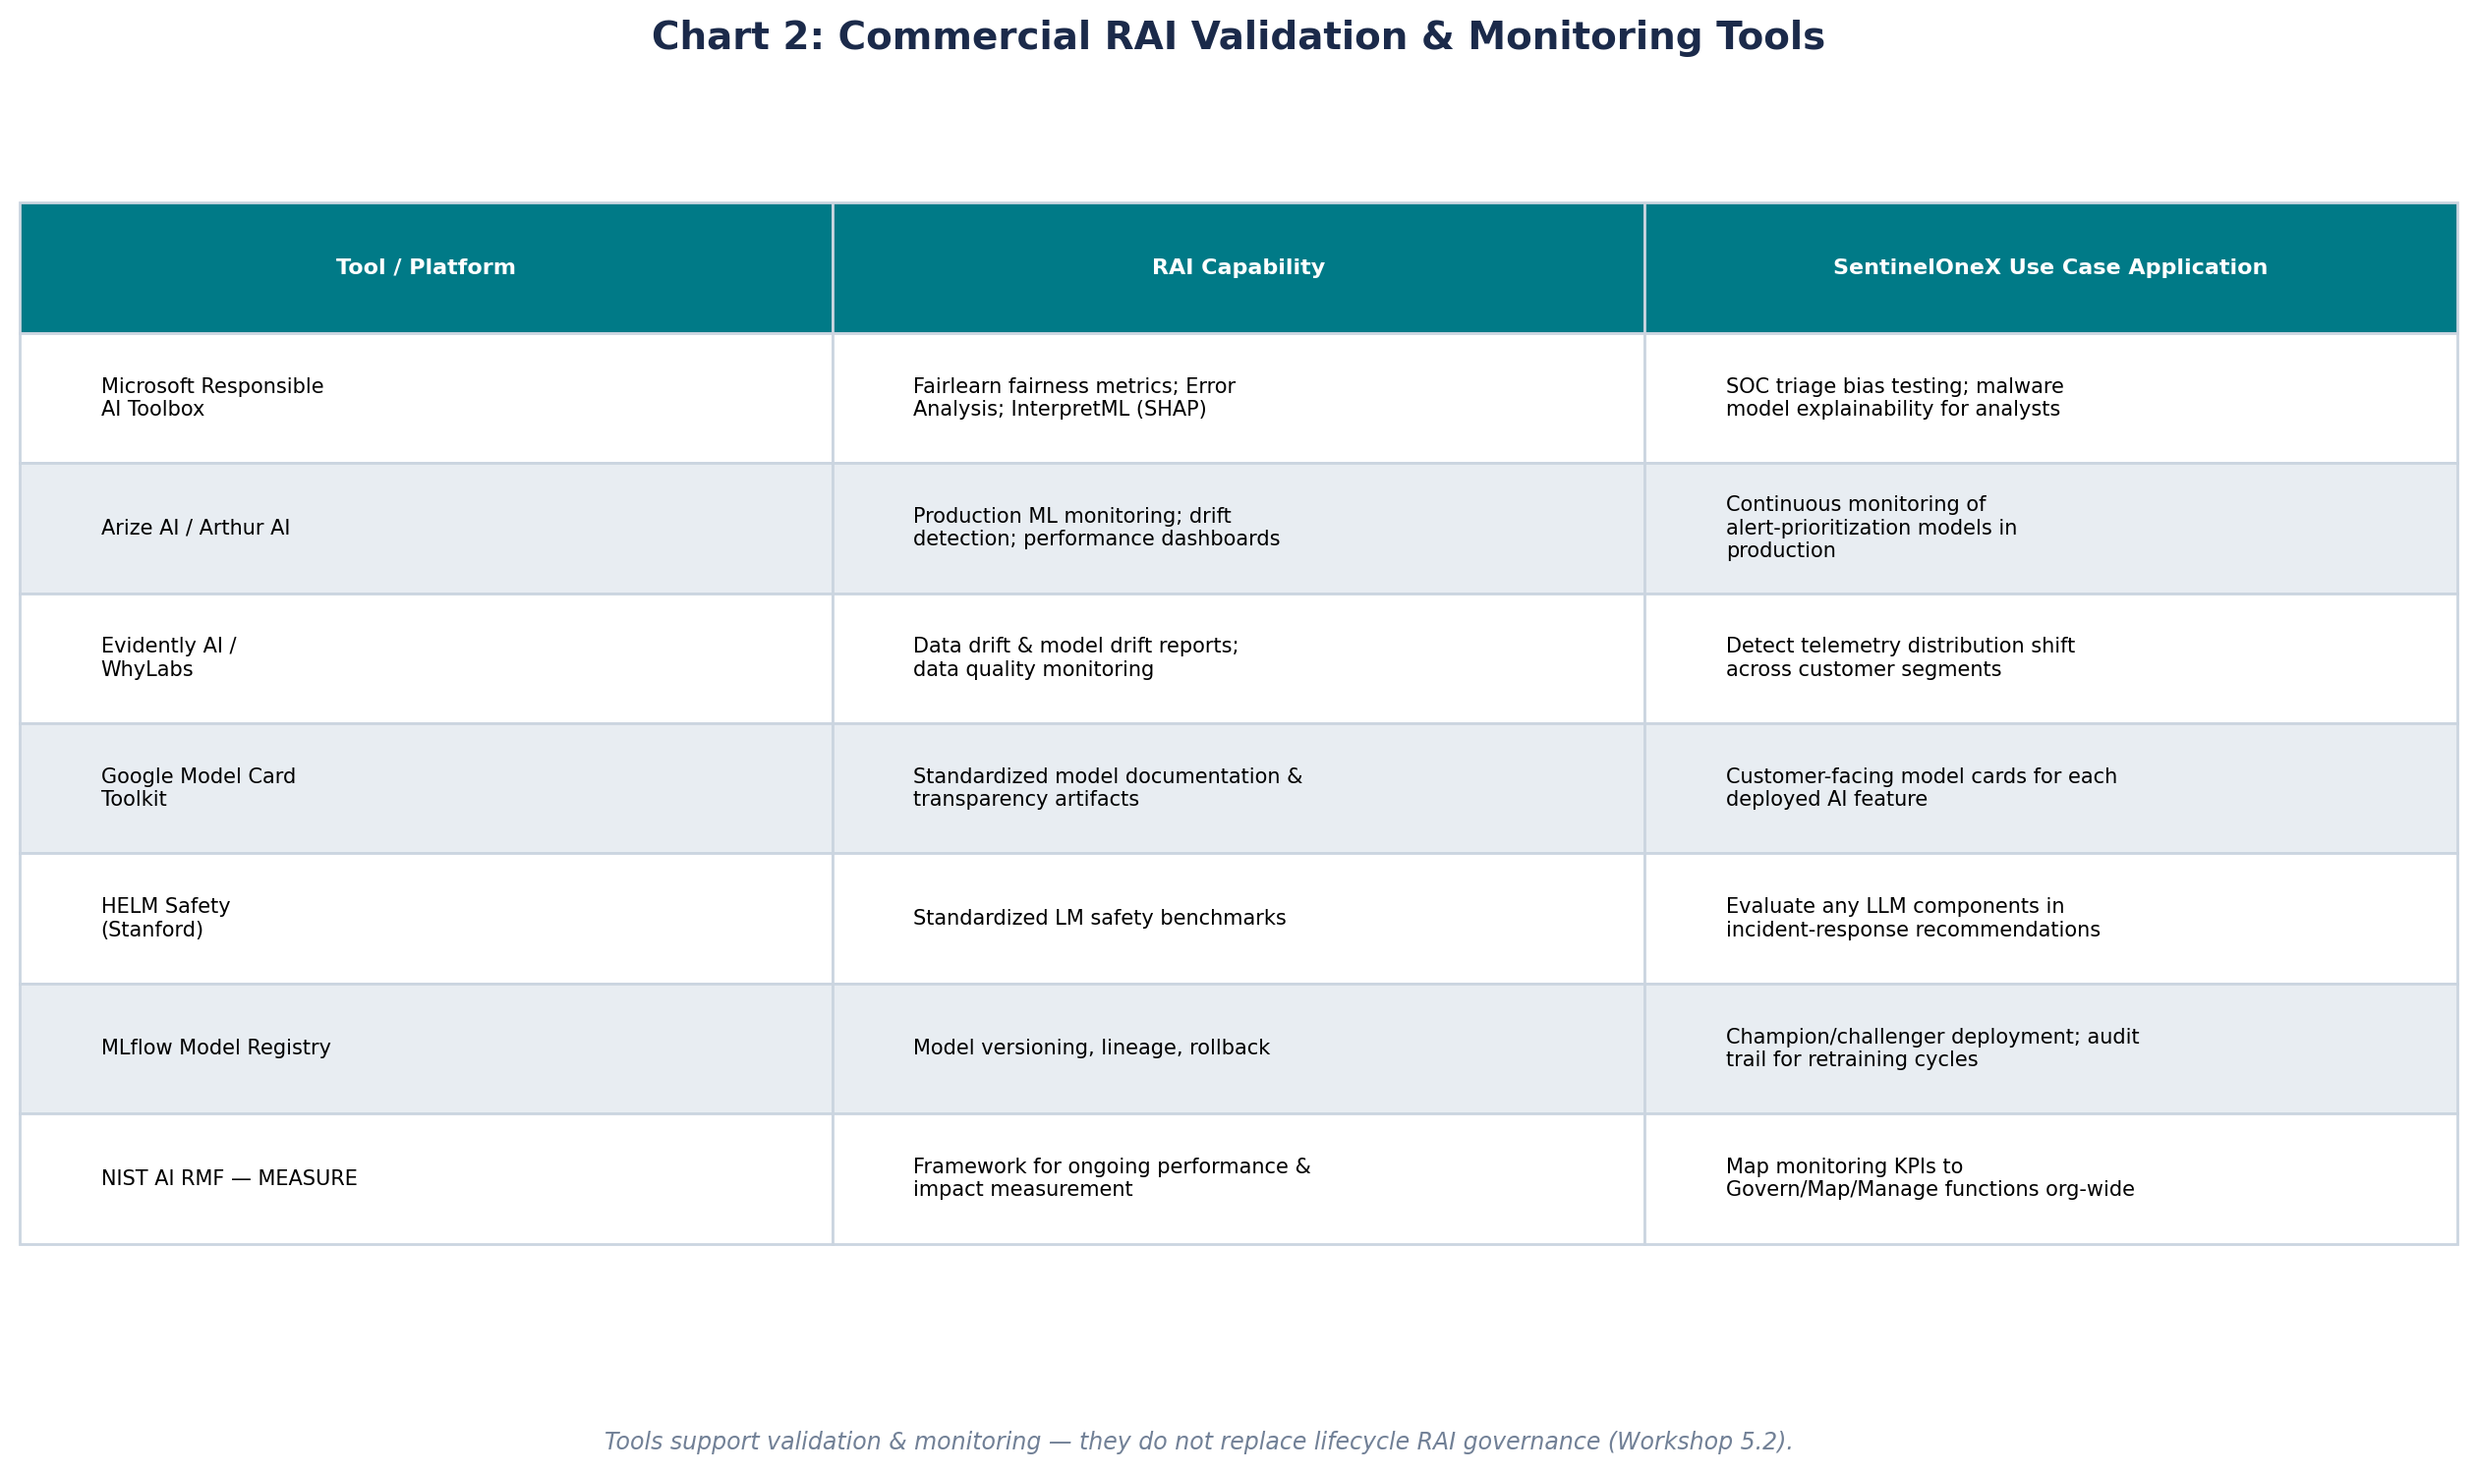
Chart: RAI Validation & Monitoring Tools
Commercial tools for SentinelOneX production AI systems
SentinelOneX Security | RAI Framework — Lifecycle & Sustainment

Slide 6
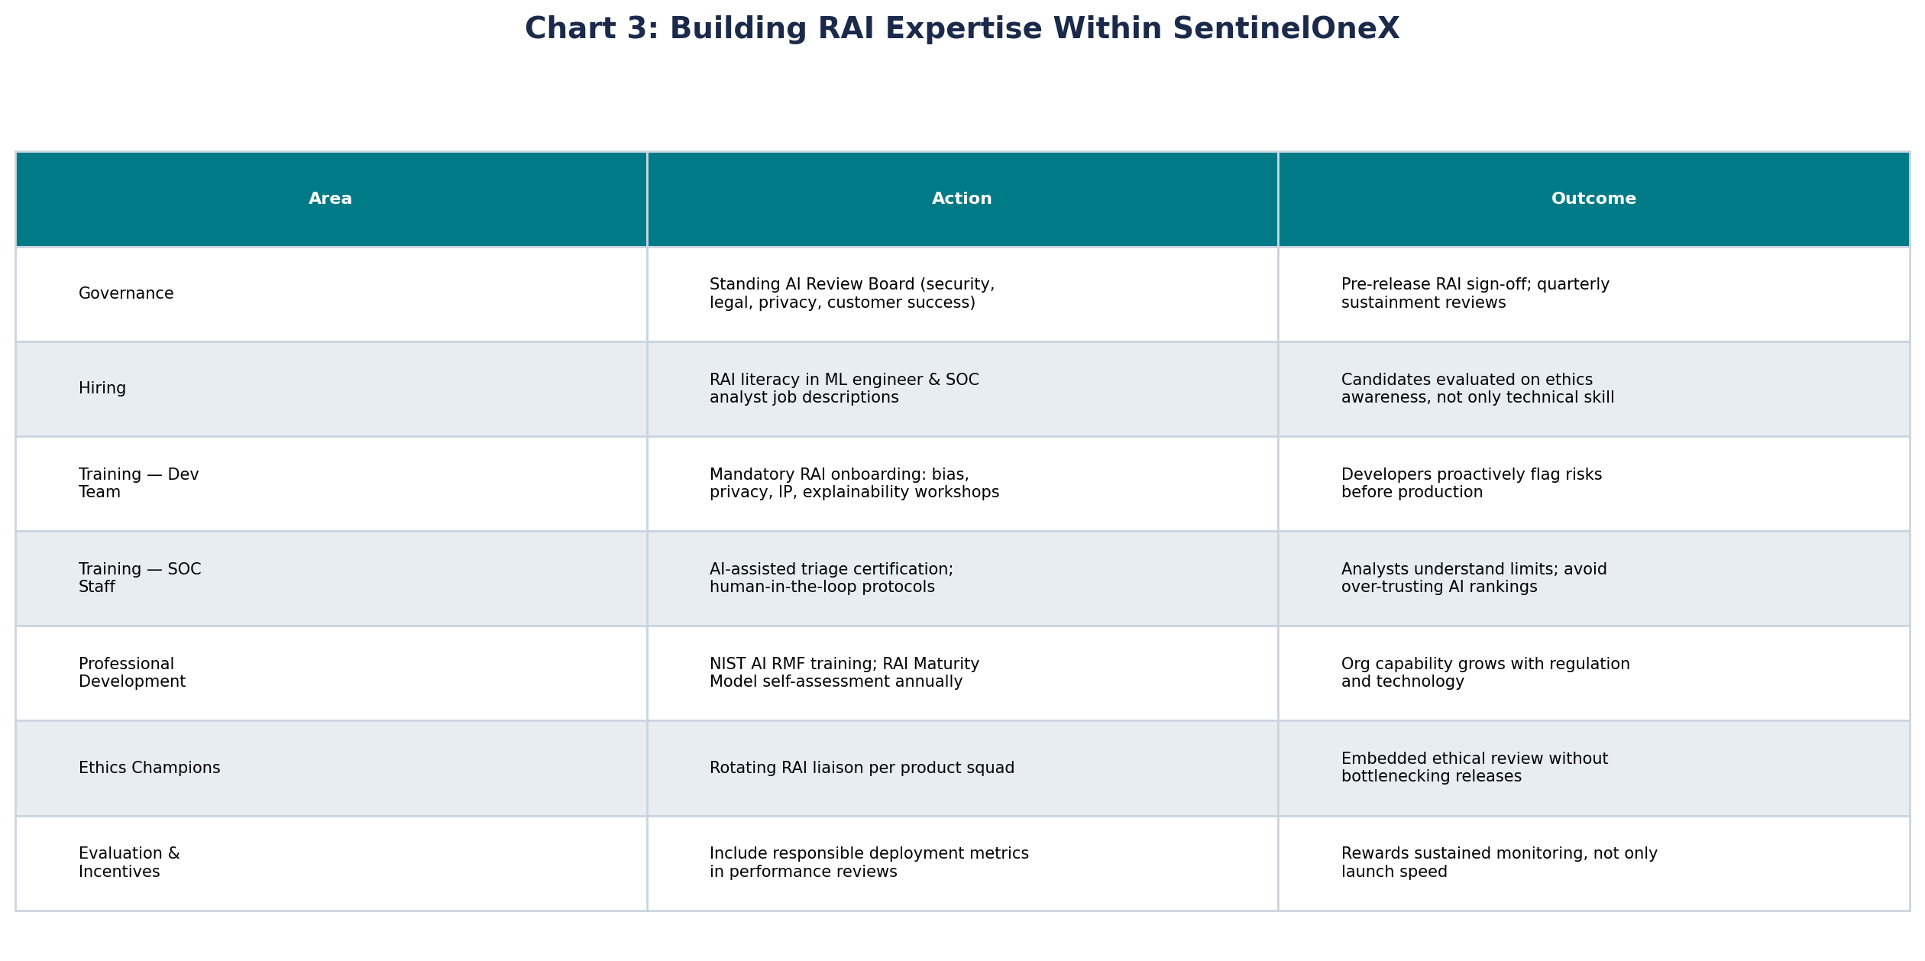
Chart: Building RAI Expertise
Internal training, governance, hiring, and professional development
SentinelOneX Security | RAI Framework — Lifecycle & Sustainment

Slide 7
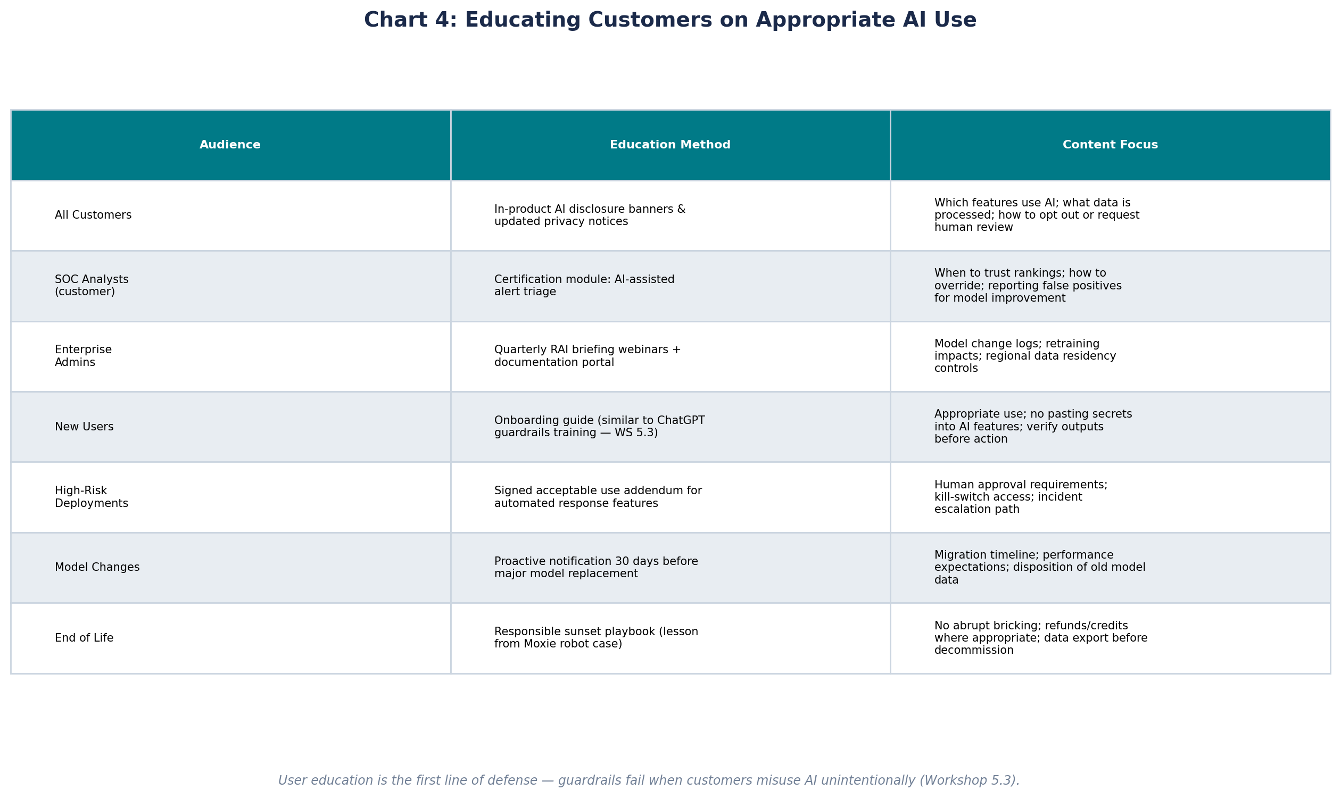
Chart: Customer AI Education
Appropriate use, model changes, and responsible end-of-life
SentinelOneX Security | RAI Framework — Lifecycle & Sustainment

Slide 8
Reflection
Difficulties and open questions from Workshop 5
Workshop 5 convinced me that launch is the midpoint, not the finish line — Ethical Machines Ch. 7 and the drift articles show models degrade without dedicated sustainment resources.
The Moxie robot story troubled me: bricking $800 devices without refunds is a warning for any AI product sunset. SentinelOneX must plan disposition with customer notice, migration, and data export — not abrupt shutdown.
Integrating education (5.3) into the lifecycle chart was harder than adding technical monitoring — culture and customer training are harder to measure than drift metrics.
5.2 taught me tools like Fairlearn and Arize are essential but insufficient; this assignment showed where they fit in the lifecycle versus where governance and training must lead.
Open question: How do we budget for continuous retraining and monitoring when customers expect cybersecurity AI to improve automatically without price increases or service interruptions?
SentinelOneX Security | RAI Framework — Lifecycle & Sustainment

Slide 9
References
Blackman, R. (2022). Ethical Machines, Chapter 7. Harvard Business Review Press.
Markkula Center for Applied Ethics. ITEC Stages & Sample Design Workflow. Santa Clara University.
Moxie emotional support robot discontinuation — Ars Technica.
Wang, J. ML model monitoring and re-training: When and How? Medium.
Wisecube AI. Why Continuous Monitoring is Essential for Maintaining AI Integrity.
Microsoft Responsible AI Toolbox — https://www.microsoft.com/en-us/ai/responsible-ai
SentinelOneX AI Ethics Statement — Assignment 1.3.
SentinelOneX Security | RAI Framework — Lifecycle & Sustainment

