Slide 1
SwiftTel Workforce Recommendations
RAI Framework Analysis — Assignment 6.1
Workforce Considerations Case Study
Arun Kumar Vallala | AIML-510-01 | July 2026

Slide 2
Case Context
SwiftTel — Rapid 80% Customer Service Automation
SwiftTel: national telecom with human agents for technical support, billing, and plan upgrades
Leadership deployed SwiftBot (LLM voicebot) to automate 80% of customer service to cut costs
SwiftBot: 24/7, multilingual, escalates to humans after 3 failed resolution attempts
Initial outcomes (reported): reduced wait times, lower operating costs, faster routine resolutions
Critical feedback (reported): CSAT decline, unresolved complex cases, agent morale collapse, customer frustration with bot loops, loss of experienced staff
RAI lens: Work provides dignity and purpose (USCCB). Ethical companies owe duties to employees, not only shareholders.
SwiftTel Case Study | RAI Workforce Analysis | AIML-510-01

Slide 3
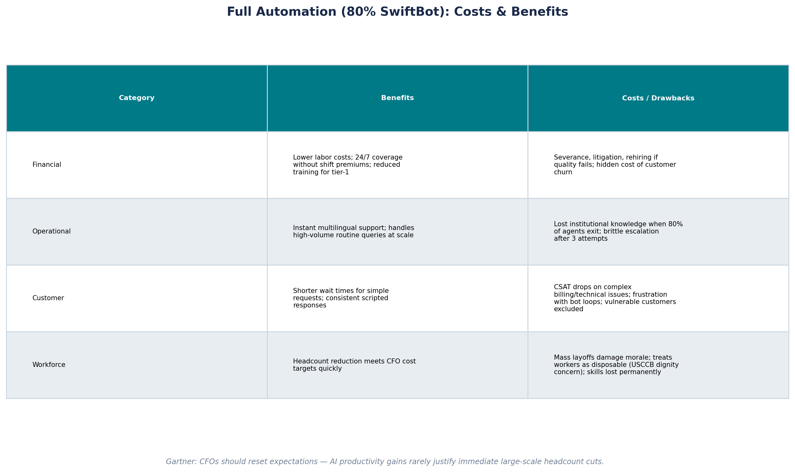
Full Automation: Costs & Benefits
80% SwiftBot deployment — financial, operational, customer, and workforce impacts
SwiftTel Case Study | RAI Workforce Analysis | AIML-510-01

Slide 4
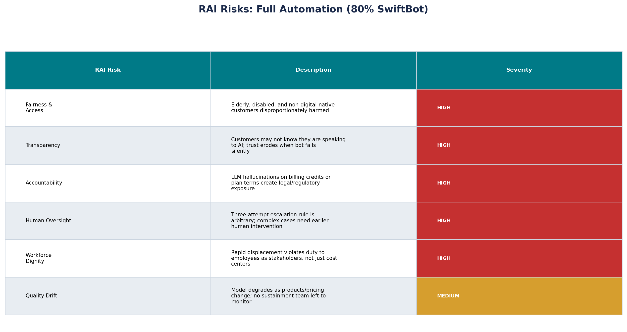
RAI Risks: Full Automation
Assessed through fairness, transparency, accountability, and workforce dignity
SwiftTel Case Study | RAI Workforce Analysis | AIML-510-01

Slide 5
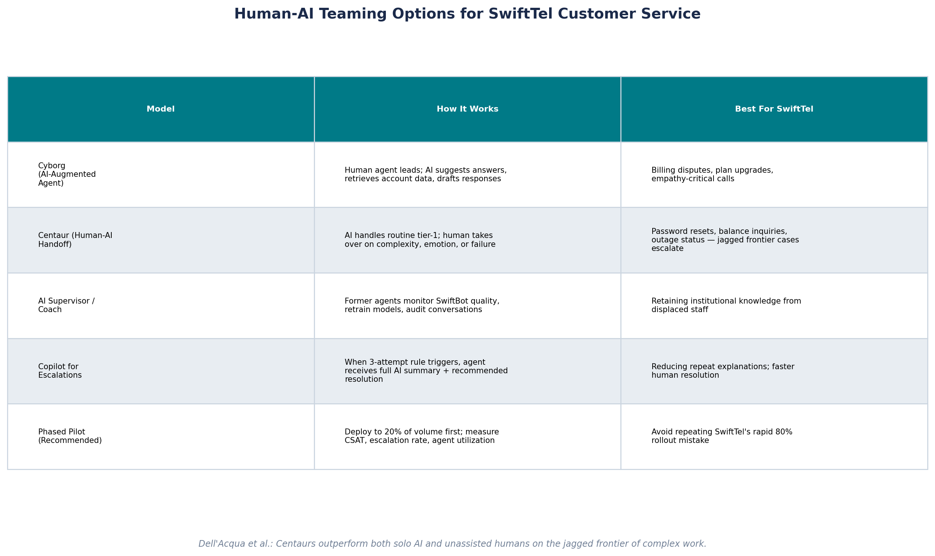
Human-AI Teaming Options
Centaur, Cyborg, and phased approaches for customer service
SwiftTel Case Study | RAI Workforce Analysis | AIML-510-01

Slide 6
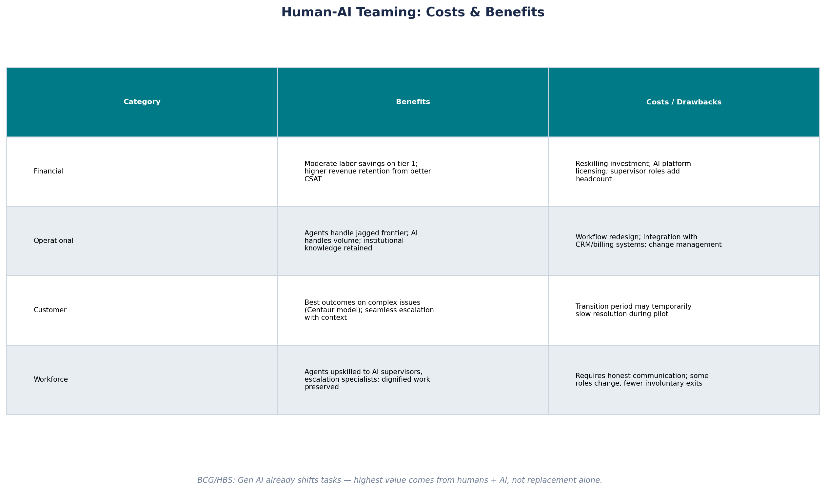
Human-AI Teaming: Costs & Benefits
Balanced model — moderate savings with retained quality and workforce dignity
SwiftTel Case Study | RAI Workforce Analysis | AIML-510-01

Slide 7
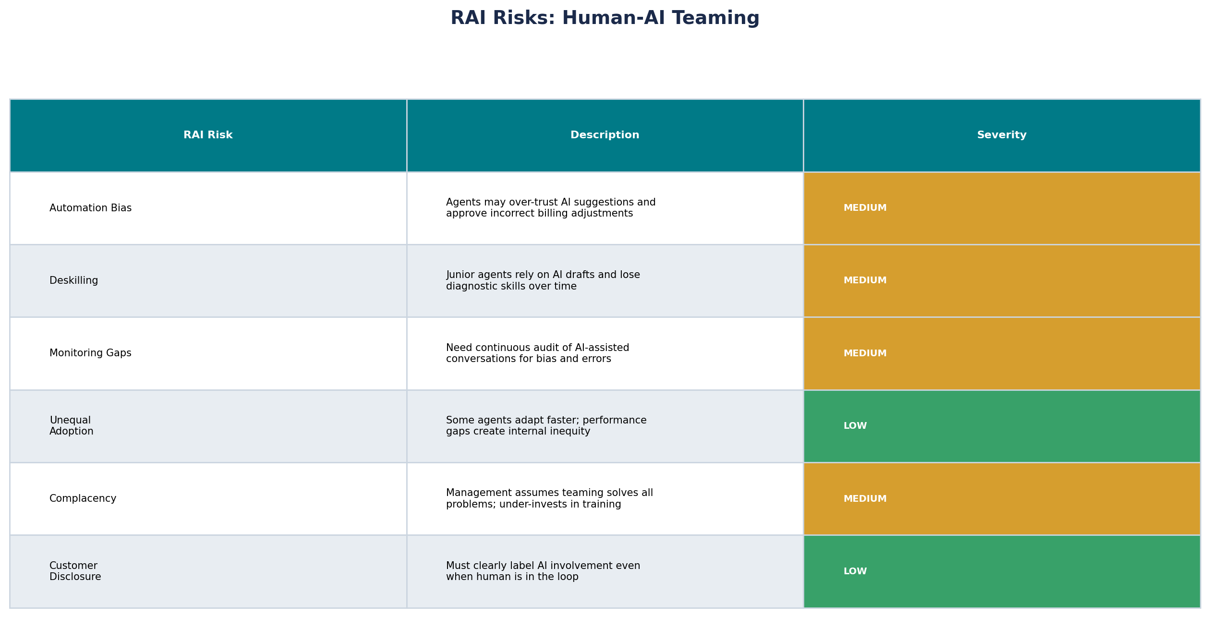
RAI Risks: Human-AI Teaming
Manageable risks with proper training, monitoring, and governance
SwiftTel Case Study | RAI Workforce Analysis | AIML-510-01

Slide 8
Recommended Approach
Phased Centaur Model with Workforce Investment
Do NOT proceed with 80% automation. Roll back to a phased Centaur model targeting 40–50% AI-handled volume after a 90-day pilot.
Pilot first: Deploy SwiftBot only on tier-1 predictable queries (balance, outage status, password reset). Measure CSAT, escalation rate, and resolution time before scaling.
Retain and reskill agents: Transition displaced-capacity roles to AI Supervisors (audit conversations), Escalation Specialists (jagged frontier), and Customer Success — honoring USCCB dignity of work.
Redesign escalation: Replace arbitrary 3-attempt rule with intelligent routing — sentiment detection, billing complexity score, or customer request triggers immediate human handoff with full AI context.
Invest in sustainment: Assign a cross-functional RAI team to monitor drift, retrain SwiftBot on plan/pricing changes, and audit for hallucinations (lessons from WS5 lifecycle framework).
Transparent disclosure: Inform customers when AI is handling their call; offer human option without penalty.
Justification: Dell'Acqua et al. show Centaurs outperform AI-only on complex work. Gartner warns CFOs against assuming headcount cuts from AI. SwiftTel's critical feedback confirms non-routine work resists automation — rushing cost savings sacrificed quality, trust, and employee dignity.
SwiftTel Case Study | RAI Workforce Analysis | AIML-510-01

Slide 9
References
APA format — sources supporting this analysis
Dell'Acqua, F., McFowland, E., Mollick, E. R., Lifshitz-Assaf, H., Kellogg, K., Adelman, L., Anderson, Z., & Lakhani, K. R. (2023). Navigating the jagged technological frontier: Field experimental evidence of the effects of AI on knowledge worker productivity and quality. Harvard Business School Working Paper, 24-013. https://doi.org/10.2139/ssrn.4573321
Gartner. (2024). Gartner says CFOs should reset expectations about AI's impact on workforce productivity and headcount. Gartner Newsroom. https://www.gartner.com/en/newsroom/press-releases/2024-cfo-ai-workforce
United States Conference of Catholic Bishops. (n.d.). The dignity of work and the rights of workers. USCCB. https://www.usccb.org/beliefs-and-teachings/what-we-believe/catholic-social-teaching/the-dignity-of-work-and-the-rights-of-workers
Chui, M., Roberts, R., & Yee, L. (2023). Generative AI and the future of work in America. McKinsey Global Institute. https://www.mckinsey.com/mgi/our-research/generative-ai-and-the-future-of-work-in-america
SwiftTel Case Study | RAI Workforce Analysis | AIML-510-01

