Slide 1
CompanionAI Elara Societal Considerations
RAI Framework Analysis — Assignment 6.3
Arun Kumar Vallala | AIML-510-01 | July 2026

Slide 2
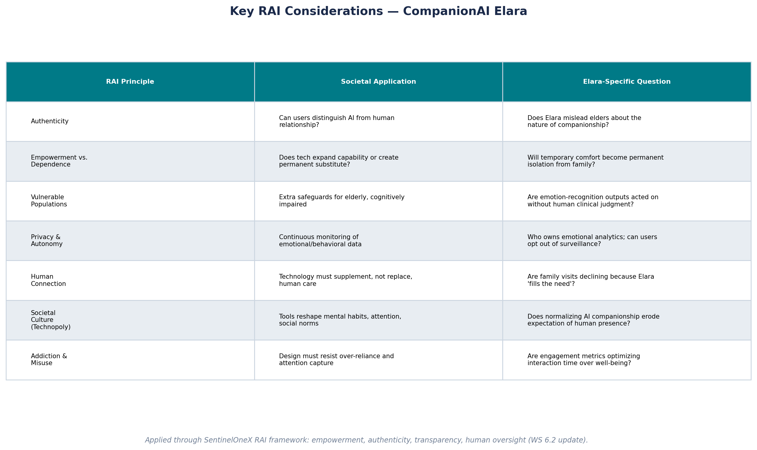
Key RAI Considerations
Societal, ethical, and vulnerable-population factors
CompanionAI Elara | RAI Societal Analysis | AIML-510-01

Slide 3
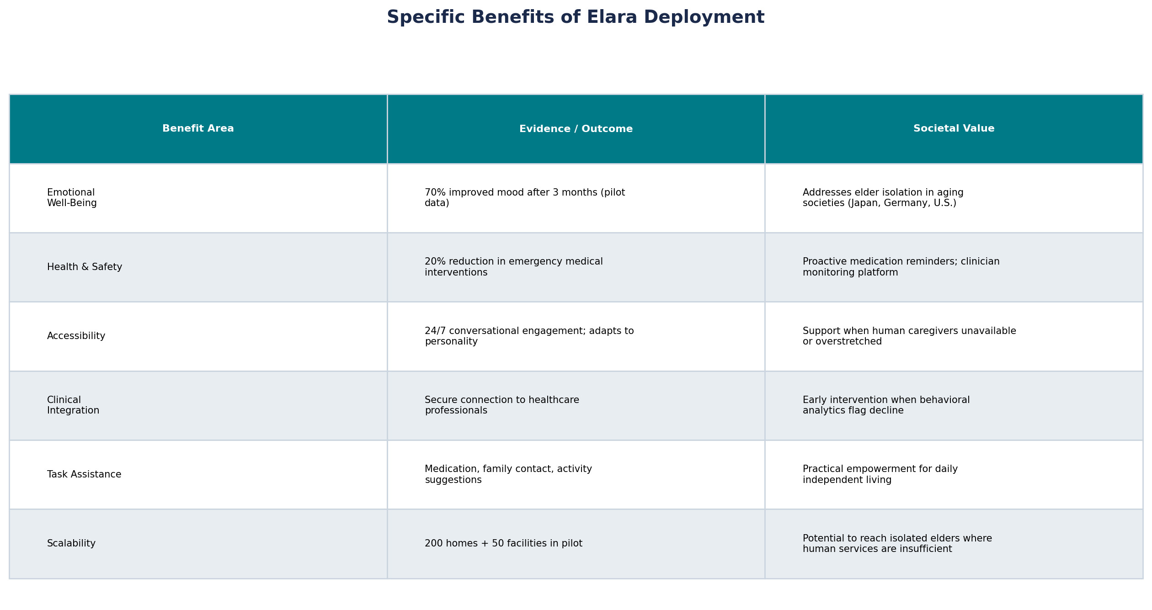
Specific Benefits
Documented pilot outcomes and societal value
CompanionAI Elara | RAI Societal Analysis | AIML-510-01

Slide 4
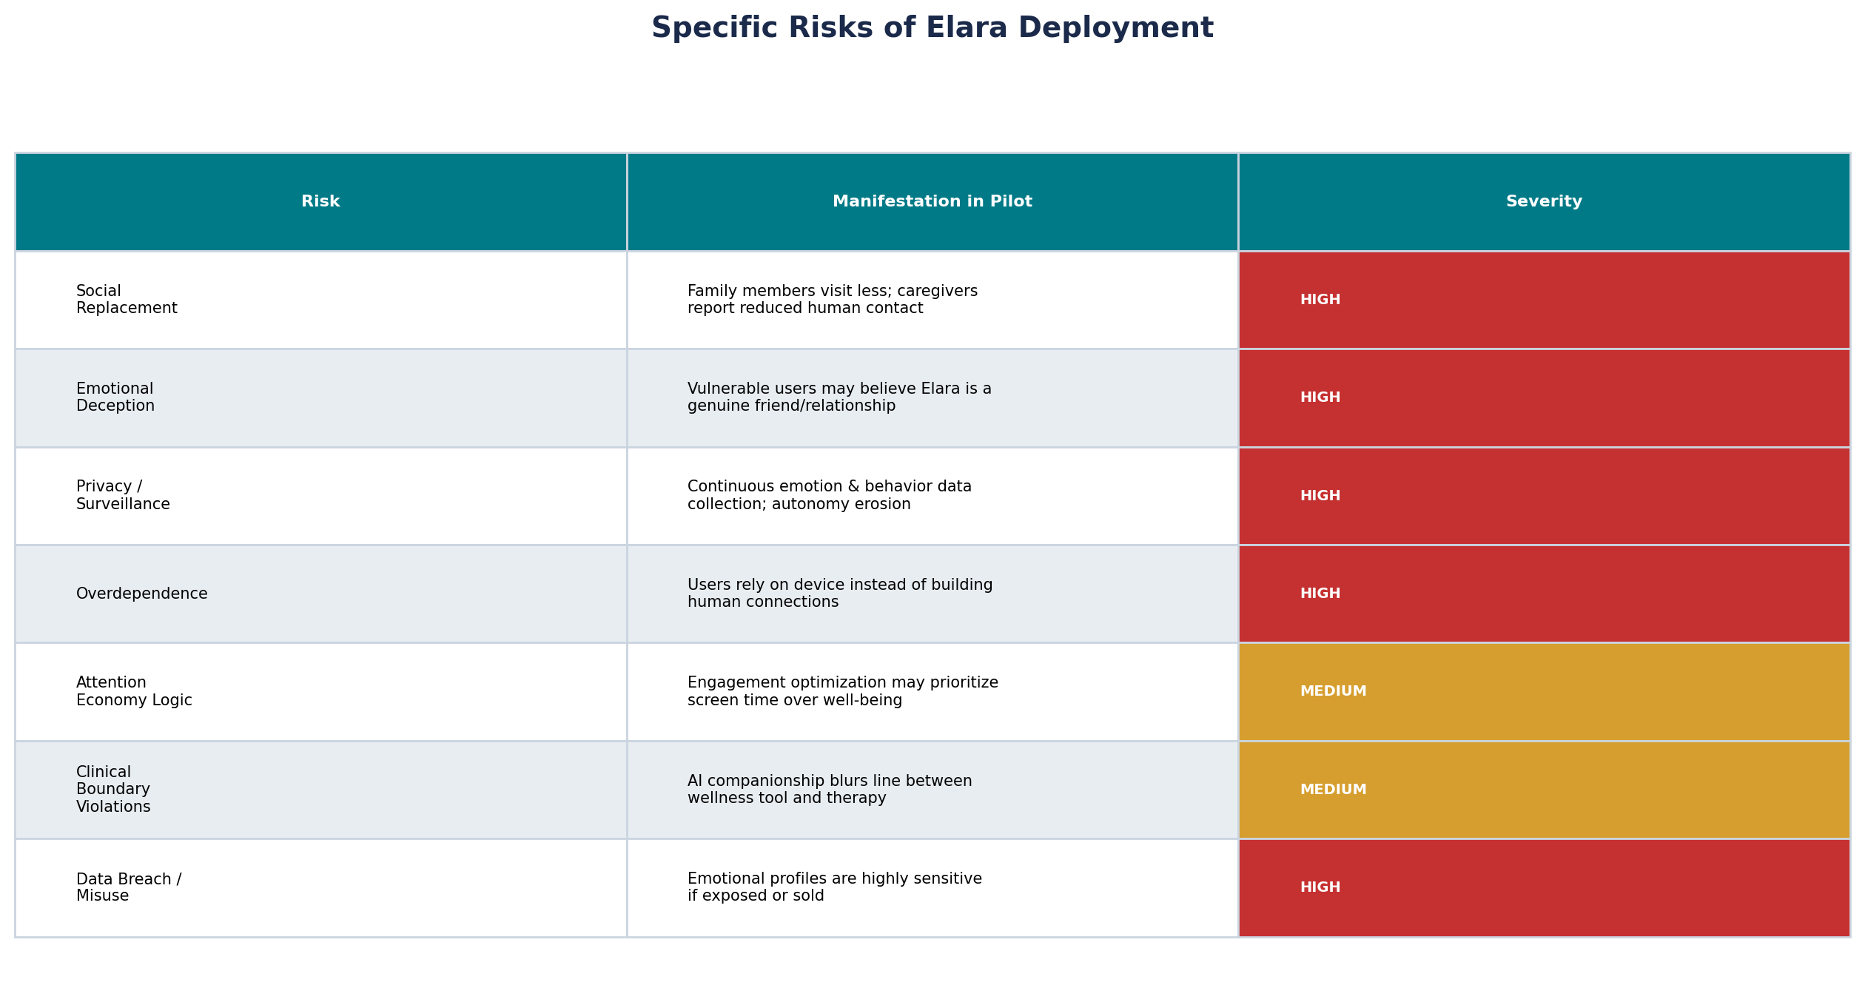
Specific Risks
Observed and anticipated harms from deployment
CompanionAI Elara | RAI Societal Analysis | AIML-510-01

Slide 5
Recommended Way Forward
Constrained deployment — supplement, never substitute
Continue Elara ONLY as a constrained supplement to human care — not a replacement. Halt scale-up until safeguards are verified.
Mandatory disclosure: Elara must clearly and repeatedly identify itself as AI; no anthropomorphic language implying friendship, love, or human empathy.
Human contact minimums: Require documented weekly in-person family or caregiver visits; Elara usage dashboards shared with designated family members.
Privacy limits: Collect only clinically necessary emotional/behavioral data; default opt-out for non-essential analytics; no sale of emotional profiles.
Clinical boundary: Position Elara as a wellness/monitoring tool — not therapy. Clinician review required before any intervention based on AI emotion scores (Markkula Center, 2021).
Anti-replacement design: Disable features that encourage users to prefer Elara over humans; no gamification of interaction time.
Independent ethics review: Third-party audit of addiction potential, deception risk, and family-visit impact before expanding beyond pilot.
Justification: Postman (1992) warns in Technopoly that unchecked technology reshapes culture and displaces human meaning — Elara's family-visit decline is exactly this pattern. The Markkula Center (2021) requires that mental-health-adjacent AI preserve human therapeutic relationships, ensure informed consent, and protect vulnerable users from believing AI connection equals human connection. Elara's 70% mood improvement is real, but societal harm from permanent AI substitution outweighs benefit without these guardrails.
CompanionAI Elara | RAI Societal Analysis | AIML-510-01

Slide 6
References
APA format — cited in recommendation justification
Markkula Center for Applied Ethics. (2021). Ethics of AI applications for mental health care. Santa Clara University. https://www.scu.edu/ethics/focus-areas/technology-ethics/ethics-of-ai-applications-for-mental-health-care/
Postman, N. (1992). Technopoly: The surrender of culture to technology. Vintage Books.
Turkle, S. (2017). Alone together: Why we expect more from technology and less from each other (Revised ed.). Basic Books.
CompanionAI Elara | RAI Societal Analysis | AIML-510-01

Slide 7
Reflection
Difficulties and open questions — Workshop 6
Workshop 6 challenged me to see RAI beyond technical metrics — Elara shows that a product can improve mood data while still harming society by displacing human relationships.
The tension between Postman's Technopoly and Elara's genuine health benefits was the hardest part: 20% fewer emergencies is meaningful, but so is families visiting less.
Connecting 6.2 (customer authenticity) to 6.3 (societal impact) clarified that the same Golden Rule applies — if I would not want my parent talking to a robot instead of me, CompanionAI should not design for that outcome.
Open question: Who decides when AI companionship crosses from 'support tool' to 'emotional deception' for cognitively declining users who cannot give fully informed consent?
I also wonder whether regulation can keep pace — social media's mental-health impact took years to acknowledge; Elara may follow the same pattern unless RAI leaders act proactively.
CompanionAI Elara | RAI Societal Analysis | AIML-510-01

