Slide 1
SentinelOneX Security Final Responsible AI Framework
AIML-510-01 — Course Capstone | Assignment 6.5
Integrated from Assignments 1.3, 1.4, 2.4, 3.4, 4.4, 5.4 & Workshop 6
Arun Kumar Vallala | Indiana Wesleyan University | July 2026

Slide 2
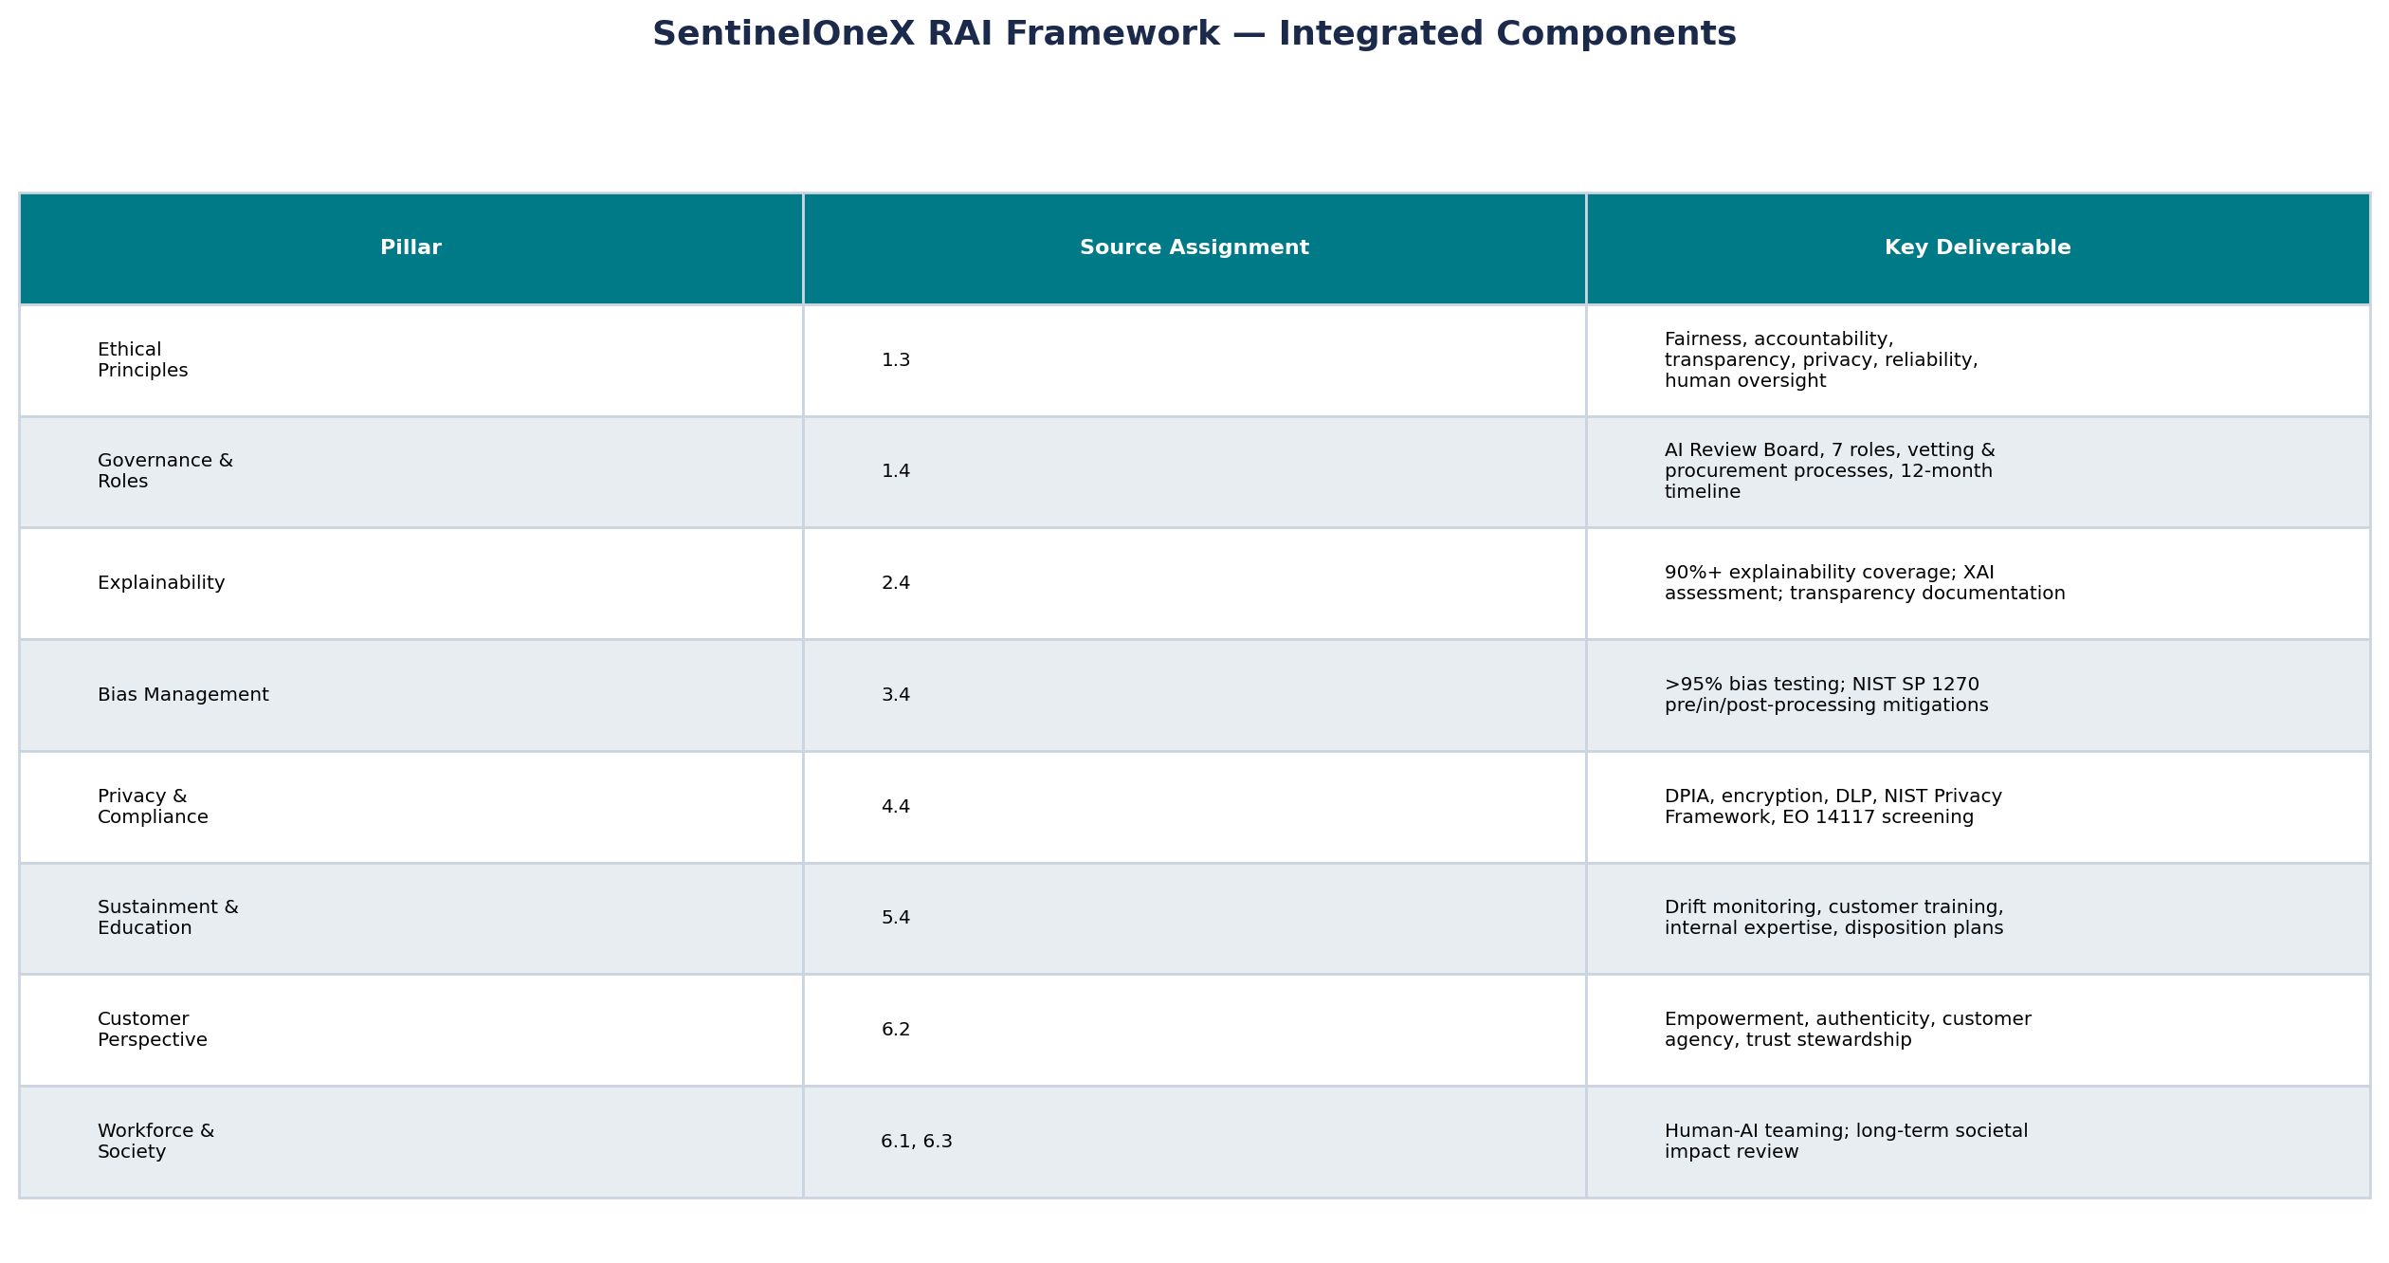
Framework Integration Overview
How course assignments combine into one actionable RAI program
SentinelOneX Security | Final Responsible AI Framework | AIML-510-01

Slide 3
Ethical Principles Statement
Assignment 1.3 — enhanced with Workshop 6 customer & societal dimensions
SentinelOneX AI Ethics Statement
Our AI systems will improve cybersecurity outcomes while respecting privacy, fairness, transparency, and human oversight. We commit to secure, reliable, explainable, and accountable AI. Human decision-makers retain authority over critical security actions. We continuously monitor for bias, performance degradation, and unintended consequences. We empower customers—not create dependence. We communicate authentically about AI capabilities. We invest in workforce dignity, long-term sustainment, and societal responsibility in every AI product we build or deploy.
Core principles: Fairness | Accountability | Transparency | Privacy | Reliability | Human Oversight
Customer additions (6.2): Empowerment | Authenticity | Customer Agency | Trust Stewardship
Use cases: Malware Detection | SOC Alert Triage | Incident Response | Vendor AI Risk Assessment
SentinelOneX Security | Final Responsible AI Framework | AIML-510-01

Slide 4
Governance Structure & Oversight
Assignment 1.4 — organizational hierarchy
Level | Body / Role | Oversight Function
Executive | Board of Directors + CTO (Executive Sponsor) | Strategy, funding, ultimate accountability
Governance | AI Governance Manager + AI Ethics Officer | Policy ownership, ethical reviews, compliance
Technical | AI Security Architect + AI/ML Lead Engineer | Secure design, model development, testing
Cross-Functional | AI Review Board (quarterly) | Pre-release sign-off; sustainment audits; incident review
Operations | SOC AI Product Manager + Risk & Compliance Analyst | Use case management, audits, KPI tracking
Internal Process | 10-step AI Vetting Workflow | Request → risk → ethics → data → dev → bias → security → board → deploy → monitor
External Process | 9-step Vendor AI Procurement | Identify → security → privacy → ethics → legal → pilot → approve → use → reassess
SentinelOneX Security | Final Responsible AI Framework | AIML-510-01

Slide 5
Key Roles & Responsibilities
Seven accountable roles — Assignment 1.4
Role | Primary Responsibilities | Key Skills
CTO (Executive Sponsor) | AI strategy, budget, final production approval | Leadership, AI governance
AI Governance Manager | Policy, AI inventory, KPI dashboard, compliance | Risk management, NIST AI RMF
AI Ethics Officer | Bias oversight, ethical gate reviews, stakeholder analysis | Ethics, fairness, Markkula ITEC
AI Security Architect | Adversarial testing, secure architecture, red-team | Cybersecurity, ML security
AI/ML Lead Engineer | Model development, versioning, retraining pipelines | ML, Python, MLOps
AI Risk & Compliance Analyst | Audits, DPIA support, regulatory tracking | GDPR, NIST Privacy, EO 14117
SOC AI Product Manager | Use case lifecycle, customer disclosure, training rollout | Product mgmt, SOC operations
SentinelOneX Security | Final Responsible AI Framework | AIML-510-01

Slide 6
12-Month RAI Accountability Timeline
Phased stand-up — Assignment 1.4
Month | Milestone | Deliverable
1–2 | Define AI policies & ethics statement | Published RAI policy; risk tier definitions
3 | Hire AI Governance Manager | Role filled; reporting line to CTO established
4 | Establish AI Review Board | Charter, membership, meeting cadence (monthly → quarterly)
5 | Deploy risk assessment process | Use case intake form; pre-mortem template
6 | Launch ethics review workflow | Markkula ITEC integrated into design gates
7 | Vendor AI assessment process live | Procurement checklist; EO 14117 screening
8 | Complete AI system inventory | All production & pilot AI catalogued with risk tier
9 | KPI dashboard launch | Real-time metrics from Assignment 1.3 targets
10 | Company-wide RAI training | Role-based modules (see training chart)
11 | Internal RAI audit | Gap analysis against NIST AI RMF Govern function
12 | Governance maturity review | Board report; year-2 roadmap; portfolio upload
SentinelOneX Security | Final Responsible AI Framework | AIML-510-01

Slide 7
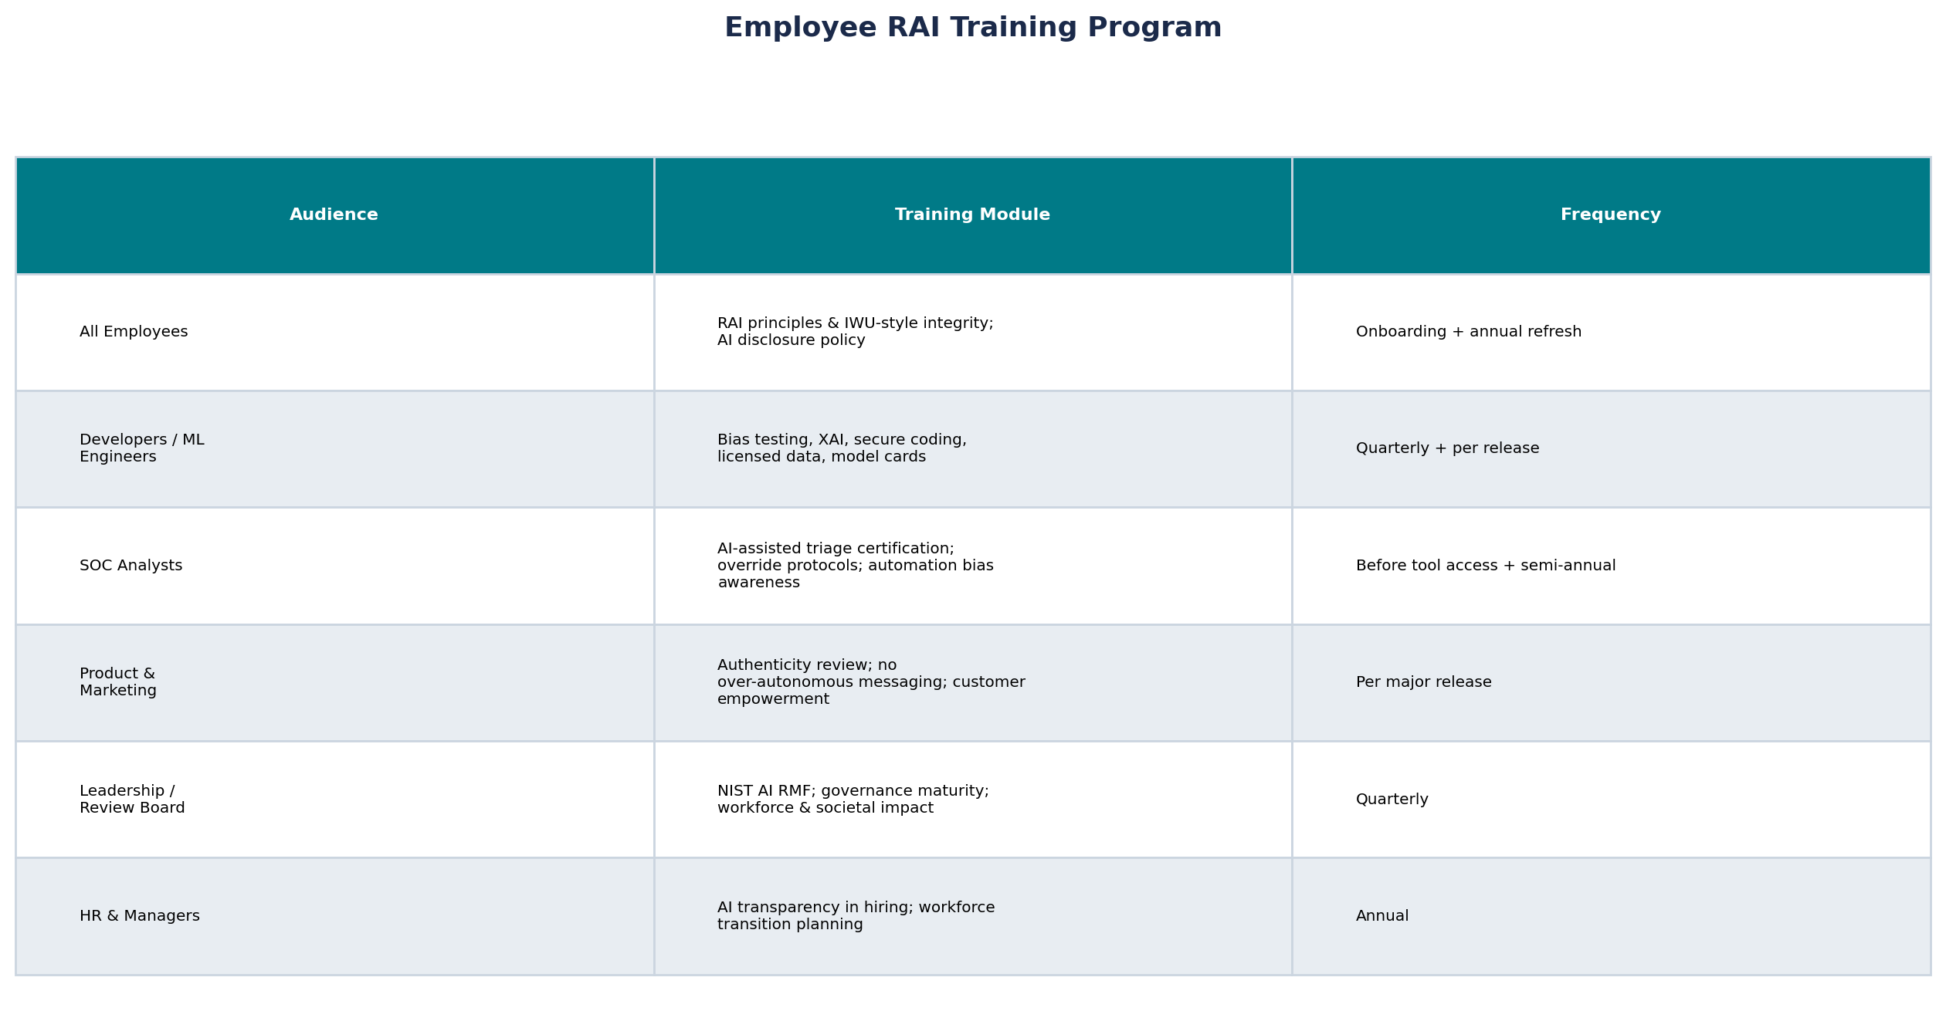
Employee RAI Training
Role-based program — Assignments 5.3, 5.4, 6.4
SentinelOneX Security | Final Responsible AI Framework | AIML-510-01

Slide 8
Effective RAI Metrics
Assignment 1.3 targets + Assignment 1.4 KPI dashboard
Metric | Target | Measurement Method
Bias Testing Pass Rate | >95% | Fairlearn subgroup audit per release
False Positive Rate | <5% | Production telemetry vs. labeled holdout set
Human Review Coverage | 100% critical incidents | SOC workflow audit logs
Explainability Coverage | 90%+ high/critical use cases | SHAP/LIME report completion rate
AI Governance Compliance | 100% before production | AI Review Board approval records
Ethics Review Completion | 100% of AI systems | Vetting workflow tracker
High-Risk Findings Resolved | >95% | Risk register closure rate
Vendor AI Assessments | 100% of third-party AI | Procurement checklist completion
RAI Training Completion | 100% employees | LMS completion by role
Drift / Degradation Response | <30 days to remediate | Monitoring dashboard SLA
SentinelOneX Security | Final Responsible AI Framework | AIML-510-01

Slide 9
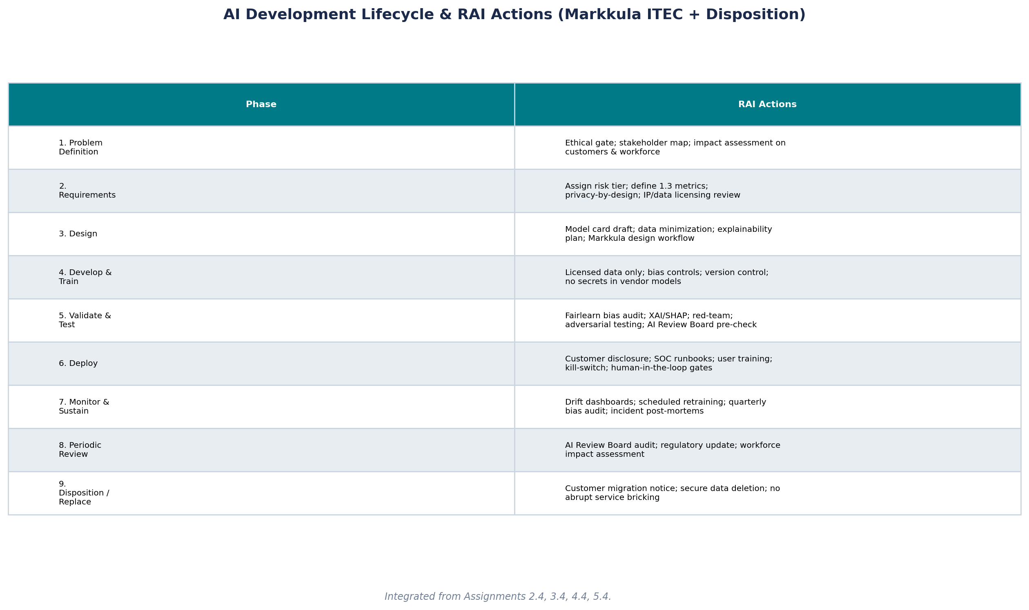
AI Development Lifecycle
RAI actions at each step including disposition — Assignment 5.4
SentinelOneX Security | Final Responsible AI Framework | AIML-510-01

Slide 10
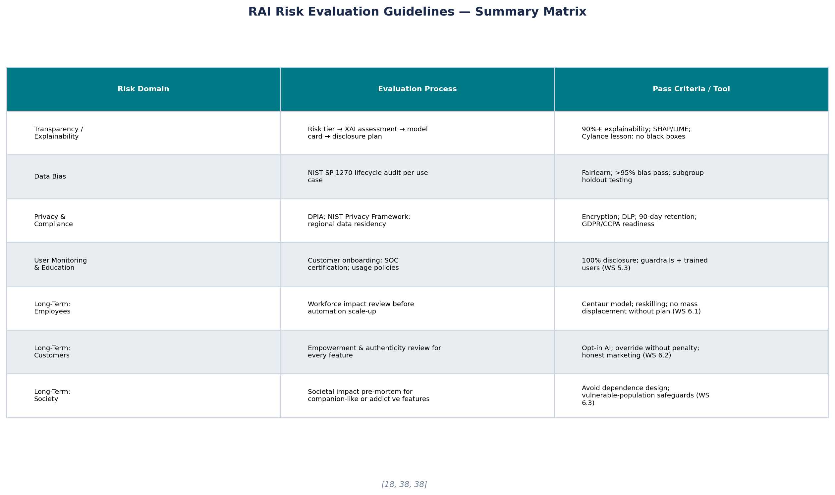
RAI Risk Evaluation Guidelines
Integrated evaluation across all risk domains
SentinelOneX Security | Final Responsible AI Framework | AIML-510-01

Slide 11
Additional Best Practices & Organizational Commitment
Actionable commitments beyond compliance
Pre-mortem every high-risk use case before development (Markkula Center; WS 3.3 CAIO simulation lesson).
Champion/challenger deployment: no full cutover without measured pilot (SwiftTel WS 6.1 lesson).
Never use customer telemetry to train global models without explicit consent (4.4 privacy; 4.3 IP).
Pair technical guardrails with user education — trained users are the first line of defense (5.3).
Biblical stewardship: build maintainable systems; plan disposition before launch (5.1; Moxie lesson).
Personal integrity: leaders model responsible AI use; disclose AI assistance in communications (6.4).
Portfolio commitment: upload this framework + key WS artifacts to professional portfolio.
Year-1 goal: move from compliance exercise to embedded RAI culture measured by maturity review (Month 12).
SentinelOneX Security | Final Responsible AI Framework | AIML-510-01

Slide 12
Prioritized RAI References
12 sources for ongoing professional use — APA format
1. Blackman, R. (2022). Ethical machines: Your concise guide to totally unbiased, transparent, and respectful artificial intelligence. Harvard Business Review Press.
2. Markkula Center for Applied Ethics. (2021). Ethics of AI applications for mental health care. Santa Clara University. https://www.scu.edu/ethics/focus-areas/technology-ethics/
3. Markkula Center for Applied Ethics. (n.d.). Ethics in technology practice toolkit. Santa Clara University.
4. National Institute of Standards and Technology. (2023). Artificial intelligence risk management framework (AI RMF 1.0). U.S. Department of Commerce.
5. National Institute of Standards and Technology. (2022). Towards a standard for identifying and managing bias in artificial intelligence (NIST SP 1270).
6. National Institute of Standards and Technology. (2020). NIST privacy framework: A tool for improving privacy through enterprise risk management, Version 1.0.
7. Microsoft Corporation. (2022). Microsoft responsible AI standard, v2. https://www.microsoft.com/en-us/ai/responsible-ai
8. Dell'Acqua, F., et al. (2023). Navigating the jagged technological frontier. Harvard Business School Working Paper 24-013.
9. Postman, N. (1992). Technopoly: The surrender of culture to technology. Vintage Books.
10. World Intellectual Property Organization. (2024). Generative AI: Navigating intellectual property. WIPO.
11. U.S. Executive Office of the President. (2024). Executive Order 14117: Preventing access to Americans' bulk sensitive personal data (DHS implementation guidance).
12. Vallor, S. (2016). Technology and the virtues: A philosophical guide to a future worth wanting. Oxford University Press.
SentinelOneX Security | Final Responsible AI Framework | AIML-510-01

