Slide 1

Python Workshop
EEL Enrichment Program
David House, David Story, Joe Haun

Slide 2
Requirements
PyCharm/IDLE Installed
  jetbrains.com/pycharm/download
Serial Library Installed
  pypi.org/project/pyserial/
Binascii Library Installed

Slide 3
Python Concepts
import
  Used to tell the Python interpreter to grab a specific library
def
  Used to tell the Python interpreter to create a function that can be called later
print
  Used to tell the Python interpreter to display values given to the console

Slide 4
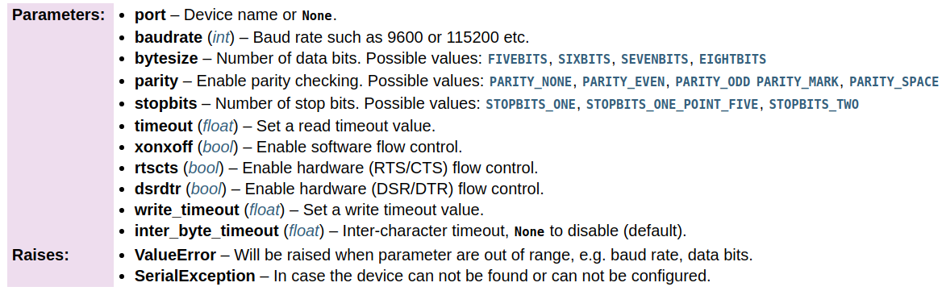
Python Concepts
Serial Class
  Initialization Parameters

Slide 5
Class Functions
open()
  Opens the port
close()
  Closes the port
read(n)
  Reads n bytes of data
write(data)
  Sends data through the port

Slide 6
Class Functions
port
  (string) Set/Get port name value
baudrate
  (int) Set/Get baudrate value
bytesize
  (int) Set/Get bytesize value
timeout
  (float) Set/Get read timeout value

Slide 7

Initializing Port
Two Methods with Identical Results
  Initializing with constructor and all relevant values
  Initializing an empty port object and using setters to initialize various values

Slide 8

Initializing Port
Method 1
Using the Setters provided
  Initialize Blank Serial Object
  Assign Port Name
    Note: This name is for Linux/MacOS. For Windows it will be COM3 instead.

Slide 9


Initializing Port
Method 1
Using the Setters provided
  Set Baudrate
  Set read timeout value (in seconds)

Slide 10


Initializing Port
Method 1
Using the Setters provided
  Set the byte size to be sent/received
  Set the parity (if any) for transmission
    Note: This will add extra bits sent to help insure data integrity

Slide 11
Initializing Port
Method 1
Using the Setters provided
  Set the number of stop bits to be sent
The Port is now setup for transfer of data

Slide 12

Initializing Port
Method 2
Use the Constructor and set all parameters desired at once
The port is now setup for the transfer of data

Slide 13
Hardware Interfacing
Setup a Python script to interface with provided FTDI chip
  Baudrate – 9600
  Bytesize – 8
  Stopbits – 0
  Parity – None

Slide 14
Challenges
Using USB to Send/Receive Data
Using one of the stations
  Send “Hello, world!” to yourself
  Send “Hello, friend!” to another device
  Receive values from another device
  Increase the baud rate value until data is no longer comprehensible

Slide 15
Questions/Comments
Feedback Welcome!
Please feel free to give us feedback on any aspect of the workshop

