Slide 1

Introduction to Through Hole Soldering
David House, David Story, Joe Haun, Adam Ortega

Slide 2
Requirements
Circuit board (PCB) and components
Soldering iron and solder
Circuit schematic
Excitement to learn!

Slide 3
Soldering Concepts
Soldering is “process of joining two or more electronic parts together by melting solder around the connection.” [1]
A soldering iron is used to melt solder into “liquid metal”
The liquid metal will re-solidify into an electrical connection when the iron is taken off and the solder joint cools.
[1] https://www.makerspaces.com/how-to-solder/

Slide 4
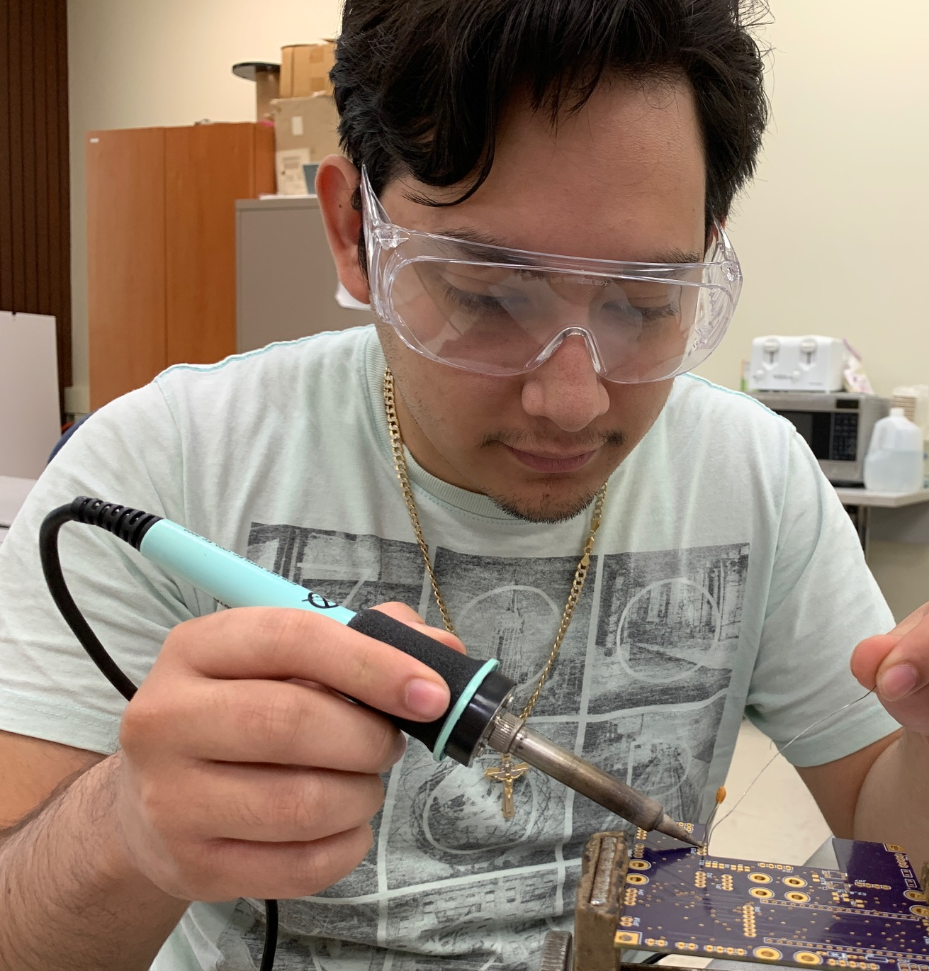
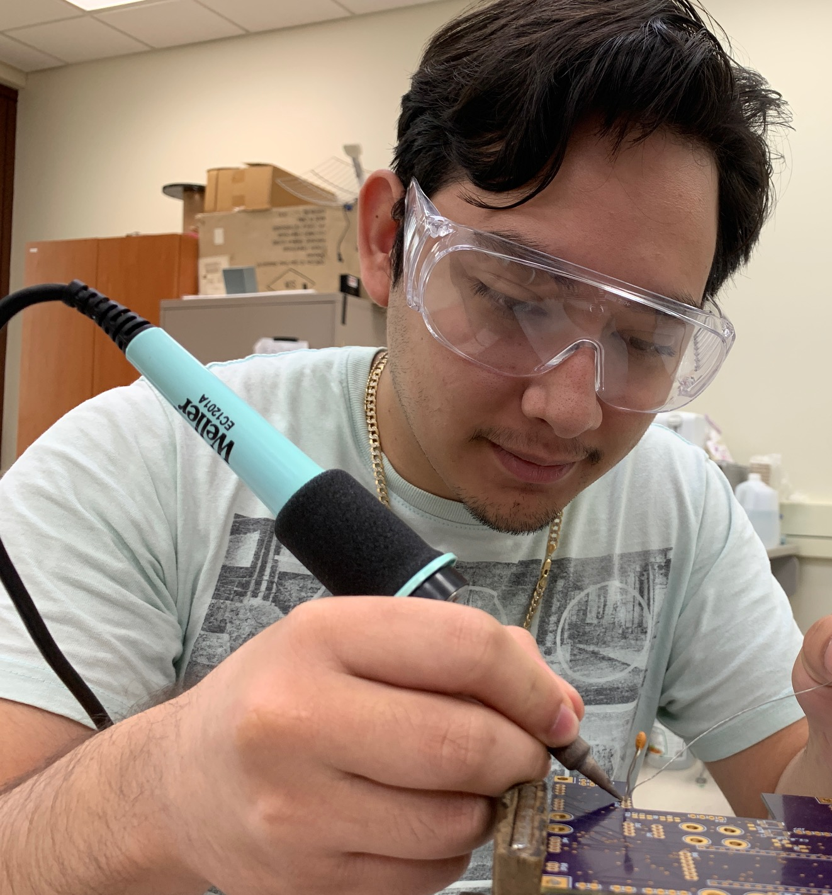


Safety Warning!
Soldering irons are hot. Do NOT hold iron by tip.

Slide 5


Safety Warning!
Some solders are leaded, wash your hands after use

Slide 6
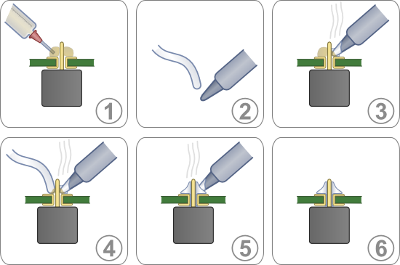
Steps To Soldering
Ensure solder pad is clean; if not, clean with isopropyl alcohol (IPA)
Apply solder flux to the pad (optional)
Tin solder tip, this can be done by applying solder directly to the tip of the soldering iron
Clean excess solder on
tip.
Touch solder tip to pad
Heat pad ~1-2 seconds

Slide 7
Steps To Soldering
While still heating pad with iron, with other hand apply solder to pad
Apply until pad is fully covered, but do not “blob” the whole pad
Remove iron, wait ~2-3 seconds
Solder will now solidify
If adjustments needed, heat soldered directly following original steps.

Slide 8
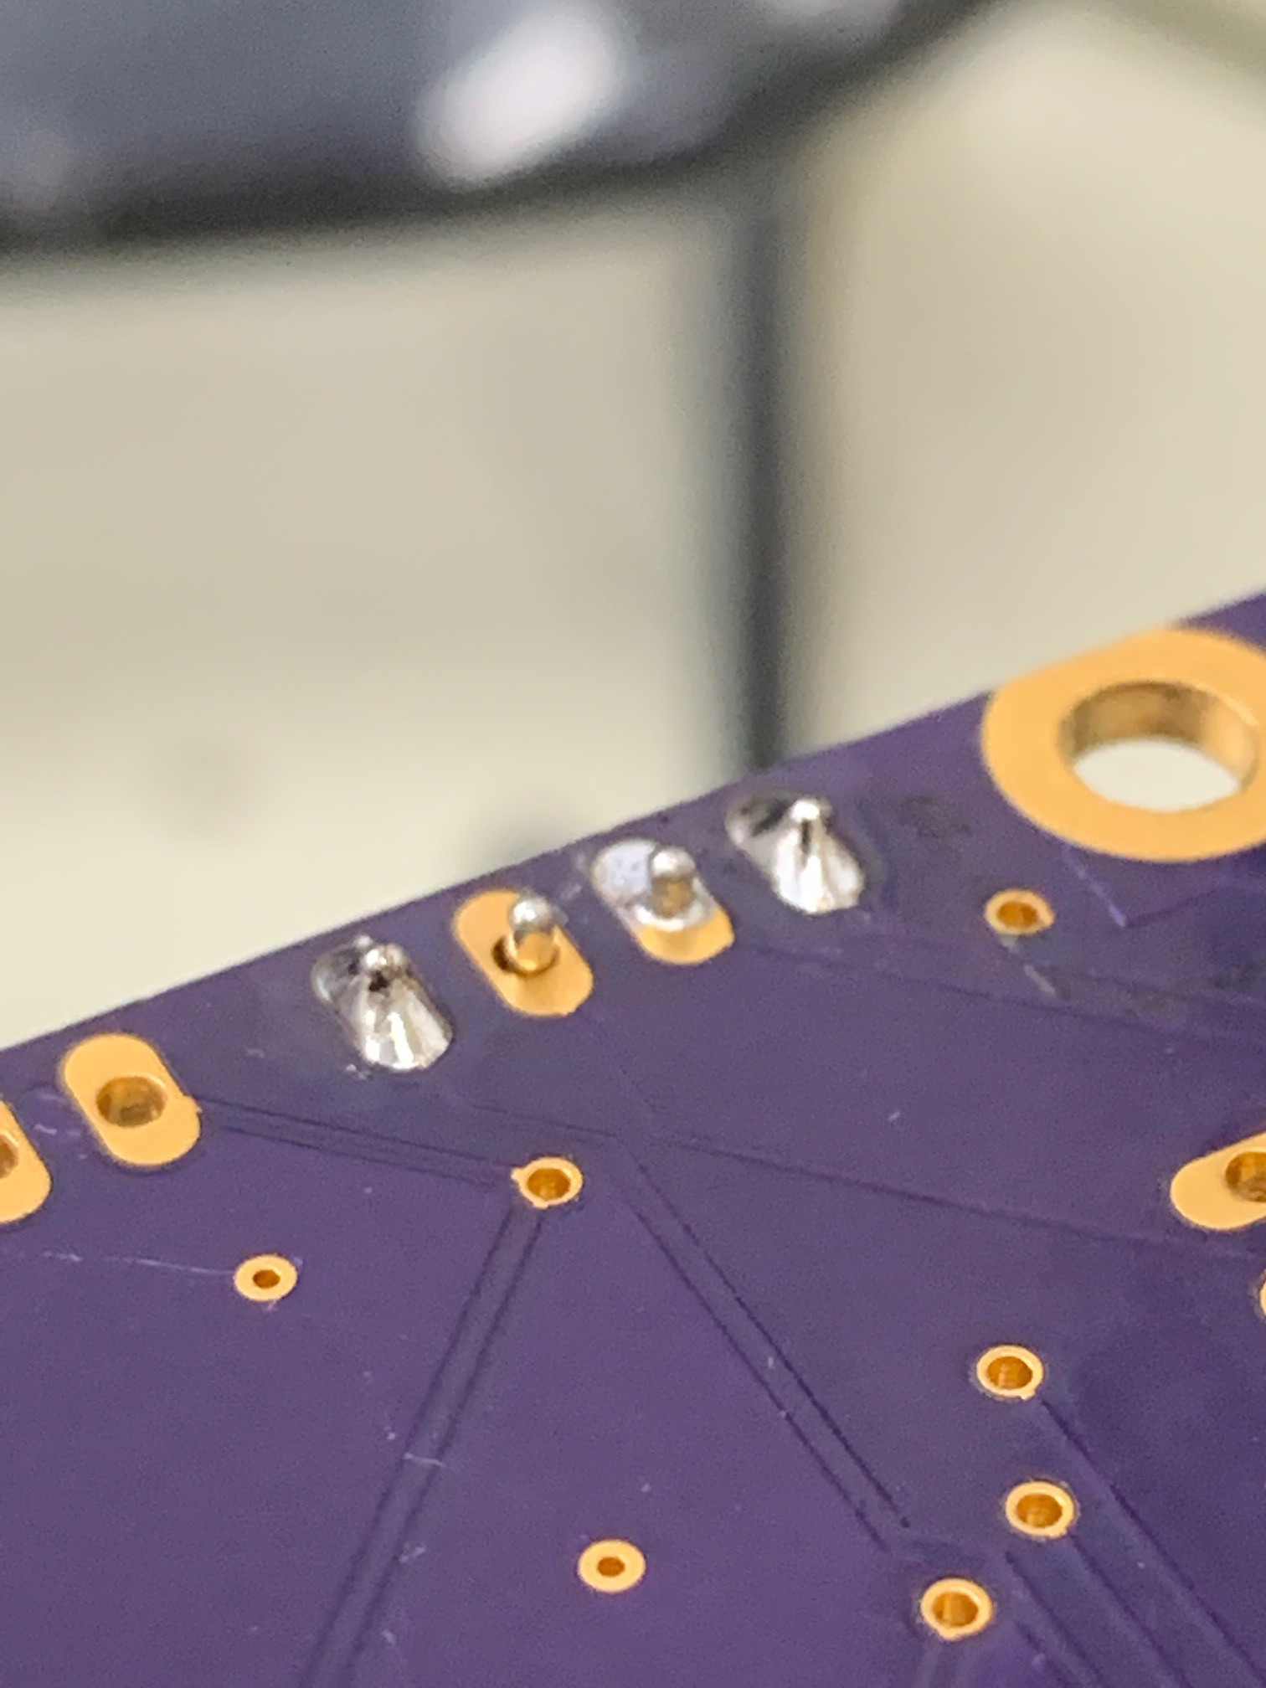
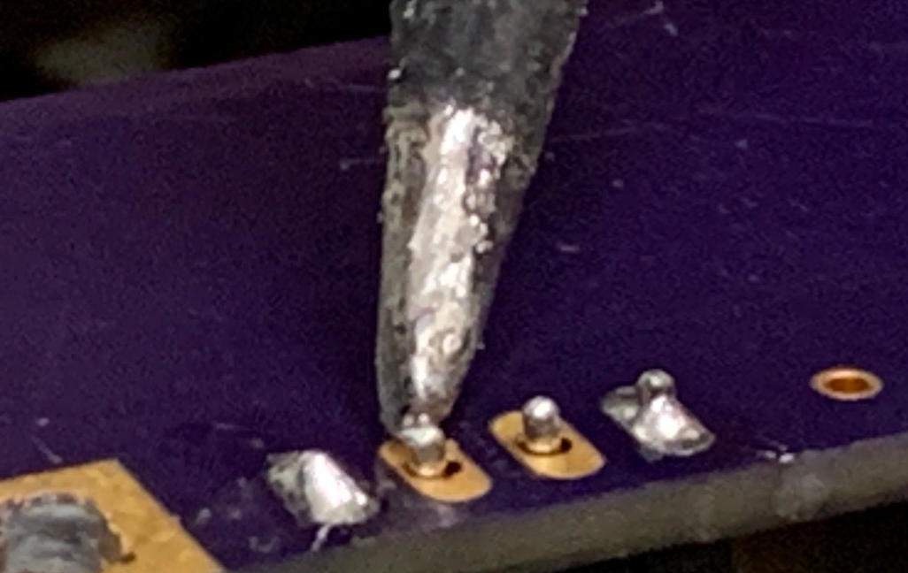
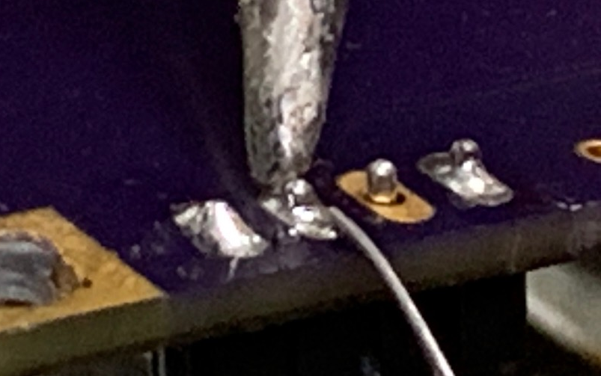
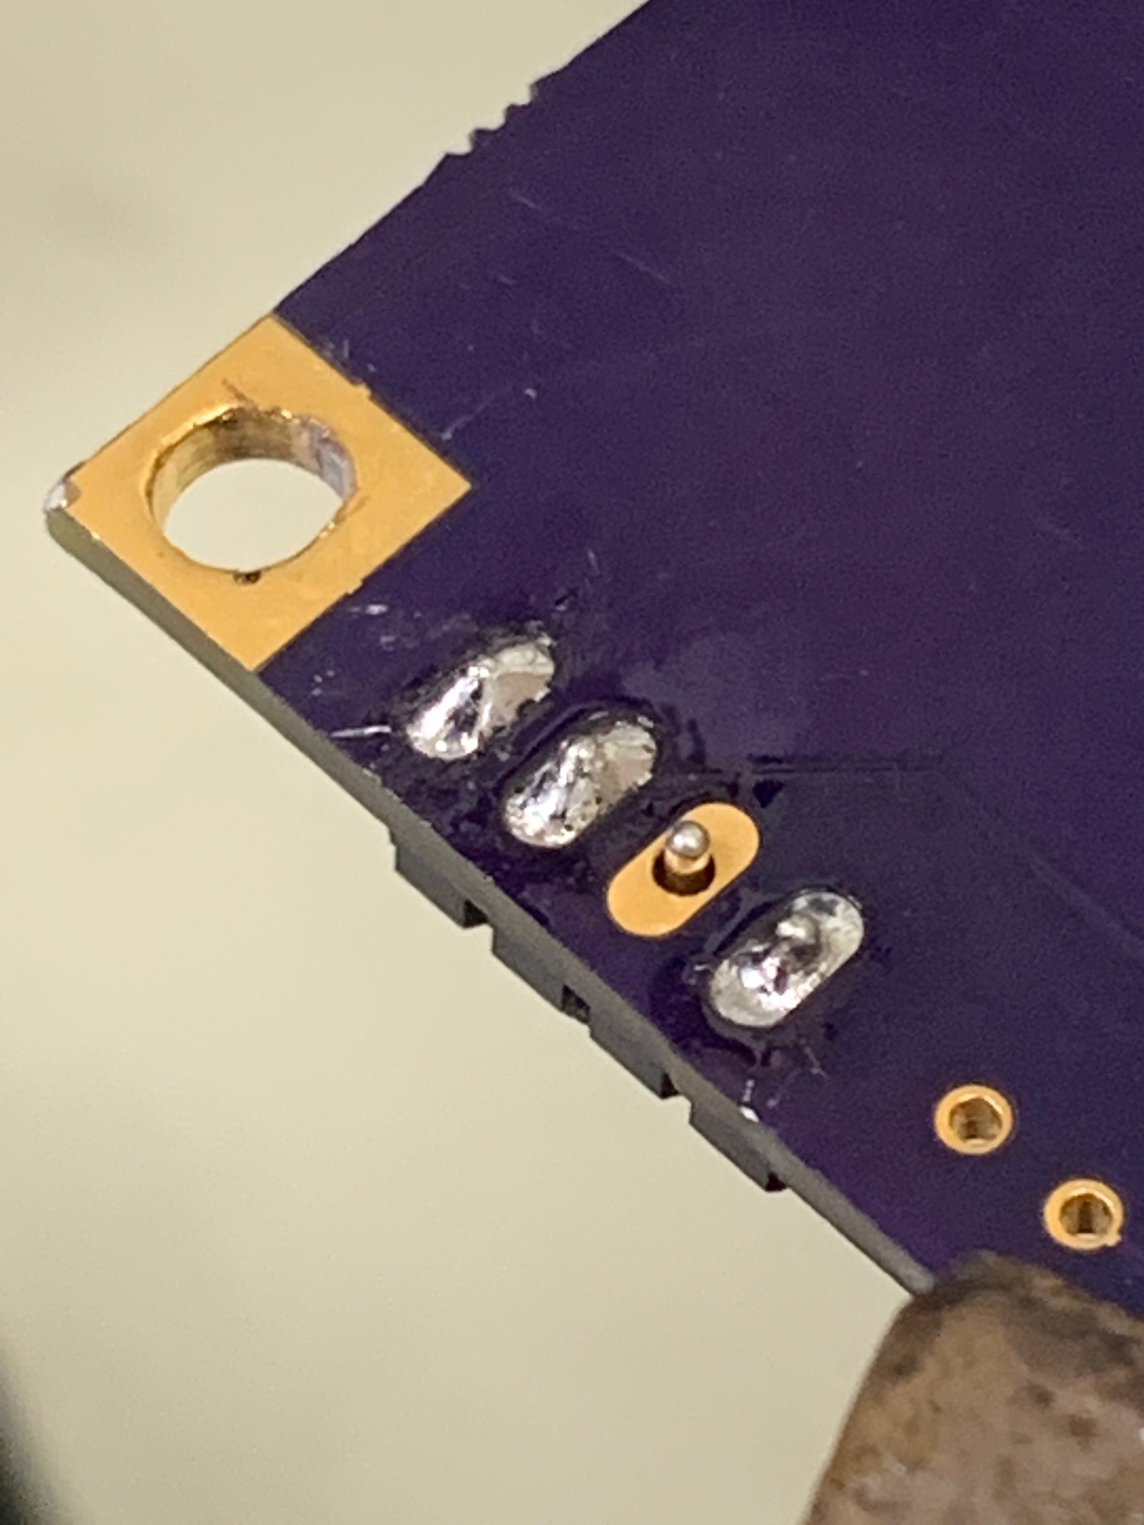
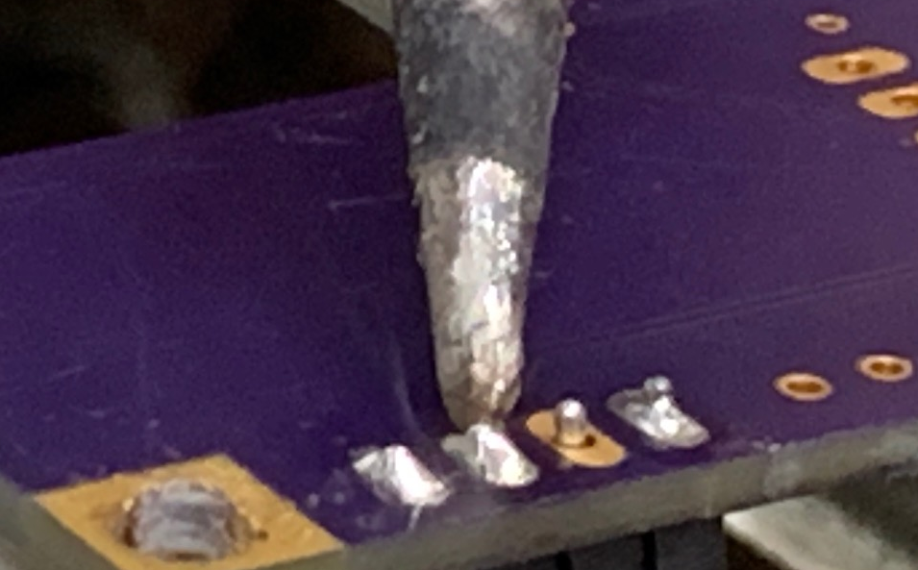
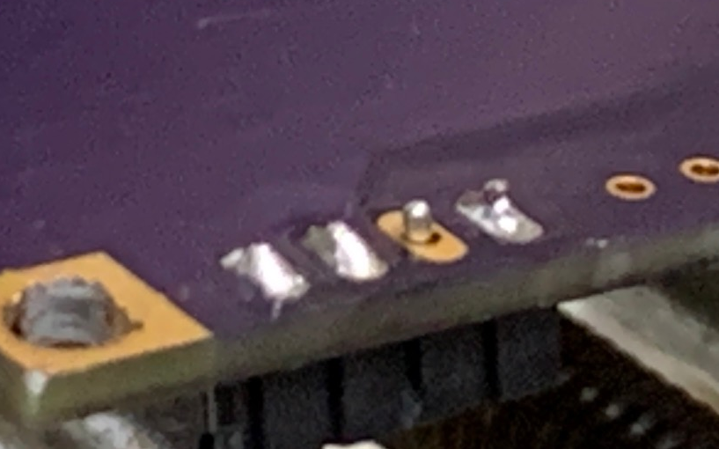
Steps To Soldering
With Images
Check pad for blemishes or dirt
Heat pad with soldering iron
Add solder while still heating
Remove solder while still heating
Remove Iron
Allow solder to solidify and cool

Slide 9
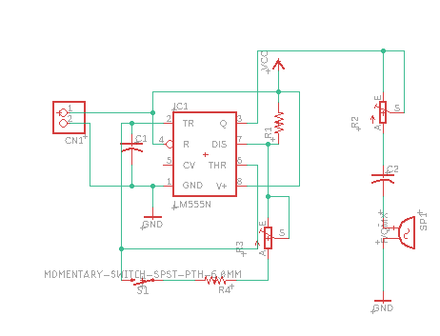
Schematic

Slide 10
Questions, Comments, Concerns

