Slide 1
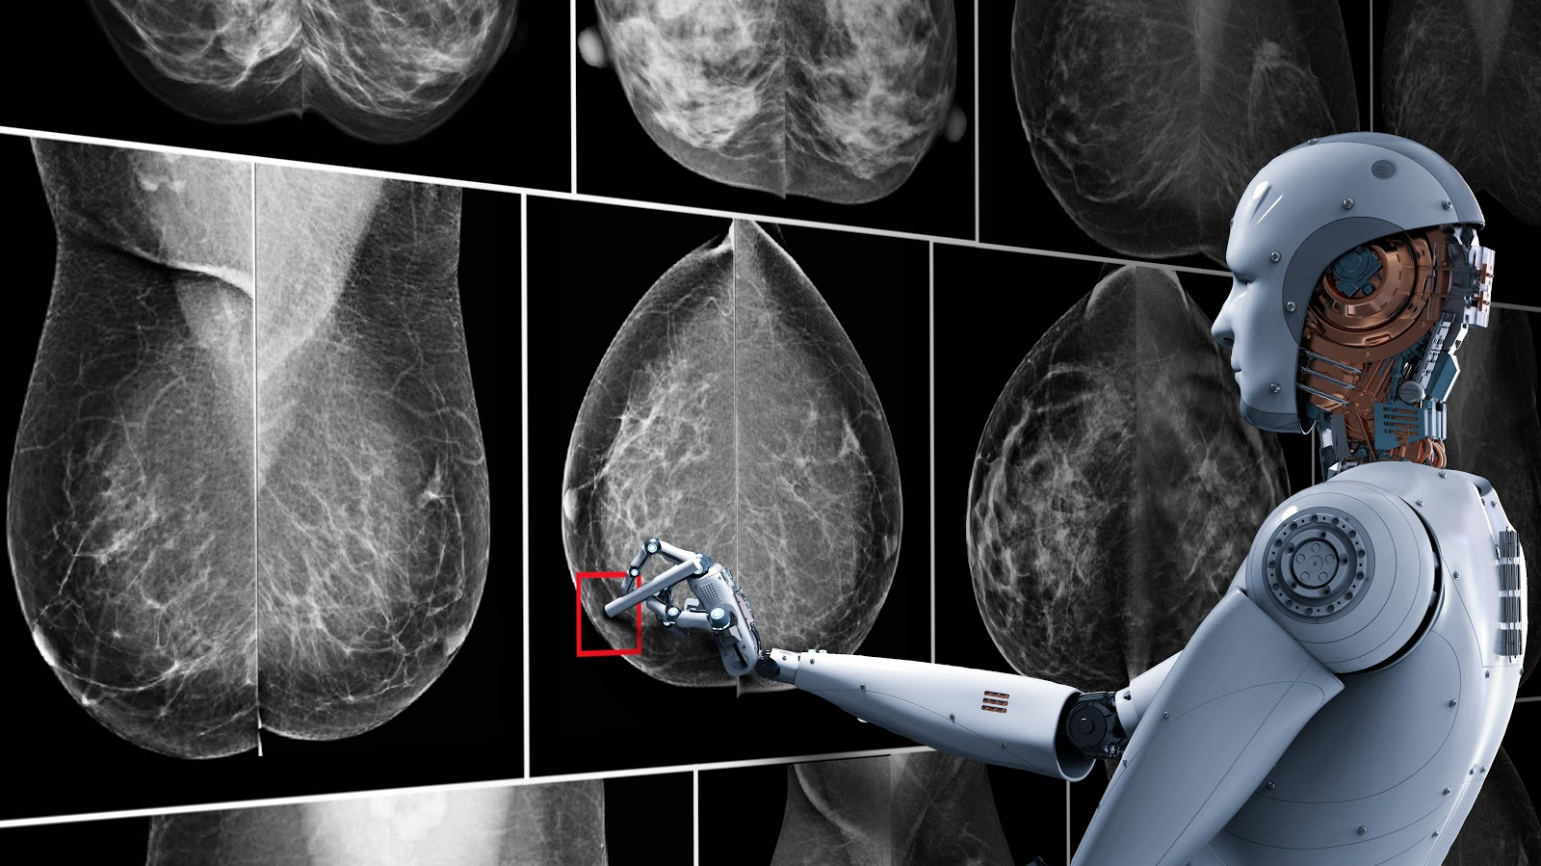



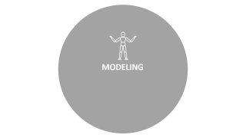
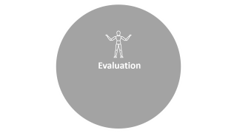


Slide 2

BUSINESS UNDERSTANDING

Slide 3


BUSINESS UNDERSTANDING
Breast cancer (BC) is one of the most common cancers among women worldwide, representing the majority of new cancer cases and cancer-related deaths according to global statistics, making it a significant public health problem in today’s society.
The early diagnosis of BC can improve the prognosis and chance of survival significantly, as it can promote timely clinical treatment to patients. Further accurate classification of benign tumors can prevent patients undergoing unnecessary treatments. Thus, the correct diagnosis of BC and classification of patients into malignant or benign groups is the subject of much research. Because of its unique advantages in critical features detection from complex BC datasets, machine learning (ML) is widely recognized as the methodology of choice in BC pattern classification and forecast modelling.
Classification and data mining methods are an effective way to classify data. Especially in medical field, where those methods are widely used in diagnosis and analysis to make decisions.
Objectives:
This analysis aims to observe which features are most helpful in predicting malignant or benign cancer and to see general trends that may aid us in model selection and hyper parameter selection. The goal is to classify whether the breast cancer is benign or malignant. To achieve this i have used machine learning classification methods to fit a function that can predict the discrete class of new input.

Slide 4

DATA STUDYING

Slide 5

DATA STUDYING
(1) ID number
Diagnosis (M = malignant, B = benign) 3-32)
Ten real-valued features are computed for each cell nucleus:
1.Radius (mean of the distance from points on the perimeters )
2.Texture (standard deviation of gray-scale values)
3.Perimeter
4.Area
5.Smothness (local variation in radius lengths)
6.Compactness (perimeter^2 / area – 1.0)
7.Concavity (severity of concave portions of contour)
8. Concave points (number of concave portions of the contour)
9. Symmetry
10. Fractal dimension

Slide 6

DATA CLEANING & EDA

Slide 7

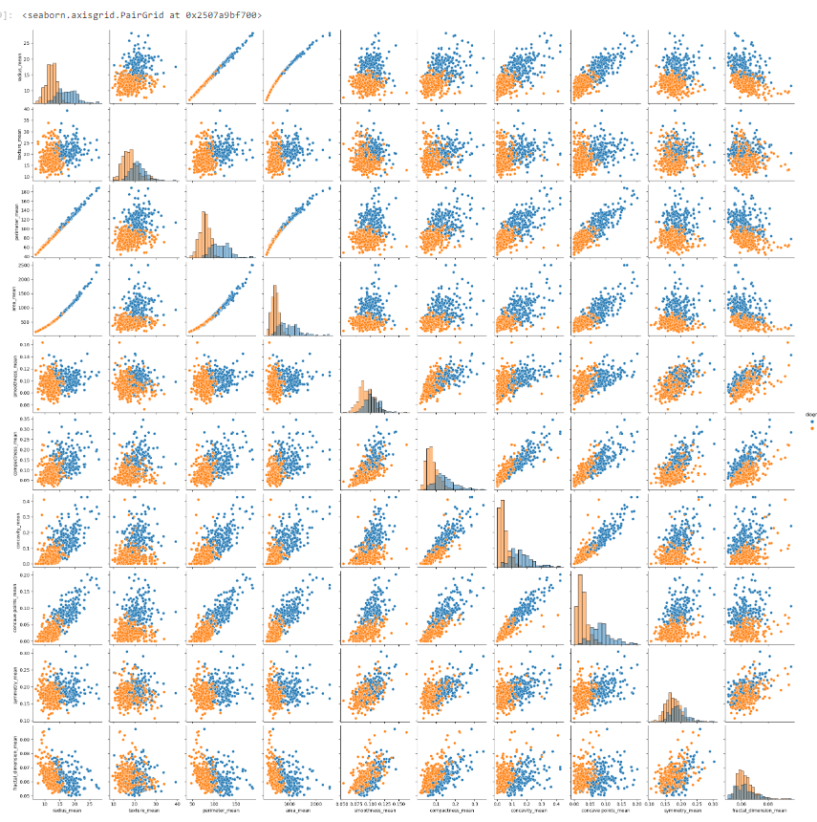
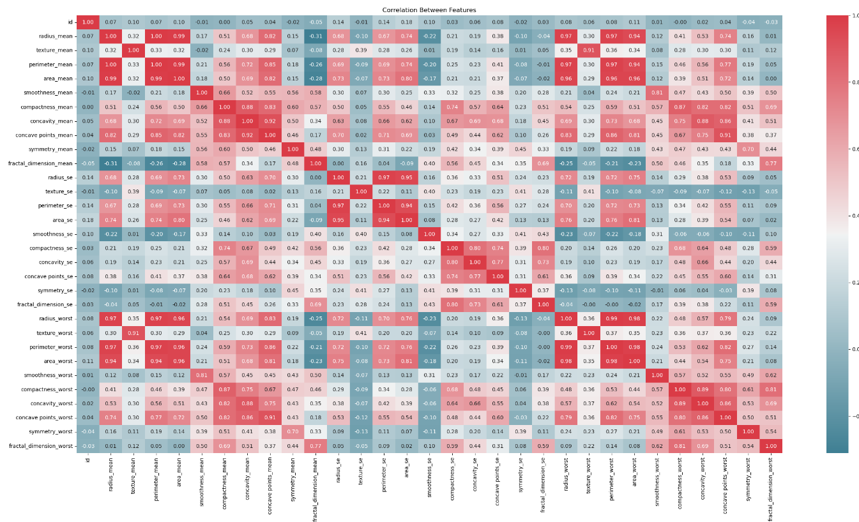
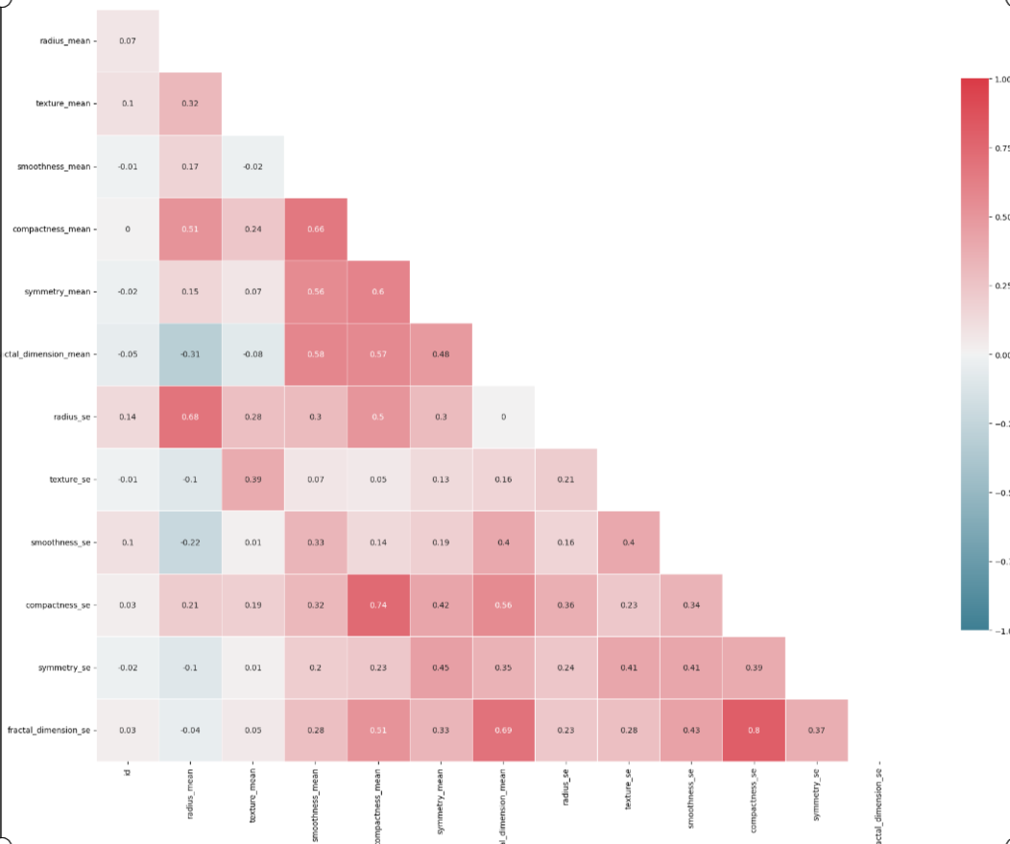
DATA CLEANING & EDA
Checking the correlation between columns graphically
After dropping the less important columns to reduce dimensionality
Checking the correlation numerically

Slide 8

MODELING

Slide 9

MODELING
Using K-fold Cross Validation to know the best model between the following Classification model:-
Logistic Regression.
K-Nearest Neighbor (KNN)
Random Forest
support vector machines.

Slide 10

The result of models using K-fold cross validation
1.Logistic classifier :
Best score : 93.317669 %
2.SVM classifier :
Best score : 92.7913533 %
3. KNN classifier :
Best score : 92.44460 %
4. RF classifier :
Best score : 93.67341 %

Slide 11
Evaluation

Slide 12
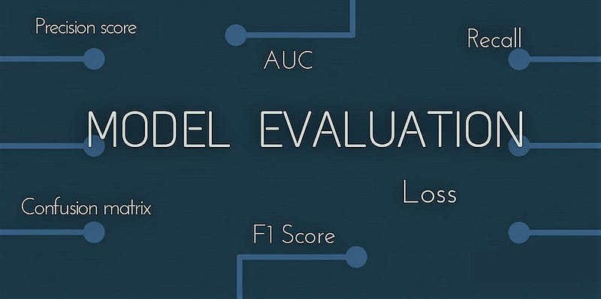
Using RF classifier
Accuracy score : % 96.42857142857143

