Slide 1
Exploiting redundancy for minimizing the reflected mass of a robotic system consisting of a linear axis and a 7-DOF lightweight robot
German Aerospace Center (DLR)
Institute of Robotics and Mechatronics
Master's Thesis presentation:
Jaime Raldúa Veuthey
06.06.2017

Slide 2
Contents
Preliminaries and Previous work
Problem and Contribution
Redundancy on Torque Level
3.1. Gradient-based vs Attractive Potential
3.2. Global Minimization
3.3. Local Minimization
Redundancy on Velocity Level
4.1. Gradient Descent: Projected vs Reduced Gradient
4.2. Computation of the Reduced Gradient
4.3. Reduced Gradient for Decoupling and Joint Limit Avoidance
4.4. Other Line Search Techniques
4.5. Comparison Line Search Techniques
Experiments
5.1. Different Directions of Minimization
5.2. External Forces
5.3. Integration with Safe Motion Unit (SMU)
Conclusions

Slide 3
1. Preliminaries and Previous work
Computation of the reflected mass
Related work
  An algorithm to obtain the self-motion manifold of a robotic system consisting on a DLR LWR and a linear axis – Fabian Beck
  On making robots understand safety: Embedding injury knowledge into control - S. Haddadin, A. Khoury, T. Rokahr, S. Parusel, R. Burgkart, A. Bicchi, A. Albu-Schäffer
Notes:
formulate the relation between robot mass, velocity, impact geometry
and the resulting injury
This formulation was used to develop an algorithm to ensure safe motions of the robot

Slide 4
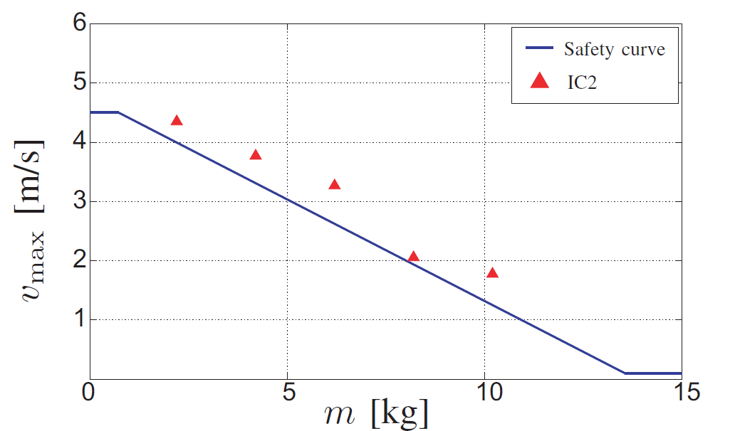
2. Problem
Safety curves from collision experiments implemented in a velocity control scheme, referred to as the Safe Motion Unit (SMU)
Aim to avoid a possible velocity reduction by the SMU by elaborating a redundancy resolution scheme that minimizes the reflected mass of a given point of interest (POI)
Notes:
IC2: contusion without skin opening;
Liner regression

Slide 5
2. Contribution
Several torque- and velocity-based minimization schemes are implemented and compared.
Joint limit avoidance scheme based on the Reduced Gradient minimization technique.
Real time capable controller that extends the safe velocity controller and allows the robot to move at higher speeds while still ensuring collision safety.

Slide 6
3. 1. Redundancy on torque level
Gradient-based
Bad performance
close to maxima
Attractive potential
Selection of goal position:
  Global minimum
  Local minimum

Slide 7
3.2. Global Minimization
In each iteration: Computation of accurate grid [~2 s] + Search of local extrema [~15 ms] => Offline
  recursive scheme starting with rough grid
Discontinuity of the global minimum => undesired goal position
PLOT IMAGE OF Z-DIRECTION SURFACE WITH TWO ARROWS POINTING AT THE GLOBAL MINIMA

Slide 8
3.3. Local Minimization
Trust Region
Analytical form of the grid required to generate a region:
Via software (Mathematical, Maple): Not solvable
Curve fitting:
  Very different grid in each direction => not unique analytical form
  Standard MATLAB polynomial surface fitting tools are unable to approximate up to sufficiently high order
  May be possible using neural networks
Line Search
Analytical form of the grid required to generate a descent direction = null space velocity that minimizes the reflected mass
Simpler approach
>> Redundancy on Velocity Level <<

Slide 9
4.1. Gradient Descent: Projected vs Reduced Gradient
Projected Gradient
Moore-Penrose pseudoinverse
Mass weighted pseudoinverse
Reduced Gradient

Slide 10
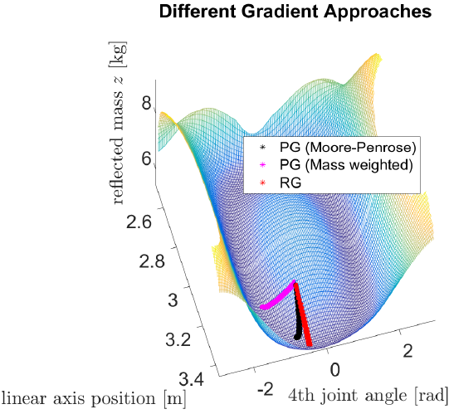
4.1. Gradient Descent: Projected vs Reduced Gradient PG MW mainly wrt q4?
Different minima > hard to measure speed of convergence
Computational efficiency
PG (MW) [t~3 ms] < PG (MP) [t~2 ms] < RG [t~0.25 ms]

Slide 11
4.2. Computation of the Reduced Gradient
Analytically
Numerically
ME FALTA UNA IMAGEN AQUI PARA EXPLICARLO MEJOR EL NUMERICO

Slide 12
4.3. Reduced Gradient. Decoupling

Slide 13
4.3. Reduced Gradient. Decoupling for Joint Limit Avoidance PI?

Slide 14
4.4. Other Line Search Techniques
Conjugate Gradient Descent
  Polak-Ribere
  Hestenes-Stiefel
  Dai-Yuan
  Worse convergence
Quasi-Newton's methods
DFP
BFGS
inexact line search, round-off and truncation errors > loss p.d.ness...Necessary restart to process to guarantee convergence...decreased convergence rate
Notes:
CGD methods add a frictional term $\beta_k$ to avoid sharp turns when getting into a (ill-conditioned) narrow valley. Since each step depends on the two last values of the gradient the zigzagging is reduced.
Newton's method assumes that the function can be locally approximated as a quadratic in the region around the optimum, and uses the first and second derivatives to find the minimum.
Newton (quadratic convergence rate) > QNM (superlinear convergence rate) > GD (linear convergence rate)

Slide 15
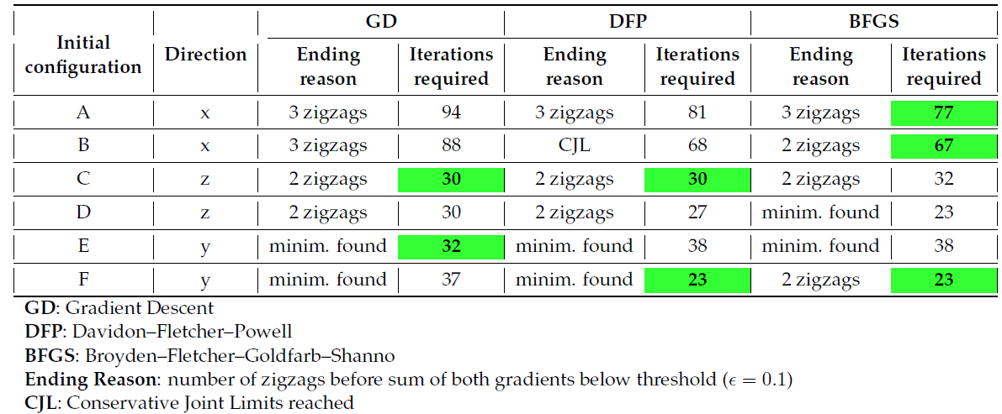
4.5. Comparison Line Search Techniques
X-direction: pseudoconvex grid. BFGS > DFP > GD. However, not significantly faster due to restart to restart
Y-& Z-direction: contour line of minima....hard to measure speed of convergence
Zigzag still present. Stops when gradient below convergence parameter. Stops close to minimum...”Ending reason” is not a criteria to select between methods
  (Reduced) Gradient Descent implemented for sake of simplicity
Notes:
tested cases were chosen so the initial configuration is relatively far from the minimum
BFGS was later introduced than DFP to improve some features like roundoff error and convergence tolerance

Slide 16
5.1. Experiments. Different Directions

Slide 17
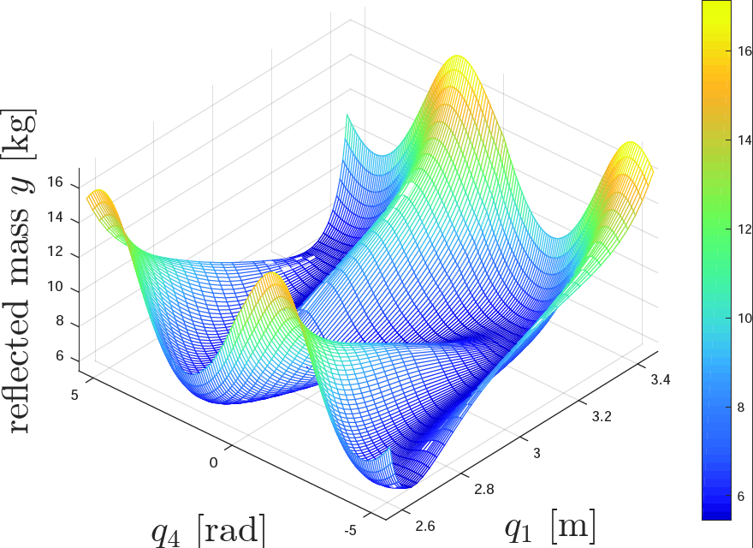
5.2. Experiments. External forces

Slide 18
5.2. Experiments. External forces

Slide 19
5.3. Experiments. Integration with the SMU

Slide 20
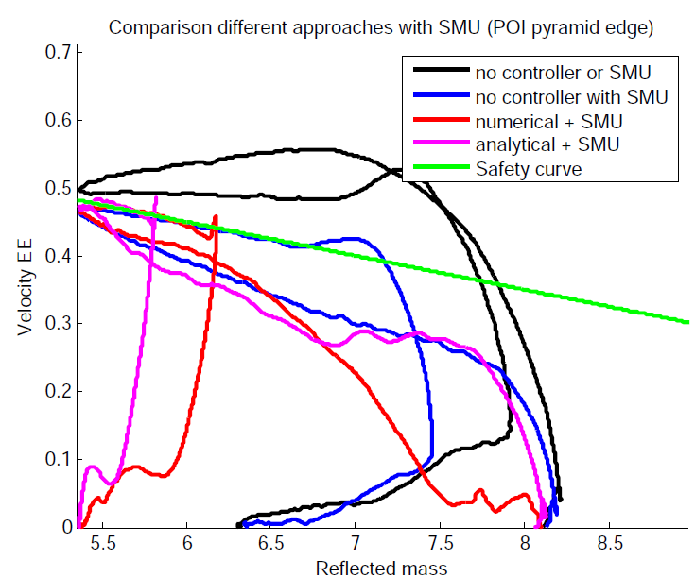
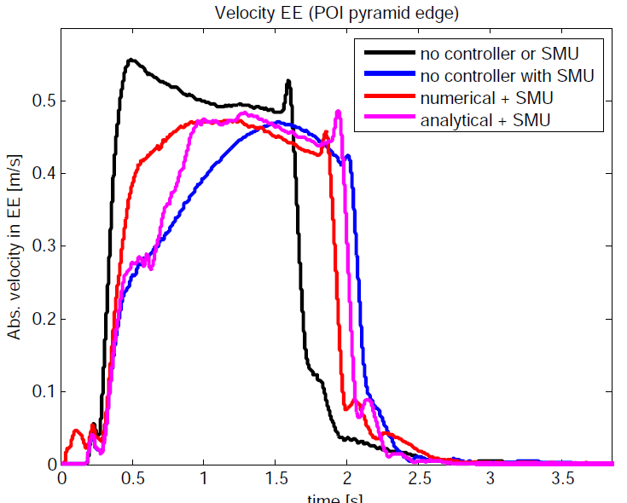
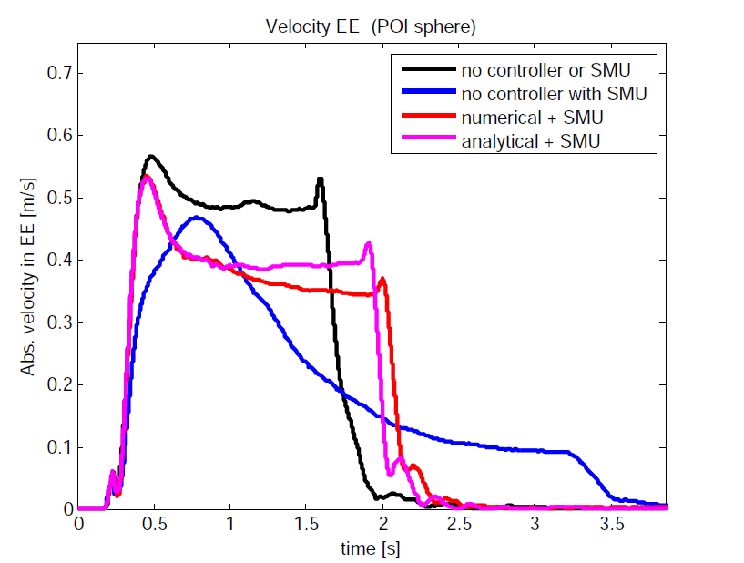
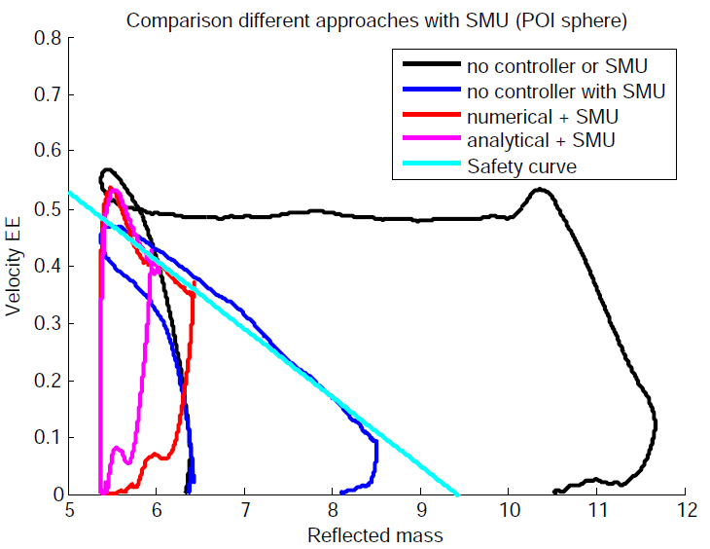
5.3. Experiments. Integration with the SMU

Slide 21
Conclusions
Attractive potential for null space torque > local minimization > RG
  Analytical approach: more computationally efficient
  Numerical approach: more robust to parameters variation
Explotation of decoupling in RG for joint limit avoidance
Real time capable minimization controller increases performance while SMU ensures safety

Slide 22
Thank you for attention!!
Do not hesitate to ask!

Slide 23
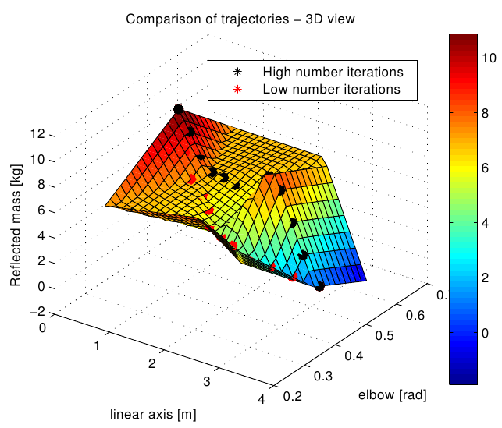
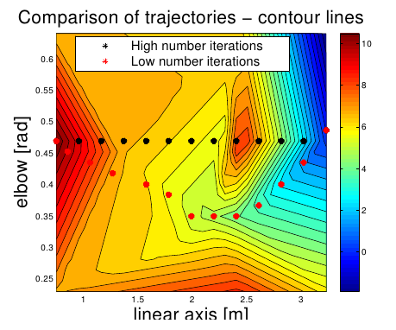

Slide 24
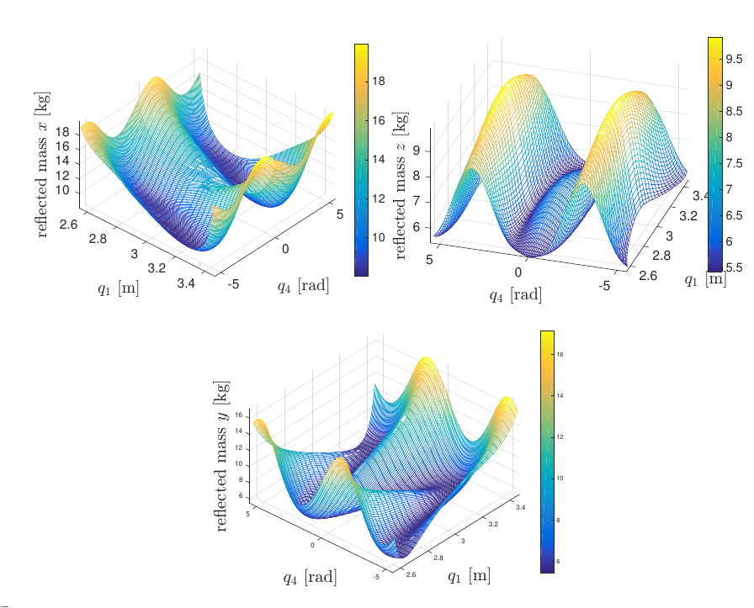

Slide 25
