Slide 1
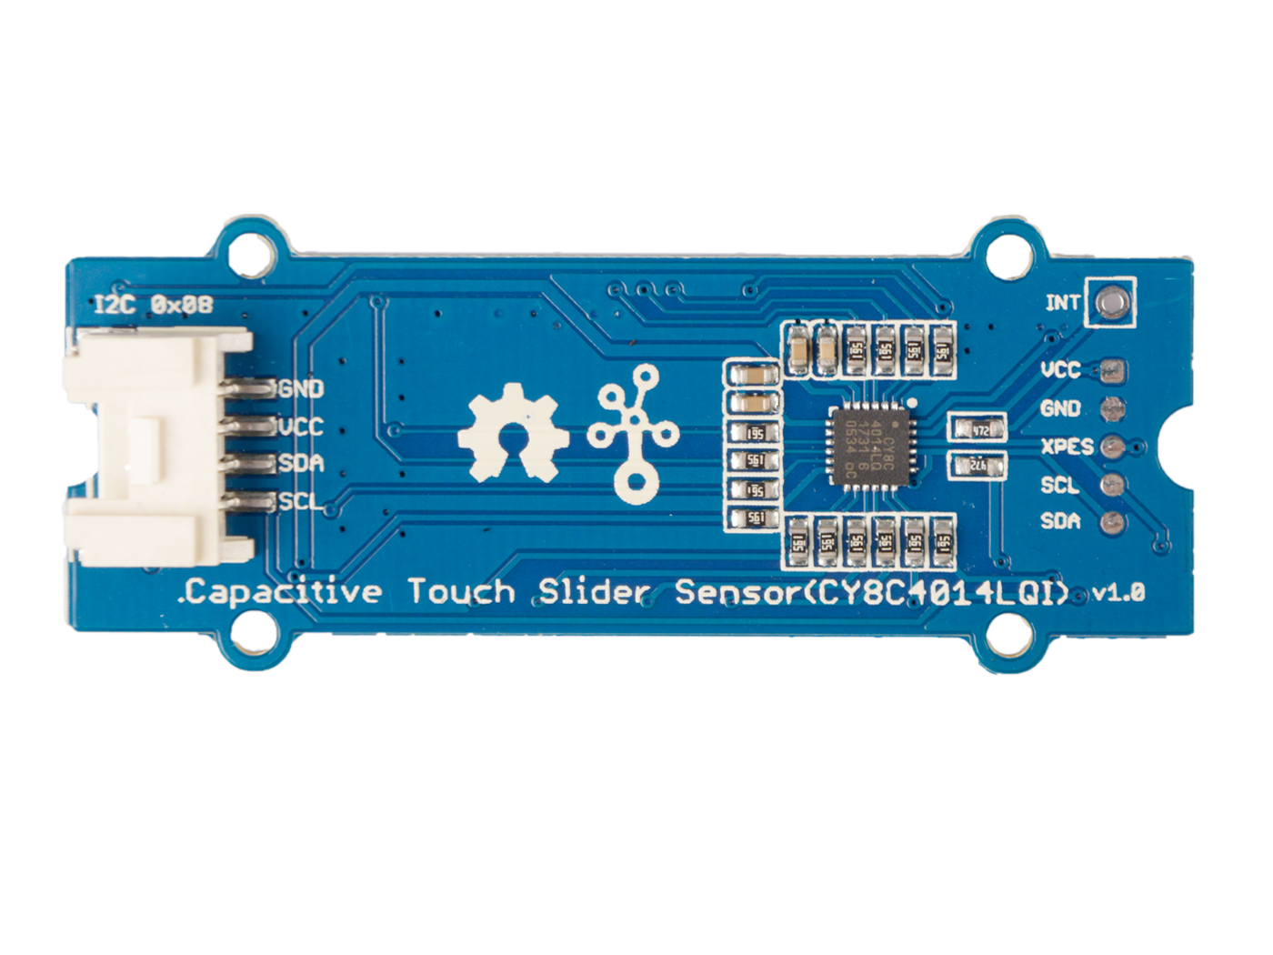










GND: connect this module to the system GND
VCC: you can use 5V or 3.3V for this module
SDA: I²C serial data
SCL: I²C serial clock
VCC: you can use 5V or 3.3V for this module
GND: connect this module to the system GND
XPES: Connect to the XRES pin, external reset I/O pin
SCL: I²C serial clock, work as SWDCLK when burn the firmware
SDA: I²C serial clock, work as SWDDATA when burn the firmware
INT: Default High, turn to low when button or slider triggered

Slide 2
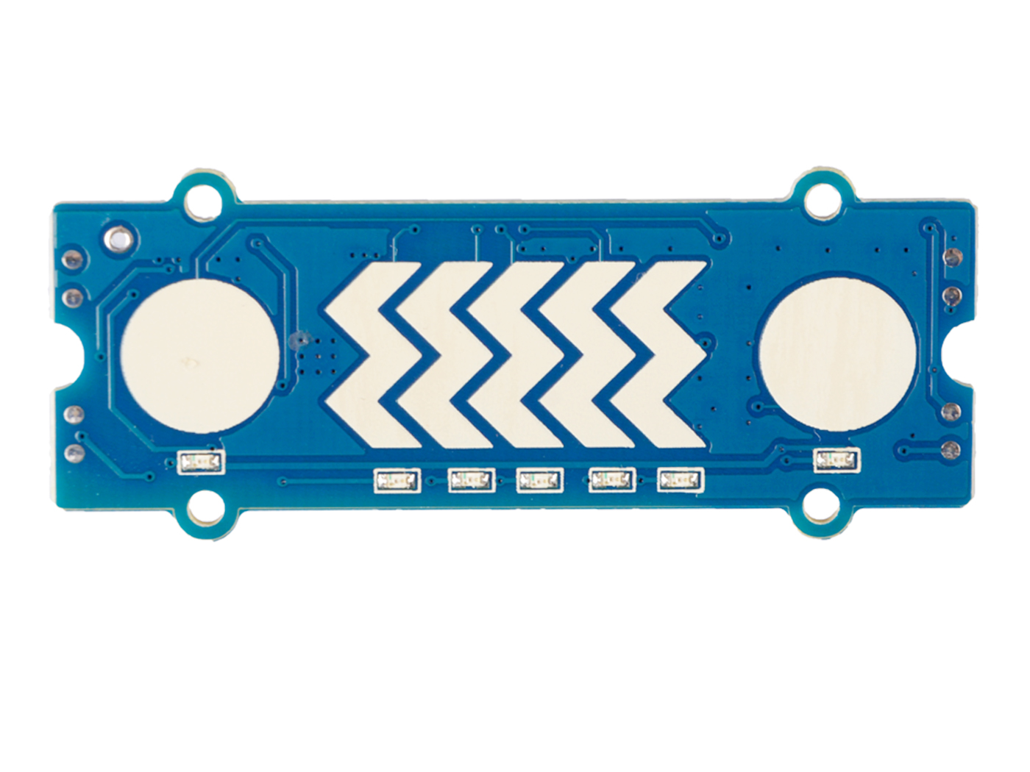
Button
Slider
Button

Slide 3
GND: 将此模块连接到系统 GND
VCC: 您可使用 5V 或 3.3V 电压
SDA: I²C 串行数据
SCL: I²C 串行时钟
VCC: 您可使用 5V 或 3.3V 电压
GND: 将此模块连接到 GND
XPES: 连接到 XRES 引脚，外部重置I/O 引脚
SCL: I²C 串行时钟，烧写固件时作为 SWDCLK
SDA: I²C串行时钟，烧写固件时作为 SWDDATA
INT: 默认为高电平，当按钮或滑块被触发时变低

Slide 4
按钮
滑块
按钮

