Slide 1
Chapter 6: Model building and regression
Mahri K
Dr. Hanli Liu
BE 3343

Slide 2
Function discovery
Regression (aka least squares method) can be used to fit the data
Three most used functions:
The linear function: y(x)=m*x+b; y(0)=b
Gives a straight line when plotted on rectilinear axes
The power function: y(x)=b*x^{m} ; y(0)=0 if m≥0 and y(0)=ꝏ if m<0
Gives a straight line when plotted on log-log axes
The exponential function: y(x)=b*10^{mx} or y=b*e^{mx}; y(0)=b
Gives a straight line when plotted on semilog plot whose y axis is logarithmic

Slide 3
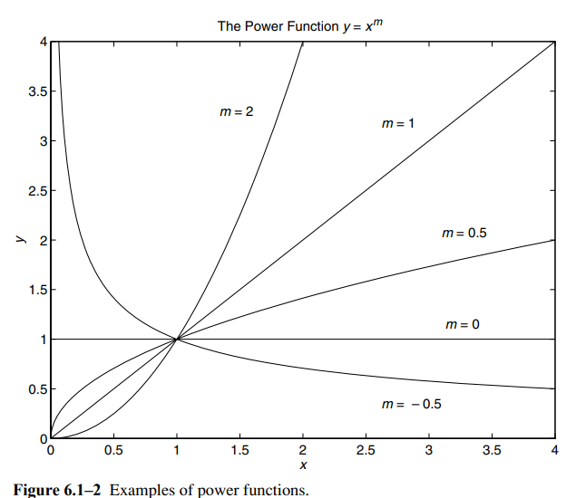
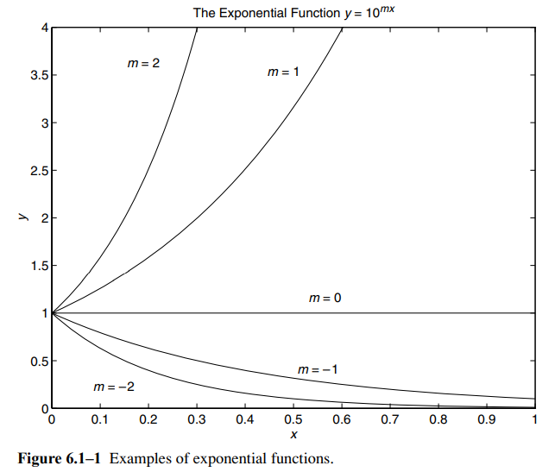
Function discovery
The following steps can be used to determine the function for the data :
Examine the origin
Linear function passes through origin when b=0
Exponential function passes through origin when b=0 by otherwise is never 0
Power function passes through origin only if m>0

Slide 4
Function discovery
Plot data using rectilinear scales and see if the graph gives a straight line
Otherwise, if y(0)=0 at x=0, try power function (log-log axes)
If that is not the case, try exponential function if y(0)≠0 (semiology axes)
If none work, move to the next step
Plot the data on log-log axes
Plot the data on semilog y axes

Slide 5
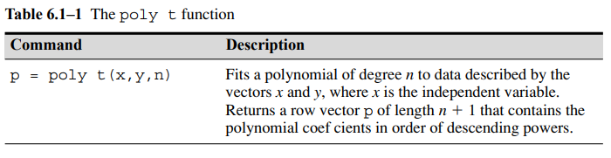
Coefficient discovery
Function discovery provides the type of function and not coefficient
Can utilize polyfit to obtain b and m of a polynomial of specified degree n that best fits the data which uses the least squares method
Vector p gives [p₁,p₂] when n =1 which means that it is first degree polynomial
For the linear function, vector p gives [m,b]
For the power function, vector p gives [m,b] when the following is used polyfit(log10(x), log10(y),1) due to the following relationship log₁₀y=m*log₁₀x+log₁₀b
For the exponential function, vector p gives [m,log₁₀b] when the following is used polyfit(x,log10(y),1) due to the following relationship log₁₀y=m*x+log₁₀b

Slide 6
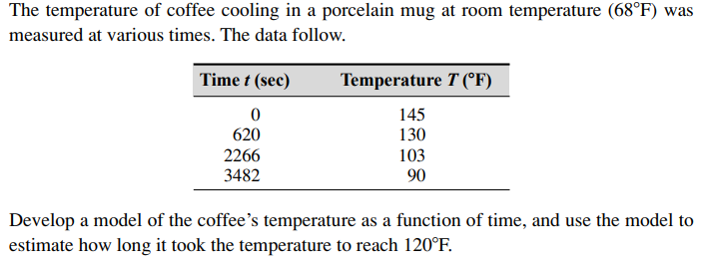
Example 6.1-1
Solution:
Not a power function due to nonzero y-intercept
Room temperature of 68 F needs to be subtracted to plot relative temperature
Linear function will look as follows: T-68=mx+b
Exponential function will look as follows: T-68=b*10^{mt}
Plot the functions to find the straight line fit

Slide 7
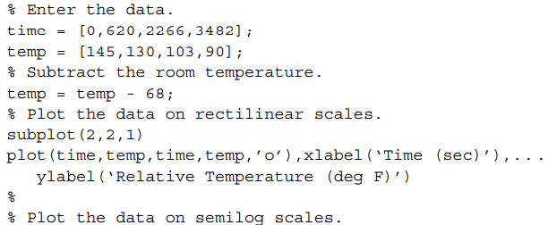

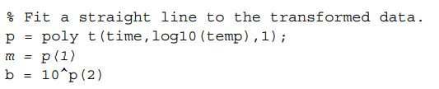
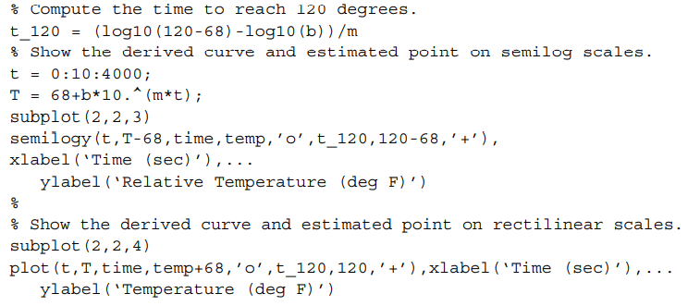
Example 6.1-1

Slide 8
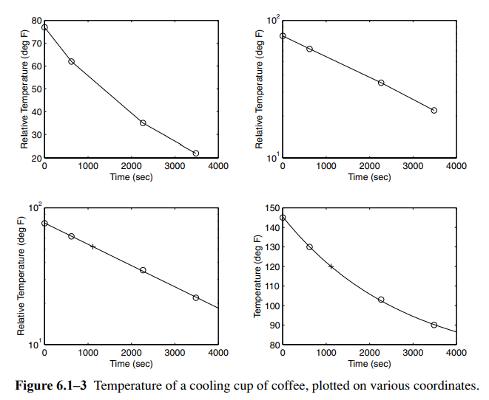
Example 6.1-1
Graph 1-rectilinear scales; Graph 2-semiology scales; Graph 3-estimation on semiology scales; Graph 4-estimation on rectilinear scales
Function discovery: exponential function – T=68+b*10^{mt}
Using polyfit find following: m=-1.5557*10⁻⁴ and b=77.4469
Find the time when temperature reaches 120 F: t=1112 sec

Slide 9

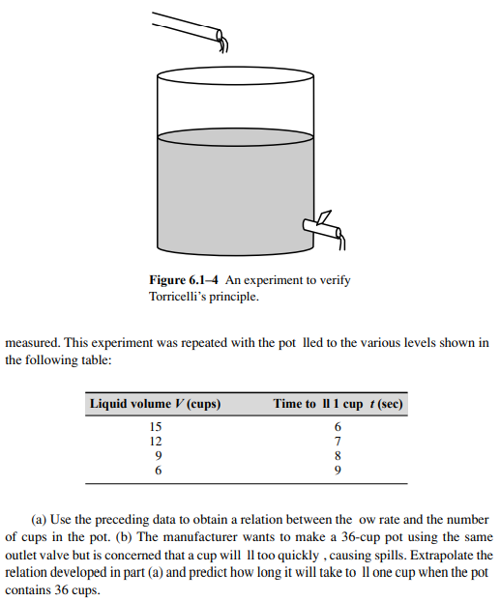
Example 6.1-2

Slide 10
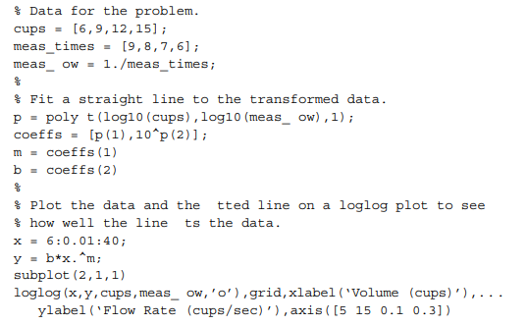
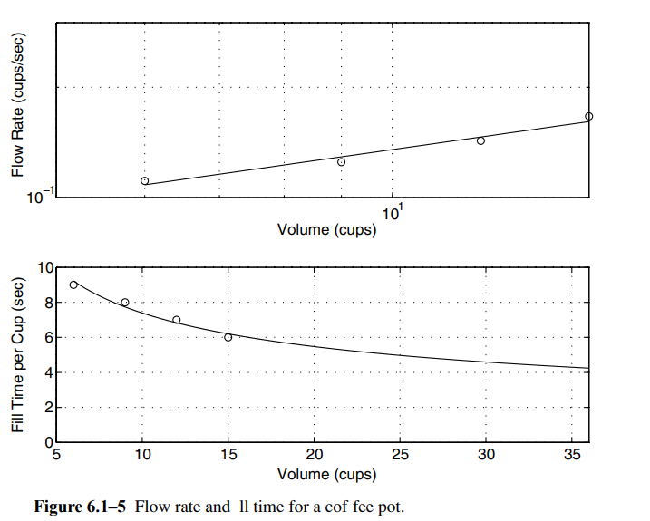
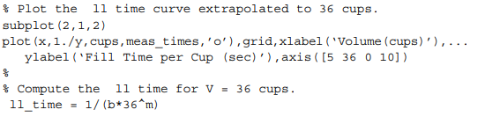
Example 6.1-2
Toricelli’s principle: f=r*V^{1/2} where f=1/T
Results: m=0.433 ; b=0.0499 ; predicted fill time of 1 cup =4.2 sec
Graph 1- loglog scale; Graph 2- rectilinear scale of extrapolation to 36 cups

Slide 11

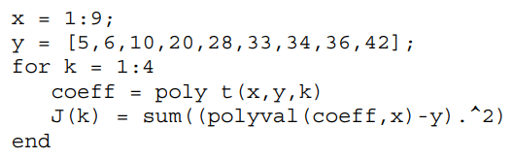
Regression
polyfit function is based on least squares method (aka regression)
Least squares method:
the line that gives the best fit is the one that minimizes the sum of the squares of the vertical differences between the line and the data points (aka J) where these differences are called residuals
a_{i} are coefficients of n+1 terms that can minimize J by solving n+1 linear equations
J decreases as the polynomial degree is increased
minimized J values can be obtained by setting partial derivatives of m and b to zero
Use the following to obtain J values for 1-4 polynomials:

Slide 12
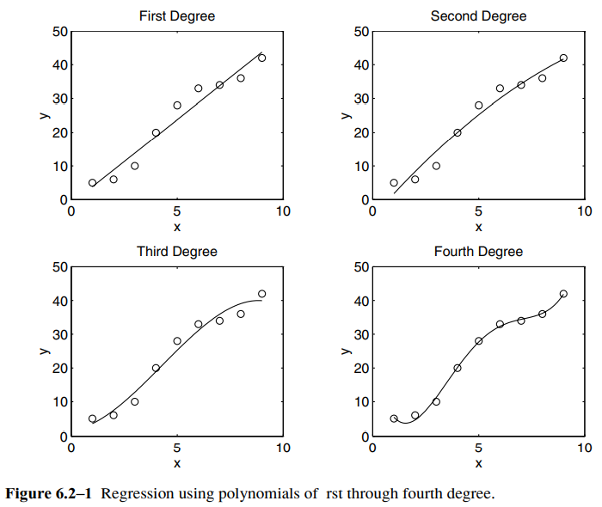
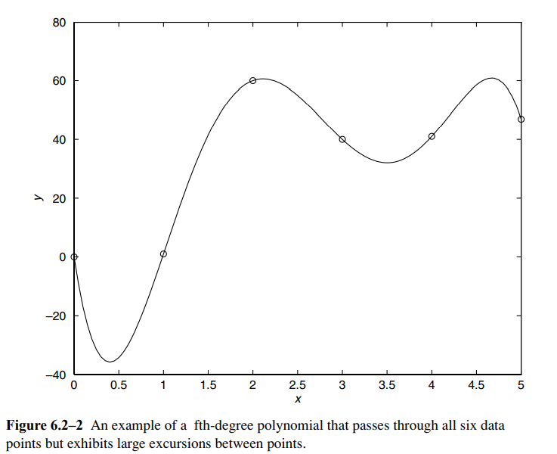
Regression example
Warning: avoid using high degree polynomial to avoid large excusions between data points and large errors if coefficients are not represented with a large number of sig figures

Slide 13
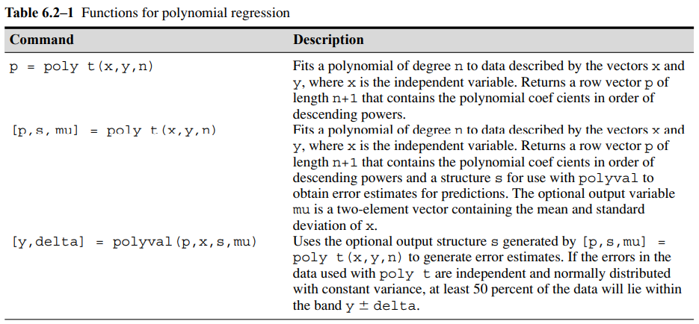
Table 6.2-1

Slide 14



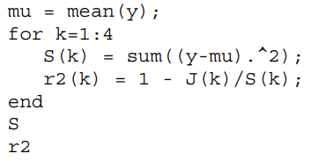
Quality of a curve fit
The function with smallest J value gives the best fit
Perfect J is J=0
J indicates how much of the data spread is unaccounted for by the model
The coefficient of determination can be used to measure the quality of the curve fit (aka r-squared value)
Perfect coefficient of determination is r²=1
Sum of the squares of the deviation (aka S) of the y values from their mean indicates how much data is spread around the mean
Use the following to find J, r², S for k=1:n

Slide 15
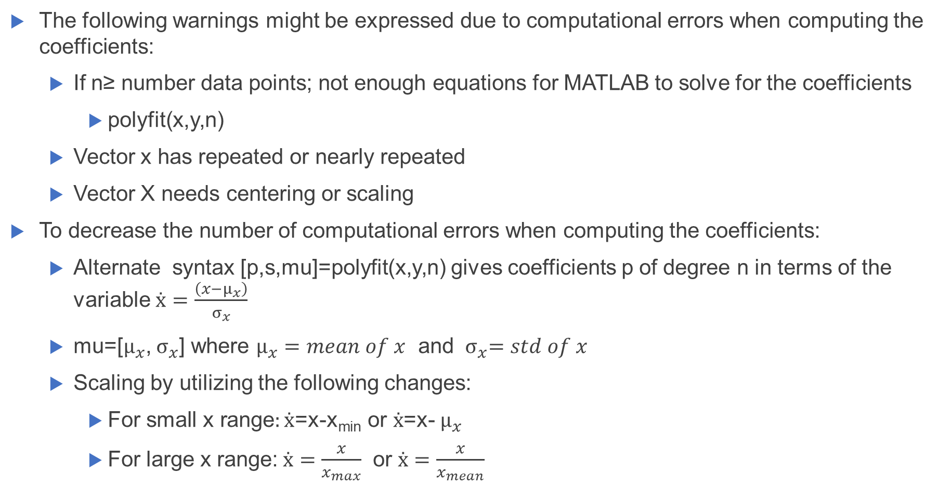
Scaling the data
The following warnings might be expressed due to computational errors when computing the coefficients:
If n≥ number data points; not enough equations for MATLAB to solve for the coefficients
polyfit(x,y,n)
Vector x has repeated or nearly repeated
Vector X needs centering or scaling
To decrease the number of computational errors when computing the coefficients:
Alternate syntax [p,s,mu]=polyfit(x,y,n) gives coefficients p of degree n in terms of the variable $ẋ=\frac{\left(x−μ_{x}\right)}{σ_{x}}$
mu=[$μ_{x}$, $σ_{x}$] where $μ_{x}=mean of x$ and ${ σ}_{x}=std of x$
Scaling by utilizing the following changes:
$\text{For} \text{small} \text{x} \text{range}:ẋ$=x-x_{min} or $ẋ$=x- $μ_{x}$
For large x range:$ẋ=\frac{x}{x_{max}}$ or $ẋ=\frac{x}{x_{mean}}$

Slide 16


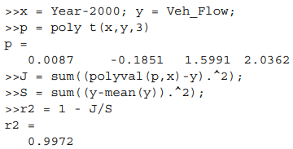
Example 6.2-1
Description: the following data give the number of vehicles, in millions, crossing a bridge each year for 10 years. Fit a cubit polynomial to the data and use the fit to estimate the flow in the year 2010.
Attempt when using polyfit syntax:
Large values in vector Year
Due to small range, subtract x_{min} or Year_{min}
Solution:
Coefficient of determination gives an approval for the calculated coefficient
The final equation:
Where f is the traffic flow in millions of vehicles; t is the time in years measure from 0
Using polyval(p,10) which is t=2010 gives an answer of 8.2 million vehicles.

Slide 17
Using residuals
Use residuals as a guide to choose appropriate function to describe the data

Slide 18
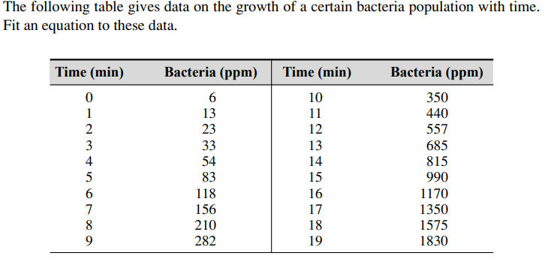
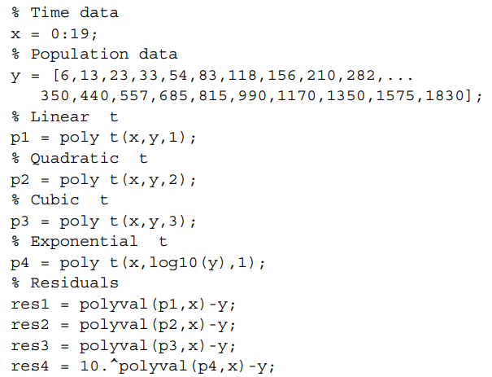

Example 6.2-2
Try three fittings: linear, quadratic, cubic, exponential
Exponential form: $y=b(10)^{mt}={10}^{mt+a} where b={10}^{a}$
Solution:

Slide 19

Example 6.2-2
Results:
Analysis of residuals: Linear, quadratic, and exponential have large residuals compared to cubic function and the coefficient determination of the cubic function is $r^{2}=0.999$ so the final equation is:

Slide 20
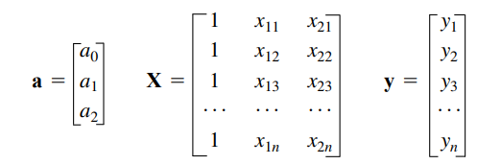
Multiple linear regression
Use left division method for solving linear equations which uses the least squares method when the equation set is overdetermined:
Use linear equation I matrix form where
n=number of points and i=1,2,….,n
Xa=y where x and y are data
a vector gives coefficients when X/y

Slide 21
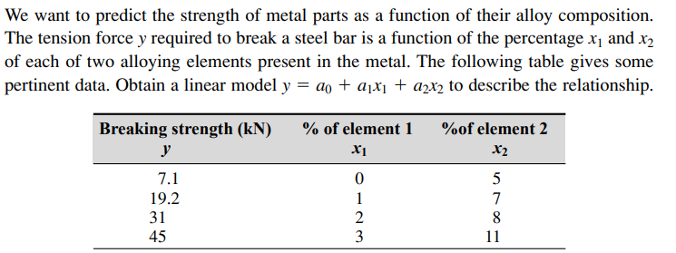
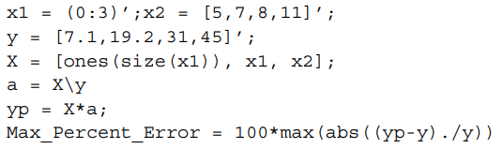
Example 6.2-3
a=[0.8000 10.2429 1.2143]
Model: y=0.8+10.2429*x₁+1.2143*x₂
Maximum percent error of the model’s predictions: 3.2193 %

Slide 22
Linear-in-parameters regression
Used when dealing with non-polynomial or non-functional
Need to be converted to linear form by:
Logarithmic transformation
Other transformation

Slide 23
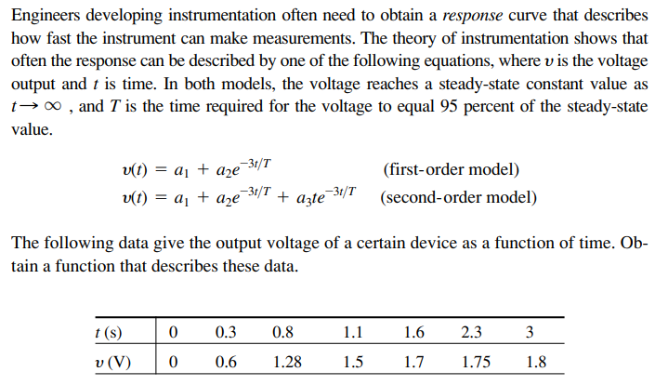
Example 6.2-4

Slide 24
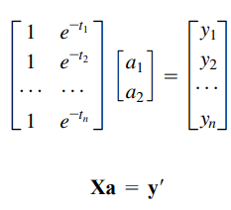

Example 6.2-4
Solution:
Estimation of 3 seconds for voltage to become constant
T=3
Express first order model in matrix form where n data points gives n equations:
Using left division, coefficient vector a can be obtained:
Results: a₁=2.0258 and a₂=-1.9307

Slide 25
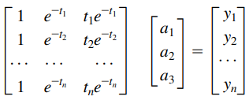
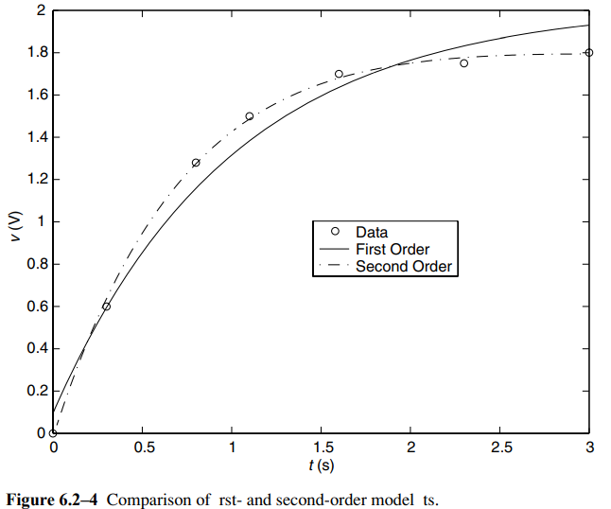

Example 6.2-4
Express second order model in matrix form where n data points gives n equations:
Using left division, coefficient vector a can be obtained:
Results: a₁=1.7496, a₂=-1.7682, a₃=0.8885

Slide 26
Basic fitting interface
This function can gives coefficients of equation using the following steps:
Fit data using a cubic spline or polynomial up to degree 10
Plot multiple fits simultaneously for a given data set
Plot the residuals
Examine the numerical results of a fit
Interpolate or extrapolate a fit
Annotate the plot with the numerical fit results and the norm of residuals
Save the fit and evaluated results to the MATLAB workspace

Slide 27
Basic fitting interface steps
Plot some data
Select Basic Fitting from the Tools menu of the Figure window
When the first pane of the Basic Fitting interface appears, click the right button once
Third pane is used for interpolating or extrapolating a fit. It appears when you click the right arrow button a second time
At the top of the first pane is the Select data window which contains the names of all the data sets you display in the Figure window associated with the Basic Fitting interface. Use this menu to select the data set to be fit. You can perform multiple fits for the current data set. Use the Plot Editor to change the name of a data set. Use the Plot Editor to change the name of a data set. The remaining items on the first pane are used as follows.

