Slide 1
Minecraft
Richard Smith

Slide 2
3d co-ordinates
(Demo my game)

Slide 3
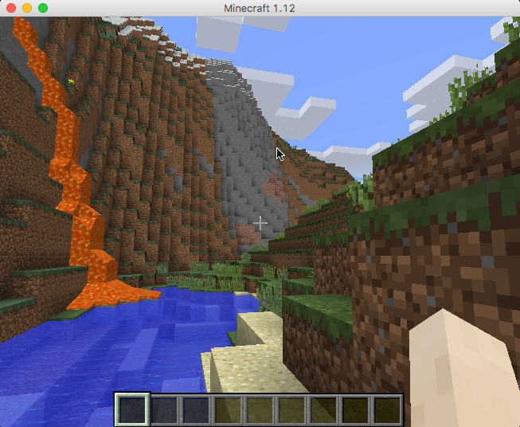
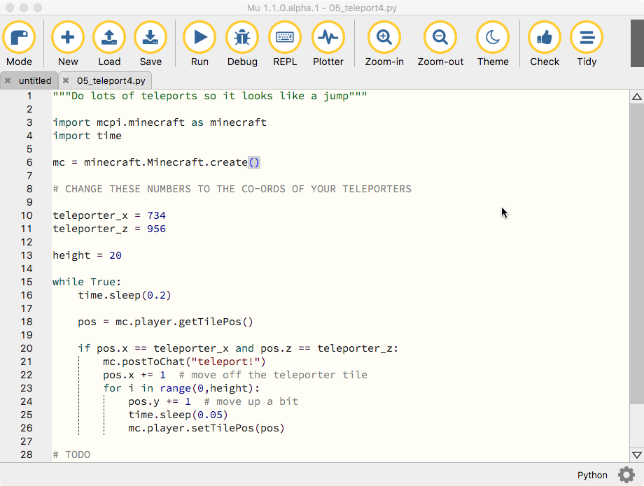
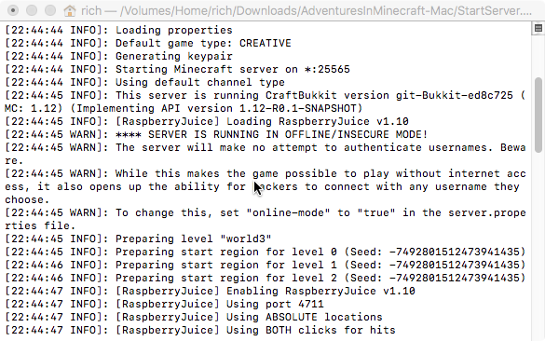
Minecraft
Python program
Server

Slide 4
Possible to work in pairs

Slide 5

wifi

Slide 6
But not larger groups this week

Slide 8
(demo 00 hello world)
(demo 01 coordinates)

Slide 9
Press F3 for debug mode
Shows XYZ co-ordinates
Shows axis
Shows lots of other stuff you dont need

Slide 10
(demo 02 teleport)
(talk about 03 telport2)

