Slide 1
Reinforcement learning
Andrii Maurin CS-31

Slide 2
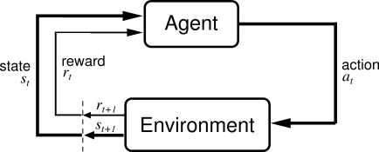
Reinforcement Learning
Basic idea:
  Receive feedback in the form of rewards
  Agent’s utility is defined by the reward function
  Must (learn to) act so as to maximize expected rewards

Slide 3
Reinforcement Learning (RL)
RL algorithms attempt to find a policy for maximizing cumulative reward for the agent over the course of the problem.
Typically represented by a Markov Decision Process
RL differs from supervised learning in that correct input/output pairs are never presented, nor sub-optimal actions explicitly corrected.

Slide 4
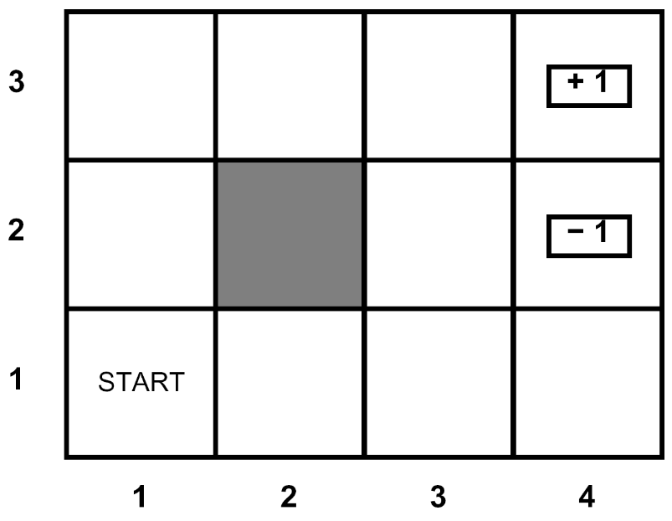
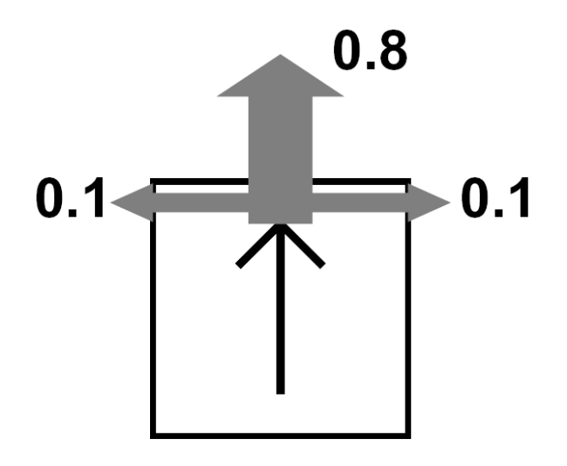
Grid World
The agent lives in a grid
Walls block the agent’s path
The agent’s actions do not always go as planned:
  80% of the time, the action North takes the agent North
  (if there is no wall there)
  10% of the time, North takes the agent West; 10% East
  If there is a wall in the direction the agent would have been taken, the agent stays put
Small “living” reward each step
Big rewards come at the end
Goal: maximize sum of rewards*

Slide 5
Grid Futures
Deterministic Grid World
Stochastic Grid World
 | X
 | X
E N S W
E N S W
?
 | X
X
 | X
 |  | X

Slide 6
Markov Decision Processes
An MDP is defined by:
  A set of states s ∈ S
  A set of actions a ∈ A
  A transition function T(s,a,s’)
    Prob that a from s leads to s’
    i.e., P(s’ | s,a)
    Also called the model
  A reward function R(s, a, s’)
    Sometimes just R(s) or R(s’)
  A start state (or distribution)
  Maybe a terminal state
  A discount factor: γ
MDPs are a family of non-deterministic search problems
  Reinforcement learning: MDPs where we don’t know the transition or reward functions

Slide 7
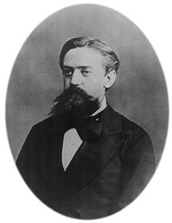

What is Markov about MDPs?
Andrey Markov (1856-1922)
“Markov” generally means that given the present state, the future and the past are independent
For Markov decision processes, “Markov” means:

Slide 8
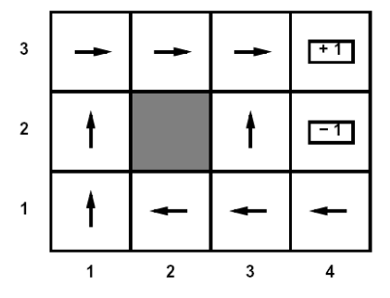
Solving MDPs
In deterministic single-agent search problems, want an optimal plan, or sequence of actions, from start to a goal
In an MDP, we want an optimal policy π*: S → A
  A policy π gives an action for each state
  An optimal policy maximizes expected utility if followed
  Defines a reflex agent
Optimal policy when R(s, a, s’) = -0.03 for all non-terminals s

Slide 9
Recap: Defining MDPs
Markov decision processes:
  States S
  Start state s₀
  Actions A
  Transitions P(s’|s,a) (or T(s,a,s’))
  Rewards R(s,a,s’) (and discount γ)
MDP quantities so far:
  Policy = Choice of action for each state
  Utility (or return) = sum of discounted rewards
s
a
s, a
s,a,s’
s’

Slide 10
Discounted Rewards
Rewards in the future are worth less than an immediate reward
  Because of uncertainty: who knows if/when you’re going to get to that reward state
Notes:
Sum to inf

Slide 11

Exponential Moving Average
Exponential moving average
  Makes recent samples more important
  Forgets about the past (distant past values were wrong anyway)
  Easy to compute from the running average
Decreasing learning rate can give converging averages

Slide 12
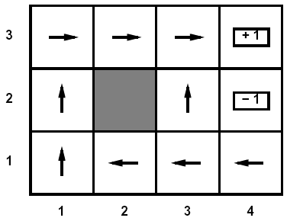
Active Learning
Full reinforcement learning
  You don’t know the transitions T(s,a,s’)
  You don’t know the rewards R(s,a,s’)
  You can choose any actions you like
  Goal: learn the optimal policy
  … what value iteration did!
In this case:
  Learner makes choices!
  Fundamental tradeoff: exploration vs. exploitation
  This is NOT offline planning! You actually take actions in the world and find out what happens…

Slide 13

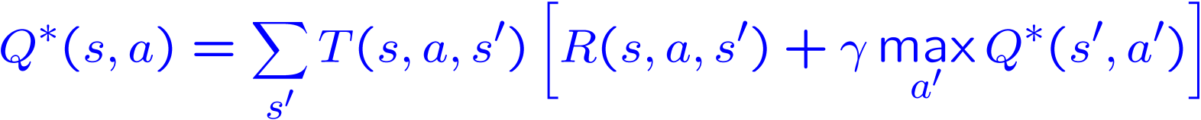
Q-Learning
Q-Learning: sample-based Q-value iteration
Learn Q*(s,a) values
  Receive a sample (s,a,s’,r)
  Consider your old estimate:
  Consider your new sample estimate:
  Incorporate the new estimate into a running average:

Slide 14
Q-Learning Properties
Amazing result: Q-learning converges to optimal policy
  If you explore enough
  If you make the learning rate small enough
  … but not decrease it too quickly!
  Basically doesn’t matter how you select actions (!)
Neat property: off-policy learning
  learn optimal policy without following it (some caveats)
S |  |  |  |  |  | E
S |  |  |  |  |  | E

Slide 15
Exploration / Exploitation
Several schemes for forcing exploration
  Simplest: random actions (ε greedy)
    Every time step, flip a coin
    With probability ε, act randomly
    With probability 1-ε, act according to current policy
  Problems with random actions?
    You do explore the space, but keep thrashing around once learning is done
    One solution: lower ε over time
    Another solution: exploration functions

Slide 16
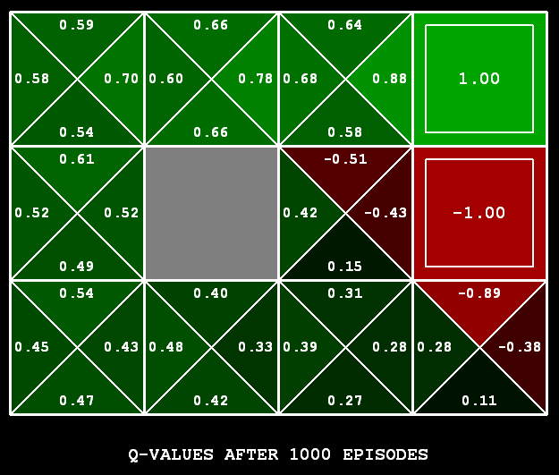
Q-Learning
Q-learning produces tables of q-values:

Slide 17
Q-Learning
In realistic situations, we cannot possibly learn about every single state!
  Too many states to visit them all in training
  Too many states to hold the q-tables in memory
Instead, we want to generalize:
  Learn about some small number of training states from experience
  Generalize that experience to new, similar states
  This is a fundamental idea in machine learning, and we’ll see it over and over again

Slide 18
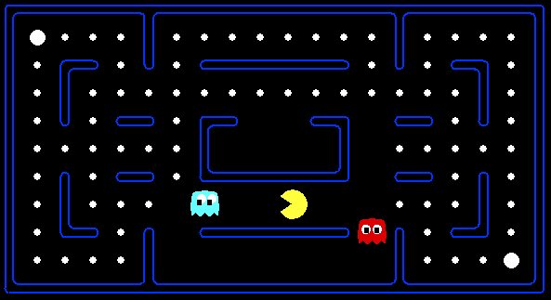



Example: Pacman
Let’s say we discover through experience that this state is bad:
In naïve q learning, we know nothing about this state or its q states:
Or even this one!

Slide 19
Feature-Based Representations
Solution: describe a state using a vector of features
  Example features:
    Distance to closest ghost
    Distance to closest dot
    Number of ghosts
    Distance to dot
    Is Pacman in a tunnel?

