Slide 1
Best Style Forever – Fashion, Trending Ecommerce Store
ICT-1 Project

Slide 2
Agenda
Roles & Responsibilities
Vision Statement
Justification and Unique Selling Proposition
Stakeholders
Project Timeline
Project Features
Burn down chart
Client Acceptance and Feedback of Prototype
Project Development and Release Infrastructure
ICT-2 Project Plan

Slide 3
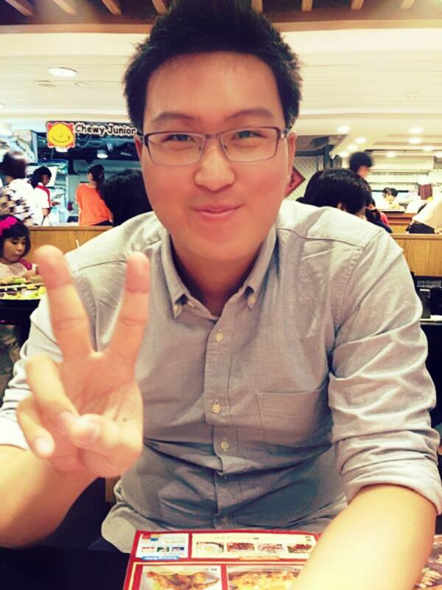
Roles & Responsibilities
Le Anh Tuan
Project leader and GUI designer
Has an ultimate authority over the project.
Establishing and leading the team.
Planning and monitoring of project.
Designing GUI of the website.
Preparing documentation.

Slide 4
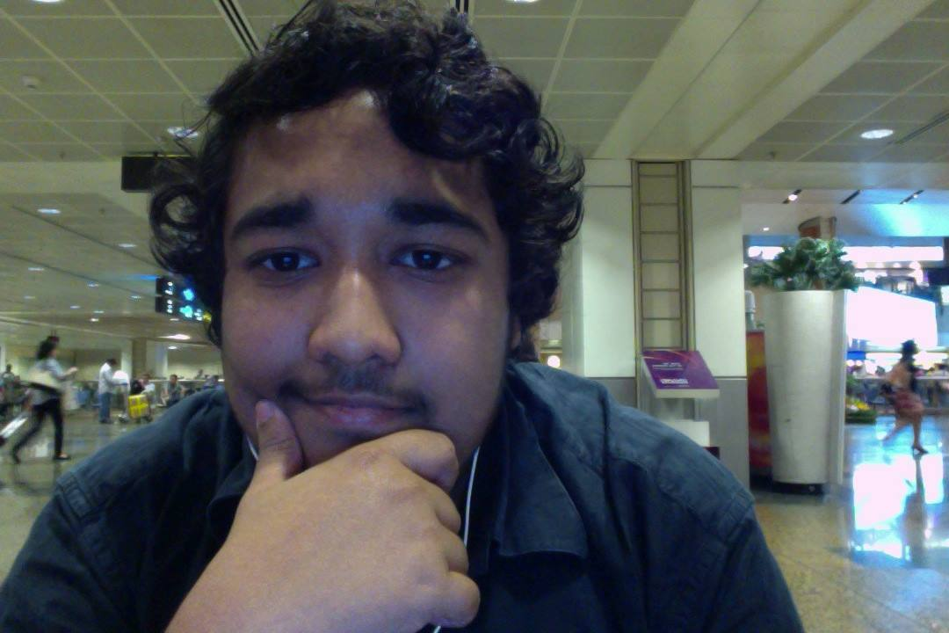
Roles & Responsibilities
Sreejith Warrier
Project’s assistant and graphic designer
Arrangement of client meetings weekly.
Keeping track of project’s milestones and iterations.
Designing website’s elements and materials.
Communicating with client regularly to monitor client’s requirement changes and to inform the team about those changes.

Slide 5
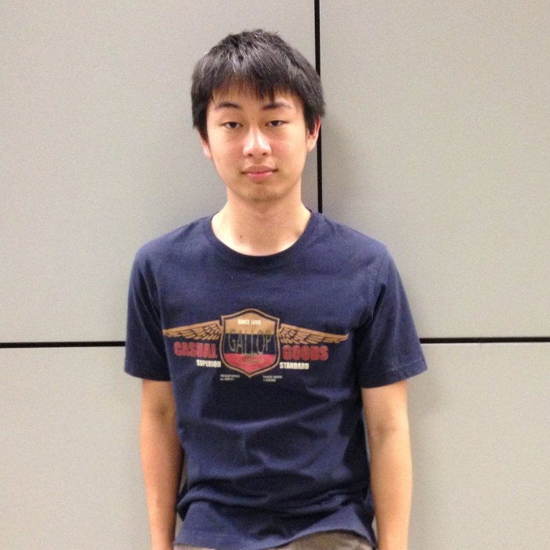
Roles & Responsibilities
Wannajak Kopraditsakul
Web developer and database engineer
MySQL database design, maintenance and testing.
Implementation of the backend system of the project.
Troubleshooting technical difficulties and problems of the database.
Conducting unit testing, system testing and client testing.

Slide 6
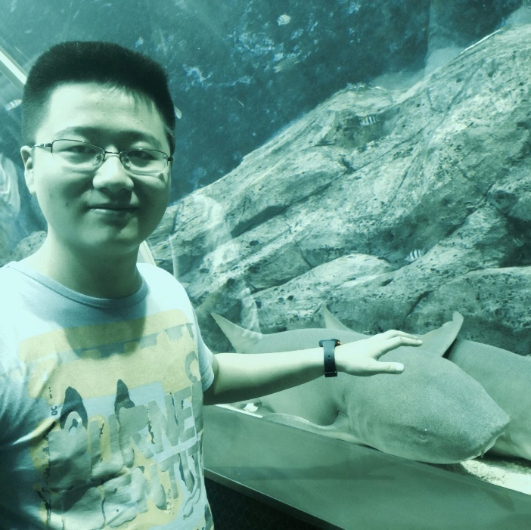
Roles & Responsibilities
Huang Yi
A full stack engineer of the project
System administration of the website.
Leading in the development of the back-end system.
Distributing development tasks and monitoring performance of the project.
Managing version control of the project through GitHub repository.
Providing additional technical helps when the other team member requires it.

Slide 7
Vision Statement
I
Providing customers the best online shopping experiences.
II
Increase the competitive advantages of the store by enhancing customers benefits.
III
Offering customers more sustainable and reliable choices over various products.

Slide 8
Justification and Unique Selling Proposition
What values our project will deliver?
E-commerce has become a phenomenal.
Allowing shop owner to reach out to a larger number of customers with various interests and demographics.
Always available on the Internet 24 hours/7 days.
Better interaction with customers through testimonials and reviews system.
Better shopping experiences with online membership, account management system, wish list, order history, etc…
Physical Store
More Sales
Anywhere & Anytime
Online Store
More Profit
Owner Happier

Slide 9
Justification and Unique Selling Proposition
What has made our project better?
Based on flexible Bootstrap framework that powered many popular websites around the world. E.g. Walmart.com, Target.com.
Mobile friendly thanks to Bootstrap dynamic grid system.
Project development using Java Servlet that provide faster responses and robust securities.
Implementation of advanced features >>>
My account
In-store (local) search
Order history
Wish list

Slide 10
Stakeholders
Best Style Forever E-Store
Dr. Sarita Singh
Dr. Insu Song
The Project Team
Target Audience
Dr. Insu Song – ICT-1 project management.
Dr. Sarita Singh – Product owner & ICT-1 workshop lecturer.
Target audiences – Includes teenagers, young adults, working adults.

Slide 11
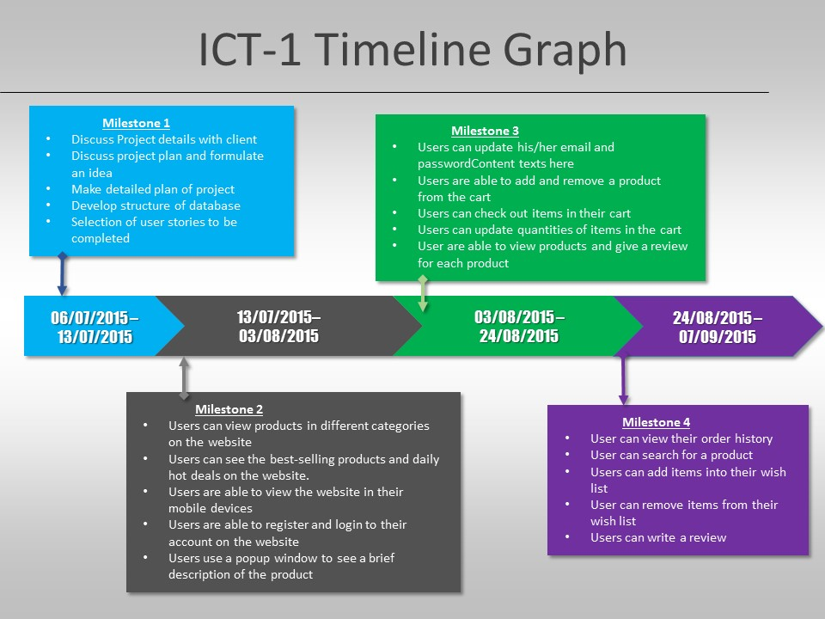

Slide 12
Project Features
Responsive design
In-store search function
Ajax login and register form

Slide 13
Project Features
Quick view of product
Wish list
Real-time review system

Slide 14
Demo of alpha-release – Phase 1
By: Wannajak Kopraditsakul & Sreejith Warrier

Slide 15
Project Features
Product categories
Account management
Ajax cart system

Slide 16
Project Features
Order history
Check out system
Contact form

Slide 17
Demo of alpha-release – Phase 2
By: Le Anh Tuan & Huang Yi

Slide 18
How do we make the it happen?

Slide 19
Client Feedback to Iteration 1 Implementation
Overall Customer Experience & Comment:

Slide 20
Client Feedback to Iteration 2 Implementation
Overall Customer Experience & Comment:

Slide 21
Client Feedback to Iteration 3 Implementation
Overall Customer Experience & Comment:

Slide 22
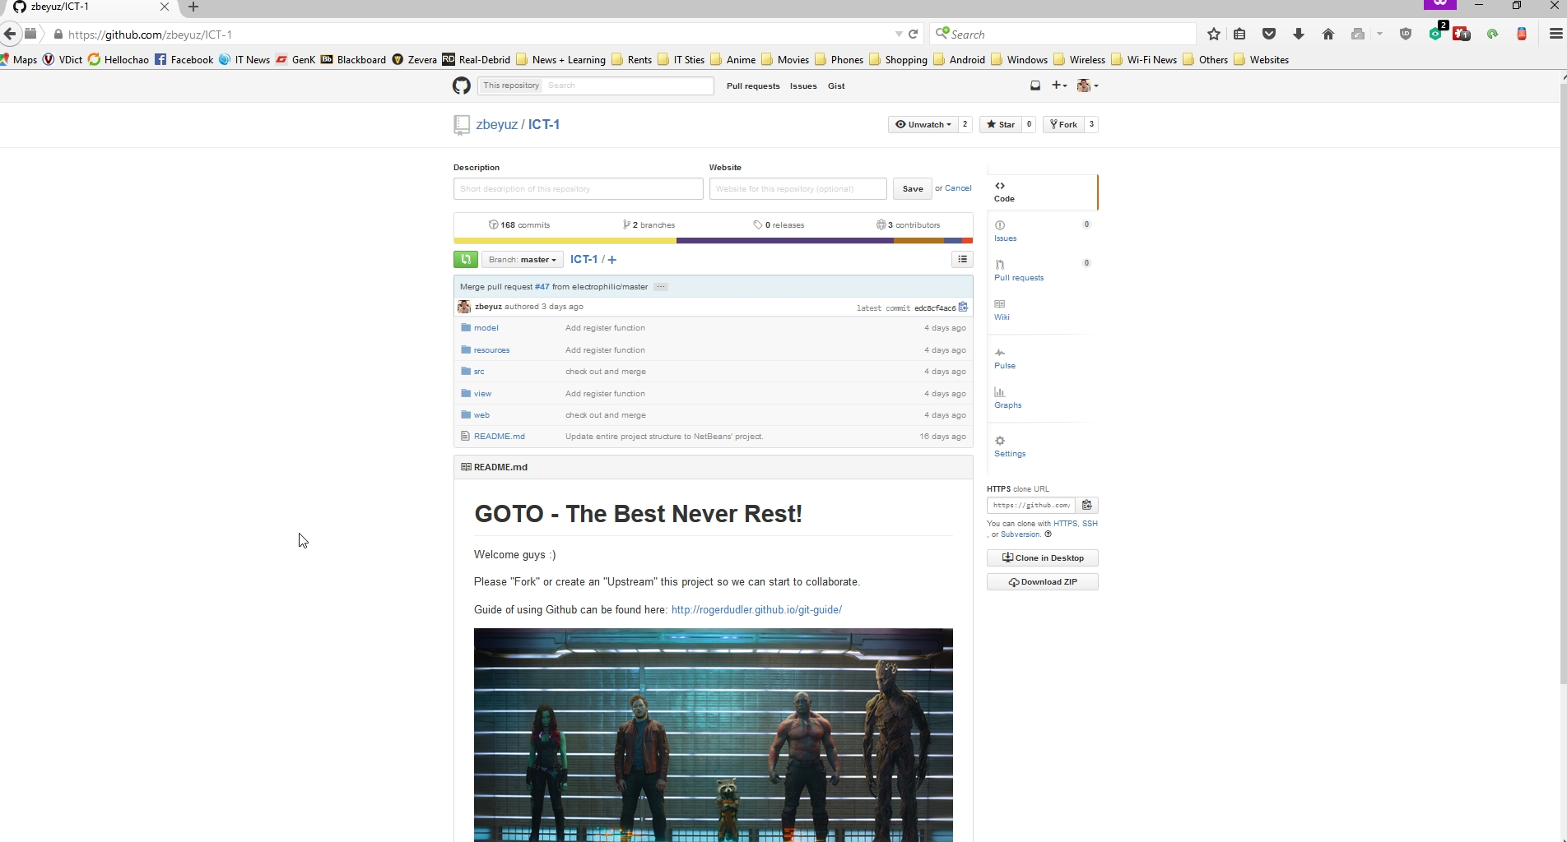
Project Development Tool – GitHub https://github.com/zbeyuz/ICT-1.git

Slide 23
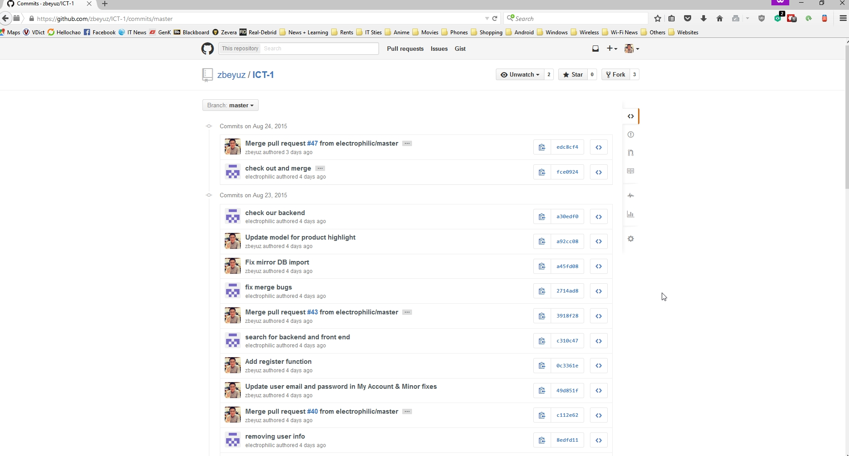
Project Development Tool – GitHub https://github.com/zbeyuz/ICT-1.git

Slide 24
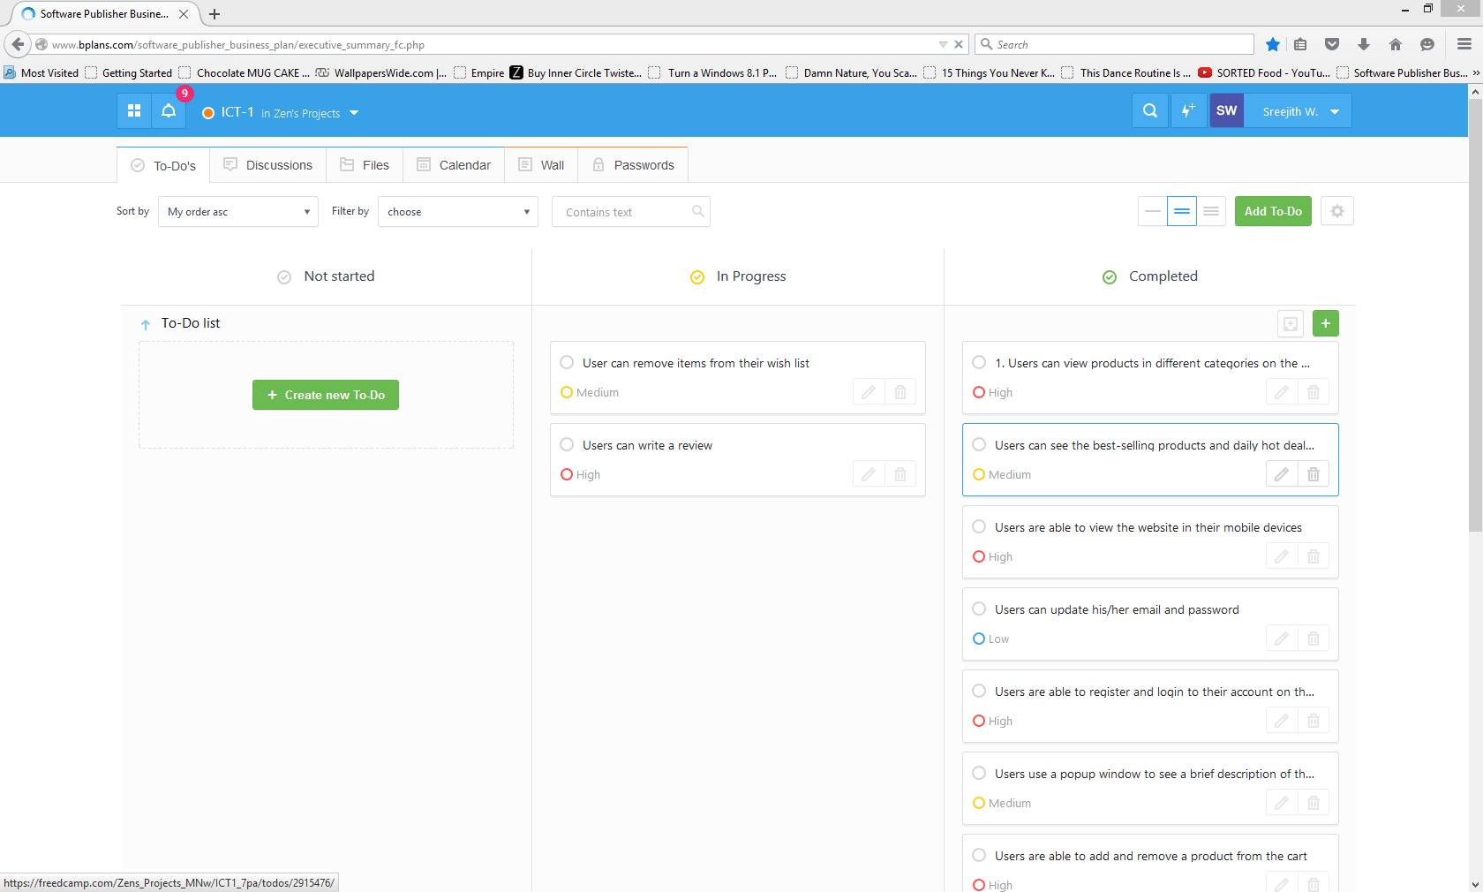
Project Development Tool – FreedCamp

Slide 25
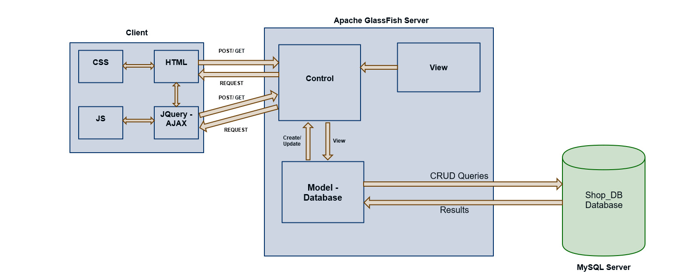
Technologies – Project Architecture

Slide 26
Project Development
High-level list of features and requirements
Admin can delete or update invalid or out of stock orders.
Users can ask for helps online with the online chat system.
Users can send a support email to the admin.
Users can pay by PayPal.
Users can login with Facebook.
Users can have multiple shipping addresses in the address book.
Enable users to popularize website through social media

Slide 27
Goals of the project -- > Core values
Where if we did in time? Did you achieve the goals or not
Break down the development processes -> complex and a lot of work -> Client will pay
Go back to the goals -> Conclusion -> Client Pay -> Why? What are values ? Feedback?

Slide 28
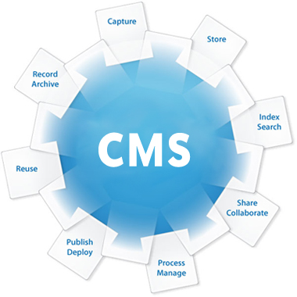
What is next?
High-level list of features and requirements
Admin can add or remove a product in the admin site.
Admin updates stocks in the admin site.
Admin can see reviews that users posted.
Admin can remove reviews that users posted.
Admin can give discounts for items in the admin’s site.
Admin can add new orders.
Admin can add new testimonials.
Admin can update orders’ status (new, delivered, in progress).
In the next semester (ICT-2), our team would bring the project to the next level by developing a content management system (CMS) that allows our client to manage the E-store using backend site effortlessly :)

Slide 29

What is next?
High-level list of features and requirements
Admin can delete or update invalid or out of stock orders.
Users can ask for helps online with the online chat system.
Users can send a support email to the admin.
Users can pay by PayPal.
Users can login with Facebook.
Users can have multiple shipping addresses in the address book.
Enable users to popularize website through social media
Our team also makes improvement and enhancement in the support system of the main website to ensure customers’ (users) satisfactions and shopping experiences.

Slide 30
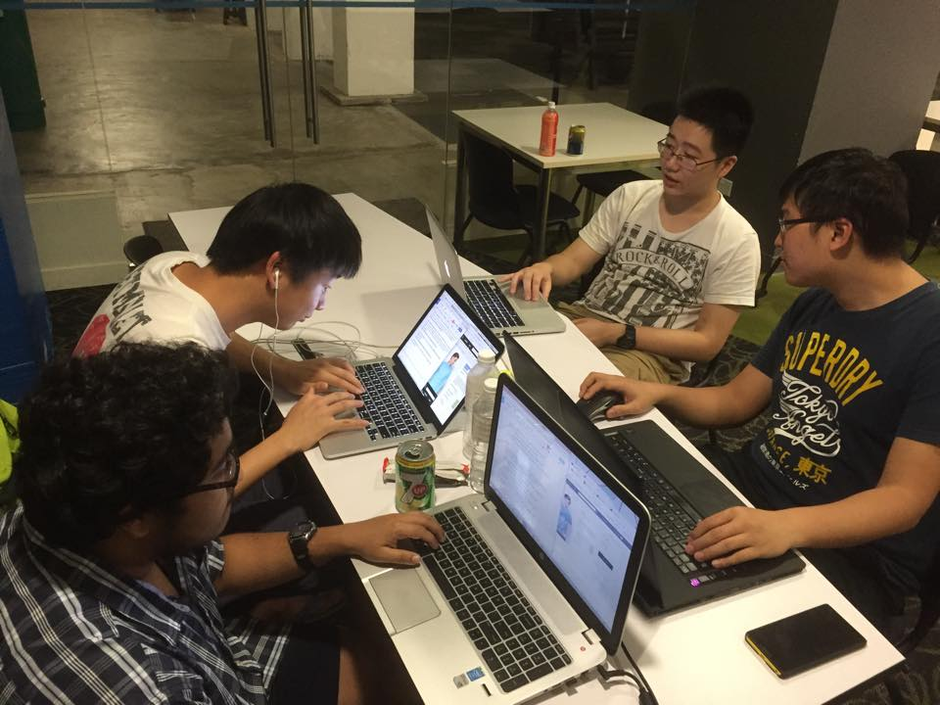
Thank you for your valuable time ☺
P/S: Our team are always welcome new ideas and suggestions for our project. If you have one, please do not hesitate contact our team leader or our team engineer at:
anhtuan.le@my.jcu.edu.au
yi@huang3@my.jcu.edu.au

