Slide 1
Learning Outcomes in the Workplace Law Curriculum
Teaching Employment and Labor Law
St. Louis University School of Law
February 15, 2013
Notes:
Thanks to SLU, Toni, Marcia and Miriam for convening this conference in a topic of a lot of interest obviously to those of us who teach Labor and employment law, but also a topic that is incredibly timing given the problems facing legal education.
I would like to share with you some thoughts about a topic which combines two of the areas which have taken a huge amount of my time the last couple of years. After many years of thinking about it, and honestly be too chicken to do, the last two years I have been teaching my labor law course as a simulation using the format created by professors Corrada and Dau Schmidt. As a result, I have spent a good amount of time thinking about the course and about what students are learning, etc.
For a variety of reasons I have been spending lots of time over the last three years dealing with issues of accreditation, curricular reform, etc. In particular, I have been following some of the changes being proposed by the ABA with regard to curricular issues.
This presentation, I hope brings together what I have learned in those two areas, and hopefully will be helpful to those of you who in your own schools will have to deal with curricular issues.

Slide 2
Learning Outcomes
Revisions to Chapter Three of the Standards & Rules of Procedure for Approval of Law Schools
Notes:
A few year back, the ABA Council of the Section of the Legal Education and Admissions to the Bar (which is the section that oversees the law schools accreditation process), began a comprehensive review of the standards for accreditation. In considering revisions to Chapter Three, which deals with the Program of Legal Education, the committee’s work was guided by a report issued in 2008 by a subcommittee which focused on looking at whether and how the Council should use output measures, other than bar passage and job placement, in the accreditation process.
In that report, the subcommittee recommended that the Section re-examine the current ABA Accreditation Standards in a way that would reduce the standards’ reliance on “input measures” and instead adopt greater reliance on outcome measures. Thus the report recommends that instead of focusing on whether the law schools are investing in the right types and amounts of resources, the standards focus on whether the law school is imparting certain types of knowledge and enabling students to attain certain types of capacities.

Slide 3
Learning Outcomes
Standard 302
Academic Knowledge
knowledge and understanding of substantive law, legal theory and procedure;
Lawyering Skills
legal analysis and reasoning, critical thinking, legal research, problem solving, written and oral communication in a legal context; and
Professional Values
the exercise of professional judgment consistent with the values of the legal profession and professional duties to society, including recognizing and resolving ethical and other professional dilemmas.
Notes:
A couple of years ago, some specific language began to be drafted implementing these suggestions.
As recommended in the subcommittee report, the proposed language focuses on output as opposed to input measures.
Standard 302, in particular will require schools to identify their own objectives and create their own assessment tools.
Consistent with the framing of learning outcomes in other disciplines, the standard frames the discussion in terms of things that the students should know (Academic knowledge) and things that the student should be able to do (skills and values).

Slide 4
Assessment of outcomes
Standard 304. ASSESSMENT OF STUDENT LEARNING
A law school shall apply a variety of formative and summative assessment methods across the curriculum to provide meaningful feedback to students.
Notes:
Standard 304 goes on to require that law schools develop different methodologies to assess whether the student are achieving the outcomes the school has defined as their goal. Additionally, the proposed language requires that in evaluating students schools develop both summative/evaluative as well as formative assessment.
The distinction here is between assessments that evaluate what the student know or can do at the end of the semester, and assessments that evaluate and provide feedback to students during the semester in order to allow the student to improve her performance.

Slide 5
What does this mean?
Curricular Mapping
process which identifies the topics and skills that student would be learning and how those topics and skills interact among courses
Notes:
If the proposed standard is adopted, law schools will have to identify learning objectives and evaluate whether those objectives are being achieved at both the student and institutional levels
The way in which law schools seem to be approaching this is by engaging in the process refer to as curricular mapping.
CM is a process which identifies the topics and skills that student would be learning at school across the years and how those topics and skills interact which each other.

Slide 6
Curricular Mapping
Topics (specific to each course)
Skills
Case analysis
Problem solving
Oral advocacy
Legal writing
Document drafting
Use and interpretation of statutes
Litigation Skill
Negotiation
Interviewing

Slide 7


Labor Law Simulation
Roberto Corrada
Denver
Ken Dau-Schmidt
Indiana

Slide 8
Labor Law Simulation
Class structured like a company with the professor as the owner/president and the students as the employees
Labor Law Enterprise
“Producing Labor Law Knowledge
All the Time, Always in Style”

Slide 9
Labor Law Simulation
Students (employees) receive an employment manual which describes terms of employment
Grading
Attendance
Discipline
Students are told that the terms of employment are those in the manual. If they want to change them they have to engage in collective bargaining.

Slide 10
Labor Law Simulation
Material is structured to mirror what you expect students to be doing in the simulation
Organizing
Collective Bargaining
Contract Administration
Professor might have to “motivate” students to engage in the simulation

Slide 11
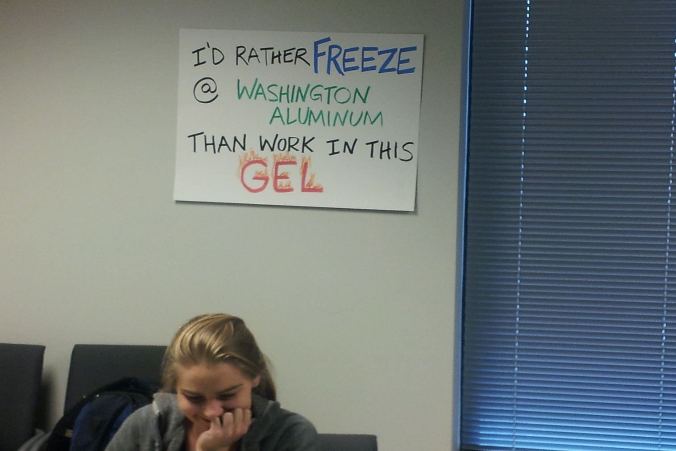
Labor Law Simulation

Slide 12

Labor Law Simulation

Slide 13
Learning Outcomes, Assessment and the Labor Law Simulation
Students should know | Students should be able to
 | Skills | Judgment
The Law related to the organizing process
The law related to the collective bargaining process
The law related to the process of contract administration

Slide 14
Learning Outcomes, Assessment and the Labor Law Simulation
Academic Knowledge (what students should know)
The law related to the union organizing process
The steps in the organizing process
The contours of what constitute “concerted activity for mutual aid and protection”
The regulation of access to the workplace by employee and non-employee organizers
The rules pertaining to the regulation of campaign speech and conduct

Slide 15
Learning Outcomes, Assessment and the Labor Law Simulation
Academic Knowledge (what students should know)
The law related to the union organizing process
Lawyering Skills
The steps in the organizing process
Document drafting - Locate and complete the forms to initiate a Board election
Problem solving – Students representing the ER need to figure out how to respond to the U’s demand for recognition, election petition, proposed bargaining unit, etc.

Slide 16
Learning Outcomes, Assessment and the Labor Law Simulation
Academic Knowledge (what students should know)
The law related to the union organizing process
Lawyering Skills
The regulation of access to the workplace by employee and non-employee organizers
Advise employees/unions as to ways of communicating their message to employees of a target organizing campaign
Advise employers on how to respond to union’s organizing efforts

Slide 17
Learning Outcomes, Assessment and the Labor Law Simulation
Academic Knowledge (what students should know)
The law related to the collective bargaining process
Lawyering Skills
Students serving as lead negotiators will interview their clients as to their negotiation goals; prepare a bargaining strategy; and, conduct the negotiations

Slide 18
Learning Outcomes, Assessment and the Labor Law Simulation
Professional Values
Assess the value of filing ULP charges

Slide 19
Learning Outcomes, Assessment and the Labor Law Simulation
With regard to assessment
Evaluative
Final exam
Formative
Journals
Group & individual debriefing

