Slide 1
W209 Project - Midterm Presentation Bitcoin The New Gold
Team 1: Jeffrey Adams, Pow Chang, Sweta Bhattacharya, Matt White

Slide 2
Presentation Outline
Project Objective and Hypothesis - Matt
Audience and Market Environment - Jeff
Tasks and Mockup - Sweta
Pipeline Overview - Pow
Conclusion - Matt

Slide 3
Objective
With the emergence of blockchain technology, bitcoin has become an important alternative financial asset for the monetary market
Bitcoin is a highly volatile commodity with a complex valuation model due to its cryptic algorithmic mining process
The objective of this project is to present bitcoin value in different graphical perspectives to give users a holistic and better understanding of the trends and movement of it’s USD value.

Slide 4
Hypothesis
Hypothesis 1: Cryptocurrency market trends mirror traditional markets.
Hypothesis 2: Alt coins are highly correlated with and follow Bitcoin price
Hypothesis 3: Cryptocurrency market is highly influenced by non-market factors that don't affect traditional markets

Slide 5
Audience
Over the years BTC has started to go from a fringe asset that only cryptographers traded and now it is an asset that the mainstream is starting trade
Many people don’t fully understand how or what BTC is
BTC is highly volatile and has many factors that influence its price
We want to help the person that is just learning about BTC and has questions about it:
Is this an asset I want to invest in?
Is it too volatile for me?
Should I invest in BTC, altcoins or traditional markets?
What causes the volatility in BTC? Can I see it coming?

Slide 6
Tasks
Compare different metrics with BTC and traditional markets such as price, daily return and ATR.
Compare different metrics with BTC and other altcoins such as price, daily return and ATR.
Discover outside influences that impact BTCs price and return
Global
Bitcoin history
Elon Musk
Google Trends

Slide 7
Proposed Insights
BTC’s returns track traditional markets but it is much more volatile
The overall returns of BTC have outpaced traditional markets
The built-in history of BTC has created cycles
Highly influential individuals and governments can impact BTC’s price

Slide 8
Data
Yahoo finance
Traditional stocks and Indexes
Crypto currencies
Google trends
Amount bitcoin is being searched for on google
BTC Events
Global influences
Bitcoin history
Elon Musk
Google Trends

Slide 9
Mockup

Slide 10
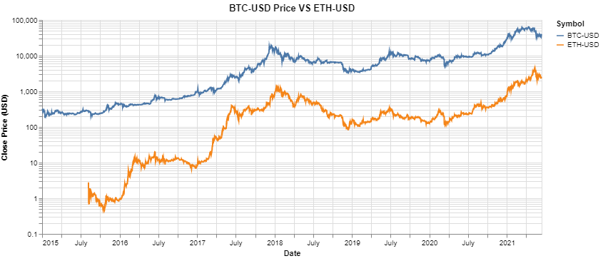
Initial Dashboard Mockup
User can determine what task they want to perform with the chart
Tasks:
Compare BTC to other markets
BTC non-market factors
The user will have different Chart Type options Depending on the task they select
Chart Type:
Close Price
Log Close Price
ATR
Daily Returns
Total Returns
Comparison with BTC:
All
Index Funds
All Stocks
Tech Stocks
Alt Coins
Moving Ave
The user can select what they would like to compare BTC to

Slide 11
There seems to be a correlation of BTC to Altcoins. Is it clearer when I look at returns?
Tasks:
Compare BTC to other markets
BTC non-market factors
Chart Type:
Close Price
Log Close Price
ATR
Daily Returns
Total Returns
User selects Daily returns
Comparison with BTC:
All
Index Funds
All Stocks
Tech Stocks
Alt Coins
Moving Ave

Slide 12
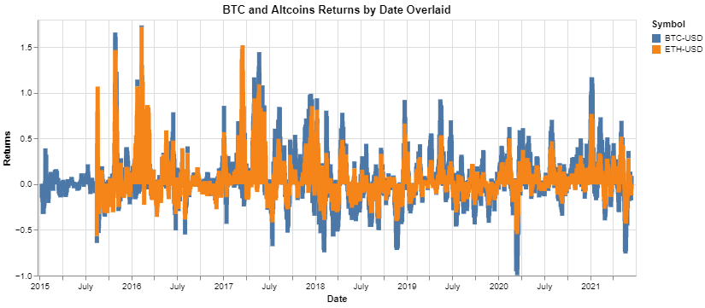
Based on this they do look very corelated, and very volatile. Is this as volatile as traditional markets?
Tasks:
Compare BTC to other markets
BTC non-market factors
Chart Type:
Close Price
Log Close Price
ATR
Daily Returns
Total Returns
Comparison with BTC:
All
Index Funds
All Stocks
Tech Stocks
Alt Coins
User selects Index Funds

Slide 13
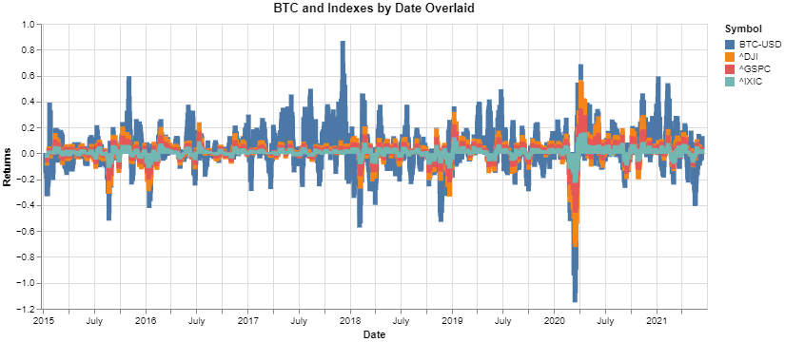
It is much more volatile than index funds. But does it have higher returns in the selected time frame?
Tasks:
Compare BTC to other markets
BTC non-market factors
Chart Type:
Close Price
Log Close Price
ATR
Daily Returns
Total Returns
User selects Total Returns
Comparison with BTC:
All
Index Funds
All Stocks
Tech Stocks
Alt Coins

Slide 14
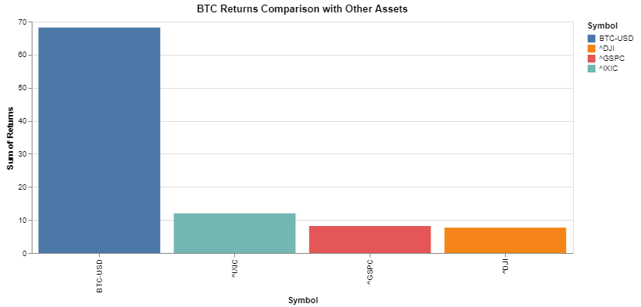
It might be more volatile, but it has much higher returns. What about with all assets in this dataset?
Tasks:
Compare BTC to other markets
BTC non-market factors
Chart Type:
Close Price
Log Close Price
ATR
Daily Returns
Total Returns
Comparison with BTC:
All
Index Funds
All Stocks
Tech Stocks
Alt Coins
User selects All Data

Slide 15
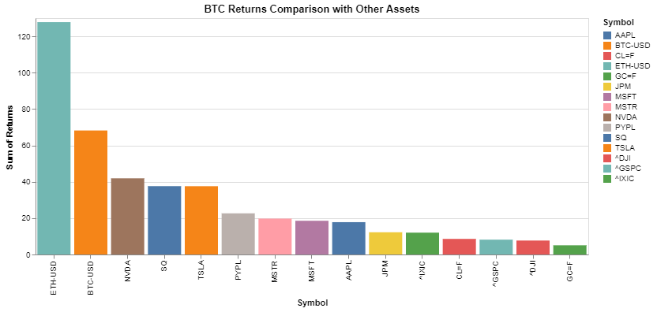
Looks like during this time frame crypto is outperforming other markets. Are there outside factors causing volatility?
Tasks:
User selects BTC non-market factors
Compare BTC to other markets
BTC non-market factors
Chart Type:
Close Price
Log Close Price
ATR
Daily Returns
Total Returns
Comparison with BTC:
All
Index Funds
All Stocks
Tech Stocks
Alt Coins

Slide 16
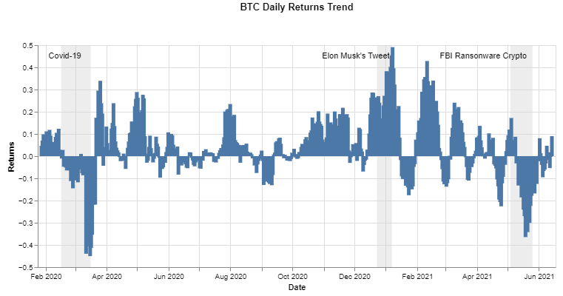
It looks like BTC has outside factors that influence its price and returns. Do these events influence ATR?
Tasks:
Compare BTC to other markets
BTC non-market factors
Chart Type:
Close Price
Log Close Price
ATR
Daily Returns
Month and DOW
User selects ATR
Events:
All
BTC History
Global
Elon
Google Trends
Chart options adjust with different tasks

Slide 17
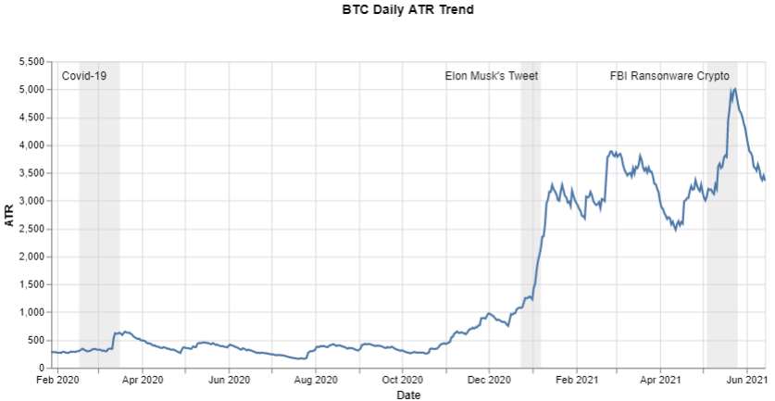
Does the month or the Day of the Week impact price?
Tasks:
Compare BTC to other markets
BTC non-market factors
Chart Type:
Close Price
Log Close Price
ATR
Daily Returns
Month and DOW
User selects Month and DOW
Events:
All
BTC History
Global
Elon
Google Trends

Slide 18
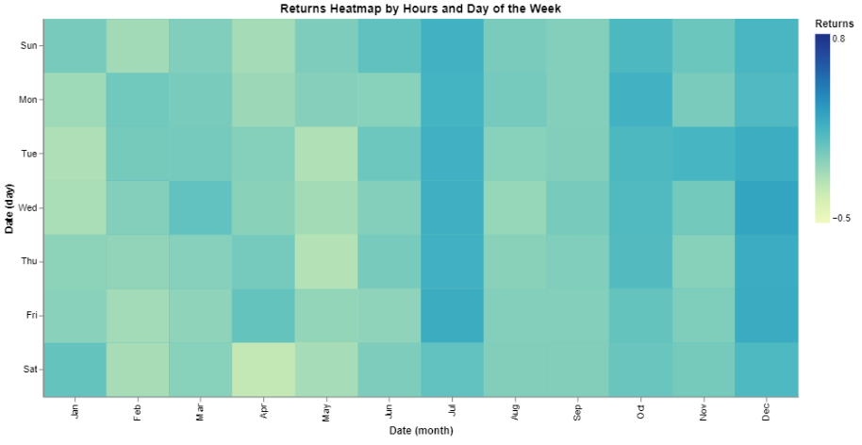
Does the month or the Day of the Week impact price?
Tasks:
Compare BTC to other markets
BTC non-market factors
Chart Type:
Close Price
Log Close Price
ATR
Daily Returns
Month and DOW
Chart options adjust with different tasks

Slide 19
Pipeline

Slide 20
Conclusions

