Slide 1
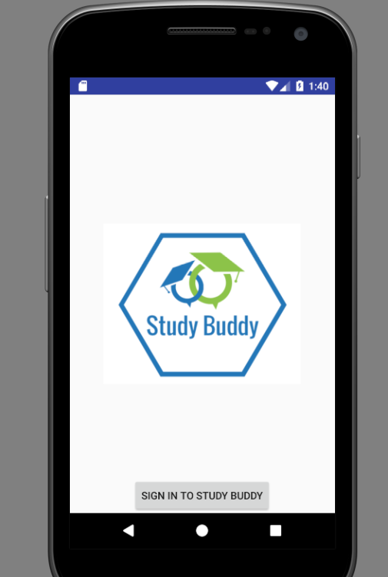
{Study Buddy}
A Caitlin Ard, Elena Davidson, Angela Kearns, and Ryan Adams
Production!

Slide 2
2. Project Overview:
Facebook, linkedin, and other networking sites use algorithms to aggregate factors and make educated guesses and suggest users to befriend others on the network. Simultaneously the rise of social has brought about the proliferation of dozens of undesirable consequences, including scams, and fake news. Users have become weary about connecting with individuals that they do not know.
Enter Study Buddy. Study Buddy seeks to recreate the professional college atmosphere that was commonplace prior to social media, by providing a medium (Study Buddy App) for individuals to connect and meetup on college campuses for the purpose of studying.

Slide 3
3. Architectural Drivers
Users need to be able to interact via an APP, but not directly
User needs to have a good experience, i.e not be burdened with technical nonsense , and needs to be able to achieve end goal.
The application needs a source of long term memory, to remember users, and groups
The App needs a way to make sense of requests from users, and to fulfill these requests.
The App needs to be able to enforce certain requirements concerning the data it ingests.
The App needs to be flexible, allowing for user changes.
The App needs to be extensible, allowing modules to be able to integrated over time.
The App needs to be able to fulfill requests in a reasonable time as enumerated in the initial requirements doc.

Slide 4
4. Architectural Style Choices
(Present 2 Candidates && State Choice)
Candidate 1: Client Server
Allows user to interact with data in a controlled manner, and does not give access to all data
long term data storage
Candidate 2: N-Tier (3-Tier)
Separates into Presentation, Logic, and Data Tier
Greater control for logic necessary in the app
Long term data storage
Choice: N-Tier (3-Tier)
All the benefits of client Server
More control over logic and what we chose

Slide 5
5. Architecture Slide, with short description.
Study Buddy - App
Displays Data
User Request
Process Data
(If Necessary)
Coordinate Query with User Info and User Input
Logic Layer
Query
Returns Data
SQLite Database

Slide 6
6. Conclusion
Architectural Style - (N-Tier) / (3-Tier System)
Issues / Risks / Questions:
Implementation of logic Tier
Could be a complex implementation
Hosting of Server
Server / Logic / App integration and compatibility
Any Questions for us?

Slide 7
BACKUP SLIDES

Slide 8

Basic Study Budy Model: Database Side
User Profile:
UserID :
Email
First Name
Last Name
Password
University
Major
Dept:
DeptName:
Dept Desc
Course ID
Course Desc
University
Courses
Course ID:
Course Desc
Year
Semester
Rating
UserID:
TimeStamp
Rating
Group:
GroupID:
UserID
User Name
Notifications:
UserID:
Message -Blob

Slide 9
Study Buddy UML
User_Profile
User_Login
Groups
-userID: string
-password: string
-loginStatus: string
1..*
-groupName: string
-meetingTime:Time
-Location: string
-courseID:string
-firstName: string
-lastName: string
-email: string
-password: string
-university: string
-major:string
-profilepic :blob
1
1
1..*
+creategroup()
+editInfo()
+deleteGroup()
+setRecurring()
1
+verifyLogin(): bool
verification
+register()
+login()
+updateProfile()
+logout
Pushes notifications
1...*
Courses
Database
User_Ratings
User_Notifications
-courseID: string
-courseDesc:string
-year: int
Semester: string
-message: Clob
-notsure:String
-rating:int
-ratingDate: Date
+addCourse()
+removeCourse()
+changeYear()
+changeSem()
+pushNotification()
+clearNotification()
+addRating()
+aggregateRating()
+postRating()
+updateTable()
+validateUser()
+queryUser()
+createCourseList()
+otherVerificationFun()

