Slide 1

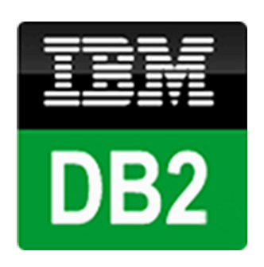
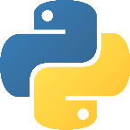
Static - PoC
Storage
Analysis and
data modeling
Structured Data
Simulation
Representation
Cognos
Dashboard
Next step: Real Time Architecture - PoC
Storage
Structured Data
Real-Time Representation
IBM stream flows
Cognos Real-Time
Dashboard
Diferent data sources
Real-Time Analysis
and modeling

