Slide 1
American Sign Language Recognition Using Machine Learning Models
Department of Electronics, Telecommunications and Informatics
University of Aveiro, Portugal
Solomonidi Eleftheria, 130364
Bilal el Hanane, 130152

Slide 2
Motivation & Problem Description
Communication between Deaf ASL users and non-signers is often limited.
Automated ASL recognition can support more accessible human–machine interaction.
Objective: identify 24 ASL hand gestures from 28×28 grayscale images.
Models trained and evaluated using the Sign Language MNIST dataset from Kaggle.

Slide 3
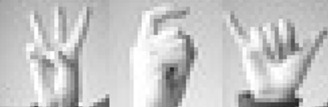
Dataset Overview & Image Characteristics
The dataset contains grayscale images of static ASL hand signs, each 28×28 pixels.
Each class has hundreds of samples, allowing supervised model training.
Data are normalized (vector (1,784)) and split into training, validation, and test sets before modeling.

Slide 4
Baseline & Transition to the MLP Model
Baseline: Logistic Regression used as a simple one-vs-rest classifier. Provides a reference accuracy and confirms the task is learnable, but performance is limited.
Motivation for MLP: Non-linear relationships in hand shapes require a deeper model. MLP is a neural network with hidden layers and non-linear activations that learns increasingly high feature representations, allowing it to model complex patterns that linear methods cannot.

Slide 5
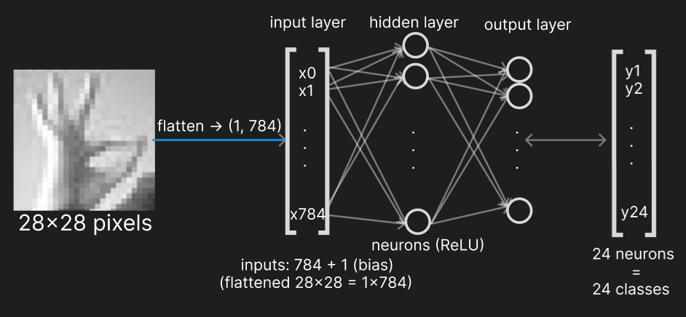
Neural Network Architecture
Input images are flattened from 28×28 to 784 features.
A hidden layer with ReLU activation learns non-linear patterns in hand shapes.
Output layer has 24 neurons, one for each ASL class.

Slide 6
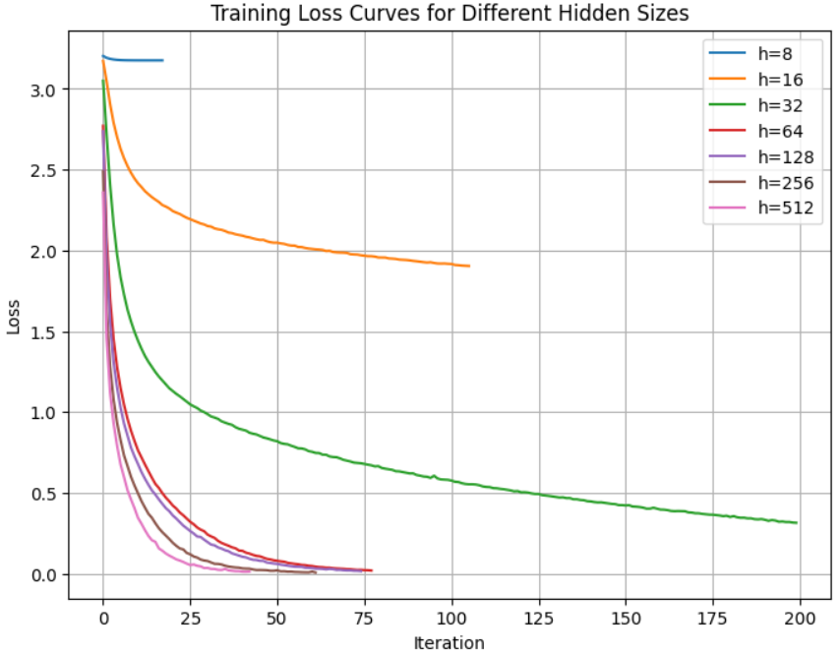
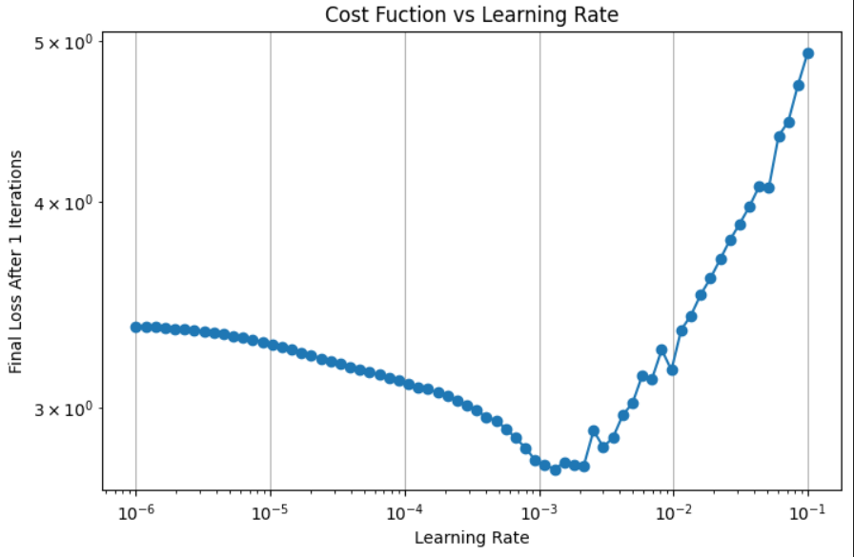
Hyperparameter tuning
Hidden Layer Size
Learning Rate (e.g. hidden layer size =64)

Slide 7
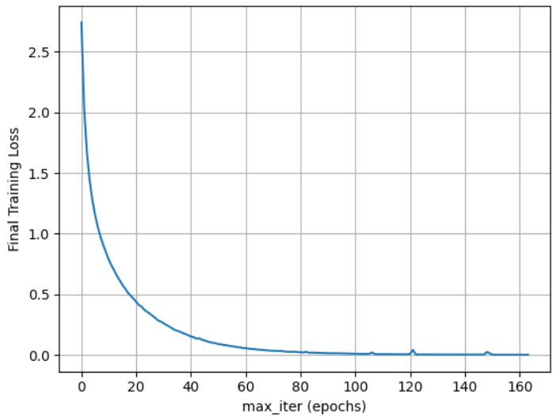
Hyperparameter tuning
Regularization Strength (λ)
Maximum Number of Iterations
λ | val accuracy | val loss | iterations
0 | 0.99891 | 0.04663 | 91
0.00001 | 0.99927 | 0.04217 | 91
0.0001 | 0.99745 | 0.06699 | 80
0.001 | 0.99818 | 0.06443 | 80
0.01 | 0.99782 | 0.08300 | 105

Slide 8
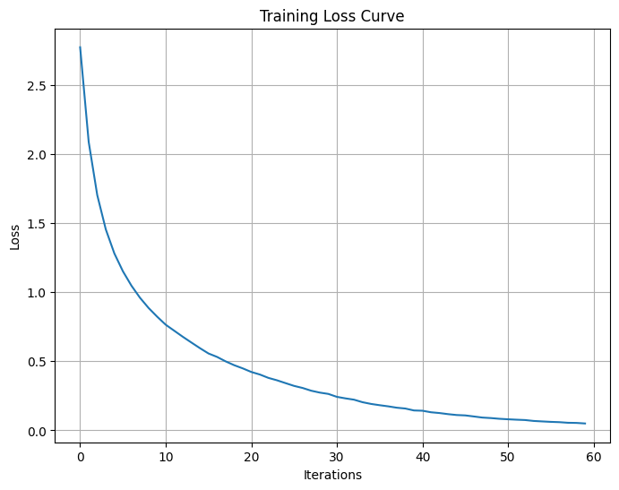
Final Model Configuration & Performance
Loss Function
Final Hyperparameters
Hidden layer size | 64
Learning rate | 0.0001
Regularization (L2) | 0.001
Maximum iterations | 60
Training accuracy: 99.8867%
Validation accuracy: 99.6723%
Test accuracy: 72.49%

Slide 9
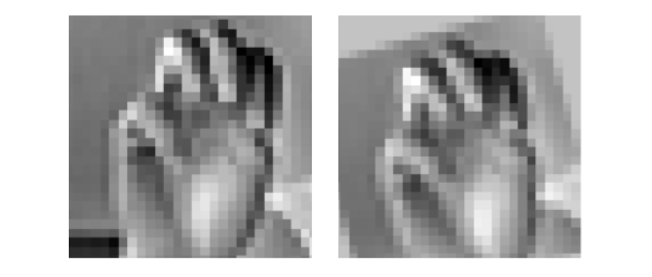
Data Augmentation & Impact on Performance
Double training set, 2*24709 images in total, using rotations, shifts, and brightness changes. These transformations create slightly different versions of the same hand sign.
Helps the model handle small changes in orientation, position, and lighting.
Test accuracy improved from 72.49% → 82.77%.

Slide 10
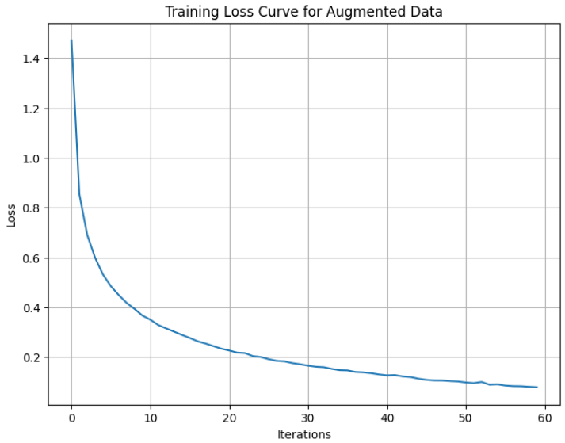
Configuration & Performance
for Augmented Dataset
Final Hyperparameters
Loss Function
Hidden layer size | 64
Learning rate | 0.0001
Regularization (L2) | 0.001
Maximum iterations | 60
Training Accuracy: 97.9400%
• Validation Accuracy: 99.8908%
• Test Accuracy: 82.7663%

Slide 11
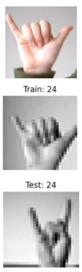
Test Set Inconsistencies
Letter Y
Some test images do not match the official ASL gestures for their assigned labels. Example: class 24 shows a hand pose in the test set that is not an ASL letter.
The model is evaluated on incorrect or mismatched labels.
As a result, test accuracy underestimates the true performance of the model.

Slide 12
Conclusion & Future Work
Logistic Regression provides a simple linear baseline, but cannot capture the complexity of ASL signs.
The MLP is a better classifier for this task because it models non-linear gesture patterns.
Augmentation significantly improved generalization on the test set.
Future work: try CNNs, more augmentation, and improved dataset quality.

