Slide 1
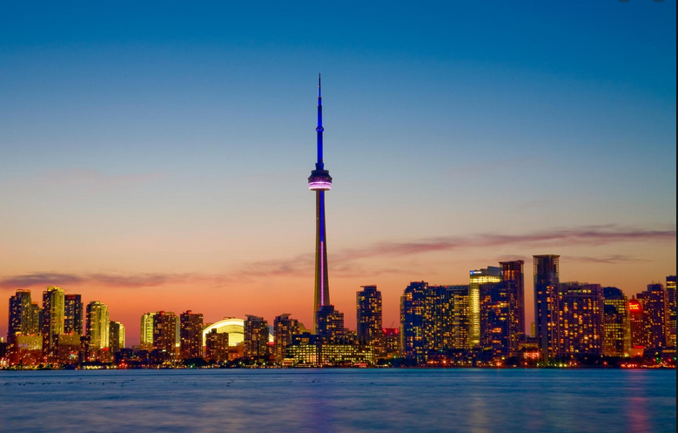
WHERE TO START A NEW GYM BUSINESS IN THE CITY OF TORONTO

Slide 2
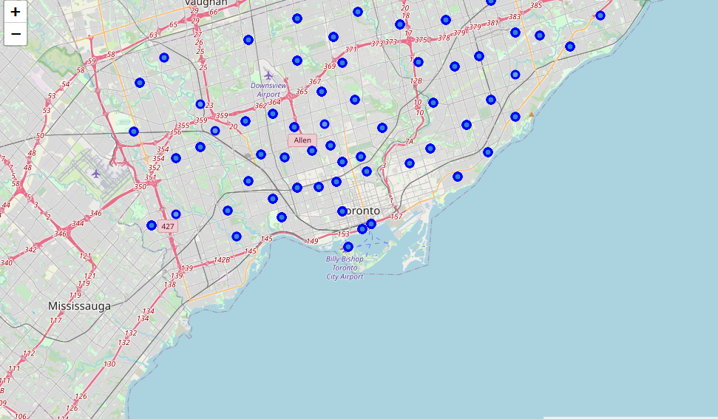
Business Problem
Which of the neighborhoods of
Toronto have no gym

Slide 3

Data Sources
Wikipedia page
https://en.wikipedia.org/wiki/List_of_postal_codes_of_Canada:_M
Csv geographical coordinates file
http://cocl.us/Geospatial_data
FourSquare API
https://api.foursquare.com/v2/venues/explore?&client_id={}&client_secret={}&v={}&ll={},{}&radius={}&limit={}

Slide 4
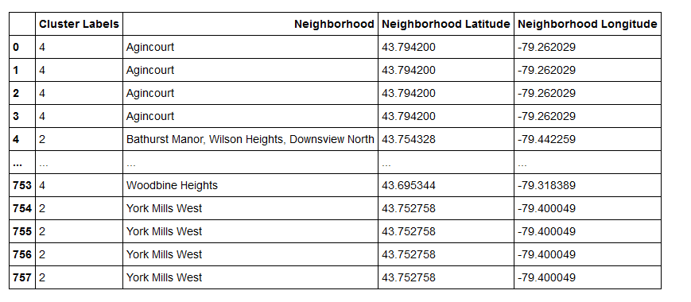
Methodology
Scraped Wikipedia page
Wrangled the data
Cleaned it
Read it into a pandas dataframe
Merged Coordinates
FourSquare API for gym venues
Modeling
Visualization

Slide 5
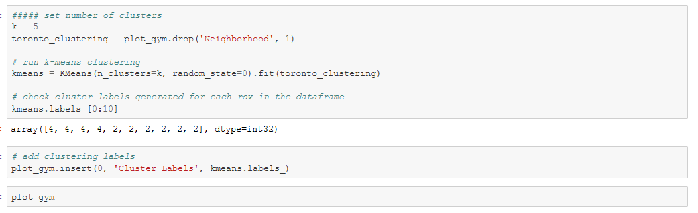
Modeling
Cluster Algorithm
K-means

Slide 6
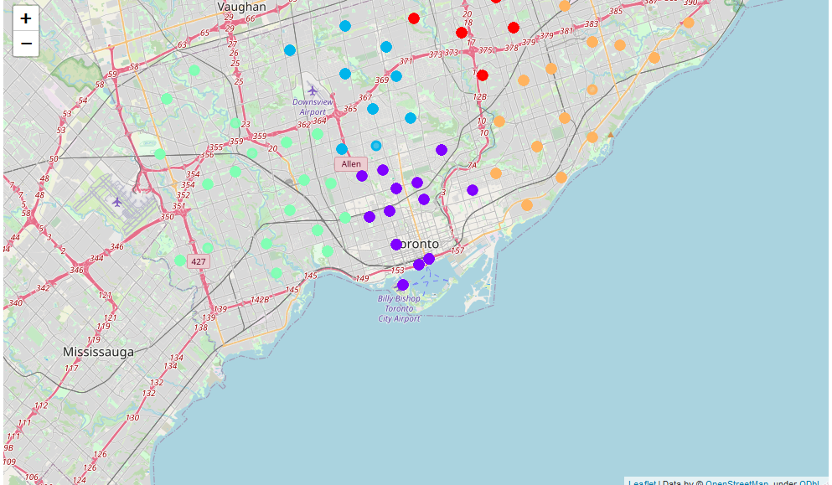
Clusters on map

Slide 7
CONCLUSION
Most people usually prefer to go to a gym that is close to their work or their home.
The criteria for opening a new gym here depend on the lack of a gym in the neighborhoods
We should also take into account the Business Improvement Area (BIA) (association of commercial property owners and tenants within a defined area who work in partnership with the City to create thriving, competitive, and safe business areas that attract shoppers, diners, tourists, and new businesses)
The density of the population in each region etc
We should consider more data to reinforce our choices

