Slide 1
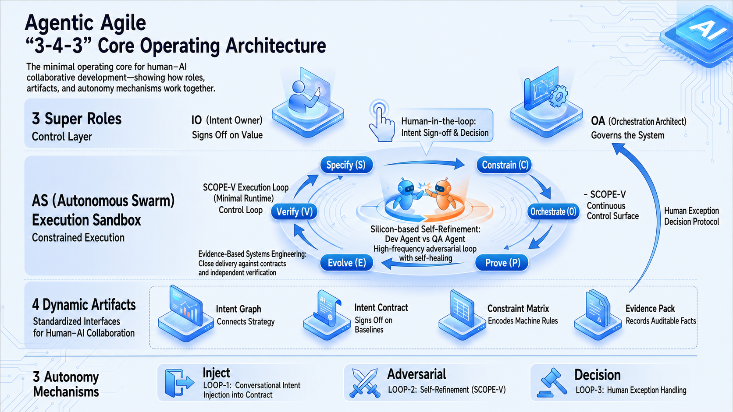

Slide 2
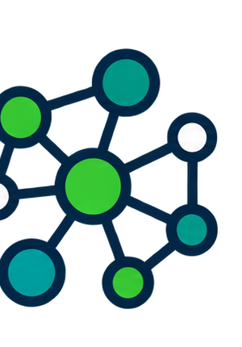
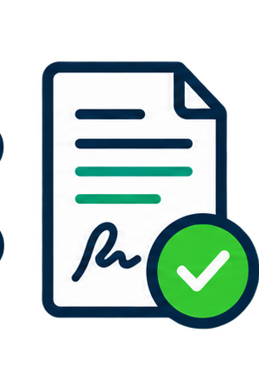

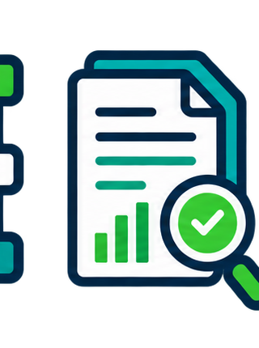


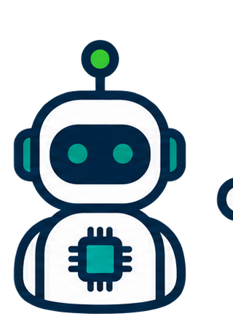
Agentic Agile 3-4-3 in the SDLC: Autonomy Along the Value Stream
From customer request to release, three roles, four artifacts, three autonomy mechanisms and SCOPE-V operate together.
Value stream: Customer request → Clarification → Definition → Architecture → Code → SIT → Integration test → Release
Intent Injection
Intent Injection
Self-refinement
HITL Gate
Request → Clarify
Define → Architect
Code → SIT
Integrate → Ship
IO + Owner: goal / guardrails
SCOPE-V: Specify
Intent Graph + IWE
IO: Contract / AC; OA: constraints
SCOPE-V: Constrain / Orchestrate
Contract + Constraint + Work Graph
AS: build / SIT; OA: Harness
SCOPE-V: Prove ↔ Evolve
Context + Code Map + Evidence
AS: integrate / regress; IO/OA: Verify
SCOPE-V: Verify → Telemetry
Evidence + Memory
3-4-3 in Four Dimensions: roles, artifacts and autonomy run on one value stream
People
IO owns intent / release; OA controls / orchestrates; AS executes code, tests and integration within boundary.
Organization
Business owner, product, architecture, engineering, test and operations collaborate on one Contract; exceptions use explicit gates.
Process
SCOPE-V: Specify → Constrain / Orchestrate → Prove ↔ Evolve → Verify → Telemetry; every step has entry, stop and evidence conditions.
Artifacts
4 artifacts: Intent Graph → Contract → Constraint Matrix → Evidence; IWE×Code Map, Harness, Memory and Telemetry.
Action Metrics
Proof: End-to-End Delivery
Demand: C&A% / rework | Build: Code→SIT LT / first-pass
Delivery: Integration→Release LT / escape defects | Run: rollback, HITL, cost
Primary: end-to-end Lead Time | Supporting: C&A%, first-pass, rework, escape defects
Comparable work, same risk: baseline vs. trend + Contract / Evidence / Telemetry
Agentic Agile | Faster, more accurate, more controllable SDLC—results you can prove
Notes:
[Sources]
- Agentic Agile book, Chapter 5: 3-4-3, four dynamic governance artifacts, and SCOPE-V.
- Agentic Agile book, Chapter 25: IWE, Document Map and Code Map.
- Agentic Agile book, Chapter 26: Basic Memory and evidence-gated learning promotion.
- Visual asset: original line-icon strip generated for this presentation; it represents generic roles and governance artifacts, not real individuals or products.
[Presenter Notes]
- Read top-to-bottom: the value stream is the operating surface, cards show where the three autonomy mechanisms occur, and rails show the people, organization, process and tools that make them governable.
- The three avatar icons denote IO, OA and AS. The four artifact icons denote Intent Graph, Intent Contract, Constraint Matrix and Evidence.
- Judge improvement with comparable work and the same risk boundary: shorter end-to-end lead time must be accompanied by evidence, quality and governance controls.

