Slide 1
Do hormonal contraceptives differ in their effect?
Study B — the contraceptive comparison (Group B?, Wednesday–Thursday)
  Pair 1: community composition · Pair 2: host genes
Durban Data Science for Biology, workshop 2
Notes:
First slide for the Friday audience: they have not seen this study.

Slide 2
The study, in one slide
93 women, sampled once each (cross-sectional)
They chose their own contraceptive method — nobody was randomised
Three arms: 39 injectable · 28 pill · 26 vaginal ring
Recorded for each woman: BV status (Amsel), Nugent score, pH, STI, sequencing batch
  Two count tables: 220 bacterial species and 13,713 host genes
Because it is observational, every difference is an association, not proof of cause
Notes:
Read this out before any result — the audience needs the design.

Slide 3
Our question, in one sentence
Do the three contraceptive methods differ in vaginal bacterial community composition or in host gene expression — or is bacterial vaginosis doing the explaining?
Notes:
This is the whole talk in one sentence (check-in T2 item 1).

Slide 4
What we did
QC first: all sample IDs match across tables, order verified for DESeq2, library sizes checked (smallest 5,247 reads — kept, flagged)
  Group QC decision: kept all 93 samples; species kept only if seen in ≥10 of 93 samples (62 species); genes kept if ≥10 reads in ≥24 samples (13,713 genes)
  Raw counts into every test — DESeq2 does its own normalisation (poscounts)
Composition: Bray-Curtis PCoA + PERMANOVA, adjusted for BV/pH/STI; dispersion checked; CLR+Euclidean as a second opinion
Host genes: DESeq2, ring vs systemic pooled (26 vs 67), adjusted for BV/pH/STI
Notes:
Deliverable item 2: what we did, including filters and why.

Slide 5
Our QC decision (agreed Wednesday)
Drop nothing: the smallest library (B006, 5,247 reads) stays, pending checks that did not flag it
Filter species at prevalence ≥10/93 samples before any community analysis
  30 species seen in exactly one sample cannot support any comparison
Filter genes at ≥10 reads in ≥24 samples before DESeq2
Batch was cross-tabulated against arm and time point: balanced, no confound found
Notes:
This is the slide the whole group agreed at W2.

Slide 6
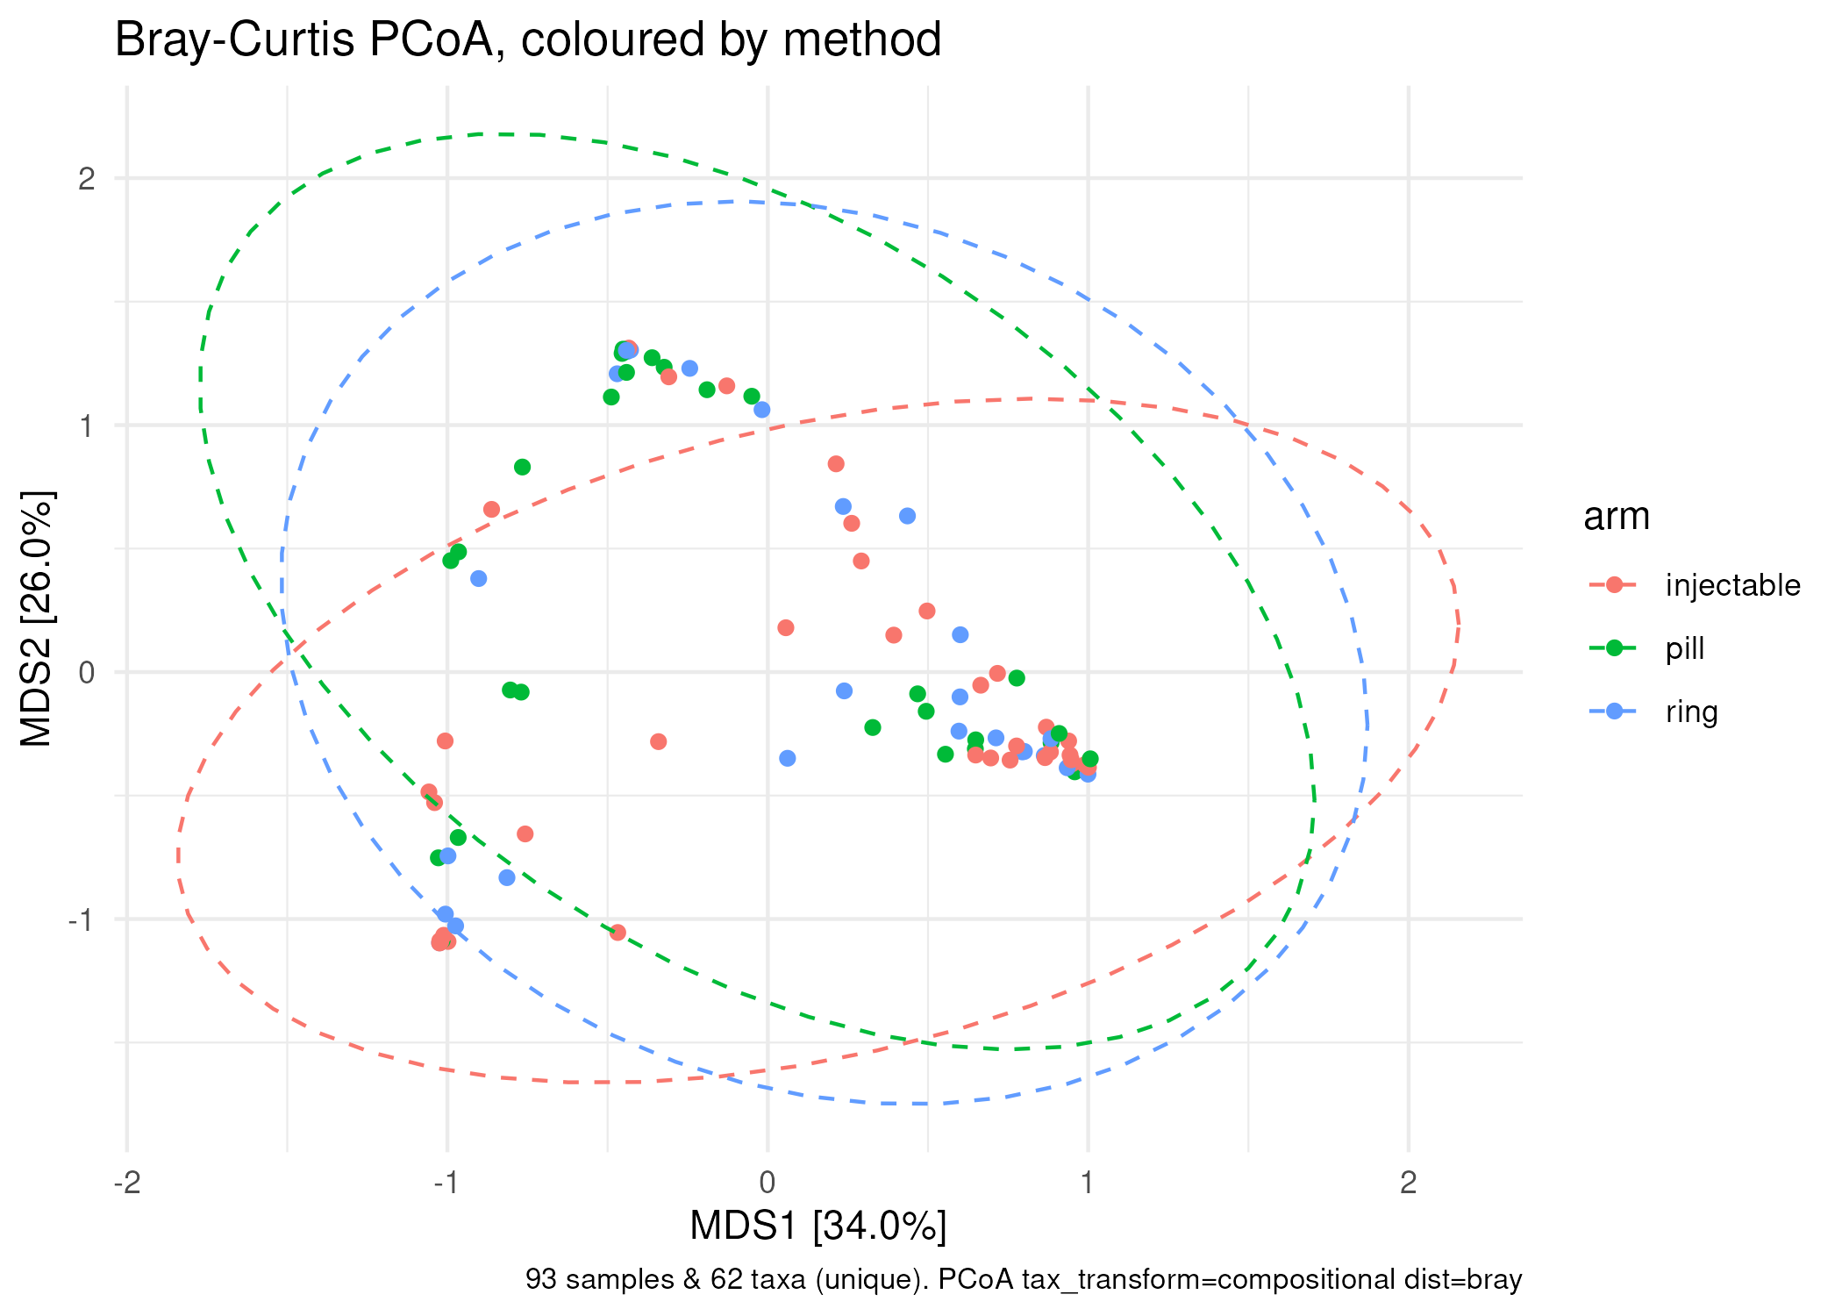
Figure: pcoa-by-arm.png
Notes:
Each point is one woman's vaginal community, 93 samples, ordinated on Bray-Curtis distance of relative abundance (species in ≥10 samples). The ellipses by method overlap almost completely — and colouring the same plot by BV status separates the points far better than method does.

Slide 7
Choice we made: the distance
Two routes: Bray-Curtis on relative abundance, or CLR + Euclidean (Aitchison), which treats the counts as compositional from the start
We kept BOTH and showed the result does not depend on it — the two ordinations and PERMANOVAs agree
  Source we opened and read: Anderson & Walsh (2013) on PERMANOVA and dispersion
Notes:
Deliverable item 4: 'choice we made' slide for the composition sub-question.

Slide 8
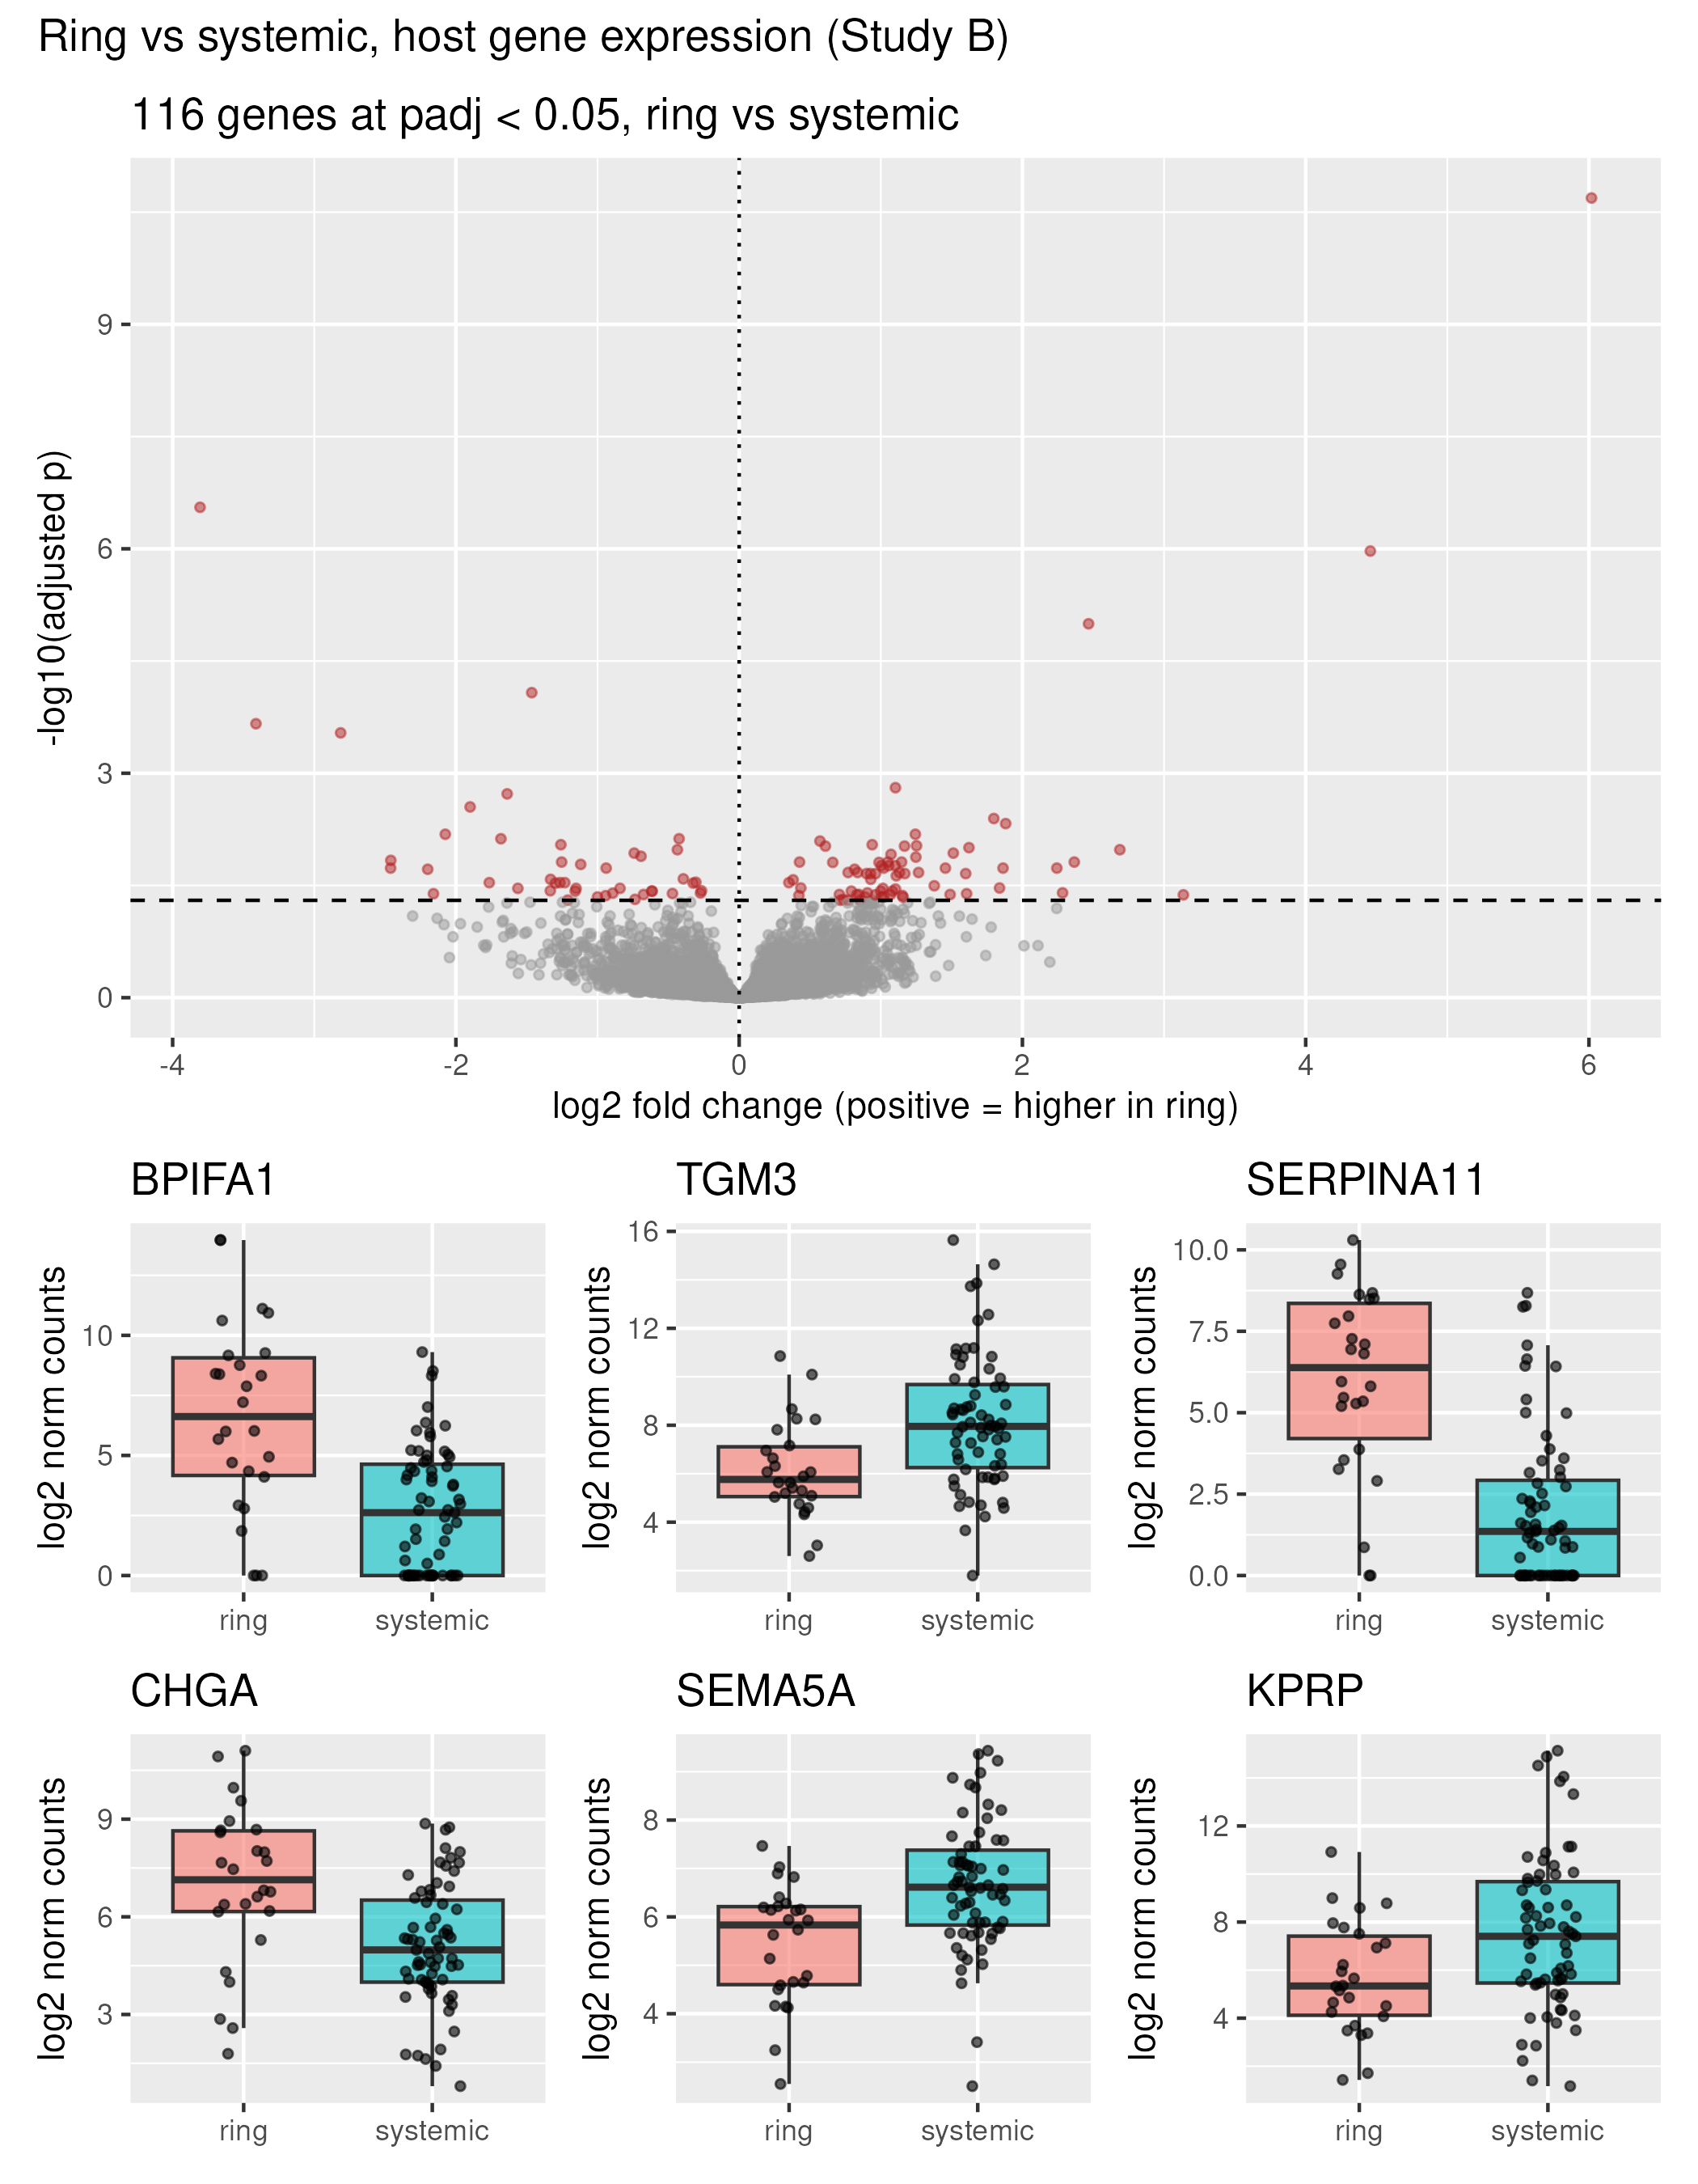
Figure: volcano-ring-vs-systemic.png
Notes:
DESeq2 on raw counts, ring (26) vs systemic methods pooled (67), adjusted for BV, pH and STI. 116 of 13,713 genes at adjusted p < 0.05 (72 higher in ring, 44 lower). BPIFA1, a mucosal innate-immunity protein, is ~64-fold higher in the ring. Boxplots below the volcano show the top genes raw, not just claimed.

Slide 9
Choice we made: adjust or not
Two routes: test ring vs systemic bare (~ systemic), or adjust for BV/pH/STI because nobody was randomised
Bare design calls 227 genes; the adjusted one 116 — about half the unadjusted signal was the covariates talking
  We kept the adjusted run and kept the bare one side by side so the cost of adjustment is visible; STI especially is lopsided (17/26 ring vs 31/67)
  Source we opened and read: DESeq2 paper / vignette on design formulas
Notes:
Deliverable item 4: 'choice we made' slide for the host sub-question.

Slide 10
The answer, stated as plainly as the data allow
The three methods do not detectably differ in vaginal community composition (arm p = 0.075, ring vs systemic p = 0.85; Shannon p = 0.47)
Bacterial vaginosis dominates the community picture: R² = 14%, p = 0.001 — five times the method's share
The ring does differ from the systemic methods in host gene expression: 116 genes, led by a large BPIFA1 increase
  Whether that gene signal is the method, or BV acting through the host, is exactly what we have not separated yet
Notes:
Deliverable item 5: the answer, plainly. The last bullet is the honest hinge.

Slide 11
What we do NOT believe about our own result
No randomisation: women chose their methods, so BV, STI and pH differences across arms may predate any contraceptive effect
Power: arms of 26–39. We can rule out a LARGE method effect on composition; a small one could hide inside p = 0.075. Sample counts are on every comparison slide.
BPIFA1's 64-fold change rests on 26 ring samples, and DESeq2 flagged 6 outlier genes overall — we show the boxplot, but it is one gene
'The ring touches the tissue' is a story we brought to the data, not one the data proved — enrichment (Thursday) is what tests it
Both count tables are compositional: 'relative abundance went down' is not 'there was less of it'
Notes:
Deliverable item 6, REQUIRED. Read this one out loud.

Slide 12
Open questions from our pair
Is the ring's gene signal BV-mediated? (community-type sub-question)
Which processes do the ring-vs-systemic genes point to? (enrichment, Thursday)
  Would paired sampling over time change the composition answer? This study cannot tell us — cross-sectional by design
Notes:
The open-questions slide, updated as we went.

