Slide 1
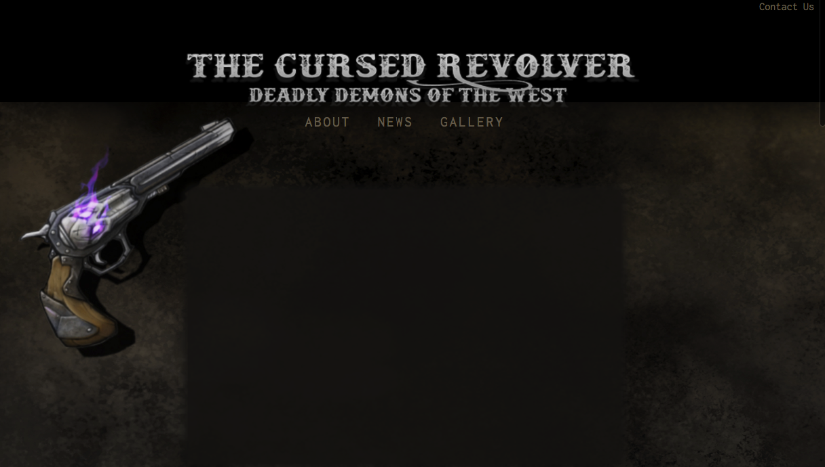
Home Page
Missing: Video, Trailer, Central Content

Slide 2
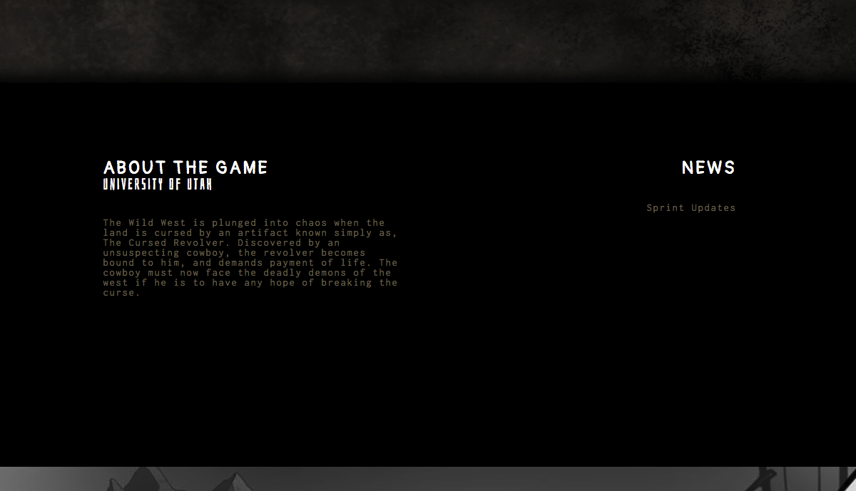
Middle Content of Home Page
Missing: Additional About Information, News

Slide 3
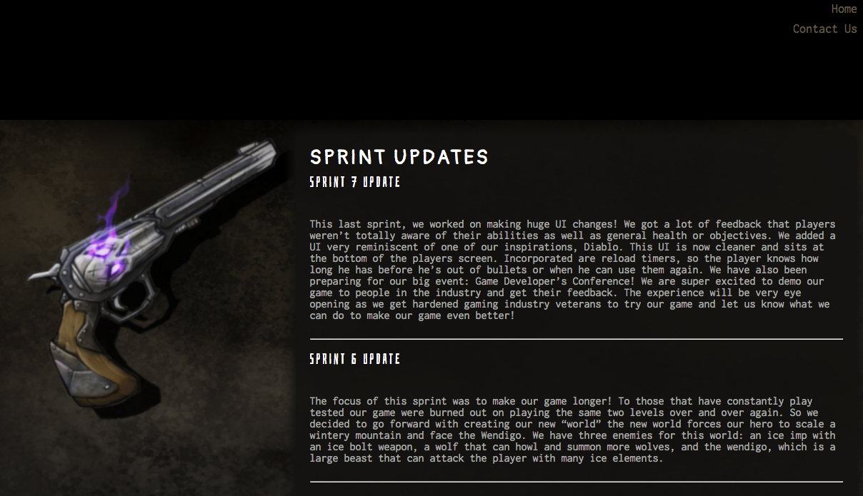
Sprint Updates – Linked Page

Slide 4
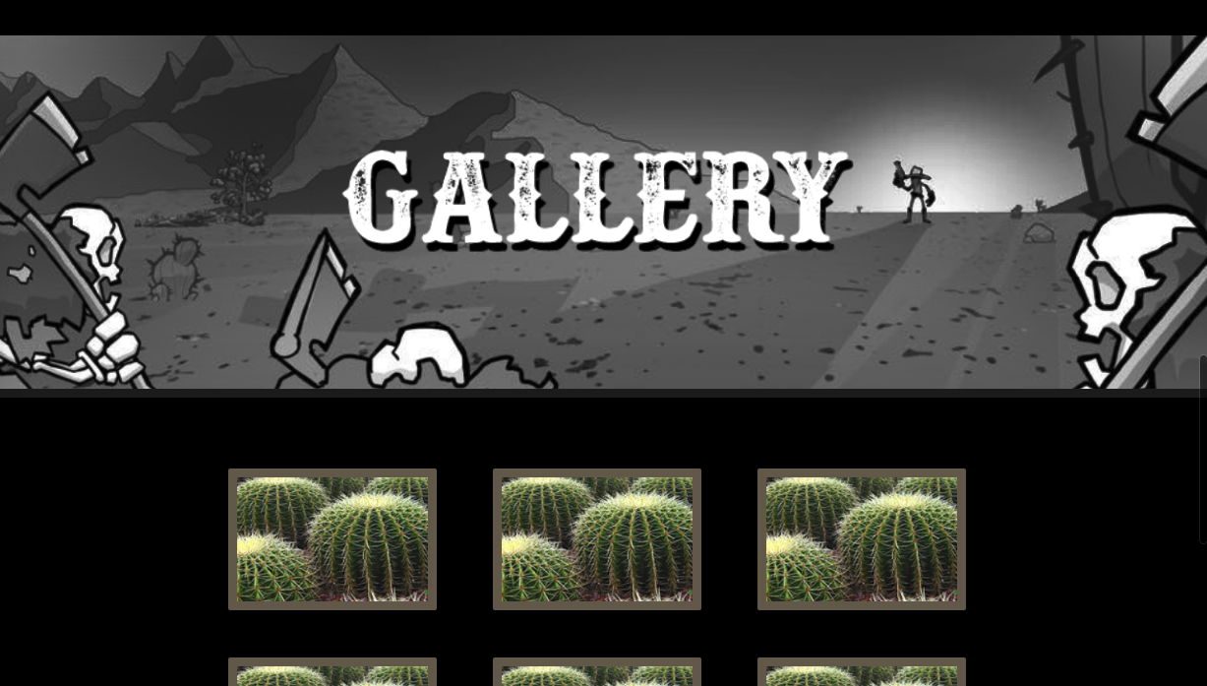
Gallery on Home Page
Missing: Game Screenshots

Slide 5

Gallery image Expand Functionality
Missing: Game Screenshots

Slide 6
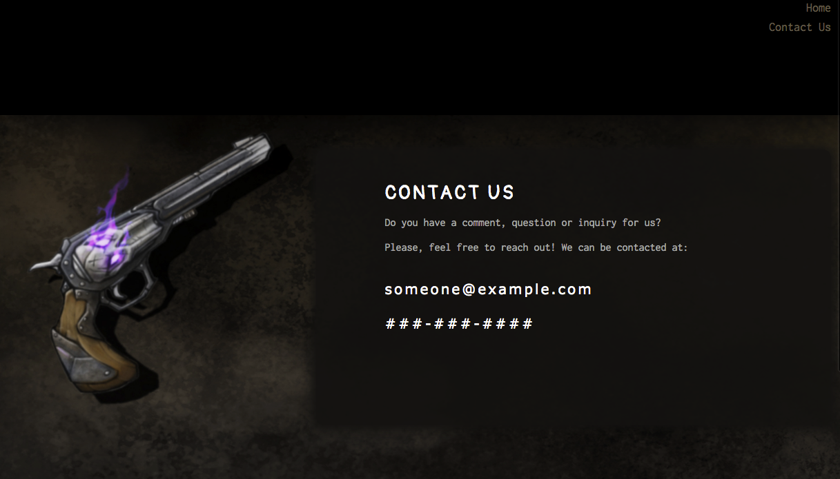
Contact Us Linked Page

