Slide 1

Speech Denoising via
Nonnegative Matrix Factorization
Oleg Alenkin
Artyom Chashchin
Vladimir Chernykh
German Novikov
December 2016

Slide 2




Problem
Noise
+
Denoising
Noisy speech
Denoised speech
Clean speech

Slide 3

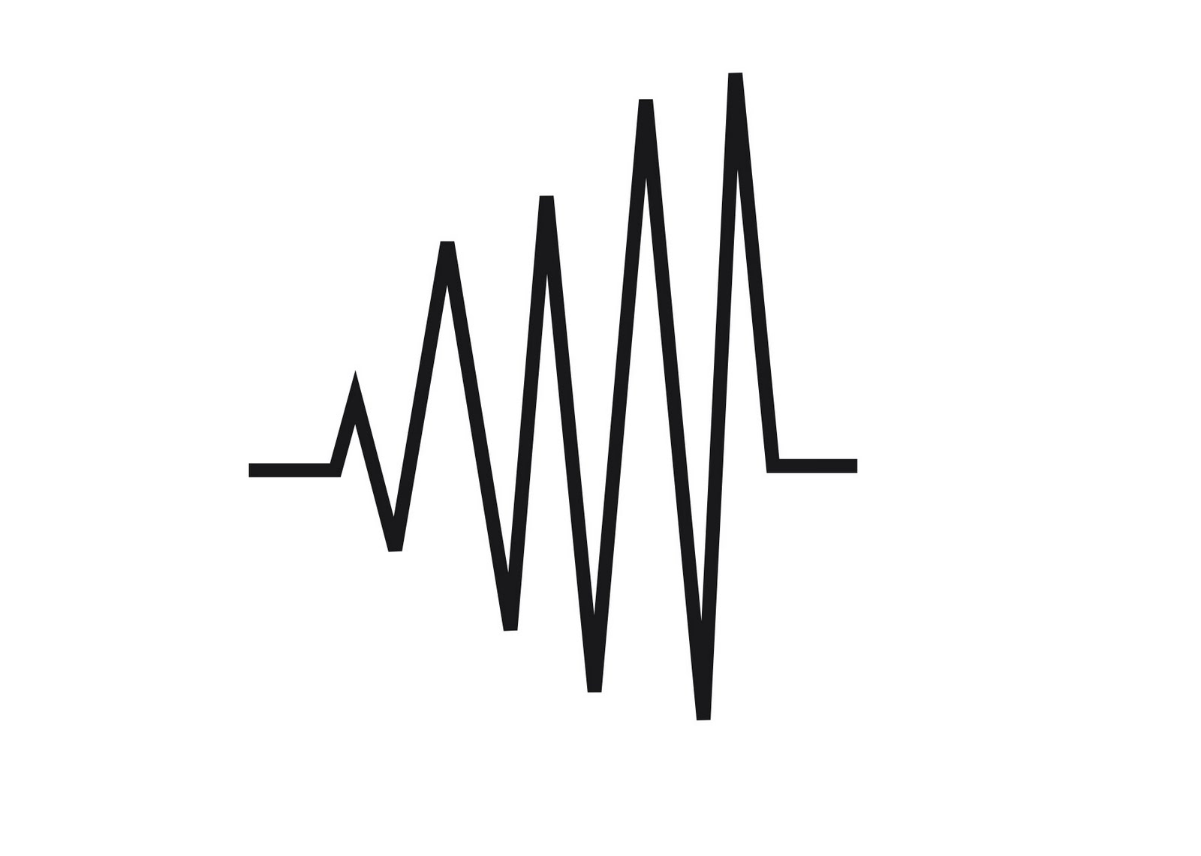



Applications
Automatic Speech Recognition
Telephone conversations
Hearing aids

Slide 4
Data
CHiME Speech Separation and Recognition Challenge
http://spandh.dcs.shef.ac.uk/chime_challenge/chime_download.html
Recordings of WSJ utterances + 8 hours of noise
Berlin Database of Emotional Speech
http://www.emodb.bilderbar.info/download/
Clean utterances
Aurora noising
http://aurora.hsnr.de/download.html

Slide 5
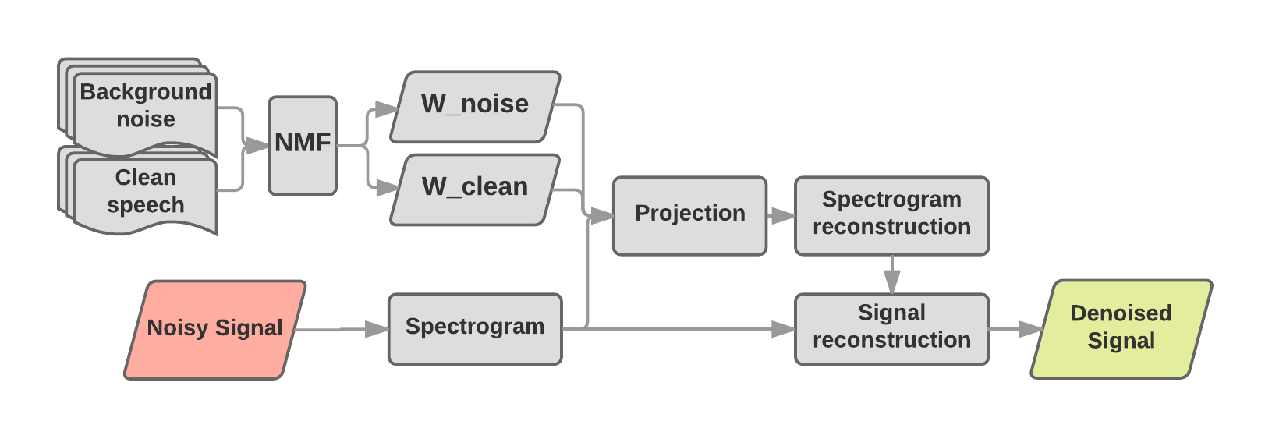
Solution
Learn frequency patterns from speech and noise via NMF
Decompose new signal on joint “dictionary” of patterns
Take only projection corresponding to “clean speech”

Slide 6
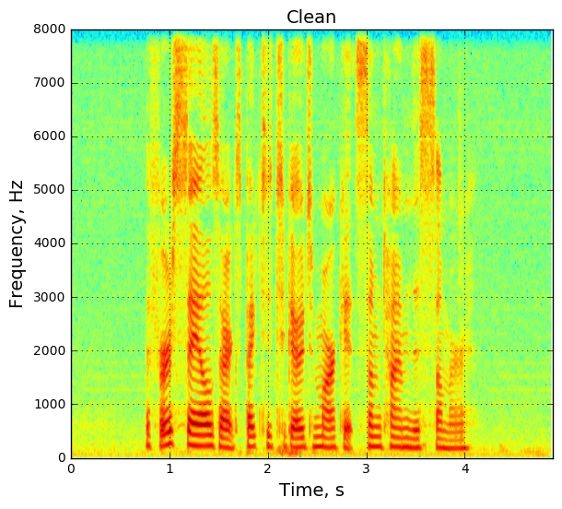
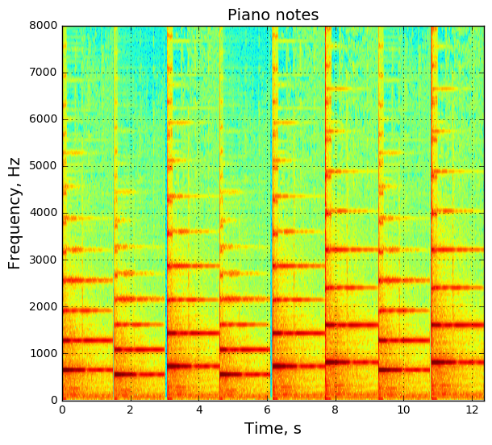
Spectrogram
Represent signal in Time-Frequency domain
Built via Short-Term Fourier Transform - FFT with sliding overlapped window
STFT - Complex spectrogram S ⇒ Amplitudes V

Slide 7
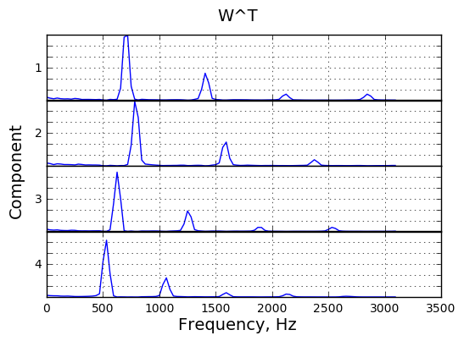
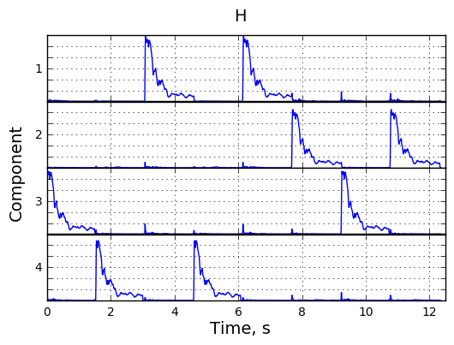
NMF
Factorization V ≈ W * H, where V, W, H - real nonnegative
Interpretation: W - frequency patterns, H - time-activation matrix
Hidden dimension ≈ number of phonemes ≈ 40
Learn speech and noise “building blocks”

Slide 8
Projection
Join “dictionaries” - concatenate matrices W_{noise} and W_{clean}
Project signal onto them
Noisy speech spectrogram amplitudes V
H_{clean}
W_{clean}
Learn
W_{noise}
H_{noise}
Ŝ ≈ W_{clean} * H_{clean}
Fixed

Slide 9
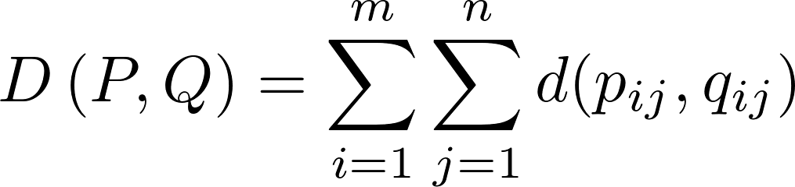

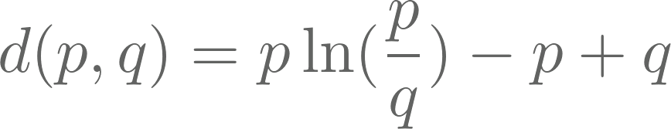
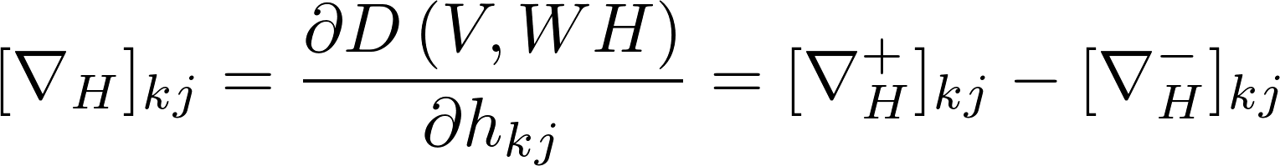
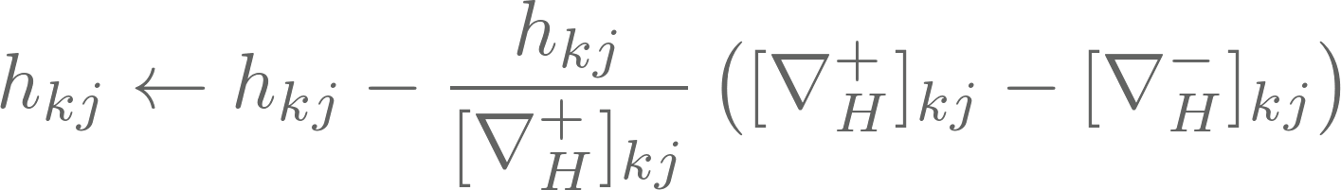
NMF: how to compute
Optimization problem:
The most popular metrics:
Frobenius norm
KL divergence
Multiplicative Update Method:

Slide 10
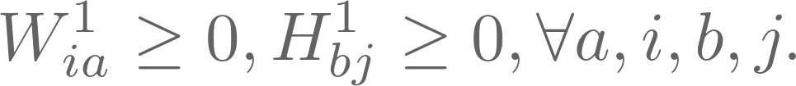
NMF: how to compute
Alternating Nonnegative Least Squares:
1) Initialize
2) For k=1,2,...

Slide 11
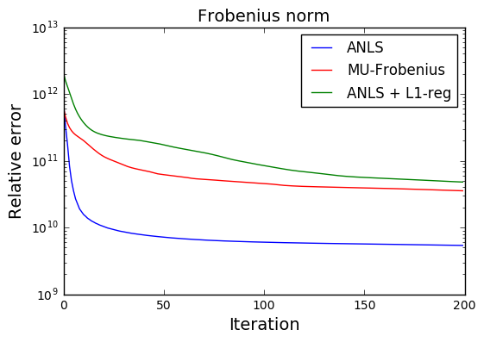
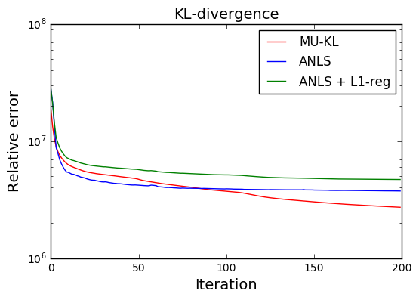
Methods’ Convergence

Slide 12
Quasi-Newton method
Problem: hard to compute inverse Hessian

Slide 13
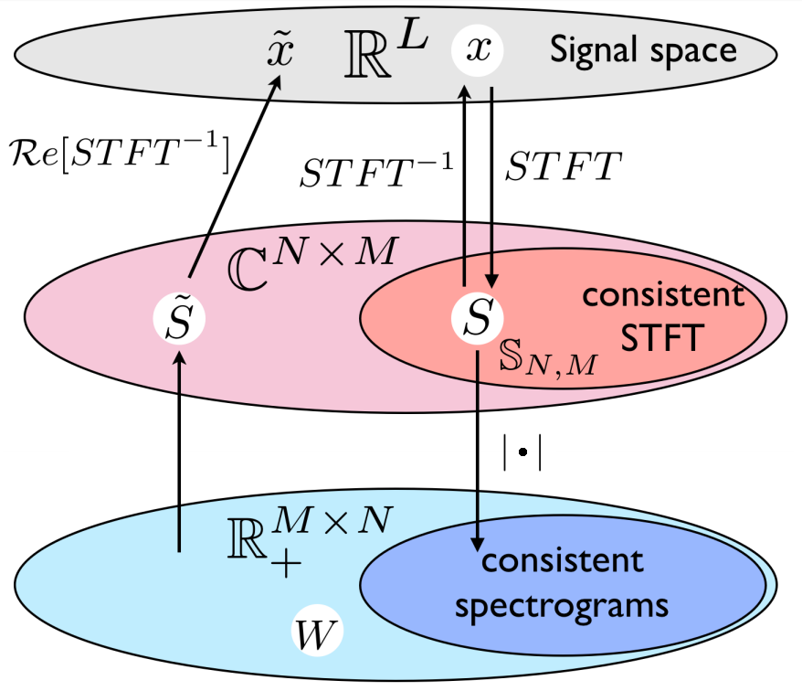
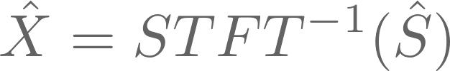
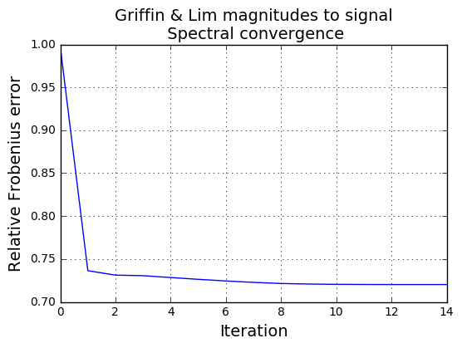
Signal reconstruction
Naive method with zero phase:
Noisy signal phases:
Griffin & Lim iterative method:

Slide 14
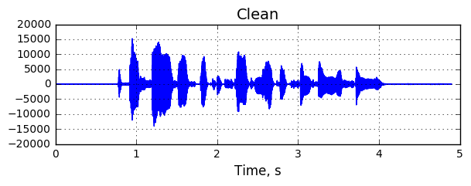
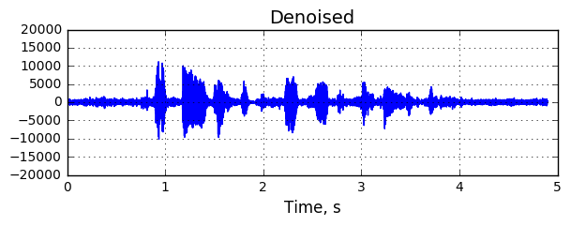
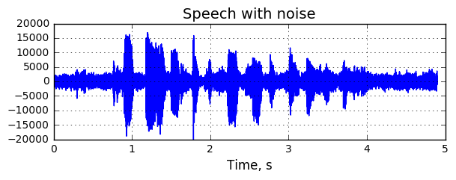
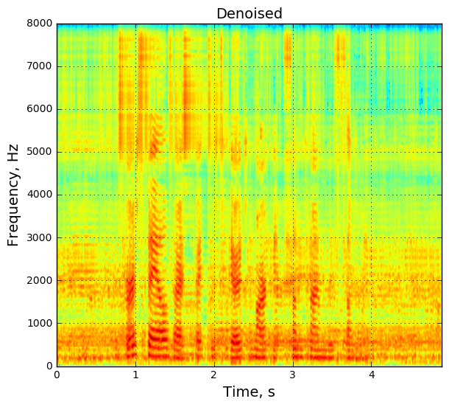
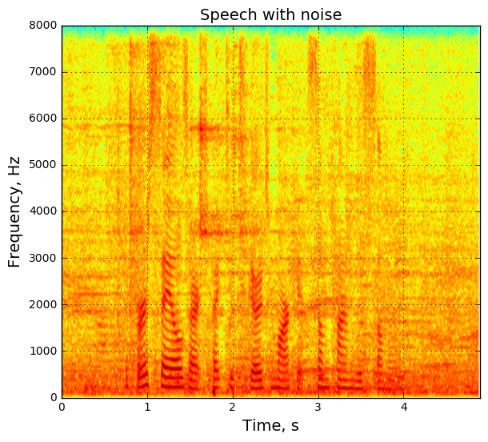


Demo

