Slide 1

Ozone Development 2.
for Developers
Ozone Up and Running
Start and debug Ozone from IntelliJ

Slide 2
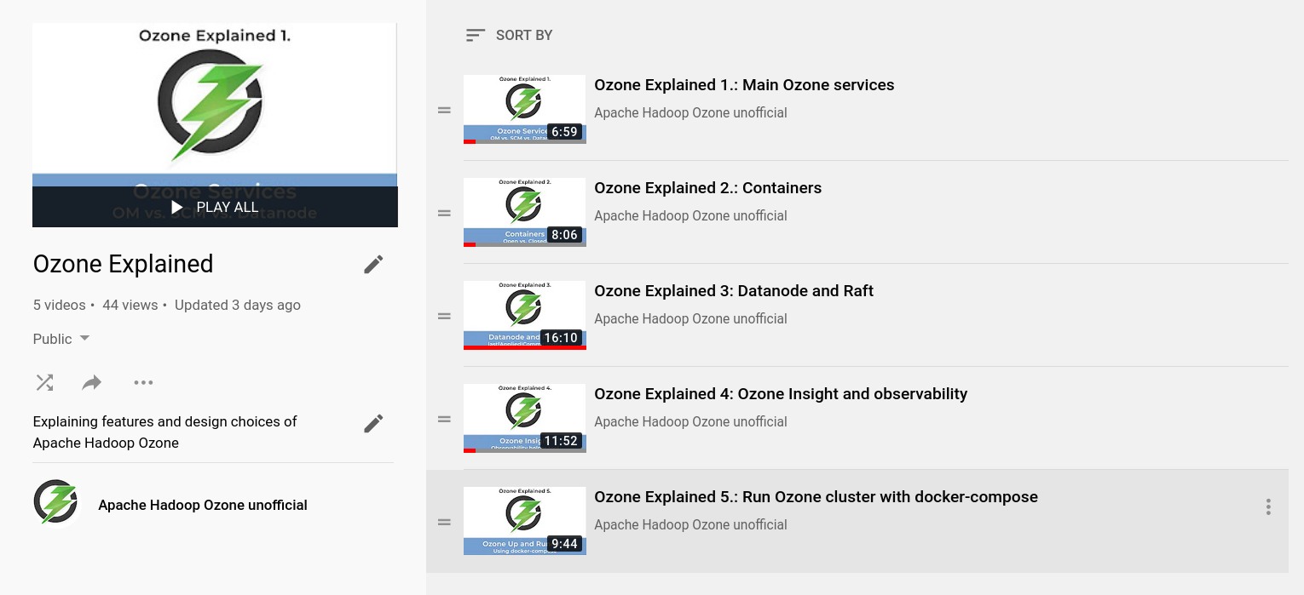

Slide 3

Ozone components (full picture)

Slide 4
Start Ozone from IntelliJ
Turn off IDE + Install the runners
  ./hadoop-ozone/dev-support/intellij/install-runconfigs.sh
Start IDE
Start services in the right order
  scm –init (only at first time)
  scm
  om –init (only at the first time
  om
  datanode1, datanode, datanode

Slide 5




S3 protocol
Hadoop FS
CSI
Apache Hadoop Ozone
hadoop.apache.org/ozone

