Slide 1

Ozone Development 3.
for Developers
Ozone CI
How to use Github Actions based CI

Slide 2
Github Actions
Master:
  built twice per day
  and after every commit
Pull requests
  checked after each commit (just create one)
All the checks are Github independent!
  hadoop-ozone/dev-support/checks.sh

Slide 3
Parallel runs
checkstyle/findbugs/author/rat
  code style and
unit
  Real unit tests
integration (run in multiple parts)
  JUnit test + MiniOzoneCluster (1 JVM cluster)
acceptance
  docker based test with robotframework
coverage
  collect coverage

Slide 4
Best practices
Download artifacts to get the root cause
  For acceptance, check the last green line
Check the master status
  https://elek.github.io/ozone-build-results/
Test your branch in your fork
  github.com/elek/hadoop-ozone/actions

Slide 5
Best practices PR
To /rebuild
  git commit --allow-empty -m "retrigger ci"
Unrelated tests should be fixed

Slide 6
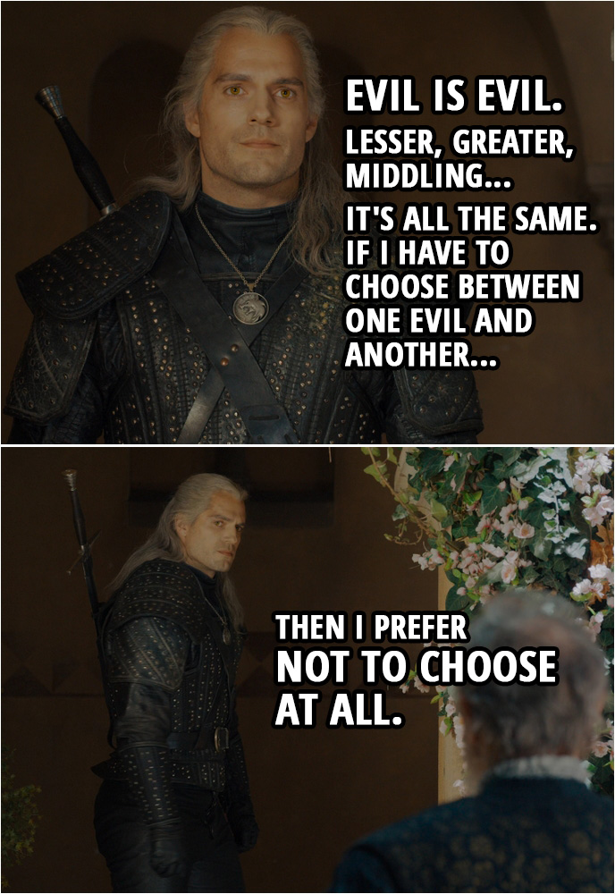
Failure is failure
There are no unrelated failures
Turn off intermittent tests
  Create a new issue
  Upload logs to make it possible to debug
  Commit the @Ignore(HDDS-...) annotation (without PR)

Slide 7




S3 protocol
Hadoop FS
CSI
Apache Hadoop Ozone
hadoop.apache.org/ozone

