Slide 1

Ozone Explained 4.
Ozone Insight
Observability helper tool

Slide 2
What’s going on?

Slide 3
Ozone Explained 4.
Ozone Insight
Observability helper tool

Slide 4




S3 protocol
Hadoop FS
CSI
Apache Hadoop Ozone
hadoop.apache.org/ozone

Slide 5
Ozone observability
Logs
Metrics (Prometheus support)
Configuration visibility
Audit logs
Distributed tracing

Slide 6

The real challenge is to
structure the information
not to collect them

Slide 7
DEMO

Slide 8
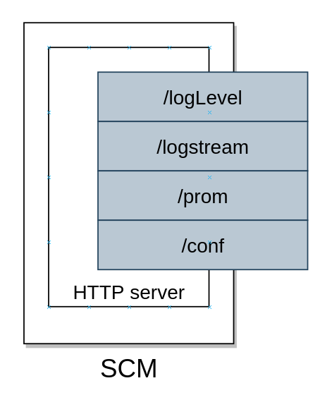
How does it work?
Predefined rulesets,
to filter out information
from the noise

Slide 9
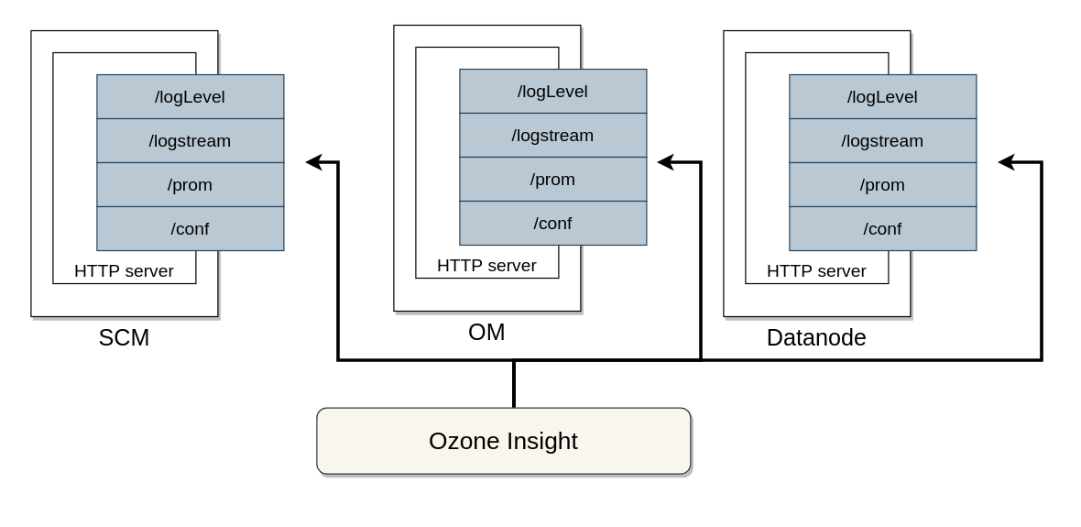
How does it work?

Slide 10
S3 protocol
Hadoop FS
CSI
Apache Hadoop Ozone
hadoop.apache.org/ozone

