Slide 1

Ozone Explained 1.
Ozone Services
OM vs. SCM vs. Datanode

Slide 2




S3 protocol
Hadoop FS
CSI
Apache Hadoop Ozone
hadoop.apache.org/ozone

Slide 3

How to Store files?

Slide 4
How to Store files?
File → Block[]
Block → Datanode[]

Slide 5
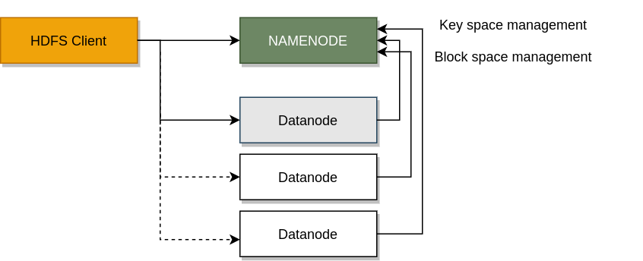
How to Store files?
File → Block[]
Block → Datanode[]

Slide 6
HDFS components

Slide 7
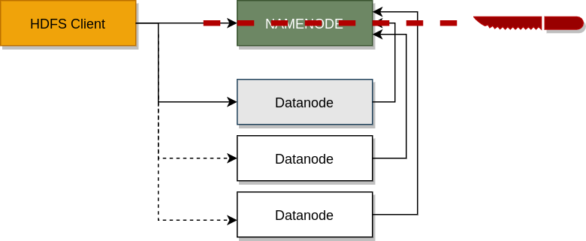
Separate key / block space management

Slide 8

Ozone components

Slide 9

Ozone components (full picture)

Slide 10
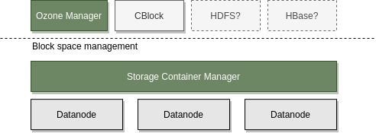
Original Vision
Use block layer by other applications not just for Object Store

Slide 11

Ozone Layers

Slide 12

Storage Container Manager
Block space management
  Allocate blocks
  Replicate containers
  Manage certificates #security

Slide 13

SCM: network services
Pipelines: List/Delete/Activate/Deactivate
  Raft groups are planned by SCM
Containers: Create / List / Delete containers
Admin related requests
  Safemode status/modification
  Replication manager start / stop
CA authority service

Slide 14
SCM: network services II.
Datanode HeartBeat protocol
  From Datanode to SCM (30 sec by default)
  Commands can be added to the response

Slide 15
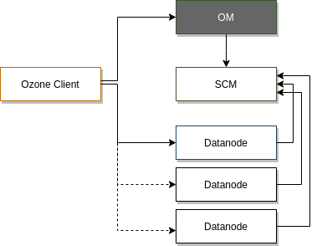
Ozone Manager (OM)
Key Space Management
  Managing volumes/buckets/keys
  Secondary indexes for fs access

Slide 16
OM: network services
Key, Bucket, Volume / CRUD
  Multipart upload (Initiate, Complete…)
FS related calls
  GetFileStatus, CreateDirectory, CreateFile, LookupFile
ACL related (for internal ACLs)
Delegation token (Get / Renew / Cancel)
Trash related commands (WIP)

Slide 17
Ozone components (full picture)

Slide 18
S3 protocol
Hadoop FS
CSI
Apache Hadoop Ozone
hadoop.apache.org/ozone

