Slide 1

Ozone Explained 3.
Datanode and RAFT last[Applied|Commit]Index

Slide 2




S3 protocol
Hadoop FS
CSI
Apache Hadoop Ozone
hadoop.apache.org/ozone

Slide 3

Ozone components

Slide 4

Datanode: network services
Datanode protocol (for the clients)
Heartbeat (DN → SCM) for management
Ratis / Raft endpoint (for other datanodes)

Slide 5
Raft
“Raft is a consensus algorithm for managing a replicated log”
“Raft more understandable thanPaxos and also provides a better foundation for build-ing practical systems”

Slide 6
Apache Ratis (incubator)
Raft protocol implementation
Embeddable library (!!!)
Pluggable interfaces
  Statemachine
  Network protocol
High performance

Slide 7
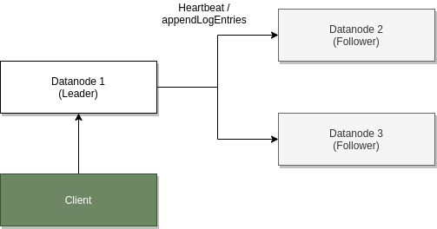

Slide 8
S3 protocol
Hadoop FS
CSI
Apache Hadoop Ozone
hadoop.apache.org/ozone

