Slide 1

Ozone Explained 9.
Hadoop compatible interface
Using o3fs:// and ofs://

Slide 2




S3 protocol
Hadoop FS
CSI
Apache Hadoop Ozone
hadoop.apache.org/ozone

Slide 3
Using Ozone from Hadoop
Hadoop Compatible File System interface
  Used by Spark, Yarn, Flink HBase, Hive, …
Ozone provides two implementations
  ofs://
  o3fs://

Slide 4
Hadoop file system (old style)
o3fs://
View to one specific bucket only!
hdfs dfs -ls o3fs://bucket1.volume1/dir1/file1.txt
o3fs://bucket1.volume1.om:port/dir1/file1.txt

Slide 5
Hadoop file system (new style)
ofs://
View to the whole keyspace
hdfs dfs -ls
ofs://om:9862/vol1/bucket1/dir1/file1.txt
DistCp friendly
First levell directories couldn’t contain files

Slide 6
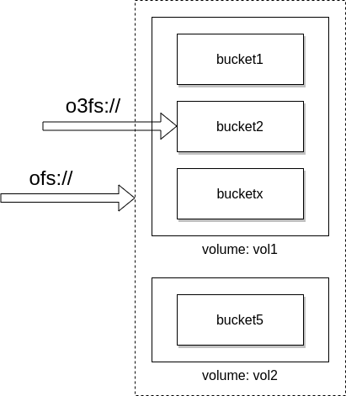
o3fs:// vs ofs://

Slide 7
ofs:// + tmp
First level directories in ofs:// are volumes
  They couldn’t contains files
How to write ofs://om/ tmp/test.txt?
/tmp is special, it should be r/w
  o3fs:/.../tmp → volume=/tmp, bucket=md5(user)

Slide 8
How to use it
Add one jar to the classpath
  share/ozone/lib/hadoop-ozone-filesystem-hadoop3-....jar
Config o3fs/ofs in core-site.xml

Slide 9
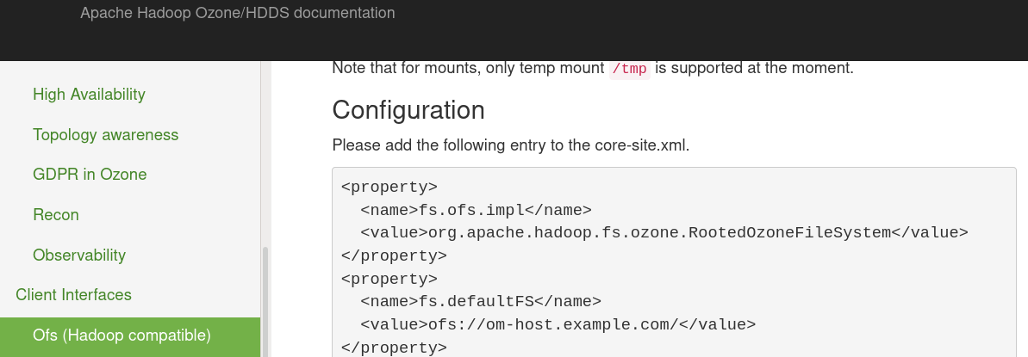

Slide 10
S3 protocol
Hadoop FS
CSI
Apache Hadoop Ozone
hadoop.apache.org/ozone

