Slide 1

Ozone Explained 10.
Container Storage Interface
Using Ozone as mounted storage

Slide 2




S3 protocol
Hadoop FS
CSI
Apache Hadoop Ozone
hadoop.apache.org/ozone

Slide 3
CSI (alpha !)
Container Storage Interface
  Standard to provide storage for container orchestrator
  Supported by Yarn, Kubernetes, Mesos, etc…
  A common language to request and mount storage

Slide 4
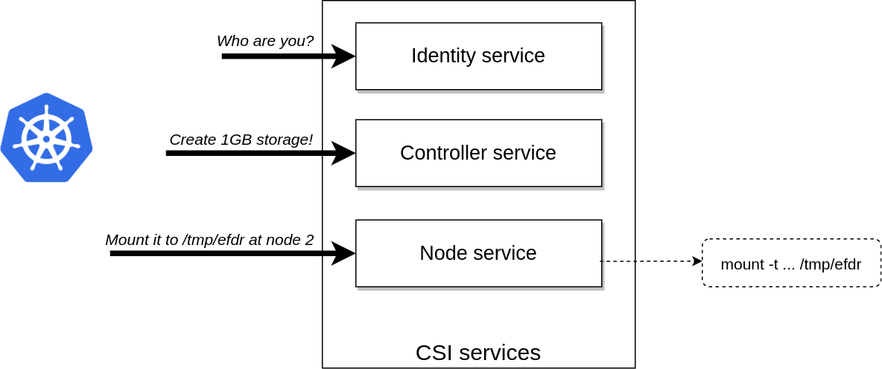
CSI

Slide 5
Use Ozone Storage as a FS
`ozone csi` –> implements CSI interface
CSI is the easy part:
  Create storage
  Mount storage to a specific dir
Hard part: how to mount?

Slide 6
CSI: Mount options
Use S3 Fuse driver
  goofys → Ozone S3 gateway → Ozone cluster
  NFS → Ozone NFS gateway → Ozone cluster
  fuse driver → libhdfs → OzoneFileSystem → …

Slide 7
S3 protocol
Hadoop FS
CSI
Apache Hadoop Ozone
hadoop.apache.org/ozone

