Slide 1



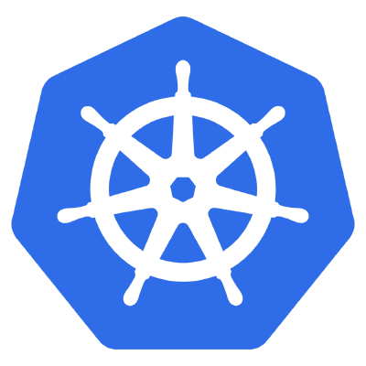

S3 protocol
Hadoop FS
CSI
Apache Hadoop Ozone
hadoop.apache.org/ozone

Slide 2
Why?

Slide 3
Scalability problem (1)
HDFS is designed for huge files
  200 million files for regular users
  Companies with core devs 400-500 million
New Opportunities and Challenges
  Cloud
  Streaming
  Small files are the norm

Slide 4
HDFS Scalability
Small files for HDFS
  Memory pressure on Namenode
  Higher network traffic (BlockReports)

Slide 5
Other solution
HDFS-5477 Separate Block Management (open)
HDFS-8286 Partial namespace in memory (open)
HDFS-1052 HDFS federation (resolved)
HDFS-10467 Router based federation (resolved/in-progress)
HDFS-7240 "Scaling HDFS" (Ozone)
Ozone borrows many idea learned from these efforts and is a super set of these approaches

Slide 6
Design Tenets
Strong Consistency
  Easier to write applications. No need for S3Guard.
Simple architecture
  Easy to understand
Use proven building blocks
  Raft protocol for consensus - E.g. HA and write pipeline.
  RocksDB from Facebook
Open Source
  Work well with the Apache Hadoop/Spark ecosystem

Slide 7
Usability problem (2)
HDFS can be used from Hadoop ecosystem?
  Machine learning code? Python?
  S3 compatible code?
  Kubernetes? Containerization? File system?
Object store seems to be a more universal abstractions

Slide 8
S3 protocol
Hadoop FS
CSI
Apache Hadoop Ozone
hadoop.apache.org/ozone

Slide 9

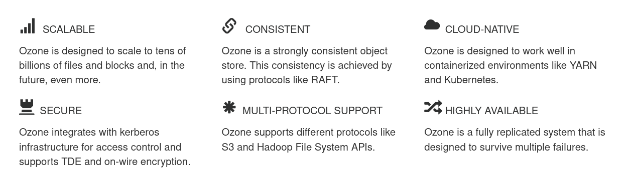
Apache Hadoop Ozone
Ozone is a scalable, redundant, and distributed object store for Hadoop

Slide 10
“Ozone is a
spiritual successor
to Hdfs”

Slide 11
History.md
Started as a feature branch in Hadoop
Merged in 2018 to Hadoop trunk
  Built by optional profile
  Separated release lifecycle
  Separated subproject (“HDDS”)
2019 Q4: Moved to a separated git repostory (apache/hadoop-ozone)
2020.03: First beta release
2020.09 Ozone 1.0.0

Slide 12
How to store?

Slide 13

How to Store files?

Slide 14
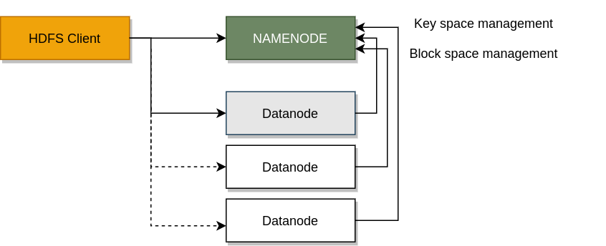
HDFS components

Slide 15
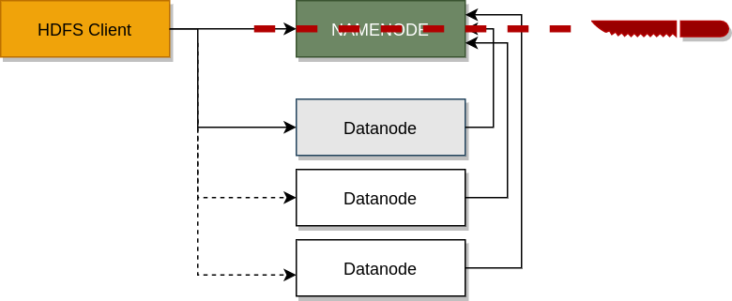
Separate key / block space management

Slide 16

Ozone components

Slide 17

Ozone components (full picture)

Slide 18
Key concepts

Slide 19
Key space
3 levels of hierarchy /vol1/bucket1/key1
  Volumes (~ user namespaces)
  administration unit, managed by admins
  Buckets (~ dirs)
  created/deleted by users
  Keys (~files)
  flat hierarchy (with indexes)

Slide 20

Block space
Each file is stored in blocks
Blocks are replicated in groups
  Container is
  unit of
  replication

Slide 21
Open Containers
Closed Containers
Read / Write support
Replicated with Ratis (sync)
Leader has the latest state (Stale reads?)
Closed: if full or in case of error
Immutable (Read Only)
Replicated with simple network copy (async)
Easy to read from all members
GC is required
(to handle delete)

Slide 22

Ozone Layers

Slide 23
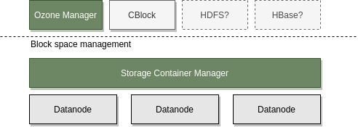
Original Vision
Use block layer by other applications not just for Object Store

Slide 24
How to scale?
Key / Block space are separated
  Less memory pressure
Report / replicate containers and not blocks
  Smaller block reports
Keep partial namespace in memory (if required)
  RocksDB + SSD can provide good enough performace

Slide 25
Ozone Services

Slide 26

Storage Container Manager
Block space management
  Allocate blocks
  Replicate containers
  Manage certificates #security

Slide 27

SCM: network services
Pipelines: List/Delete/Activate/Deactivate
  Raft groups are planned by SCM
Containers: Create / List / Delete containers
Admin related requests
  Safemode status/modification
  Replication manager start / stop
CA authority service

Slide 28
SCM: network services II.
Datanode HeartBeat protocol
  From Datanode to SCM (30 sec by default)
  Commands can be added to the response

Slide 29

SCM: persisted data (RocksDB)
Pipelines
Contaeners
Deleted blocks
Valid certs
Revoked certs
Node: in-memory

Slide 30
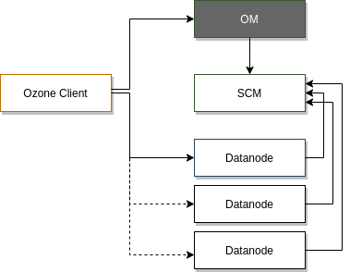
Ozone Manager (OM)
Key Space Management
  Managing volumes/buckets/keys
  Secondary indexes for fs access

Slide 31
OM: network services
Key, Bucket, Volume / CRUD
  Multipart upload (Initiate, Complete…)
FS related calls
  GetFileStatus, CreateDirectory, CreateFile, LookupFile
ACL related (for internal ACLs)
Delegation token (Get / Renew / Cancel)
Trash related commands (WIP)
Admin APIs
  Get S3 secret
  ServiceList (to find SCM)
  DBUpdates (Recon downloads snapshots)

Slide 32
OM: persisted data (RocksDB)
Volume / Bucket / Key tables
OpenKey table (created key, but not committed)
Delegation token table
PrefixInfo table (ACL for prefixes)
S3 secret table
Multipart info table
Deleted table

Slide 33
Datanodes
Health check
  reports (Containers, disk…) to the SCM as a heartbeat
  Commands can be received in the response
    Close container, Delete container
Open Containers:
  Starting RAFT server and forward requests to it
Closed Container
  Replicate as immutable package

Slide 34
Datanodes
Datanodes are forming RAFT groups (pipelines)
Client is communicating with the leader
  All requests are replicated via RAFT

Slide 35
Datanode: network services
Datanode protocol (for the clients)
Heartbeat (DN → SCM) for management
Ratis / Raft endpoint (for other datanodes)

Slide 36
Datanode client calls
Containers: Create/Read/Updated/DeleteList
Blocks: Put/Get/DeleteList
Chunks: Read/Delete/Write/List
PutSmallFiles/ GetSmallFiles
(CloseContainer)
CopyContainer (export Container)

Slide 37
Datanode → SCM messages
GetVersion/Register (Initial handshake)
SendHeartbeat (request)
  DatanodeDetails
  NodeReport
  ContainerReport
  PipelineReport
  IncrementalContainerReport
  Container/Pipeline actions (request to close

Slide 38
SCM → Datanode messages
Sent in the response
Reregister command
Container replication commands
  Replicate, Delete, Close,
Pipeline commands

Slide 39
Datanode: network services
Datanode protocol (for the clients)
Heartbeat (DN → SCM → DN) for management
Ratis / Raft endpoint (for other datanodes)

Slide 40
Raft
“Raft is a consensus algorithm for managing a replicated log”
“Raft more understandable thanPaxos and also provides a better foundation for build-ing practical systems”

Slide 41
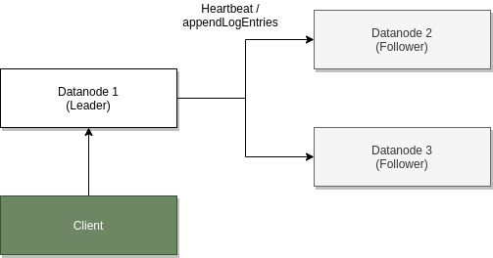

Slide 42
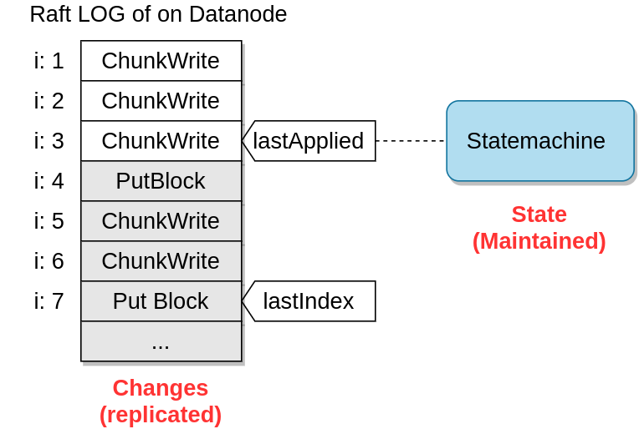

Slide 43
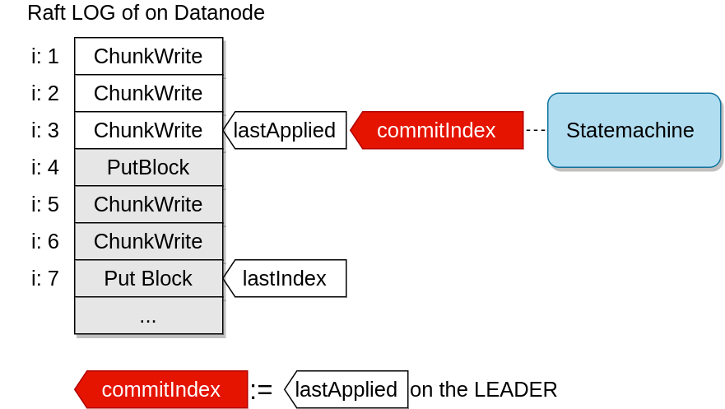

Slide 44
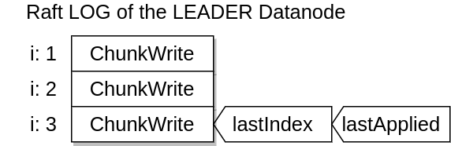

Slide 45
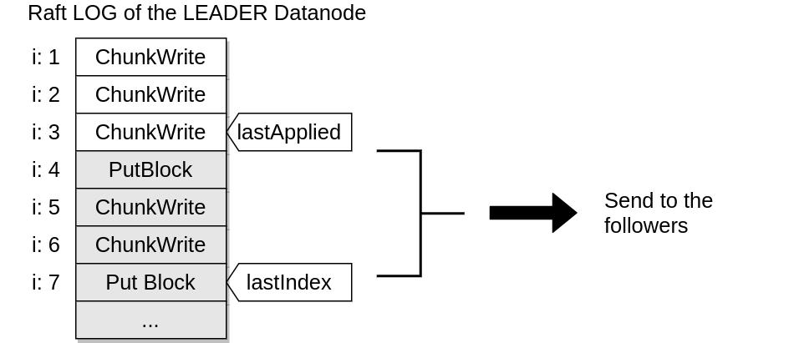

Slide 46
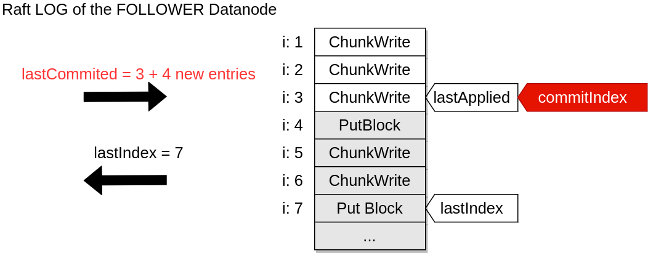

Slide 47
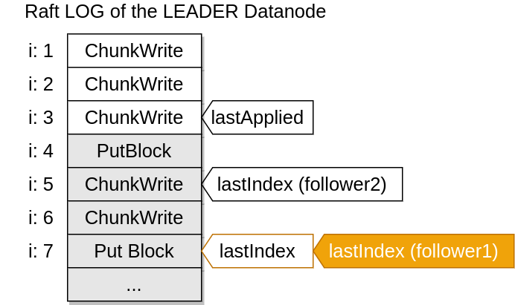

Slide 48
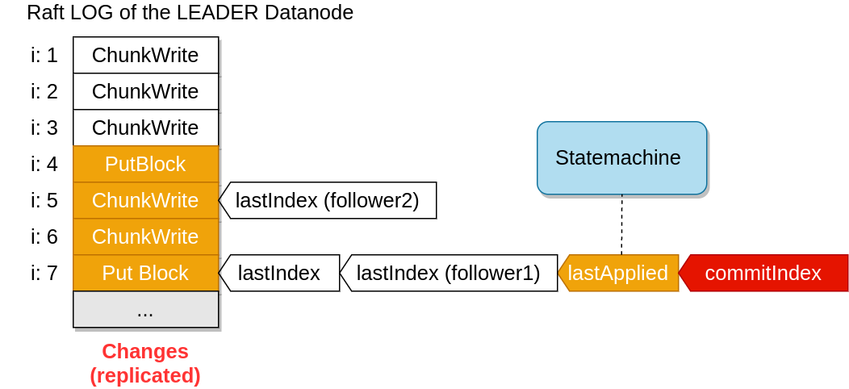

Slide 49
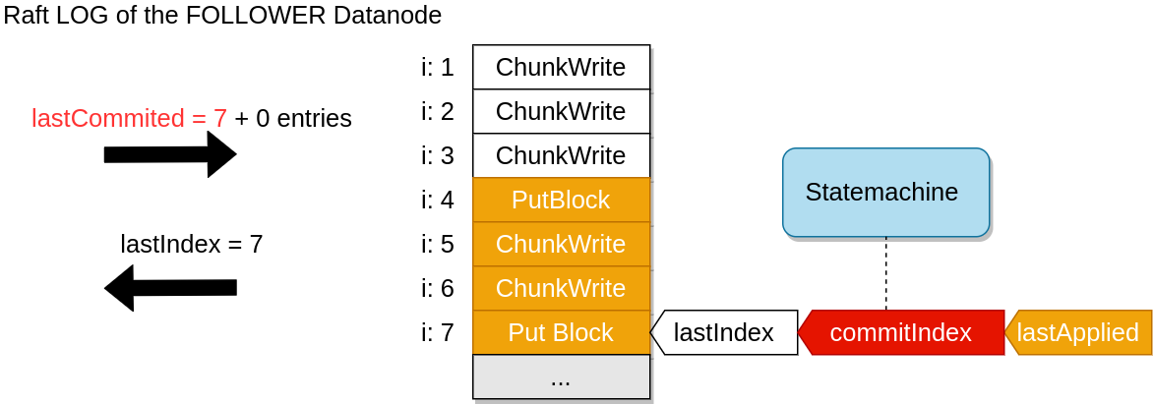

Slide 51
Apache Ratis (incubator)
RAFT implementation as a Java library
  Embeddable, pluggable protocol, statemachine,…
Support high performance with many optmization
Off the RAFT log data
  Metadata is saved to the Raft log, chunk data is not
  Multi Raft support (one datanode can be part of multiple raft ring)
  Batching and async processing

Slide 52
DN: persisted data
Per container directory
  Yaml file (metadata, verison, path,...)
  RocksDB:
    Key: LocalID
    Value:
      Map<String,String> (Generic metadata)
      List<ChunkInfo> (ChunkInfo: chunkName, length, blockOffset, checksum)
  Chunk data
    v1: 1 file per chunk
    v2: 1 file per block

Slide 53
+2 other services
Recon
  Web UI, prediction, analytics
S3 gateway
  stateless REST → Ozone RPC translator

Slide 54
Read / write path

Slide 55
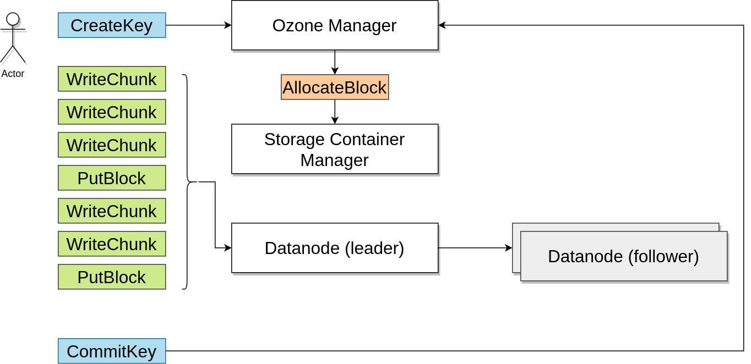
Write path

Slide 56
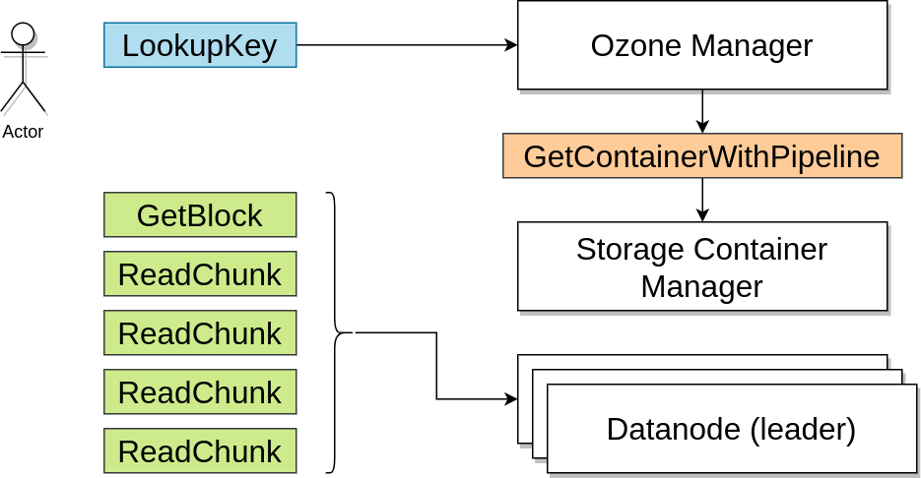
Read path

Slide 57
Use it!

Slide 58
S3 protocol
Hadoop FS
CSI
Apache Hadoop Ozone
hadoop.apache.org/ozone

Slide 59
Hadoop file system (new style)
ofs://
View to the whole keyspace
hdfs dfs -ls
o3fs://om:9862/vol1/bucket1/dir1/file1.txt
DistCp friendly

Slide 60
Hadoop file system (old style)
o3fs://
View to one specific bucket only!
hdfs dfs -ls o3fs://bucket1.volume1/dir1/file1.txt

Slide 61
S3 compatible REST api
Stateless gateway
  AWS S3 REST call → Ozone RPC call
All the important S3 endpoints are implemented, to use with
  Hadoop s3a
  AWS Cli
  S3 compatible FUSE file system (s3)
  Python based clients (boko)
  Go based clients

Slide 62
AWS Cli
aws s3api --endpoint http://localhost:9878 create-bucket –bucket=bucket1
aws s3cp --endpoint http://localhost:9878
README.txt s3://wordcount

Slide 63
Security

Slide 64
Security
HDFS security is based on Kerberos
  Kerberos cannot sustain the scale of applications running in a Hadoop Cluster.
HDFS relies on Delegation tokens and block tokens.
  Ozone uses the same, so applications have no change.
SCM comes with its own Certificate Authority.
  End users do NOT know about it.
Allows us to move away from the need of Kerberos setup for each data node. We need only Kerberos on OM and SCM.

Slide 65
Dev/ops experience

Slide 66
3…, 2…, 1…, UP!
10 secs from build to deploy
  Even a full secure cluster can be started locally
docker-compose based example clusters
  Working as documentation

Slide 67
Observability

Slide 68
Observability
Prometheus support
Distributed tracing support
Ozone Recon
  Web UI, historical data, prediction
Developer / admin tools
  “What’s going on”?

Slide 69
Recon
Separated component with SQL backend
Stores historical data
  From prometheus
  Snapshots from other services
  Receives Datanode heartbeats with reports
Can help to debug
Can predict problems (space usage?)
Can help to understand the current state

Slide 70
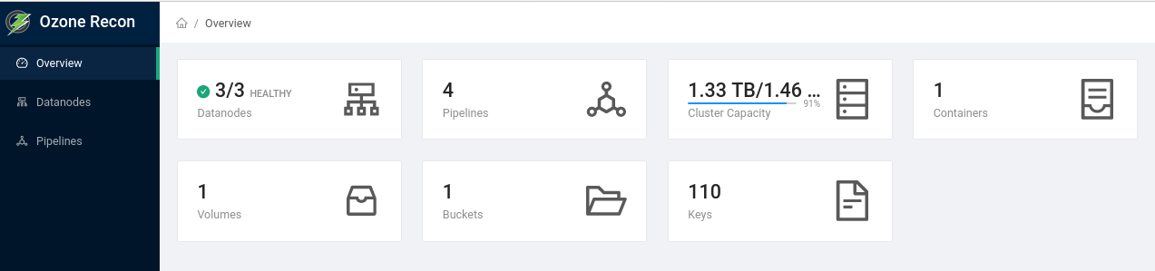
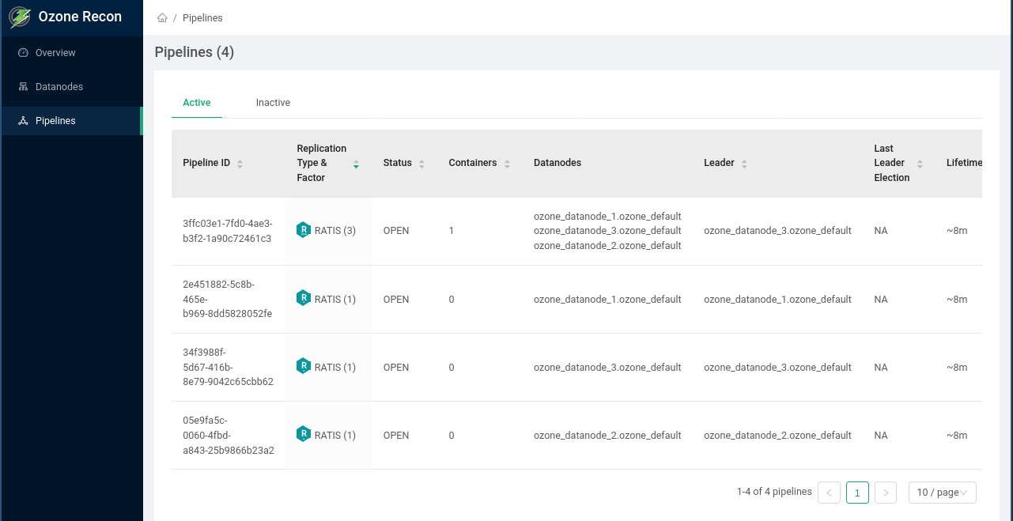

Slide 71
Ozone Insight
Command line tool to make debug easier
Profiles to define
  metrics
  logs
  configuration

Slide 72
Testing

Slide 73
Levels of testing
Acceptance tests
  Each PR is tested with full secure / unsecure clusters
MiniOzoneChaos test
Freon: load generator
Functional tests
  TPC-DS with Spark
  HBase test
Fault Injection
  Injected errors with Fuse File system
1 billion object key

Slide 74
Kubernetes support

Slide 75
Kubernetes support
Ozone  Kubernetes
  Ozone can be started quickly in K8s
  Easy way to run chaos / performance testing
  Tested in k8s / multiple configuration sets are provided
Kubernetes  Ozone
  Ozone provides storage for container orchestrator
  ozone csi service is a CSI service implementation

Slide 76
CSI (alpha !!!)
Container Storage Interface
  Standard to provide storage for container orchestrator
  Supported by Yarn, Kubernetes, Mesos, etc…
  A common language to request and mount storage
  Ozone CSI daemon

Slide 77
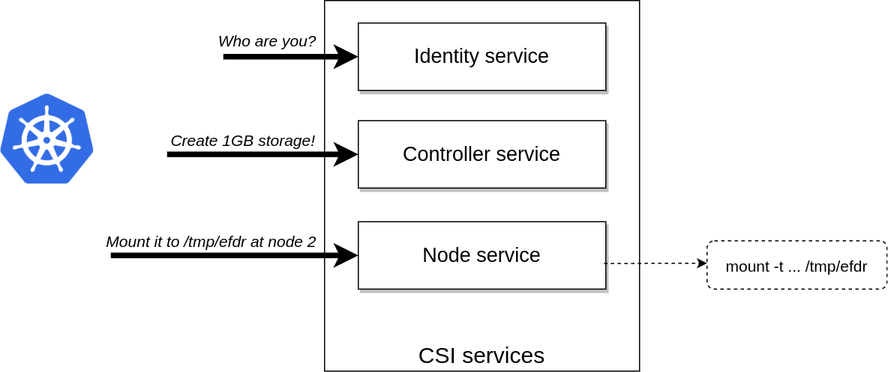
CSI

Slide 78
Use Ozone Storage as a FS
CSI is the easy part:
  Create storage
  Mount storage to a specific dir
Hard part: how to mount?

Slide 79
CSI: Mount options
Use S3 Fuse driver
  goofys → Ozone S3 gateway → Ozone cluster
  NFS → Ozone NFS gateway → Ozone cluster
  fuse driver → libhdfs → OzoneFileSystem → …

Slide 80
Ozone Operator?
Ozone has native Kubernetes support
  It doesn’t require to use an operator
Operator pattern doesn’t do gitops
  Most of the use cases can be covered by better tools

Slide 81
Summary

Slide 82
Other implemented features
TDA: encrypt data in rest
  Very similar to HDFS
GDPR support
  Right to be forgotten: Similar to TDE, but delete encryption key
Hadoop 2.7+ support (classoader magic)

Slide 83
Not (yet) implemented
SCM-HA (WIP)
Ereasure Coding (planning)
In-place Hdfs upgrade (planned)

Slide 84
Summary
Scalable (1 billion keys)
Multiple interfaces (Hadoop, S3, CSI)
Cloud native

Slide 85
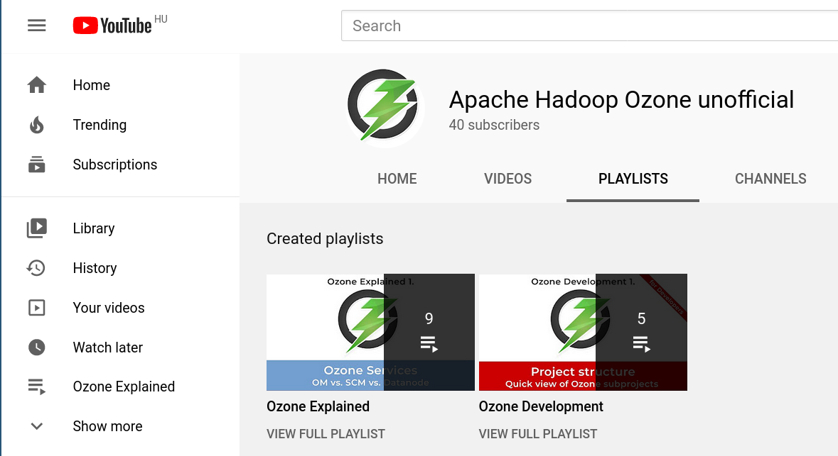
For more information:
SUBSCRIBE

Slide 86
For more information:
SUBSCRIBE

Slide 87
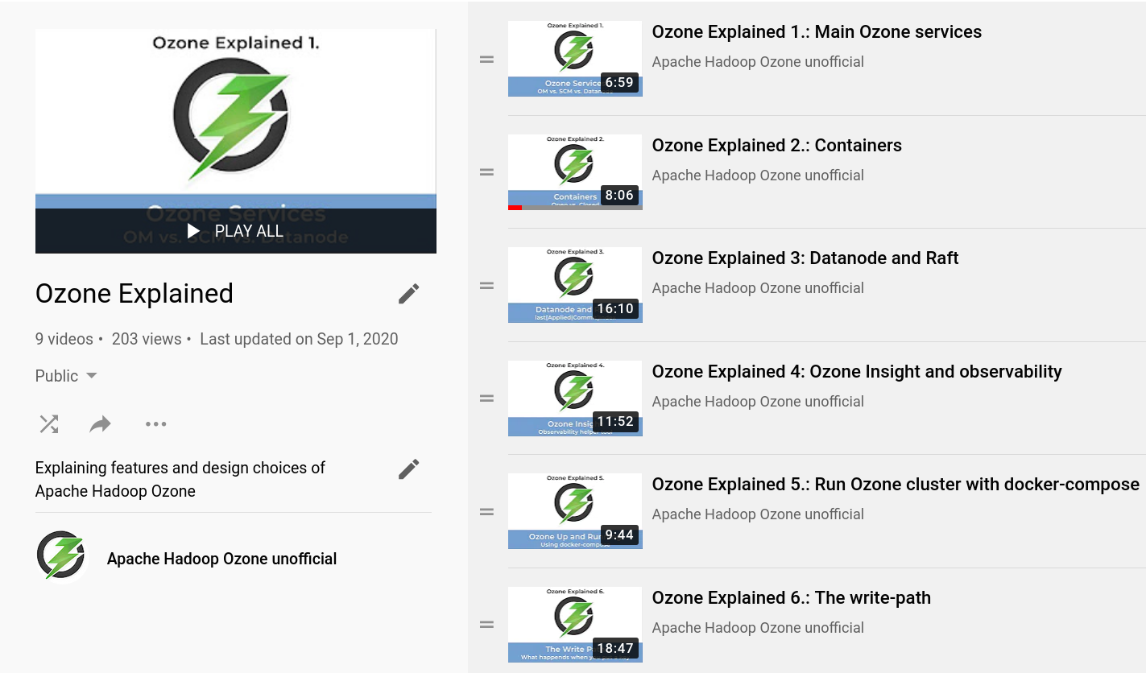

Slide 88
S3 protocol
Hadoop FS
CSI
Apache Hadoop Ozone
hadoop.apache.org/ozone

