Slide 1

Ozone Explained 12.
Security I.
SCM as CA authority

Slide 2




S3 protocol
Hadoop FS
CSI
Apache Hadoop Ozone
hadoop.apache.org/ozone

Slide 3
S3 protocol
Hadoop FS
CSI
Apache Hadoop Ozone
hadoop.apache.org/ozone

Slide 4
S3 protocol
Hadoop FS
CSI
Apache Ozone
ozone.apache.org

Slide 5
RPC communication
RPC type | Communication | Auth method
Hadoop RPC | server → server | kerberos or token
Hadoop RPC | client → server | kerberos or token
GRPC | server → server | mTLS
GRPC | client → server | token (block token)

Slide 6
Hadoop token
token := info + secret
secret can be:
  shared secret
  signature (Ozone)

Slide 7
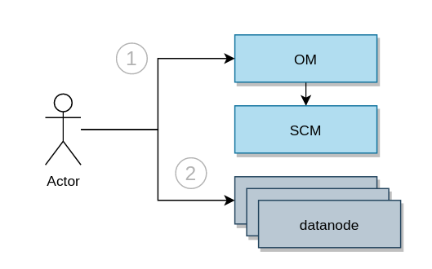
Why token?

Slide 8
SCM is a CA authority
Every service has pub/priv key (signed by SCM)
Messages signed by these keys can be trusted
RPC type | Communication | Auth method
GRPC | server → server | mTLS
GRPC | client → server | token (signed info)

Slide 9
S3 protocol
Hadoop FS
CSI
Apache Ozone
ozone.apache.org

