Slide 1

Ozone Explained 13.
Security II.
Security of the stateless S3 gateways

Slide 2




S3 protocol
Hadoop FS
CSI
Apache Ozone
ozone.apache.org

Slide 3
Warning
Check HDDS-4440 (!)

Slide 4
RPC communication
RPC type | Communication | Auth method
Hadoop RPC | server → server | kerberos or token
Hadoop RPC | client → server | kerberos or token
GRPC | server → server | mTLS
GRPC | client → server | token (block token)

Slide 5
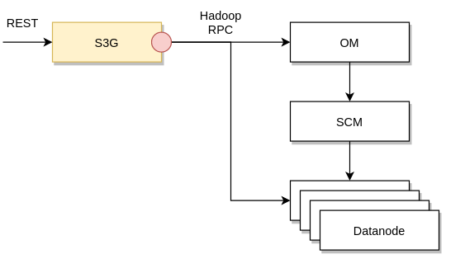

Slide 6
S3 gateway
ozone s3 getsecret
  (kerberos → AWS auth)
S3 gateway is stateless
Ozone token has two flavors
  (S3 auth vs delegation)

Slide 7
S3 protocol
Hadoop FS
CSI
Apache Ozone
ozone.apache.org

