Slide 1

Ozone Explained 14.
GDPR support
Async delete vs “right to be forgotten”

Slide 2
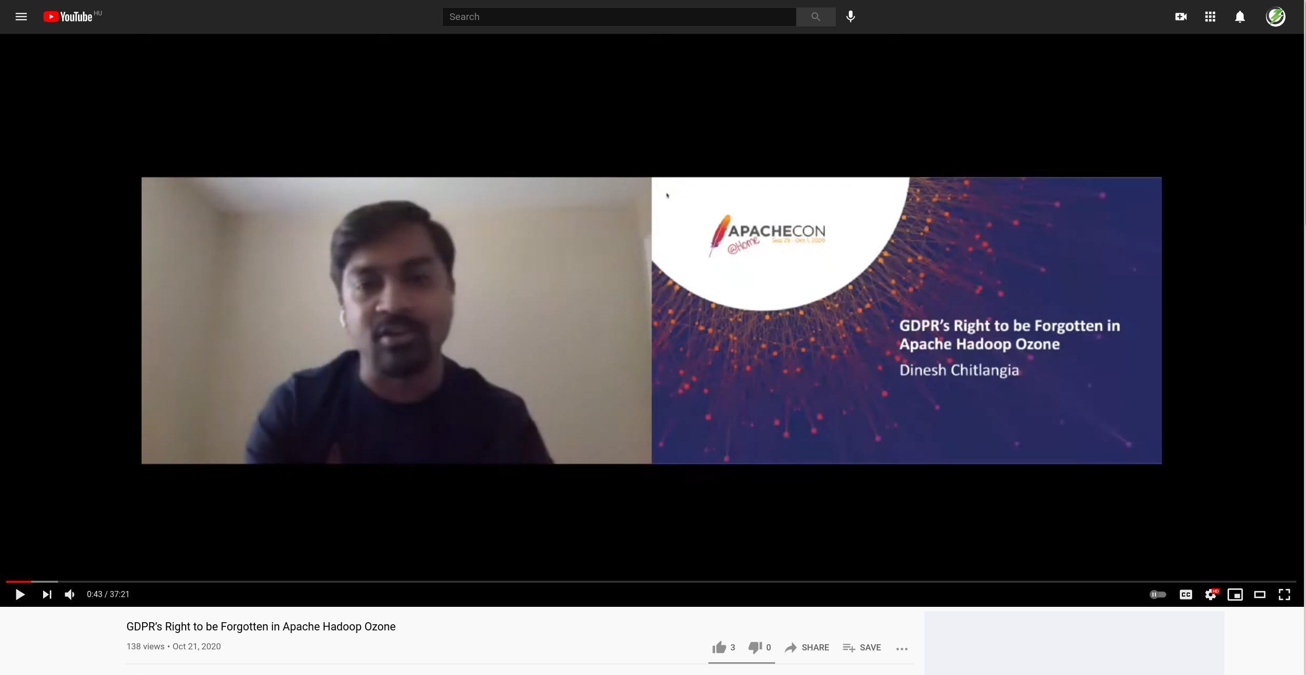
https://www.youtube.com/watch?v=mISCTU-cqt8

Slide 3




S3 protocol
Hadoop FS
CSI
Apache Ozone
ozone.apache.org

