Slide 1

Ozone Explained 11.
Ozone Classpath
How to manage JVM classpath for Ozone

Slide 2
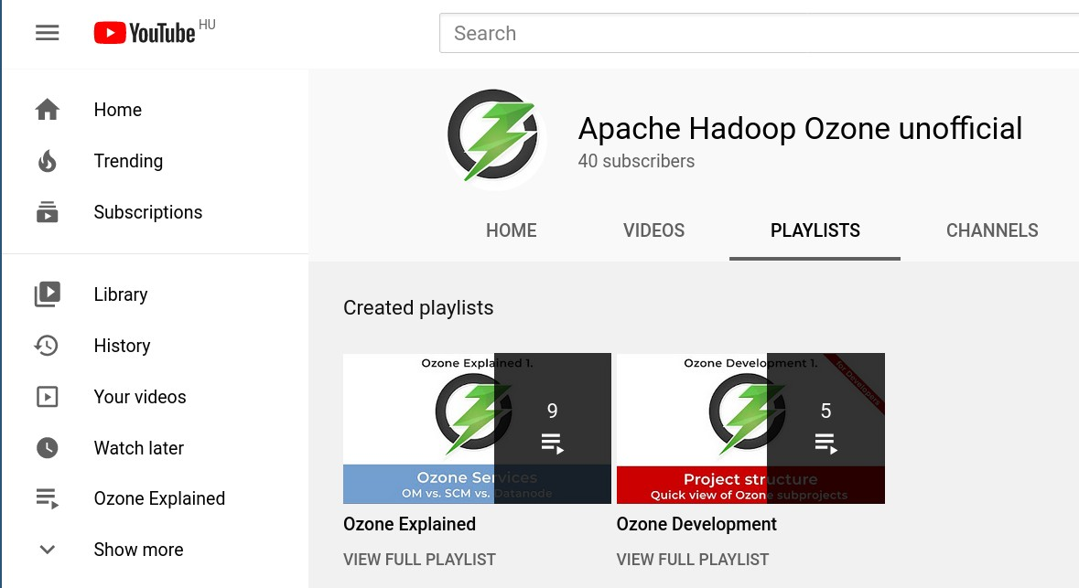

For more information:
●

Slide 3
Ozone Explained 11.
Ozone Classpath
How to manage JVM classpath for Ozone

Slide 4
Ozone classpath
Exactly the same as the mvn classpath
  project level definition included in the artifacts
Project level classpath separation
  ozone-classpath is project level
  Do not use CLASSAPTH=ozone/share/ozone/lib*
HADOOP_CLASSPATH is supported
  You can also create share/ozone/libs/<project_name>
If you need client anywhere (Spark, Flink, Kafka,...):
  hadoop-ozone-filesystem-hadoop3.jar

Slide 5




S3 protocol
Hadoop FS
CSI
Apache Hadoop Ozone
hadoop.apache.org/ozone

