Slide 1
Apache
Big-Data
Apache
Big-Data
Cloud- native

Slide 2
USABILITY
+COLLABORATION

Slide 3
Agenda
Border area
[DEMO] Recycling YAML files
Cars and washing machines
[DEMO] Collaboration and Usability

Slide 4

Márton Elek
Apache Hadoop/Ratis PMC
  elek@apache.org
Cloudera
  Principal software engineer
twitter.com/@anzix
Ozone:
  Ozone Explained (Youtube)
Kubernetes + Apache Bigdata:
  github.com/elek/flekszible
  flokkr.github.io

Slide 5
Márton Elek
Apache Hadoop/Ratis PMC
  elek@apache.org
Cloudera
  Principal software engineer
twitter.com/@anzix
Ozone:
  Ozone Explained (Youtube)
Kubernetes + Apache Bigdata:
  github.com/elek/flekszible
  flokkr.github.io

Slide 6
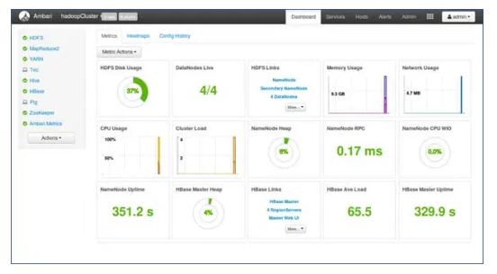
How to manage cluster?

Slide 7
Borders

Slide 8
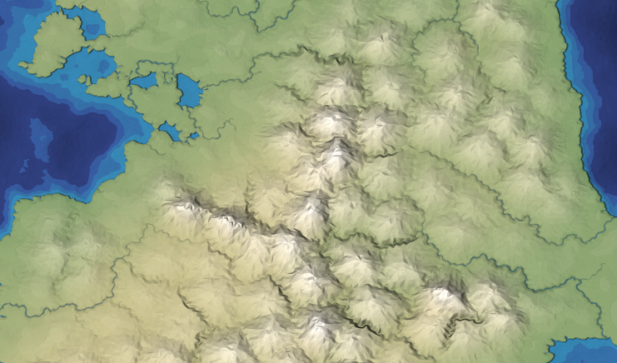


Nobody’s land

Slide 9
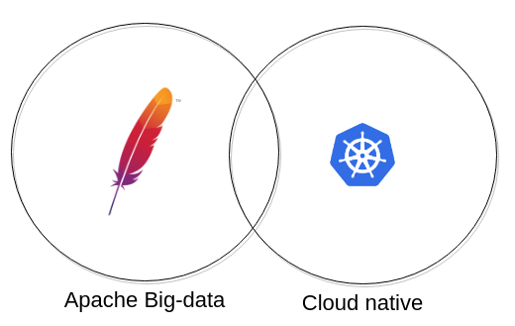

Slide 10
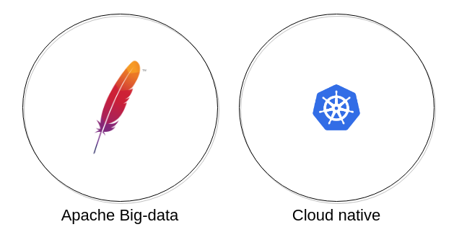

Slide 12
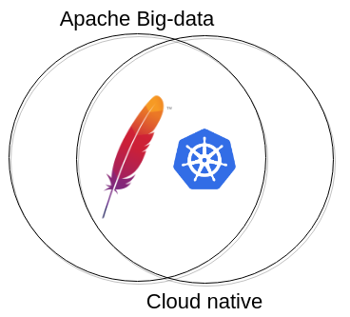

Slide 13
Cloud-native

Slide 14
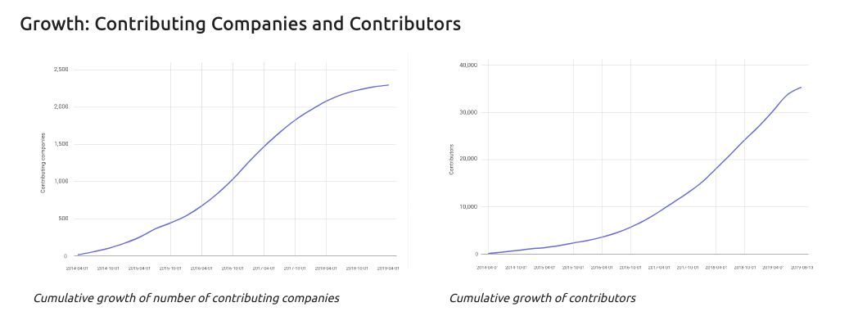
Why is it so popular?
`

Slide 15
Why is it so popular?
Good low level design
Flexible and generic api
  apiVersion/kind → CRUD
YAML files everywhere
→ Very popular

Slide 16
COLLABORATION

Slide 17
Apache Big-data

Slide 18
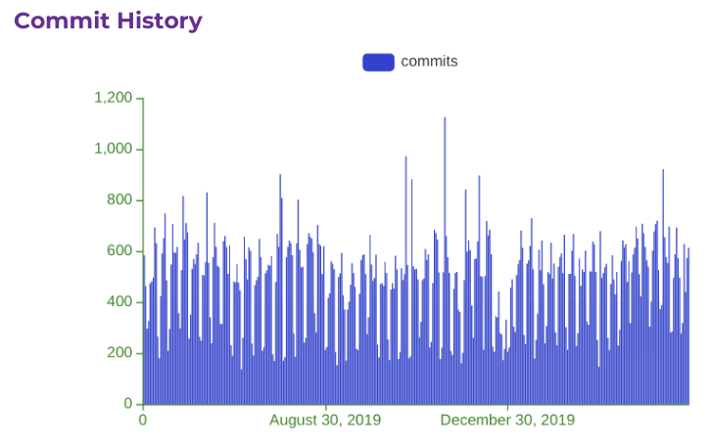
Apache ...

Slide 19
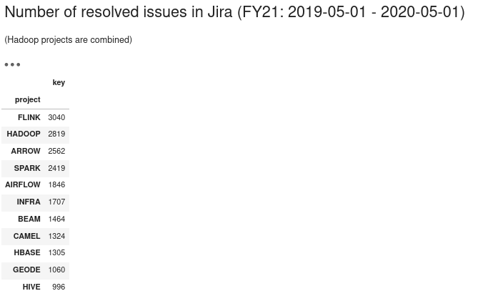
Apache … Big-Data

Slide 20
Apache Big-data ecosystem
It’s an ecosystem
  Collaboration is in the genes
Hadoop compatible file system
  Used by Spark, Flink, Hive, Hbase…
Hadoop RPC/Configuration
  Used by many projects

Slide 21
COLLABORATION

Slide 22
Nobody is an island
Most of big-data projects used together with others
  Kafka alone?, Spark alone?
There are only a few meta-project
  Apache Ambari: cluster management
  Apache Bigtop: packaging in the same way

Slide 23
COLLABORATION?

Slide 24
Collaboration
Why don’t we have more collaborative, meta-projects?
Projects are complex and hard to configure them
  Complexity is increasing with each project
Can K8s help in the collaboration?

Slide 25
USABILITY?

Slide 26
Recycling

Slide 27
K8s resource management?
Helm
  No real collaboration, not flexible
Kustomize
  Transformations are not re-usable
Any new tool?
  Reusable components + transformations

Slide 28
github.com/elek/flekszible
Kubernetes Yaml file manager
  Reusable k8s files
  Reusable transformations (!!!)
→ Final cluster definition

Slide 29
DEMO

Slide 30
flokkr.github.io
Docker images for Apache big-data projects
Reusable k8s files + transformations!!
Did we solve all the problems:
  COLLABORATION: DONE
  USABILITY: ???

Slide 31
Config granularity

Slide 32
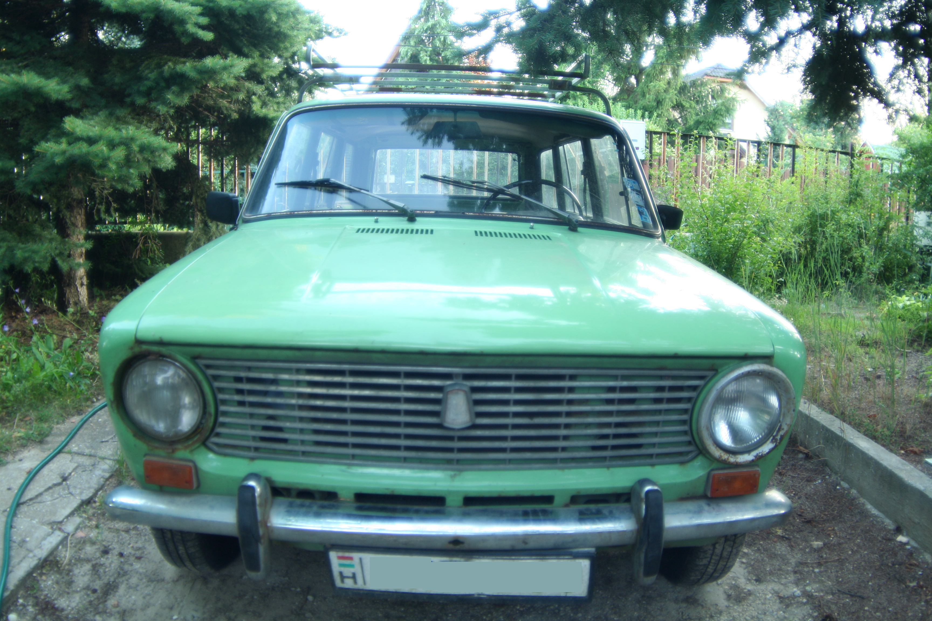

Slide 33
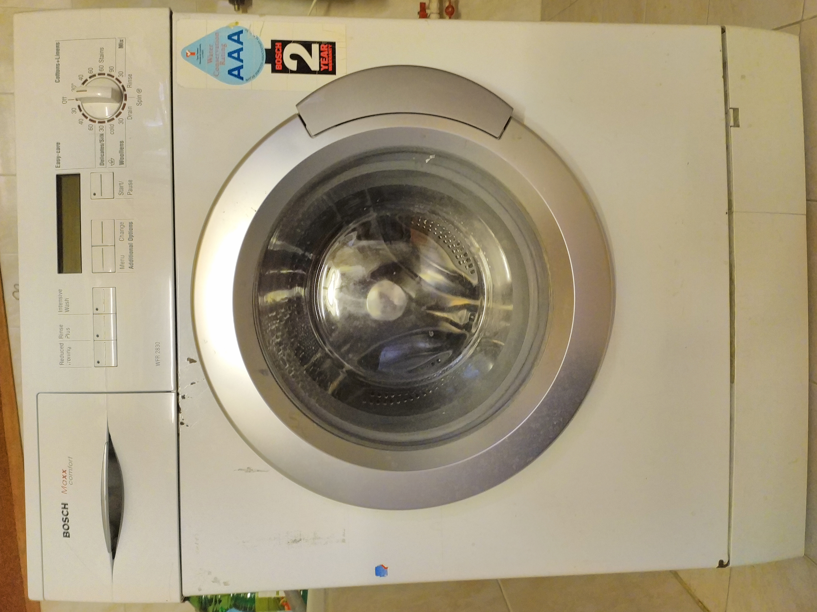

Slide 34
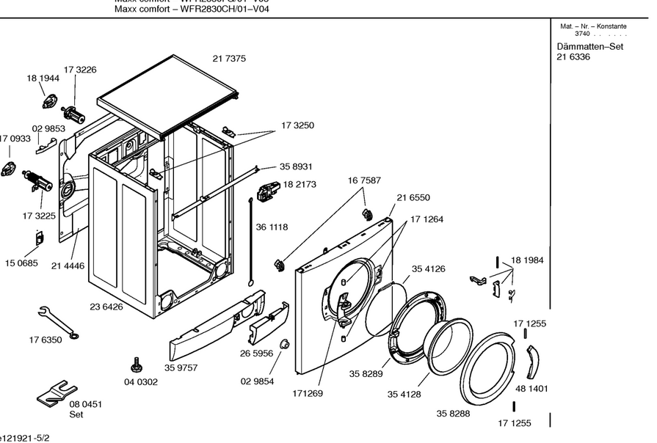

Slide 35
Usability
The challenge is to find the right abstraction level
  [Top] Give me a secure HDFS+Kafka
  ???
  [Bottom]: HDFS-SITE.XML_dfs.checksum.type: "NULL"

Slide 36
Cluster management

Slide 37
How to manage cluster?

Slide 38
COLLABORATION
+USABILITY

Slide 39
DEMO

Slide 40
Summary
Kubernetes is a good tool to improve Collaboration with increased Usability
But we need good tool with the good abstraction
New Apache “meta-projects” can be useful
  → Incubator? (if interested → elek@apache.org)

Slide 41
Márton Elek
elek@apache.org
twitter.com/anzix
Ozone:
  Ozone Explained (Youtube)
Kubernetes + Apache Bigdata:
  github.com/elek/flekszible
  flokkr.github.io

