Slide 1

Apache Hadoop Ozone
How to loose data
In a safe way

Slide 2
DATA+SCIENCE

Slide 3
DATA+SCIENCE

Slide 4
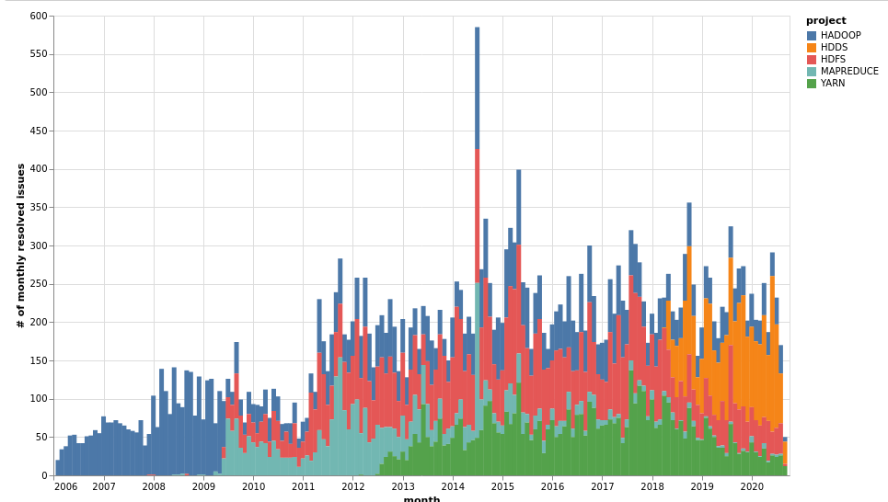
Apache Hadoop
Since 2006
Big-data for everyone: on commodity hardware
Storage: HDFS
Still popular
and used

Slide 5
World has changed (2020)
Scalability? Small files problem?
  2006: Hadoop is designed for Huge files
  2020: Streaming → small files → ?
Usability
  Hadoop is an ecosystem (Spark, Hive, Flink…)
  How to use it from ML? From Python?

Slide 6




S3 protocol
Hadoop FS
CSI
Apache Hadoop Ozone
hadoop.apache.org/ozone

Slide 7
DATA+SCIENCE

Slide 8
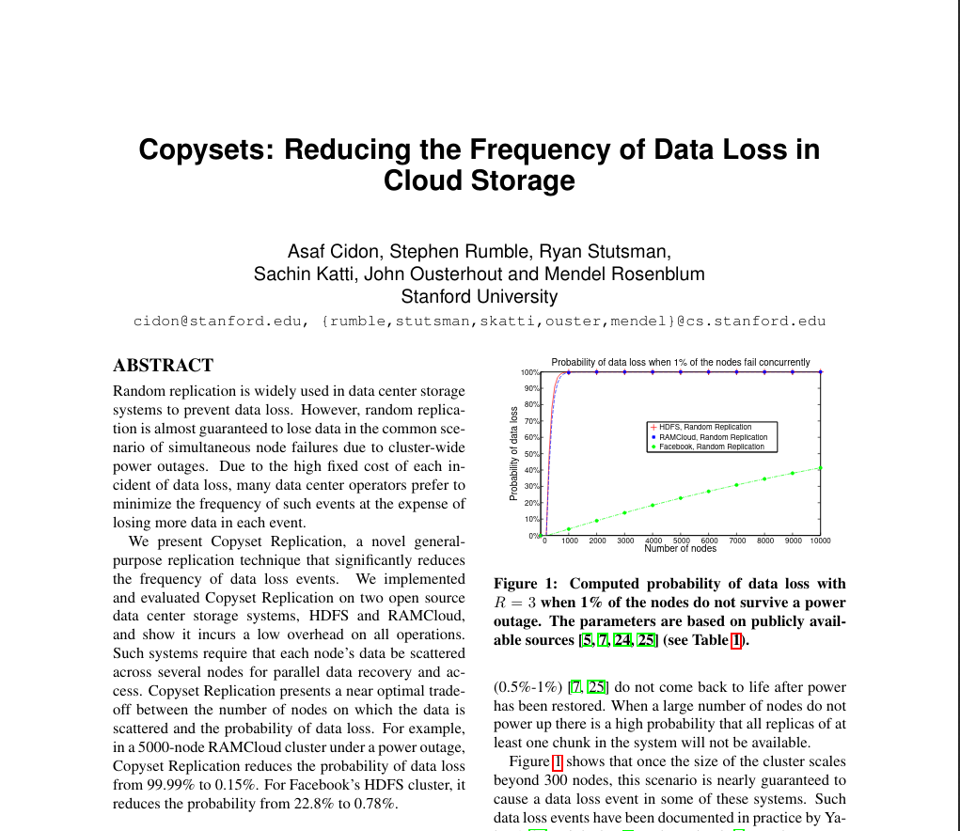
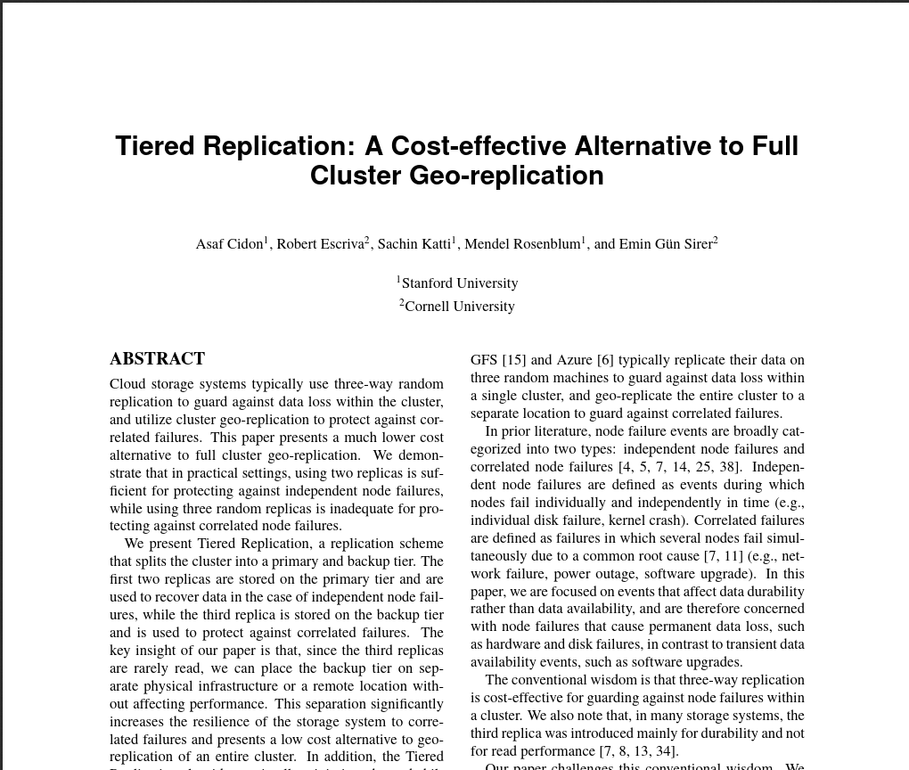
Copysets + Tiered replications

Slide 9
Copy sets + Tiered replications
https://web.stanford.edu/~skatti/pubs/usenix13-copysets.pdf
https://www.usenix.org/system/files/conference/atc15/atc15-paper-cidon.pdf

Slide 10
What can go wrong?

Slide 11
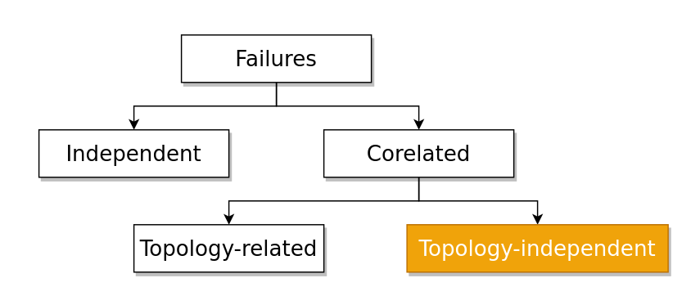
Failure types

Slide 12

How to Store files?

Slide 13
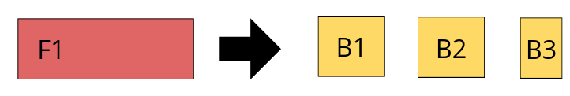
Replication: split the files

Slide 14
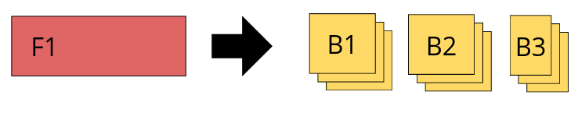
Replication: split the files

Slide 15
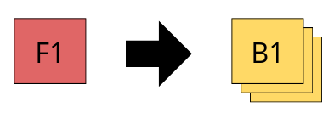
Replication: split the files

Slide 16
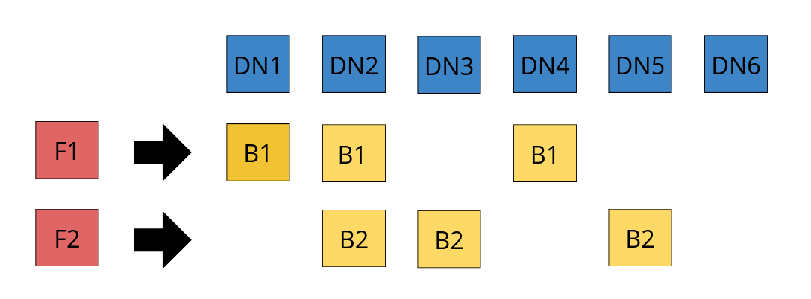
Replicate 2 files → RANDOM

Slide 17

Random failures

Slide 18
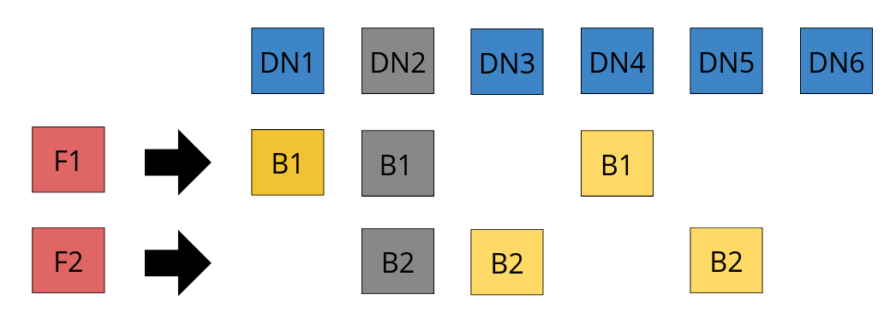
Datanode 2 → failed

Slide 19
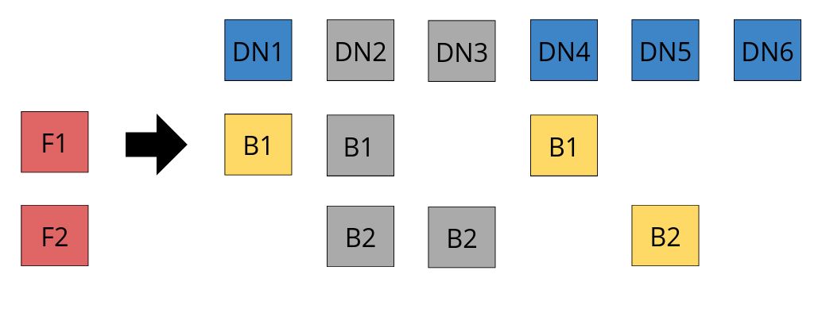
Datanode 2 → failed

Slide 20
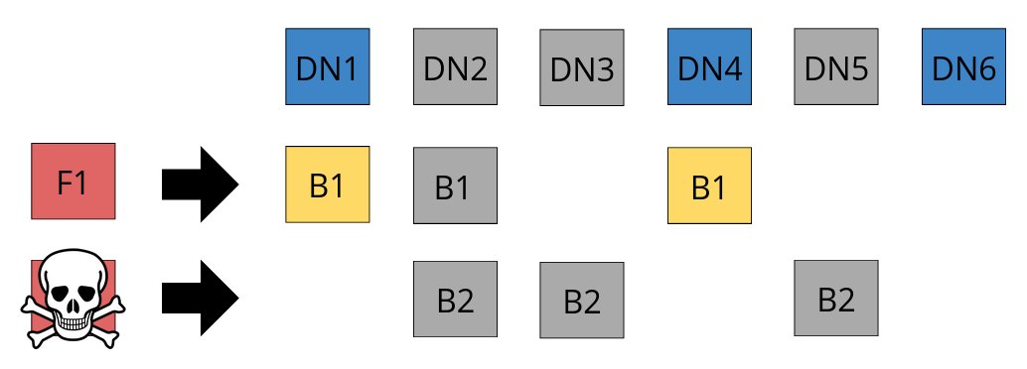
Datanode 5 → failed

Slide 21
Buy more hardware?

Slide 22

Math: random replication
6 datanodes → 20 different 3-node set:
  [1 2 3] [1 2 4]…..[3 4 6] [4 5 6]
2000 blocks (20 * 100)
  [1 2 3] --> ~100 blocks
  [1 2 4] --> ~100 blocks
  ...

Slide 23
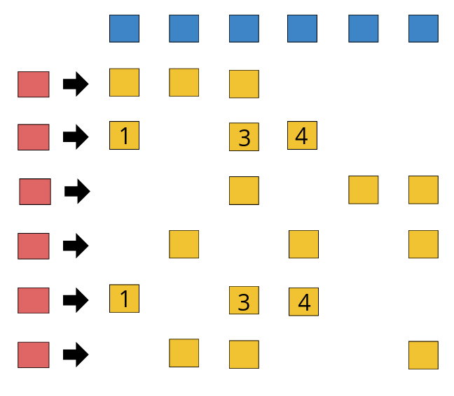

Slide 24
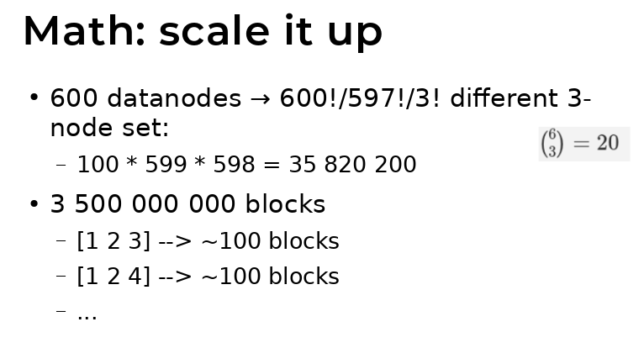

Kill 3 datanode randomly
[1 2 3] → data loss (100 blocks)

Slide 25
Kill 3 datanode randomly
[1 2 3] → data loss (100 blocks)
[3 5 6] → data loss (100 blocks)

Slide 26
Kill 3 datanode randomly
[1 2 3] → data loss (100 blocks)
[3 5 6] → data loss (100 blocks)
[2 4 6] → data loss (100 blocks)

Slide 27

Math: scale it up
600 datanodes → 600!/597!/3! different 3-node set:
  100 * 599 * 598 = 35 820 200
3 500 000 000 blocks
  [1 2 3] → ~100 blocks
  [1 2 4] → ~100 blocks
  …
  [234 248 652] → ~100 blocks

Slide 28
Kill 3 datanode randomly
[1 2 3] → data loss (100 blocks)
[23 3125 236] → data loss (100 blocks)
[232 234 126] → data loss (100 blocks)

Slide 29
Let’s try sg different

Slide 30
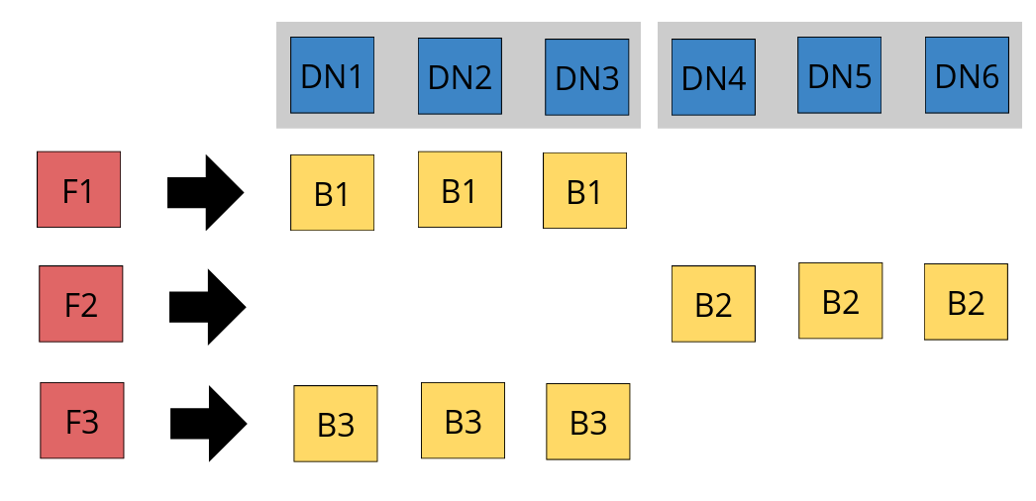

Slide 31
Math: 2 group replication
6 datanodes → 2 different 3-node set:
  [1 2 3] [4 5 6]
2000 blocks
  [1 2 3] → ~1000 blocks
  [4 5 6] → ~1000 blocks

Slide 32
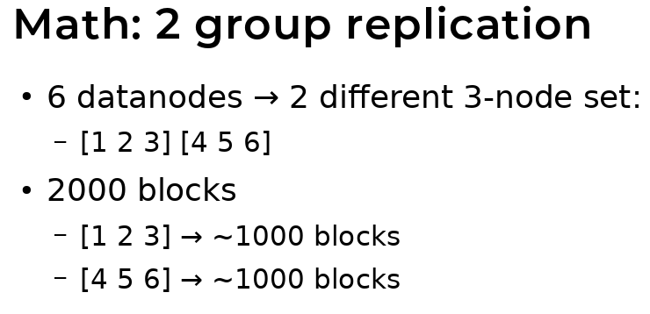
Kill 3 datanode randomly
[3 5 6] → no problem

Slide 33
Kill 3 datanode randomly
[3 5 6] → no problem
[2 4 6] → no problem

Slide 34
Kill 3 datanode randomly
[3 5 6] → no problem
[2 4 6] → no problem
[1 2 4] → no problem

Slide 35
Kill 3 datanode randomly
[3 5 6] → no problem
[2 4 6] → no problem
[1 2 4] → no problem
[1 2 3] → data loss

Slide 36
2 groups
random
datanodes: 6
copysets: 2
changes to dataloss: 2:20
blocks in sets: ~1000
datanodes: 6
copysets: 20
changes to dataloss: 20:20
blocks in sets: ~100

Slide 37
2 groups
random
10 % chance
50 % loss
100 % chance
10 % loss

Slide 38
Any problem?

Slide 39
Random replication: recovery
If only ONE node is failed (1)
[(1) 2 3] copy blocks from ← 2 3
[(1) 2 4] copy blocks from ← 2 4
[(1) 2 5] copy blocks from ← 2 5
...

Slide 40
Group replication: recovery
If only ONE node is failed (1)
[(1) 2 3] copy blocks from ← 2 3
[4 5 6] → HEALTHY

Slide 41
Next try...

Slide 42
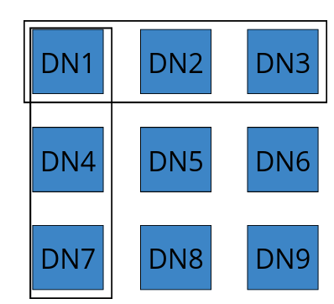
Copysets
6 groups (9 nodes!):
  [1 2 3]
  [4 5 6]
  [7 8 9]
  [1 4 7]
  [2 5 8]
  [3 6 9]

Slide 43
Copysets
Chance to loose data:
  6:84 (9 node): 7 %
Source for replication:
  4 datanodes

Slide 44
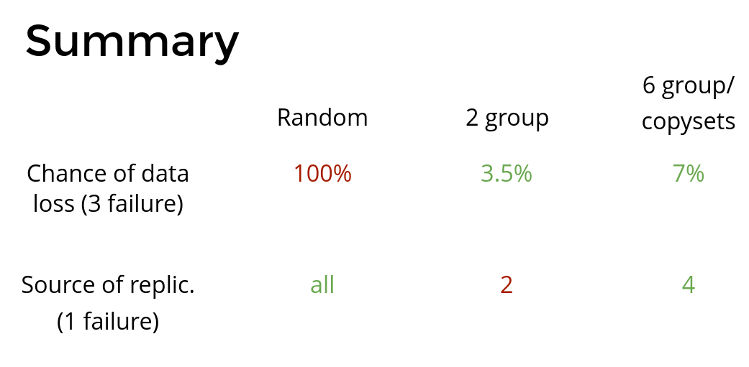

Slide 45
S3 protocol
Hadoop FS
CSI
Apache Hadoop Ozone
hadoop.apache.org/ozone

Slide 46

Elek Márton
Cloudera
  Pricipal software engineer
elek@apache.org
twitter.com/anzix
Ozone:
  Ozone Explained (Youtube)
Kubernetes + Apache Bigdata:
  github.com/elek/flekszible
  flokkr.github.io

