Slide 1

Hadoop Storage Reloaded
5 lessons Ozone learned from HDFS

Slide 2




S3 protocol
Hadoop FS
CSI
Apache Hadoop Ozone
hadoop.apache.org/ozone

Slide 3

Márton Elek
Hadoop PMC, Ratis PMC
Cloudera
  Principal software engineer
twitter.com/@anzix
Kubernetes + Apache Big-data:
  github.com/elek/flekszible
  flokkr.github.io

Slide 4
Hadoop storage

Slide 5
Why?
First release of Hadoop: 2006
2020: We are living in a different word
Streaming? Cloud?
→ small files
Machine Learning? Cloud-native tools?
→ Hadoop Compatible File System API may not enough

Slide 6
Hadoop Storage
HDFS

Slide 7
Hadoop Storage
HDFS
HCFS cloud connectors

Slide 8
Hadoop Storage
HDFS
small files ??
using from ML/Data science / s3 ??
HCFS cloud connectors
Consitency ??
On-prem ??

Slide 9
History.md
Started as a feature branch in Hadoop
Merged in 2018 to Hadoop trunk
  Built by optional profile
  Separated release lifecycle
  Separated subproject (“HDDS”)
2019 Q4: Moved to a separated git repostory (apache/hadoop-ozone)
2020.03: First beta release
2020.09 Ozone 1.0.0
2020.10 Vote: Apache Hadoop Ozone

Slide 10
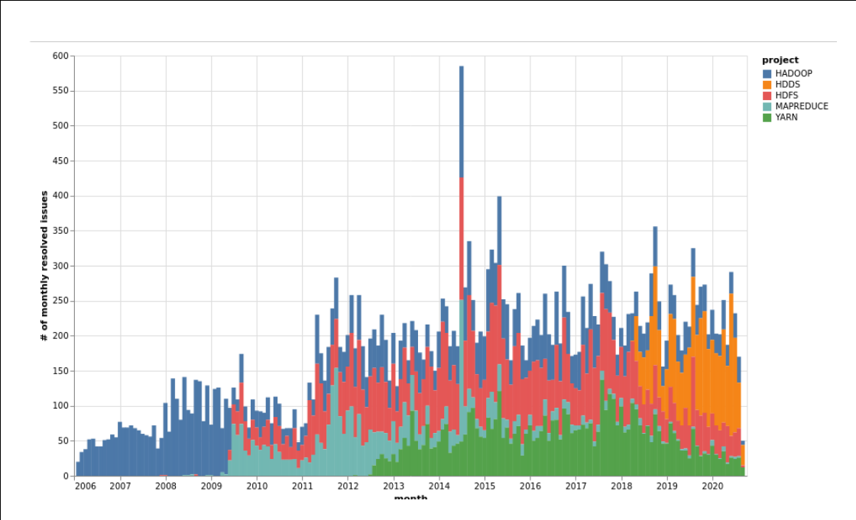

Slide 11

Apache Hadoop Ozone
SCALEABILITY
1 billion keys?
DONE
USABILITY

Slide 12

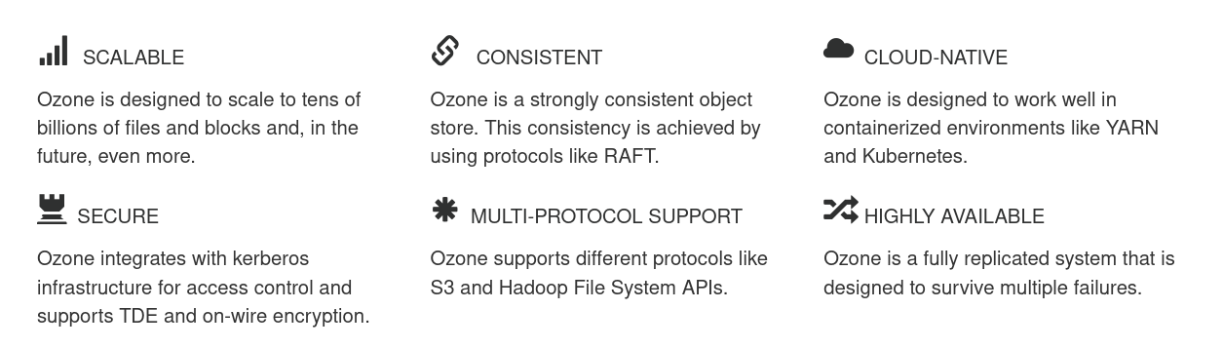
Apache Hadoop Ozone
Ozone is a scalable, redundant, and distributed object store for Hadoop

Slide 13
“Ozone is a
spiritual successor
to HDFS”

Slide 14
Five differences?

Slide 15
1
Key/blockspace

Slide 16

How to Store files?

Slide 17
How to Store files?
File → Block[]
Block → Datanode[]

Slide 18
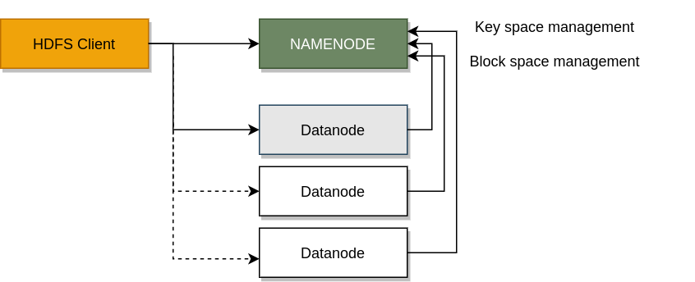
How to Store files?
File → Block[]
Block → Datanode[]

Slide 19
HDFS components

Slide 20
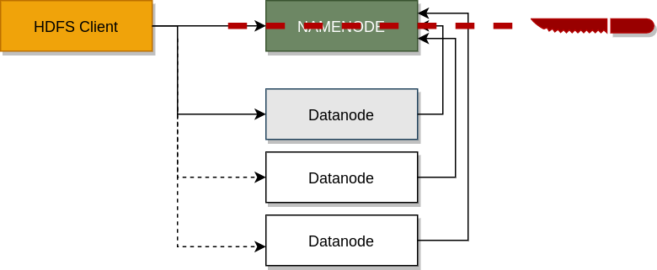
Separate key / block space management

Slide 21

Ozone components

Slide 22

Ozone components (full picture)

Slide 23
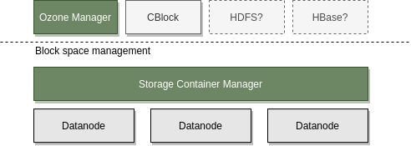
Original Vision
Use block layer by other applications not just for Object Store

Slide 24

Ozone Layers

Slide 25
2
Unit of replication

Slide 26
Small files problems
The legendary problem with HDFS
Limits:
  <~2-300 million files
  <~3-500 million files with Hadoop dev

Slide 27
Why is this limit?
Each file requires at least one new block
Each block is replicated in an independent way
Replication reported back to Namenode:
  network traffic
  memory pressure

Slide 28

Replicate conatainers
Container is the unit of replication
Multiple blocks are replicated and reported together

Slide 29
Separate key / block space management

Slide 30
Ozone components

Slide 31
3
Replication

Slide 32
Don’t re-invent
THE WHEEL

Slide 33
How to replicate
We need to replicate two types of data
  DATA
  metadata
Ozone uses standard replication mechanism: Raft

Slide 34
Raft
“Raft is a consensus algorithm for managing a replicated log”
“Raft more understandable than Paxos and also provides a better foundation for build-ing practical systems”

Slide 35
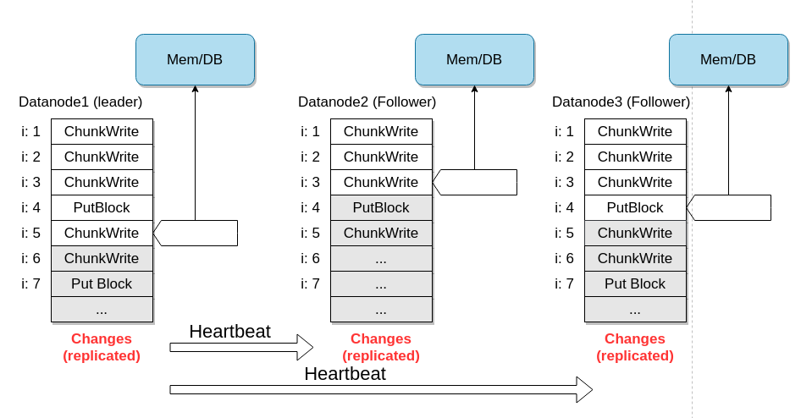

Slide 36
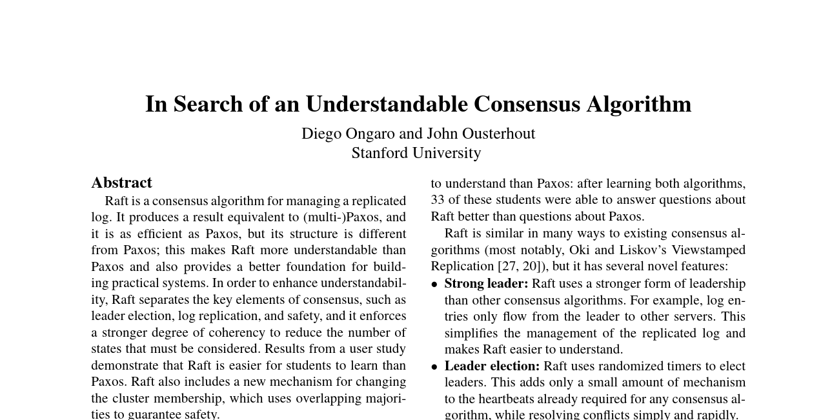

Slide 37
Apache Ratis (Incubator)
Embeddable (!) RAFT implementation
Pluggable
  pluggable transport, state machine
High performance
  Advanced batching, ad-hoc heartbeats
Used in:
  datanode groups (pipelines)
  HA (leader nodes: SCM, OM)

Slide 38
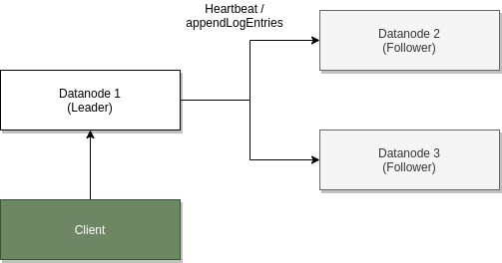

Slide 39
3
Persistence

Slide 40
STORAGE=
DATA+METADATA

Slide 41
How to persist metadata?
Store everything in the memory?
  Memory is a hard limit
Store in external database?
  Additional complexity
Memory and/or local store?
  Using fast local store and/or memory

Slide 42
Don’t re-invent
THE WHEEL

Slide 43
RocksDB
Well tested local key value store
Fork of LevelDb
Based on log-structured merge trees
Widely used (MySQL, Mongo, ...)
Don’t need to keep everything in the memory

Slide 44
5
Usability

Slide 45
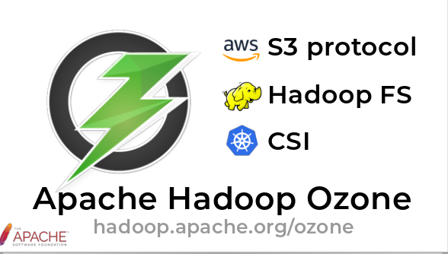
How to ….?
Start
  cd compose/ozone && docker-compose up
Use it from different apps
  S3 + HCFS + CSI
Devtools & Ops tools
  config tags and groupping

Slide 46
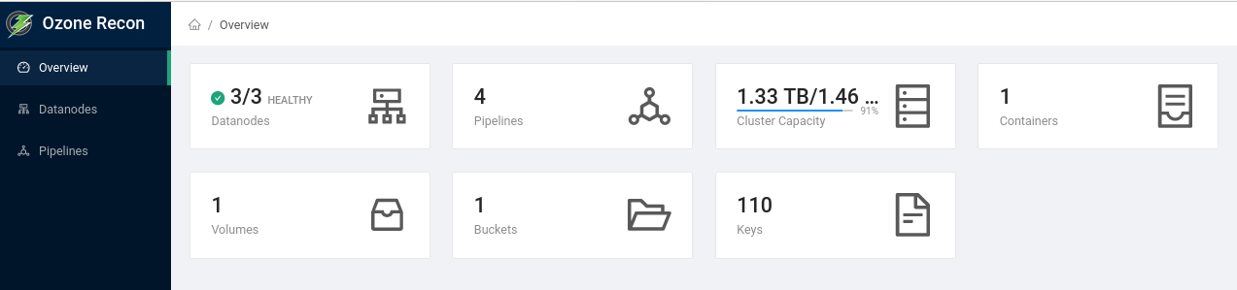
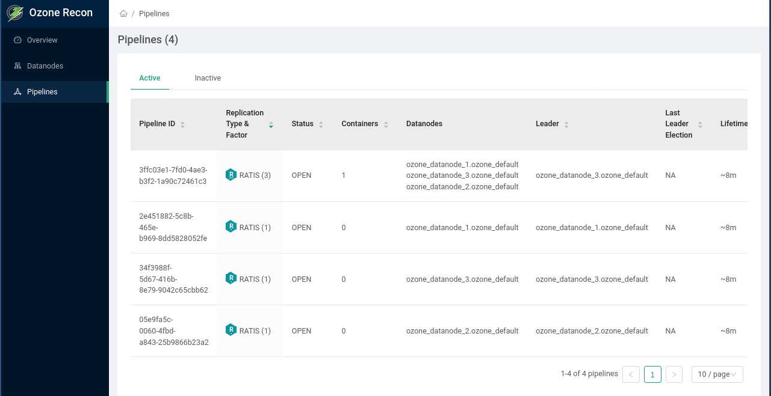

Slide 47
S3 protocol
Hadoop FS
CSI
Apache Hadoop Ozone
hadoop.apache.org/ozone

Slide 48
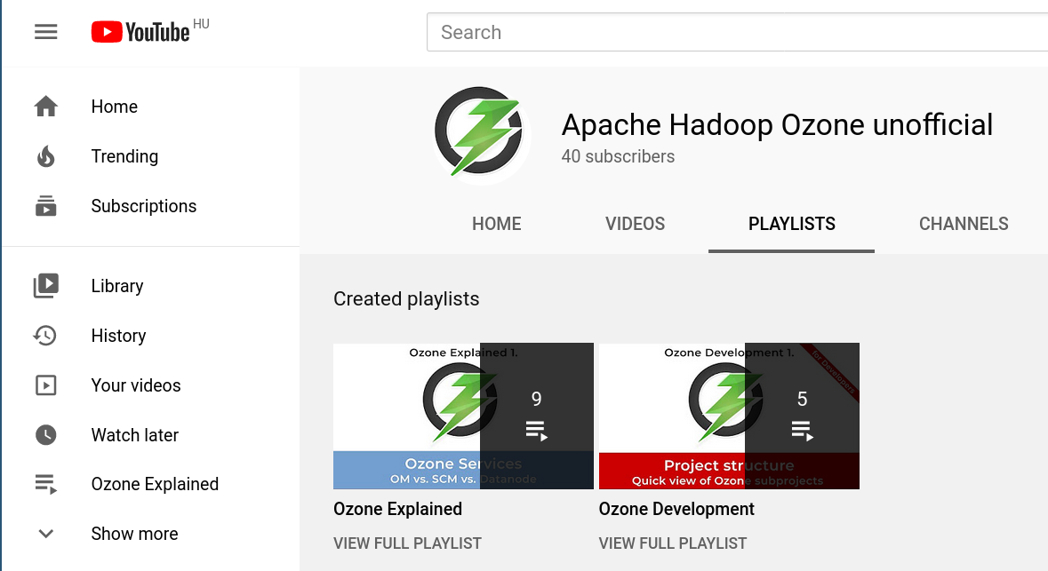
For more information:
SUBSCRIBE

Slide 49
?
Q&A

Slide 50
Márton Elek
elek@apache.org
twitter.com/anzix
Kubernetes + Apache Bigdata:
  github.com/elek/flekszible
  flokkr.github.io

