Slide 1
Beyond bus-factor data-visualizations and algorithms to better understand Apache communities

Slide 2
What’s going on?

Slide 3
What’s going on?
(in the community)

Slide 4


Márton Elek
Apache Ozone /Hadoop/Ratis PMC
  elek@apache.org
twitter.com/@anzix
Ozone:
  Code and Console (Youtube)
  Ozone Explained (Youtube)
Kubernetes + Apache Bigdata:
  github.com/elek/flekszible
  flokkr.github.io

Slide 5




S3 protocol
Hadoop FS
CSI
Apache Hadoop Ozone
ozone.apache.org

Slide 6
The "bus factor" is the minimum number of team members that have to suddenly disappear from a project before the project stalls due to lack of knowledgeable or competent personnel.
(Wikipedia)

Slide 7


Slide 8


Slide 9
Bus Leave factor

Slide 10
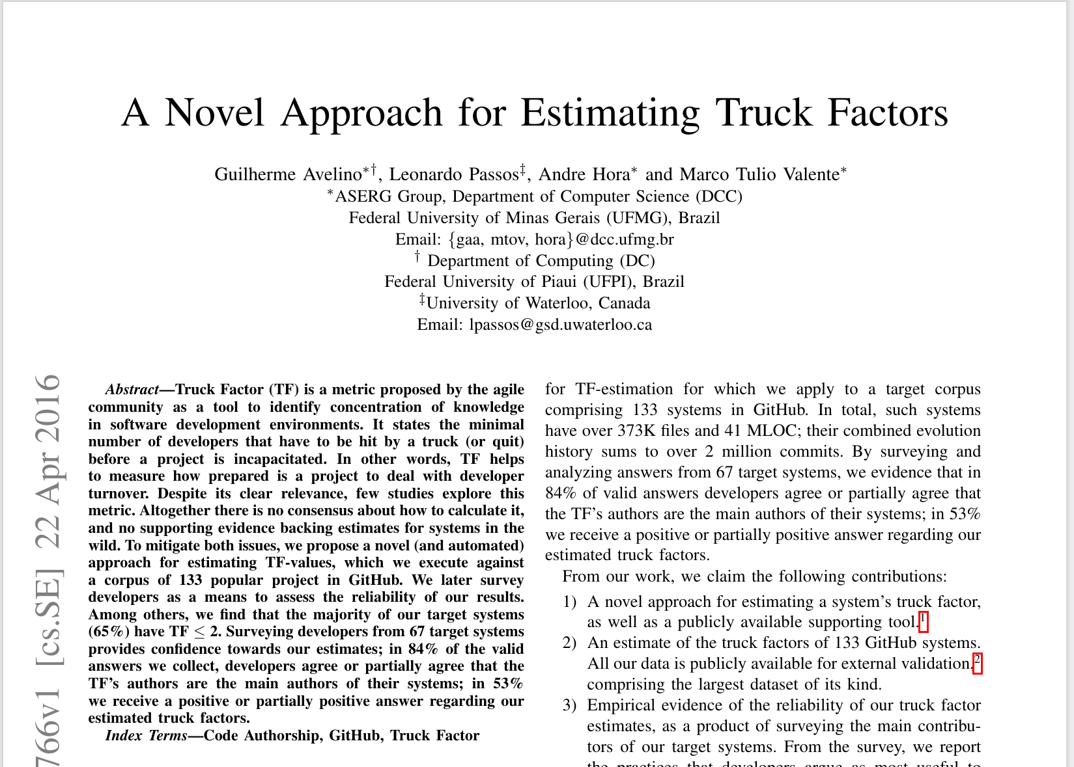

Slide 11
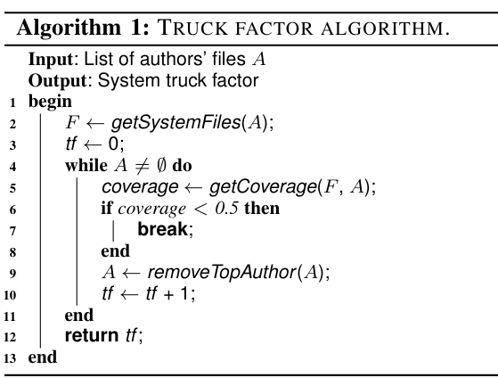

Slide 12
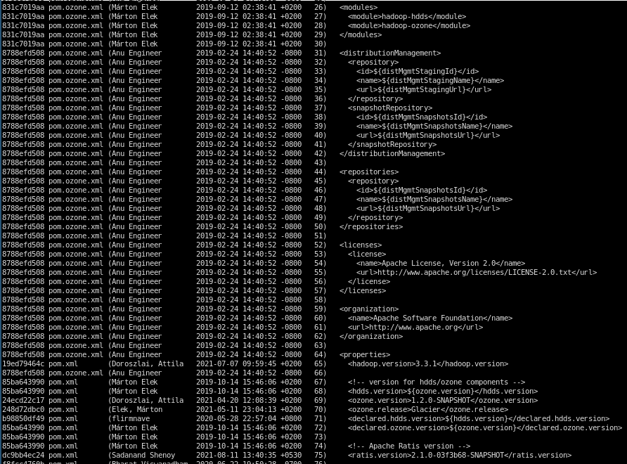
Coverage based TF

Slide 13
Leave factor / Pony number
Measurable
Grouping
Threshold
Number of groups where Σ > threshold

Slide 14

Source: IKEA recipe book

Slide 15
Pony number
Measurable: volume of ingredients
Grouping: ingredient types
Threshold: 50%
Number of groups where Σ > threshold

Slide 16
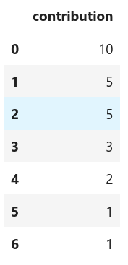

Slide 17
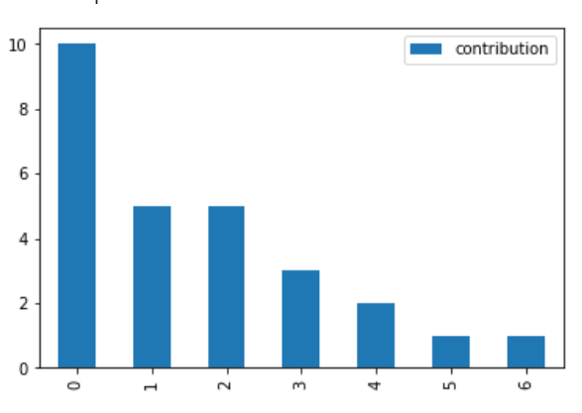

Slide 18
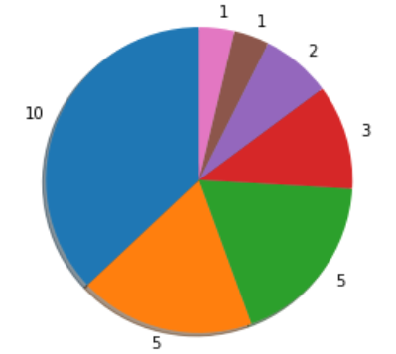

Slide 19
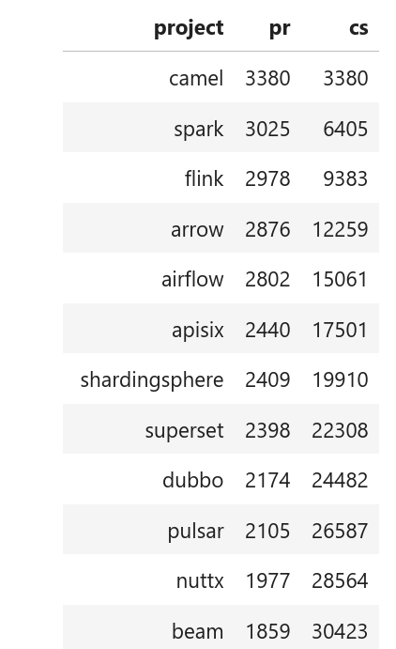
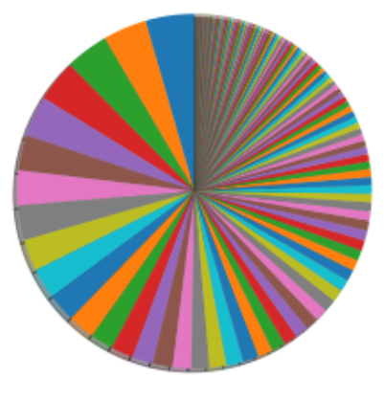
All Apache projects, prs in this year grouped by projects
Pony number: 18

Slide 20
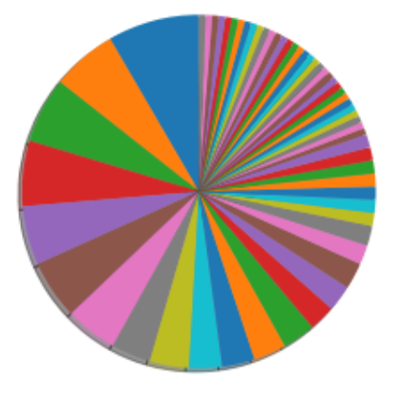
Apache Spark git commits by authors, last 30 days, apache/spark.git
Pony number: 11

Slide 21
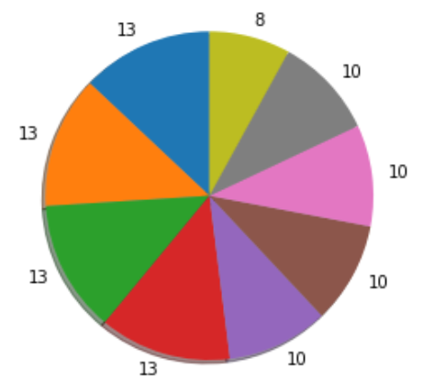
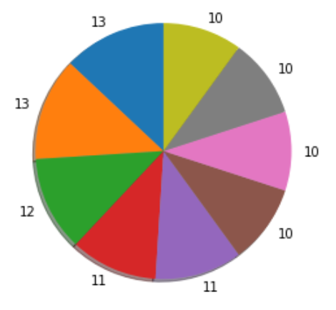
Problem #1: Granularity

Slide 22
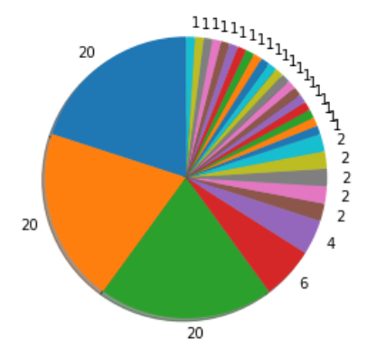
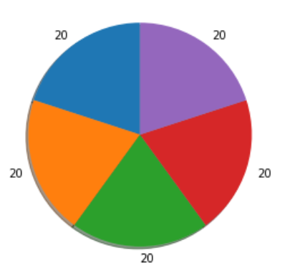
Problem #2: Long tail

Slide 23
Alternatives

Slide 25
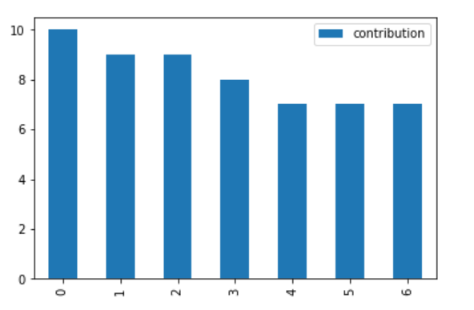

Slide 26
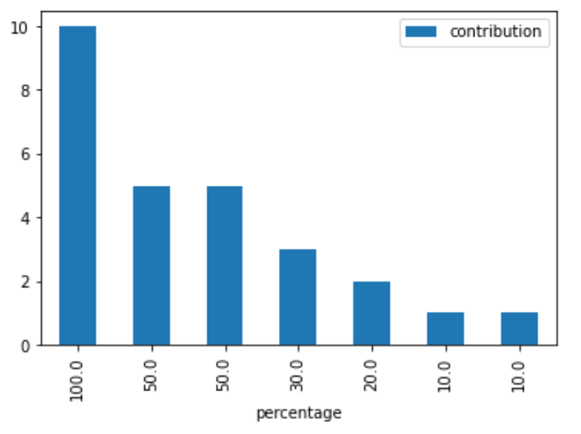
IDEA
How big is the contribution compared to the highest one?

Slide 27
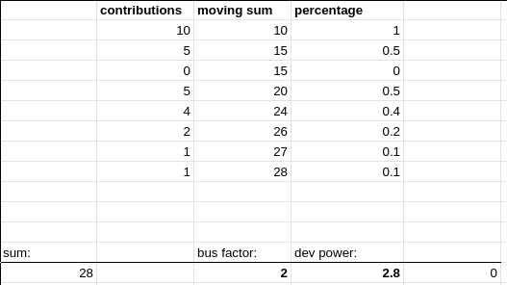

Slide 28
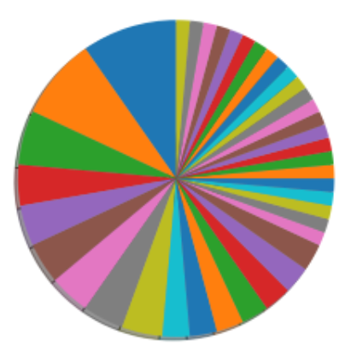
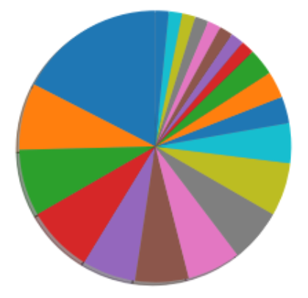
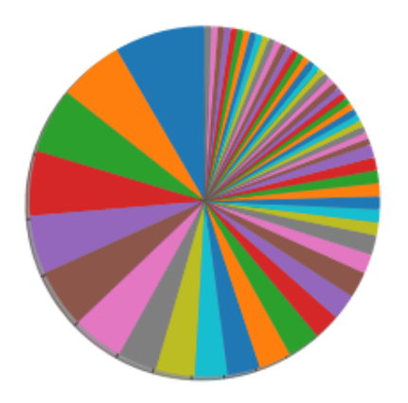
Git commits by authors, last 30 days
apache/kafka.git
apache/ozone.git
apache/spark.git
Pony number: 10
First dev ratio: 10.29
Pony number: 6
First dev ratio: 5.73
Pony number: 10
First dev ratio: 11.79

Slide 29
Problems?
sum(…) / first
How to evalute the
critical mass?

Slide 30
Notes about time

Slide 31
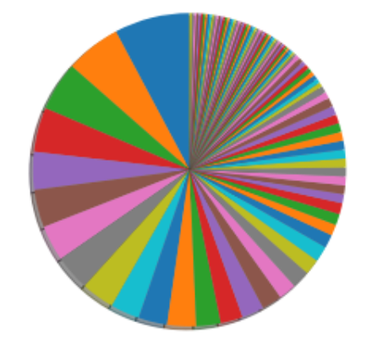
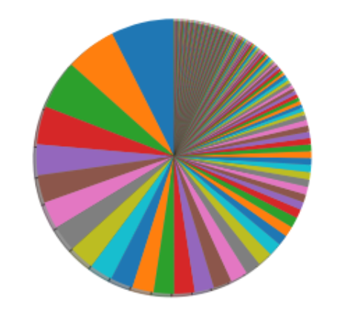
Spark commits last 30/60/180 days
Pony number: 11
First dev ratio: 11.93
Pony number: 12
First dev ratio: 12.82
Pony number: 13
First dev ratio: 13.45

Slide 32
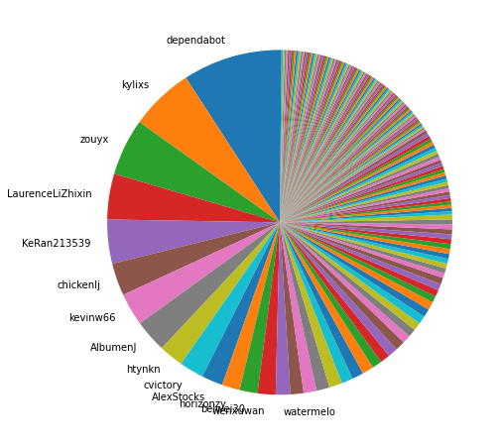
The long tail
Small contributions make the calculations unreliable
Dubbo

Slide 33
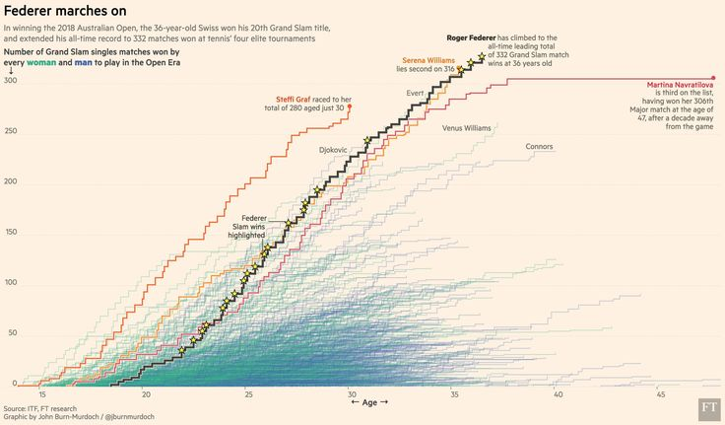
twitter.com/jburnmurdoch/

Slide 34
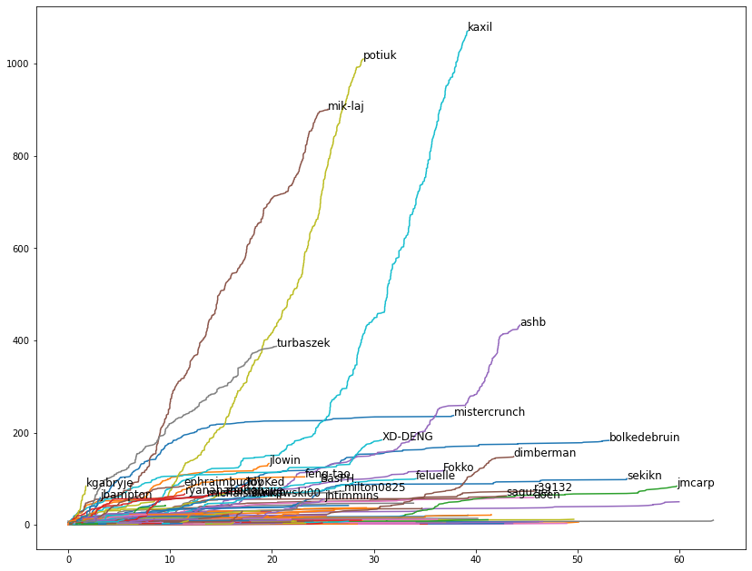
Airflow

Slide 35
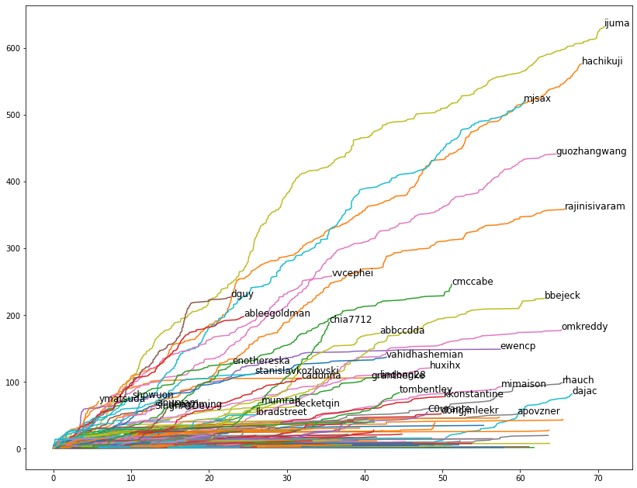
Kafka

Slide 36
The critcal mass
“every community needs a group of self-motivated people with long-term interest, who take responsibility of the project”
#FOSSback: Maximilian Michels - The Critical Mass: A Guide to Building a Strong Community

Slide 37
Kafka

Slide 38
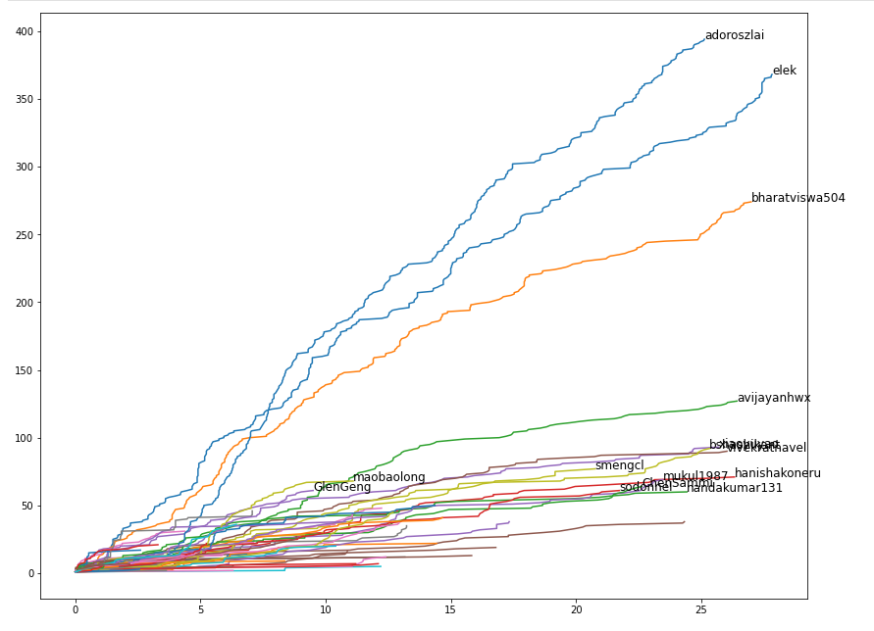
Ozone

Slide 39
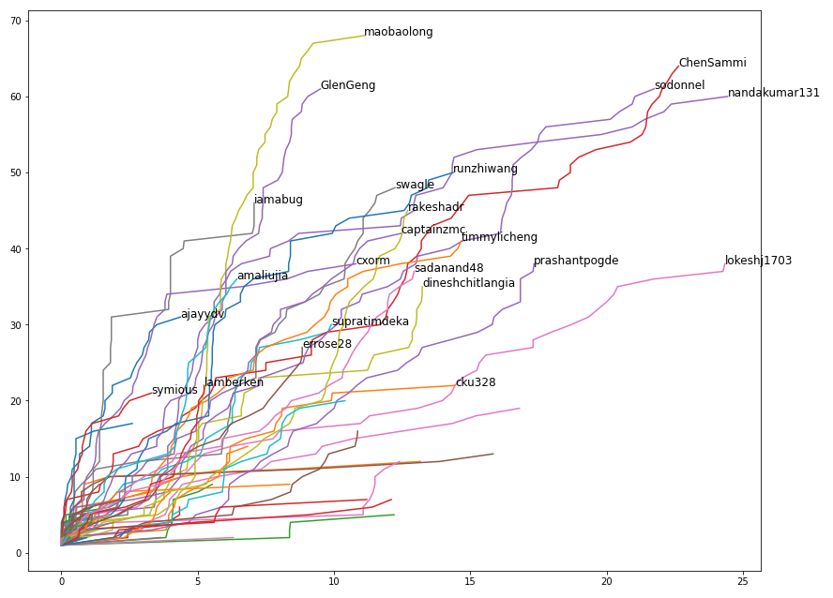
Ozone

Slide 40
Actions behind numbers?

Slide 41
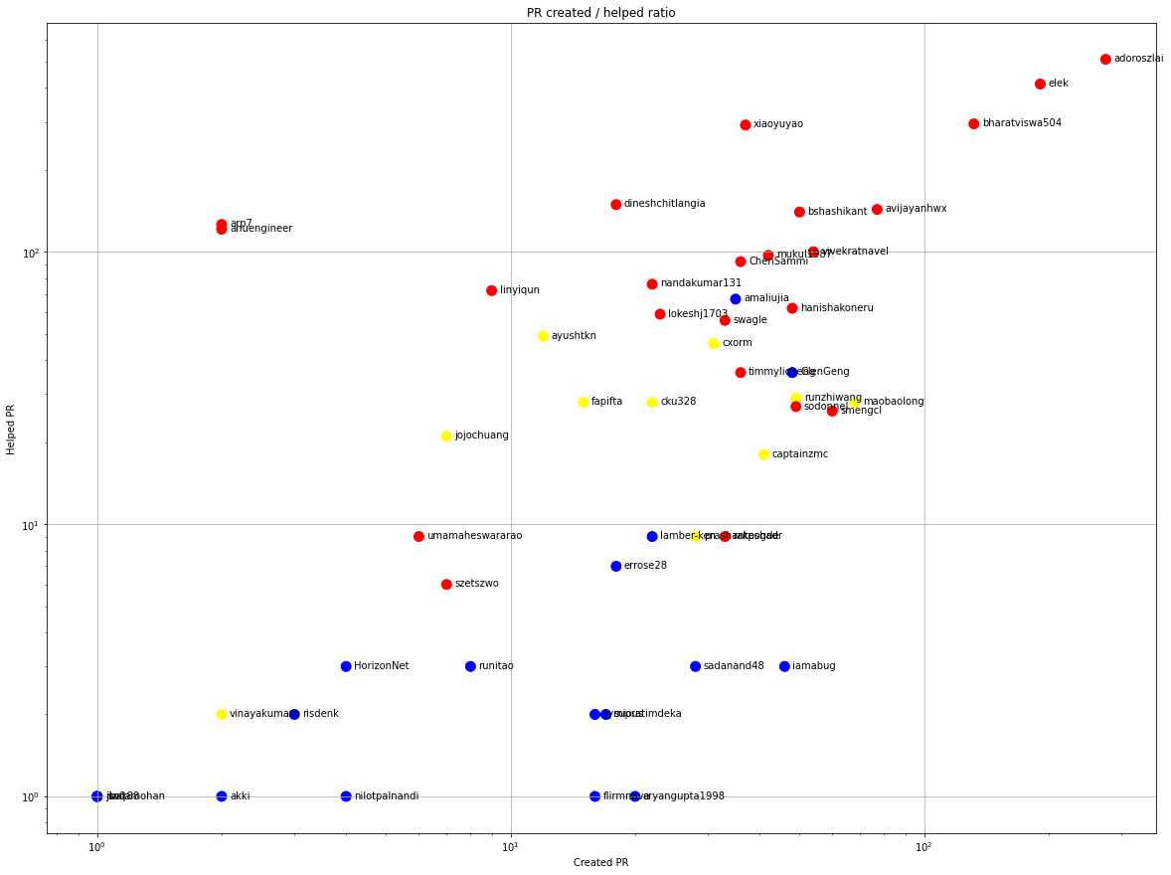
Ozone

Slide 42
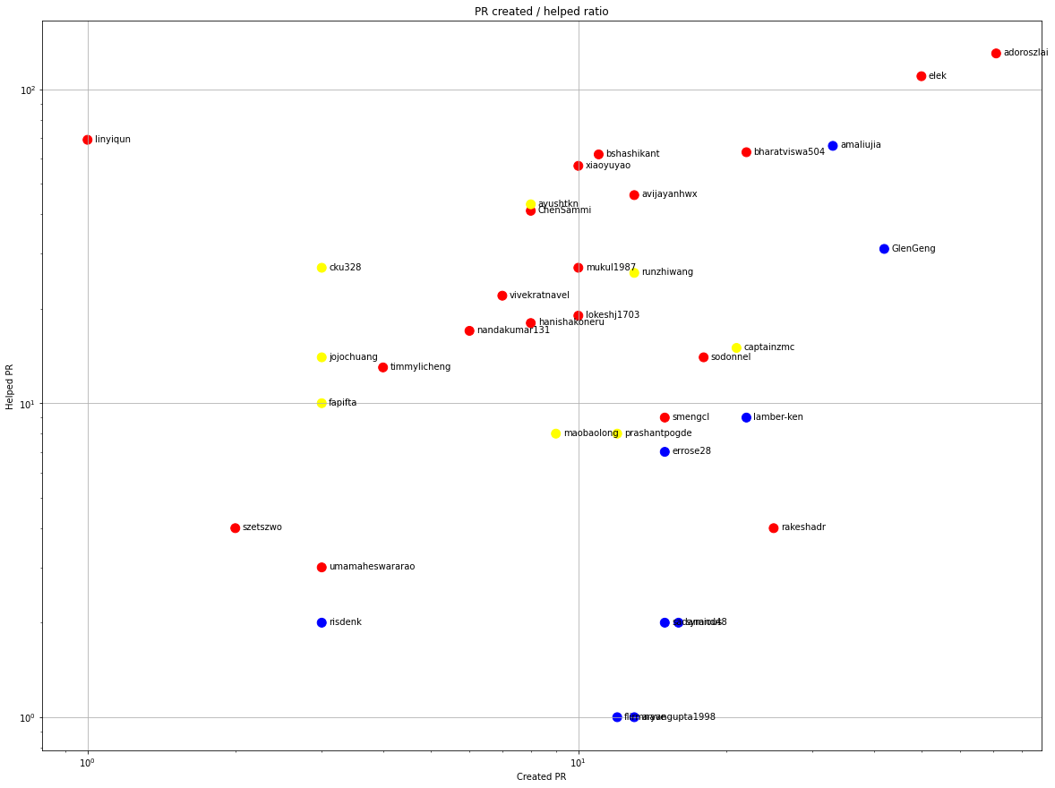
Ozone

Slide 43
Time, again

Slide 44
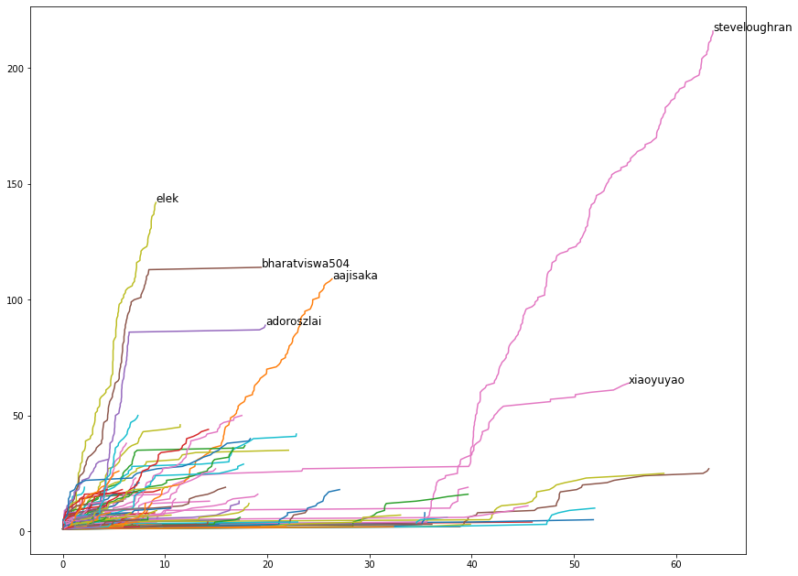
Hadoop

Slide 45
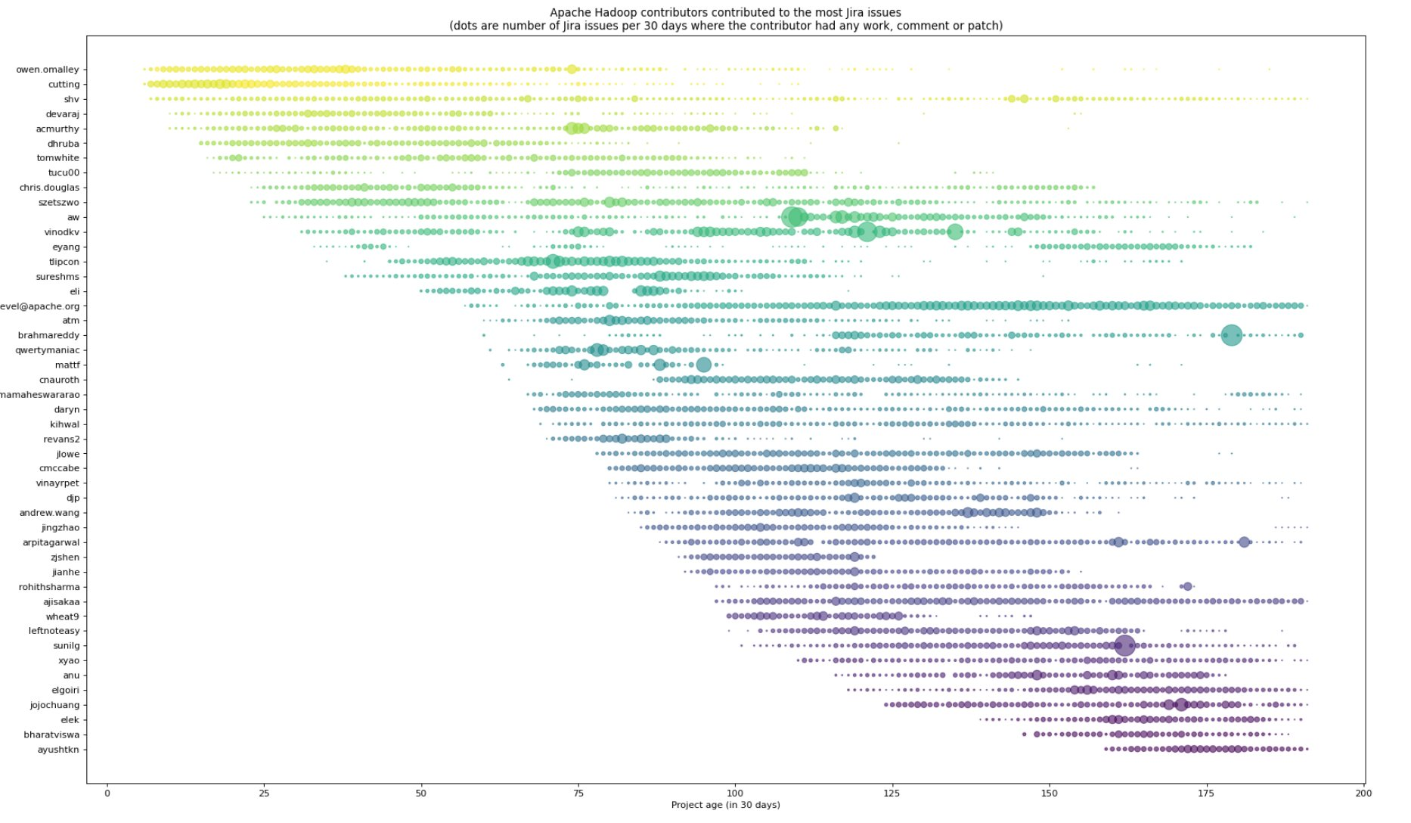

Slide 46
Ozone

Slide 47
Ozone

Slide 48
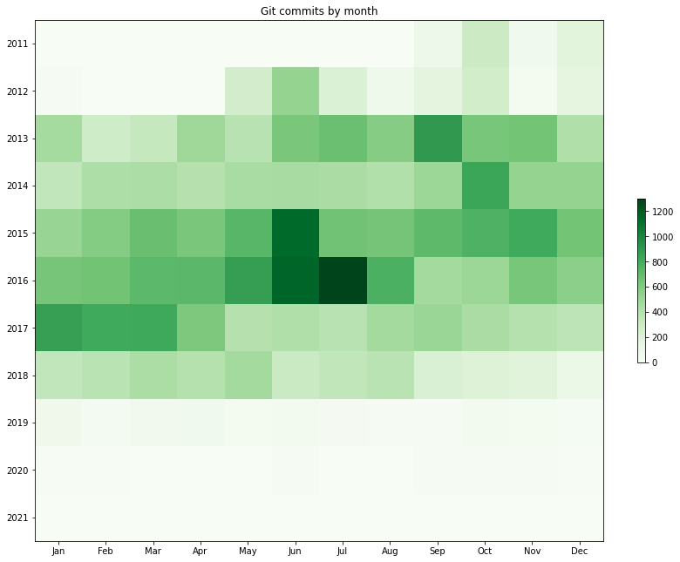
Ambari
“every community needs a group of self-motivated people ...”

Slide 49
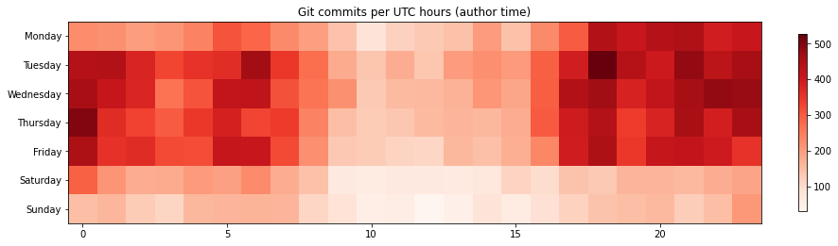
Spark

Slide 50
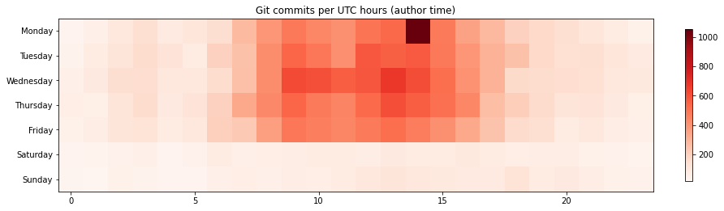

Slide 51
Flink

Slide 52
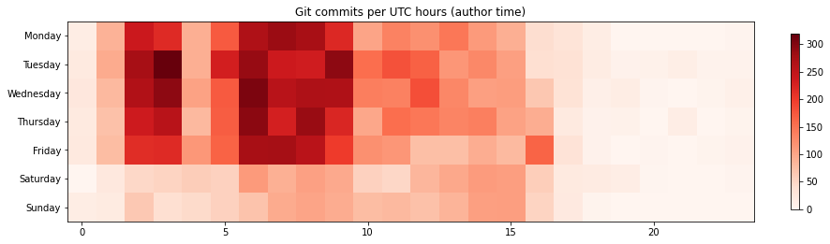

Slide 53
Dubbo

Slide 54
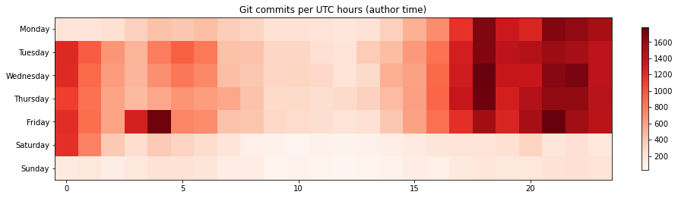

Slide 55
Hadoop

Slide 56
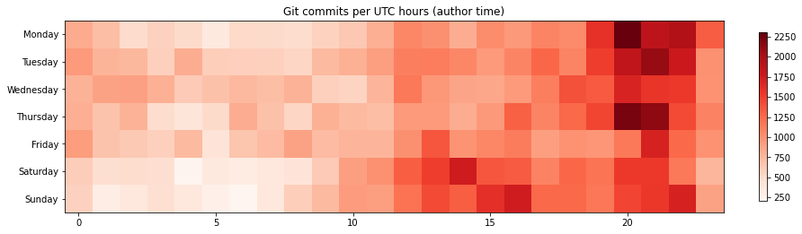

Slide 57
Maven

Slide 58
Summary?
Any statistic just a small window to the real world
One number couldn’t tell the story (bus factor)
Trend!

Slide 59
Summary?
…one day I might get hit by a bus or get cancer
But right now all I am is a fabulous dancer…
so dance with me baby...
(The Burning Hell)
Any statistic just a small window to the real world
One number couldn’t tell the story (bus factor)
Trend!

Slide 60
Márton Elek
elek@apache.org
github.com/elek
  https://github.com/elek/bus-factor
  https://github.com/elek/asf-project-stat
twitter.com/@anzix
Code and Console (Youtube)
Ozone Explained (Youtube)

