Slide 1
FPGA Basics
Written by: Domonkos VARGA, PhD
3/4/2025

Slide 2
Contents
Comparing CPU, microcontroller, GPU, FPGA
FPGA architecture, logic cells (blocks), application domain
Programming FPGA
Simple code in VHDL, open-source tools
Simple code in Verilog, open-source tools
Waveform viewer GTKWave
ModelSim GUI for compiling, simulating code, and viewing waveforms
Simple code testbench
High Level Synthesis, SystemC

Slide 3
CPU
CPU is a computer unit tasked with processing activities
Register
ALU
Control unit
Timing
Main features
Frequency
Width of data and address bus (8, 16, or 32 bits)
Set of instructions
Number of cores
Development limits
Heat generation
Width
Performance
Ideal for sequential algorithms

Slide 4
Microcontroller
A microcontroller contains one or more CPUs, memory, and programmable I/O peripherals
Mostly used in automatically controlled devices and products
Engine control systems
Office machines
Communication
Medical devices
Power tools
Toys
More practical for control tasks than CPU with separate memories and I/O devices.

Slide 5
GPU
Graphics Processing Unit initially initially designed for computer graphics.
GPU are used for non-graphic applications in parallel problems/algorithms.
Ability to perform a huge number of parallel calculations effectively
machine learning
neural networks
cryptocurrency mining
Energy consumption is an important constraint.

Slide 6
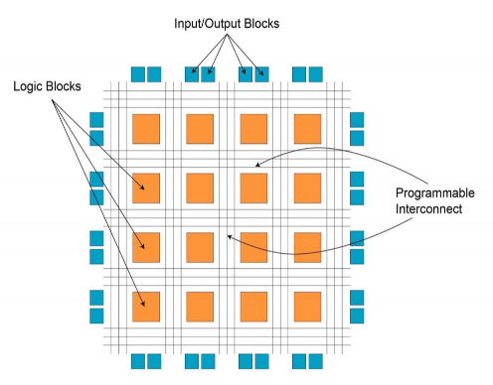
FPGA
Field Programmable Gate Array is a configurable integrated circuit that can be repeatedly programmed.
It consists of an array of programmable logic blocks with a connecting grid that can be configured to interconnect with other logic blocks (or logic cells).
FPGA configuration is generally written using a hardware description language (VHDL, Verilog).

Slide 7
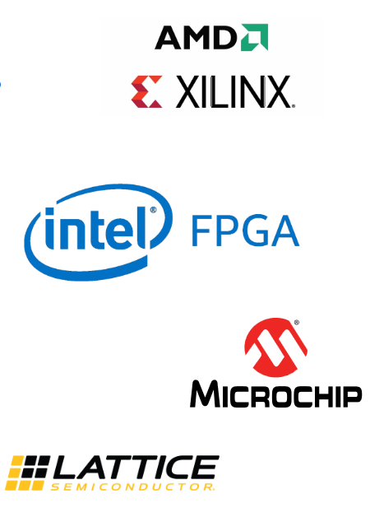
Major manufacturers
AMD Xilinx
Xilinx: first company to produce FPGAs in 1985
About 55% market share
Bought by AMD in 2022
Intel FPGA (former Altera)
About 35% market share
Microchip (Microsemi, Actel)
Lattice Semiconductor

Slide 8
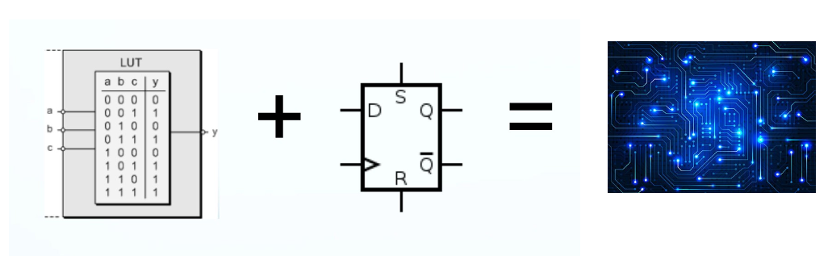
Principle
Look-up tables + Flip-flops = any kind of digital electronics can be implemented

Slide 9
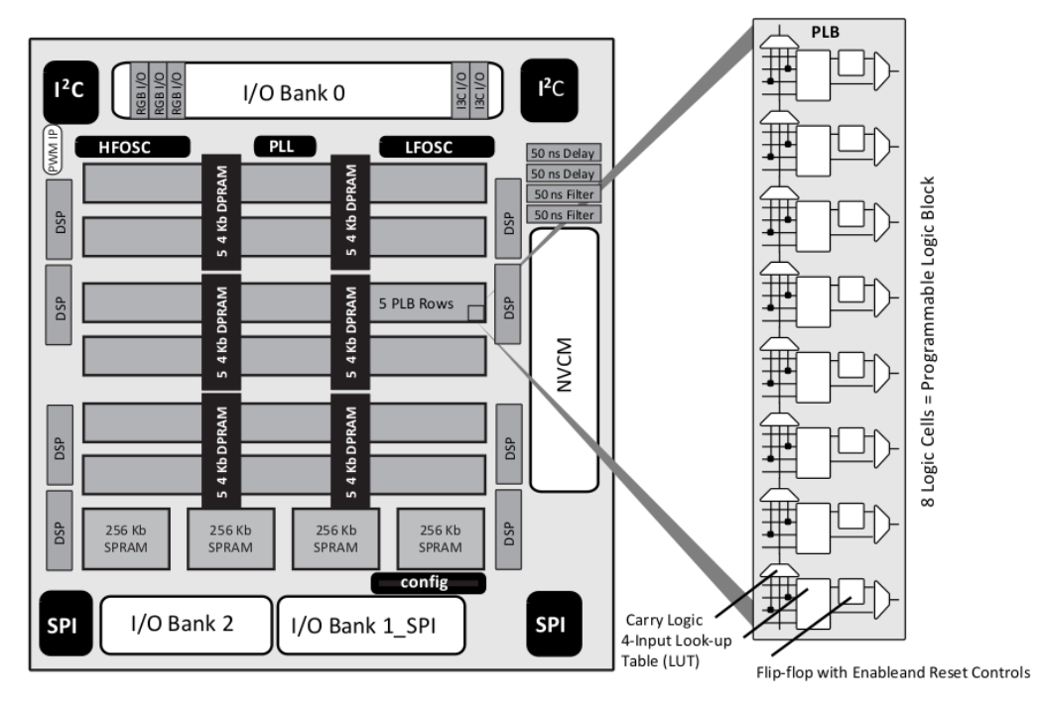
Typical FPGA architecture

Slide 10
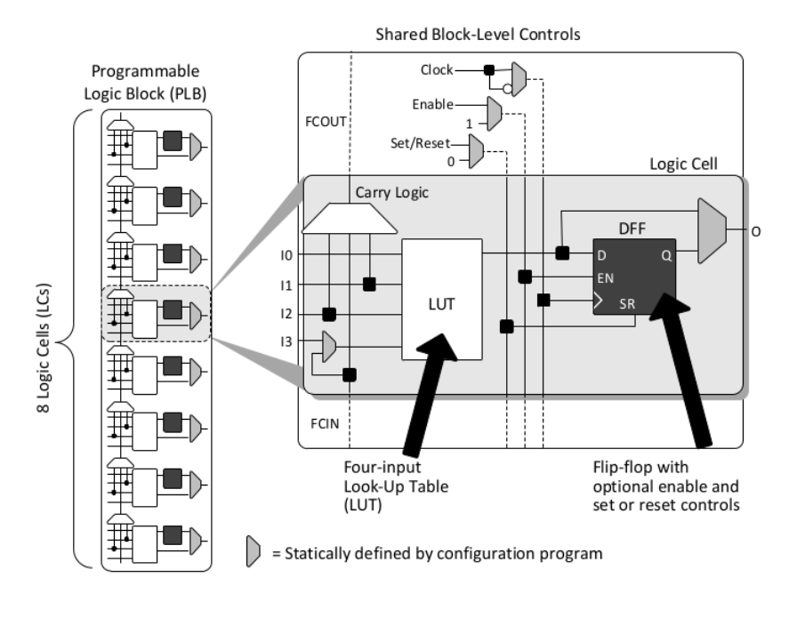
PLB and Logic Cell

Slide 11
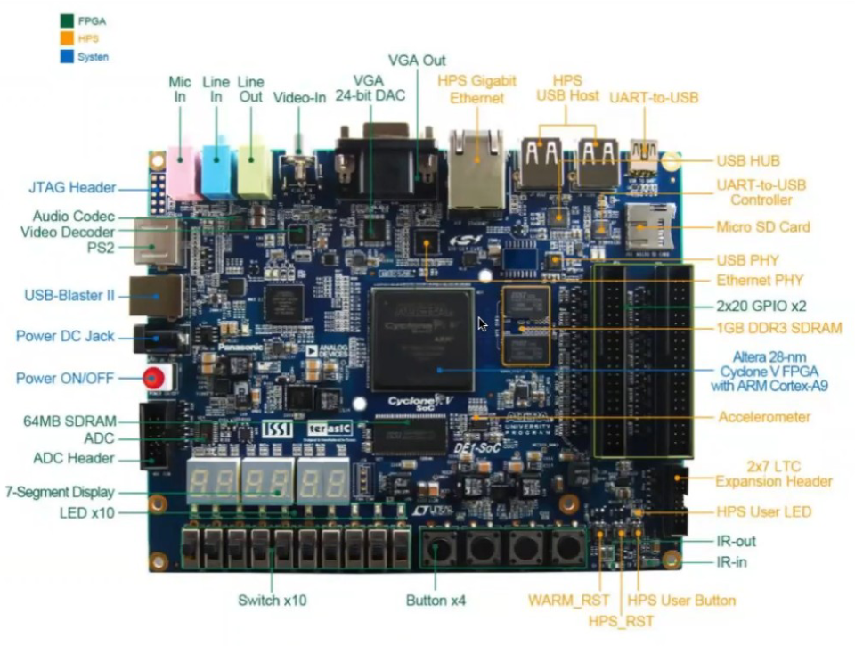
FPGA Development Board

Slide 12
FPGAs Applied in Domains
Medical imaging
Drives assistance systems
Speech recognition
Bioinformatics
Aerospace/Defence
5G wireless
Bitcoin mining
ASIC prototyping
Financial analysis
Video transcoding
Cryptography
Computing accelerators

Slide 13
Programming FPGAs
Hardware description languages
They look similar to a programming language BUT
Programming languages are translated into machine instructions that are executed by a CPU.
HDL is translated into gateware, that is logic gates and flip-flops
Common HDLs
VHDL
Verilog
New trends (less hardware knowledge, increased productivity)
High-level synthesis from C/C++
Other C-like languages (handle-C, System C)
LabView

Slide 14
Programming FPGAs
VHDL was developed by U.S. Department of Defence (MIL-STD-454N) – It borrows from ADA both in concept and in syntax later IEEE standards (IEEE 1076-1987, … updates/revisions).
Verilog was created by Prabhu Goel, Phil Moorby between 1983 and 1984. It was purchased by Cadence Design Systems in 1990, standardized as IEEE 1364 (updates/revisions).
Verilog is somewhat more popular than VHDL maybe because it is less strict and code is not as complex.
High Level Synthesis (HLS): a high-level specification of the problem, where behavior is generally decoupled from low-level circuit mechanics.
Most common sources of input for HLS are based on standard languages, such as ANSI C/C++ or MATLAB.

Slide 15
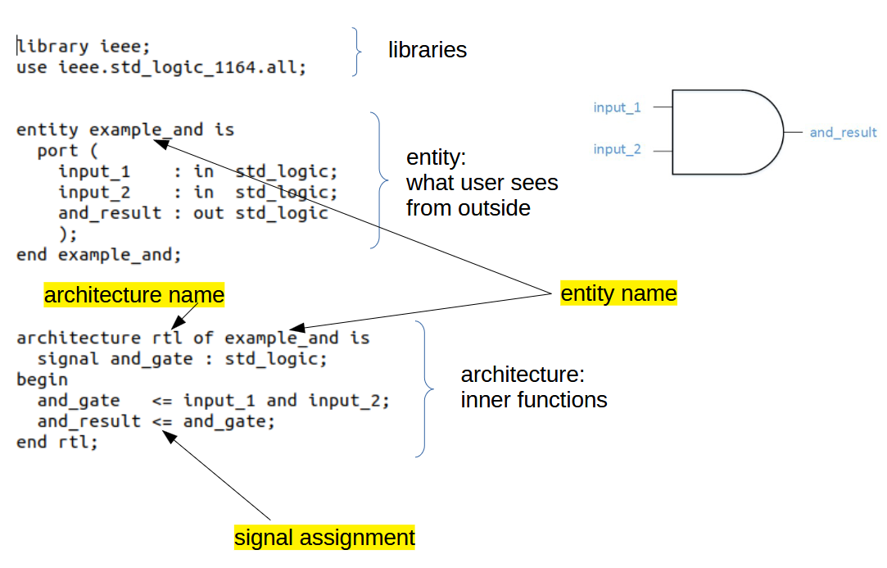
Simple VHDL code

Slide 16
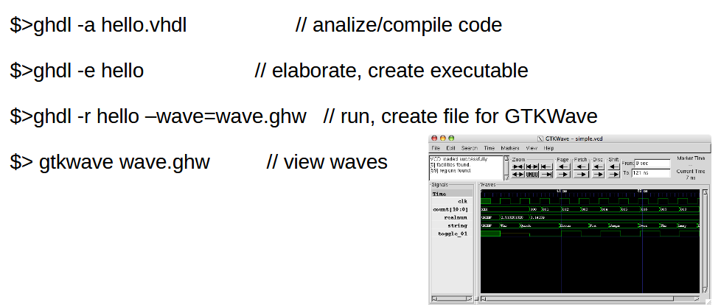
Open-source tools for VHDL
ghdl is toolset for compiling/running/simulating VHDL programs https://ghdl-rad.readthedocs.io/en/stable/using/QuickStartGuide.html
GTKWave is a fully featured GTK+ based wave viewer https://sourceforge.net/projects/gtkwave/

Slide 17
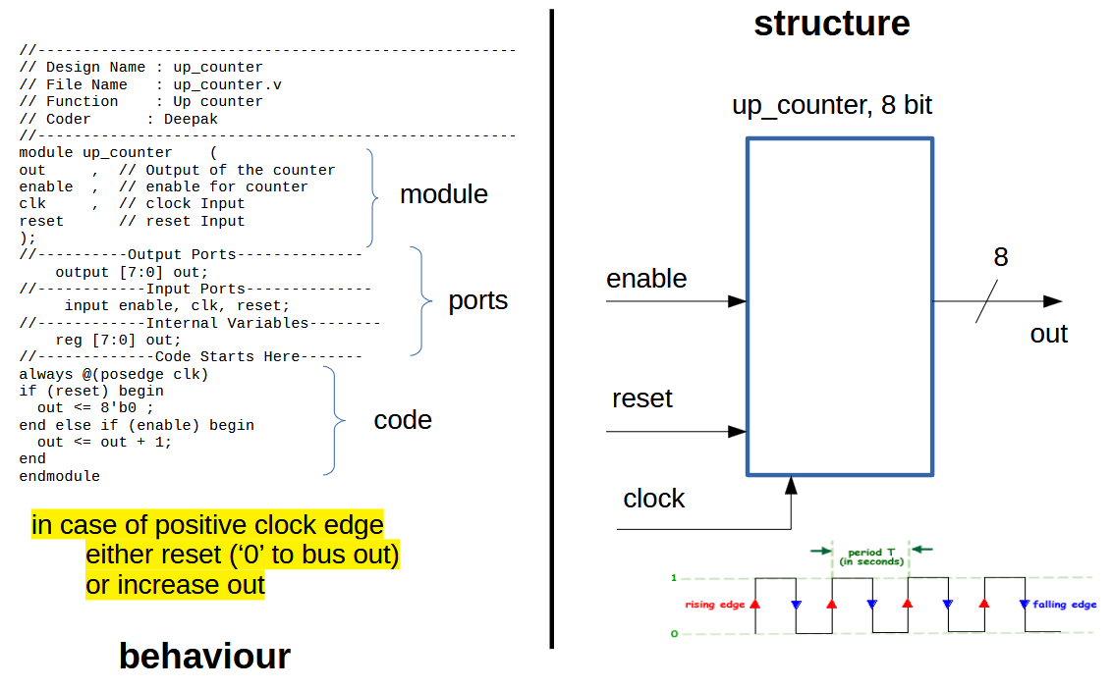
Simple Verilog code

Slide 18
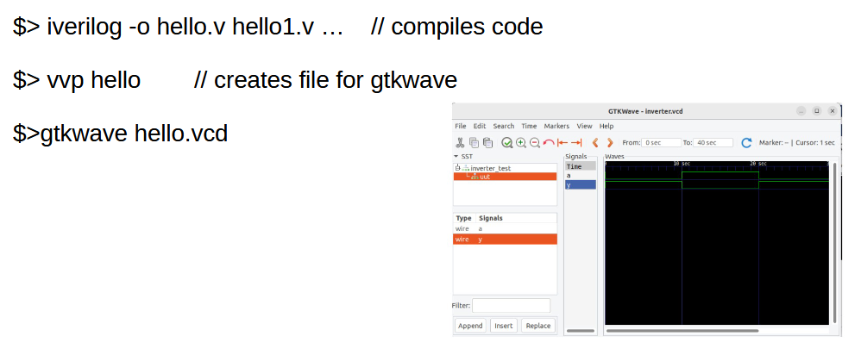
Open-source tools for Verilog
Icarus Verilog is an open-source tool for simulating programs https://steveicarus.github.io/iverilog/
Gtkwave https://circuitfever.com/verilog-simulation-using-iverilog-and-gtkwave

Slide 19
Simulation / Synthesis
FPGA terminology
Simulation:
It is rather difficult to debug a program while it is on FPGA.
Simulator is a software tool that interprets VHDL/Verilog code and runs it like a computer program. Simulator mimics like an event-driven parallel programming language. It simulates the behavior of code not the hardware. Simulation output is a text file or a waveform view of selected signals.
Synthesis: It is a design flow step that maps VHDL/Verilog code to technology dependent netlist. It is a file format that describes the components, connectivity, placement and routing of an electronic circuit. It analyses the code and finds a way to implement the logic with primitives available on the target FPGA.

Slide 20
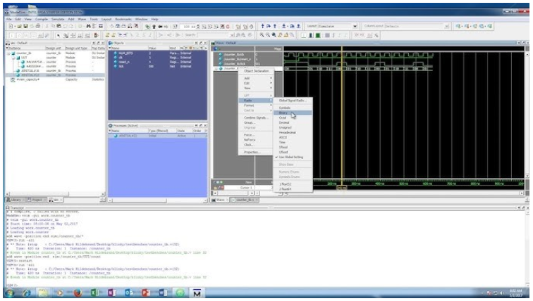
ModelSim
ModelSim is an easy to use graphical user interface that allows you to identify and debug both Verilog and VHDL code by Siemens.
It can also be used with Matlab/Simulink.
It is an environment for simulation but not for synthesis.

Slide 21
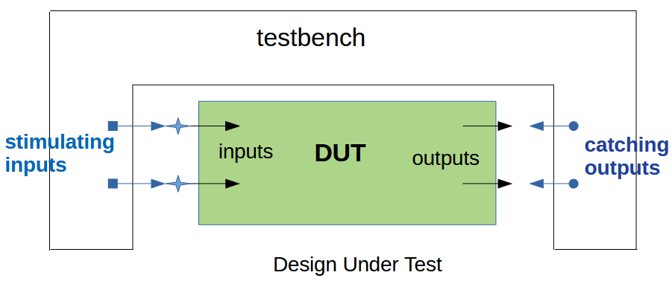
Testbench
Testbench is used in digital design to describe a test code which initializes the design under test (DUT).
Stimulates DUT inputs.
Catches DUT outputs.

Slide 22
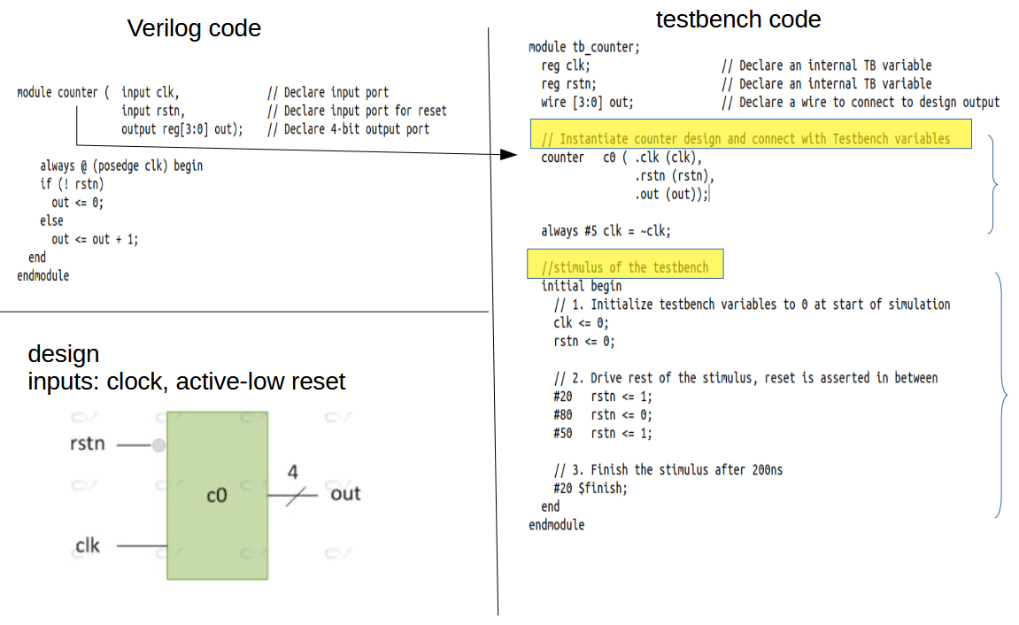
Simple code - Testbench

Slide 23
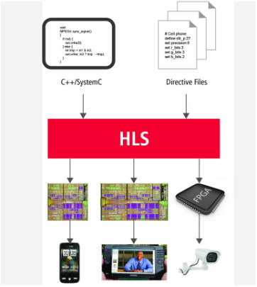
High Level Synthesis
High level synthesis is a design process that takes an abstract behavioral specification of a digital system and finds a register-transfer level structure that realizes the given behavior.
Advantage: experienced programmers can develop code without special hardware knowledge.
Most common source inputs are based on standard languages.

Slide 24

SystemC
SystemC is not a new language but C++ with set of C++ classes and macros which provide an event-driven simulation interface.
Approved by the IEEE Standards Association as IEEE 1666-2011.
Simulating event-driven processes that are described using C++ syntax.
Applied to system-level modeling, architectural exploration, performance modeling, software development, functional verification, and high-level synthesis.
It has semantic similarities to VHDL and Verilog.

Slide 25
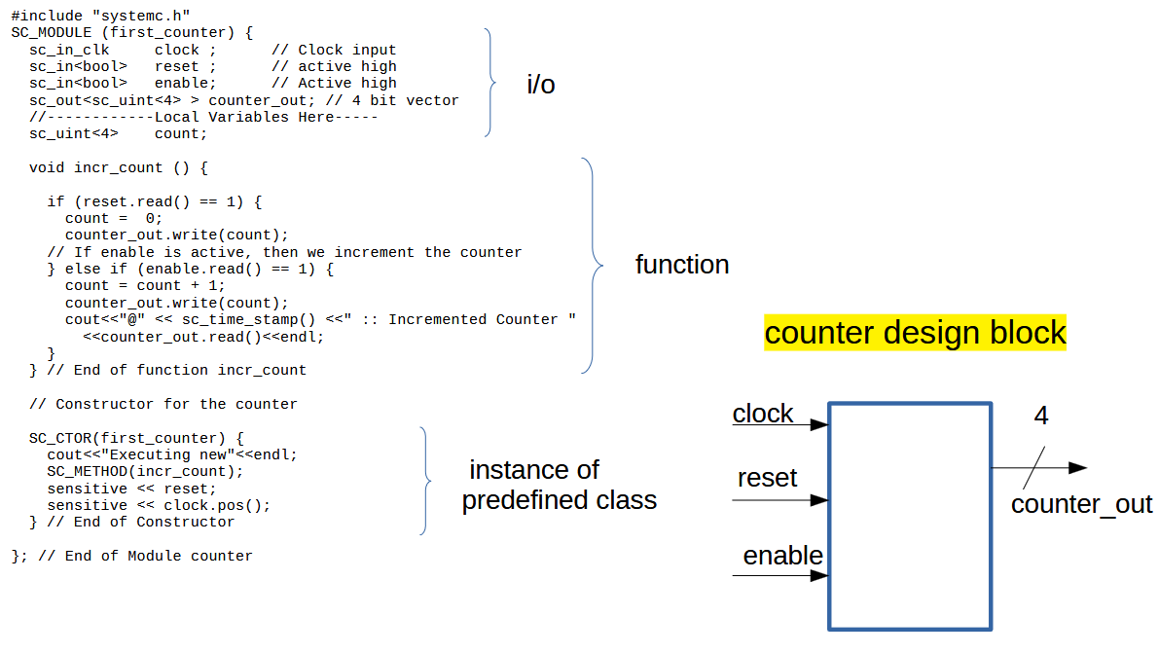
Simple SystemC code

Slide 26
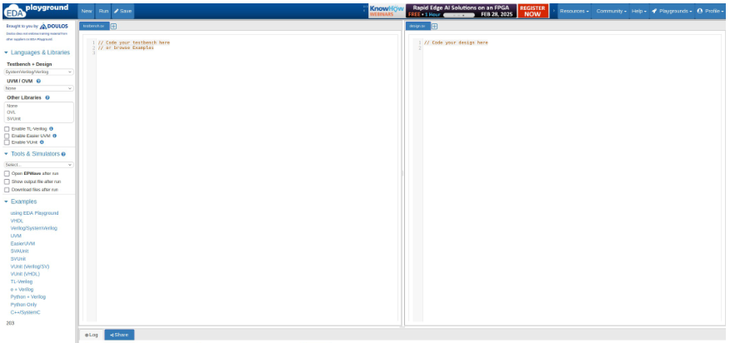
Installing, compiling
It is easy to install SystemC locally or there is a playground on the net to test it https://www.edaplayground.com/
locally compiling and running like a C++ program
g++ -I. -I /usr/local/systemc-2.3.3/include -L. -L/usr/local/systemc-2.3.3/lib-linux64 -Wl, -rpath=/usr/local/systemc-2.3.3/lib-linux64 -lsystemc -lm -o hello hello.cpp

