Slide 1
Tworzenie stron internetowych
Zajęcia nr 2 (git)

Slide 2
Git intro
git init
git status
git add / git add . / git add -A /git add -u ----> .gitignore
git commit -m "Your message about the commit„
git checkout -b <my branch name>
git branch
git remote add origin https://github.com/user/mynewrepository.git
git push -u origin master
git pull
git merge („into”)
git stash / git stash apply
git log
* git blame, git revert, git commit --amend

Slide 3
Git commit
git commit -m "Your message about the commit„
git commit -m "title" -m "description"
git commit –amend
https://www.freecodecamp.org/news/how-to-write-better-git-commit-messages/

Slide 4
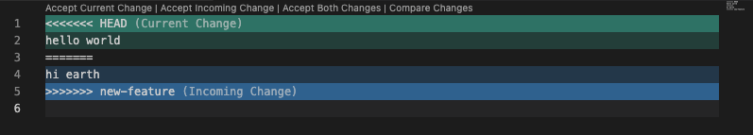
Git clone / Fork
https://docs.github.com/en/pull-requests/collaborating-with-pull-requests/working-with-forks/fork-a-repo
Git Pull Requests /PRs
https://docs.github.com/en/pull-requests/collaborating-with-pull-requests/proposing-changes-to-your-work-with-pull-requests/creating-a-pull-request
Git merge conflicts
https://www.atlassian.com/git/tutorials/using-branches/merge-conflicts
https://www.freecodecamp.org/news/how-to-fix-merge-conflicts-in-git/

Slide 5
Git links
https://rogerdudler.github.io/git-guide/index.html
https://git-school.github.io/visualizing-git/#rewritten-history
https://training.github.com/downloads/pl/github-git-cheat-sheet/

