Slide 1
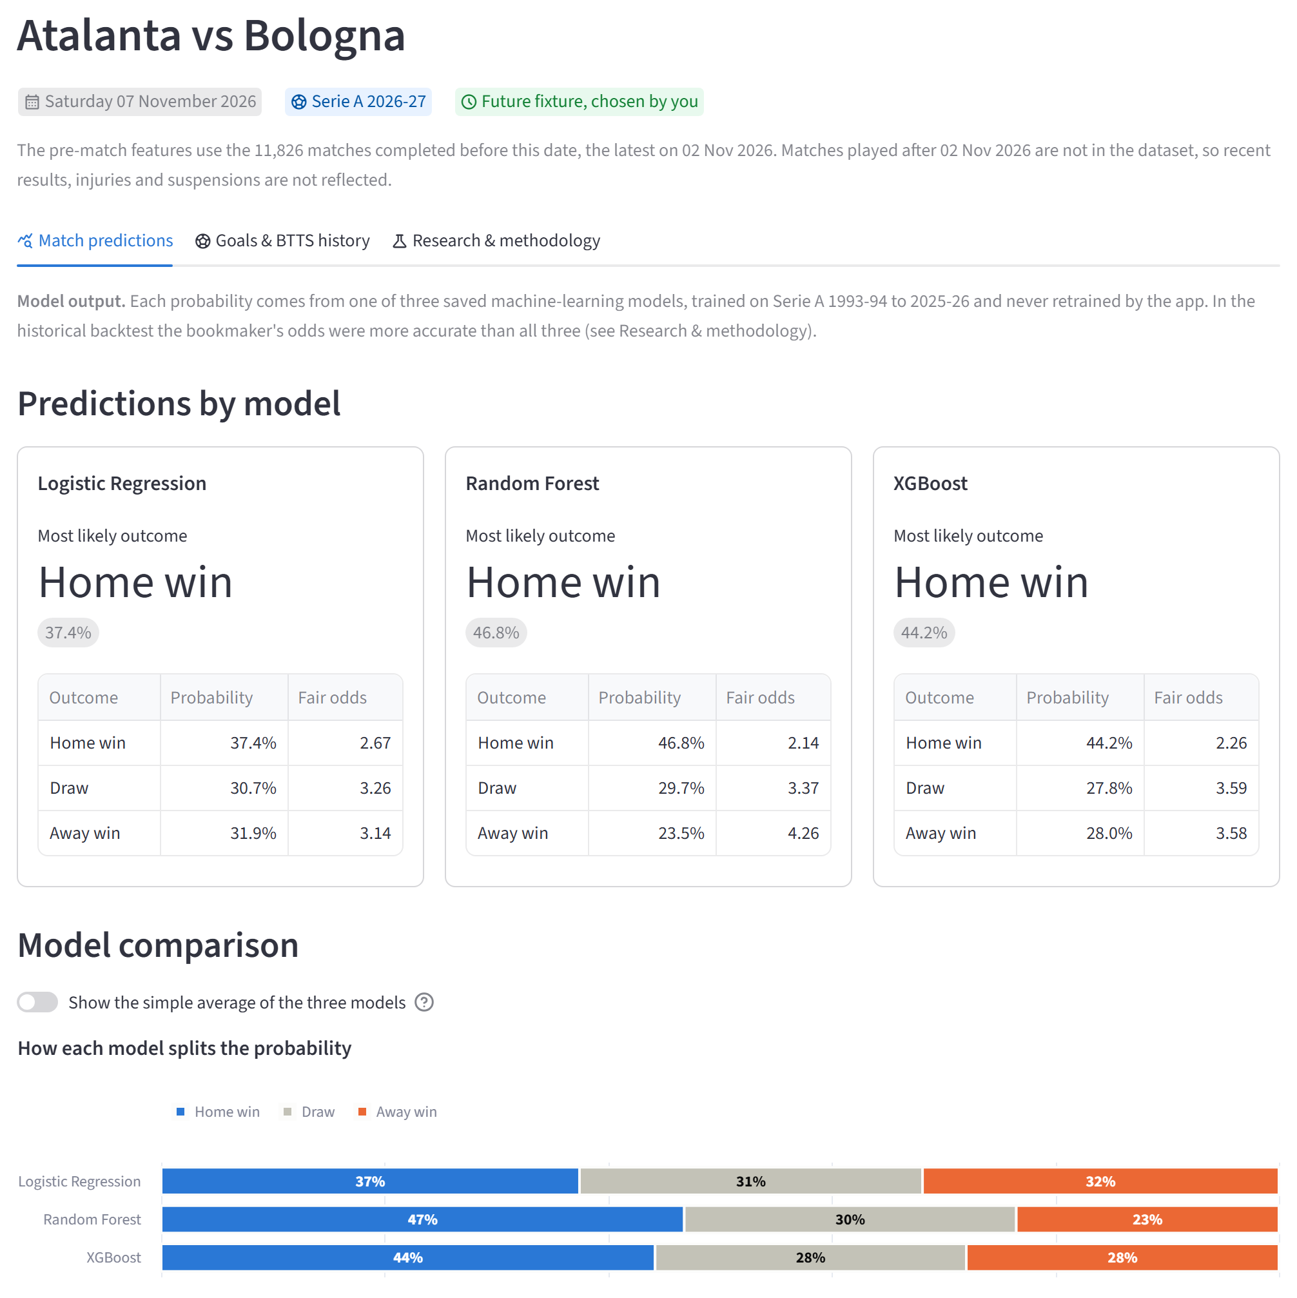
Can 30 years of results predict a football match?
DATA SCIENCE CASE STUDY
Three machine-learning models turn past Serie A results into home, draw and away probabilities, tested honestly against the bookmakers.
34
11,826
3
seasons, 1993-94 to 2026-27
completed matches
models, plus a bookmaker benchmark
Data: Football-Data.co.uk, results to 2 Nov 2026
Notes:
Here's where we ended up: an app where you pick two Serie A clubs and a date, and three machine-learning models each give you the probability of a home win, a draw and an away win.
Today I want to tell you how we got there, and more importantly how we checked whether these numbers deserve any trust.
The data is 34 seasons of Serie A, from 1993-94 to the current season: 11,826 matches, free from Football-Data.co.uk.
One thing to stress from the start: we're not trying to "pick winners". We want probabilities. If the model says 48% home win, home teams in that situation should win about 48% of the time. Most of this talk is about how you test that.
And a spoiler: some of the most interesting results are things that did not work, plus an honest comparison with the bookmakers.
Transition: before building anything, we needed to understand what we were trying to predict.

Slide 2
Home wins 45% of the time: the bar to beat
01 UNDERSTANDING SERIE A RESULTS
Share of all 11,826 matches, 1993-94 to 2 Nov 2026
45.4%
of all matches are home wins. A forecast that always says “home win” is right this often.
2.66
goals per match. The most common scores are 1-1, 1-0 and 2-1: one goal often decides it.
Notes:
Let's start with what we're predicting. Of all 11,826 matches, 45.4% were home wins, and draws and away wins were 27.3% each.
So a "model" that ignores everything and always says home win would be right about 45% of the time. That's the bar any real model has to clear. (In the seven recent seasons we test on later, home wins were rarer, so that naive pick is right only 41% of the time there.)
The second number: 2.66 goals per match, with 1-1, 1-0 and 2-1 the most common scores. When a single goal decides so many matches, luck plays a huge part, so nobody, bookmakers included, is right most of the time.
Notice draws: as common as away wins, but with no obvious favourite. Keep that in mind; draws turn out to be the hardest outcome to call.
Main point: the baseline is about 45%, and football is noisy.
Transition: but these averages hide something important: the game has been changing.

Slide 3
Home advantage has been shrinking for 30 years
02 HOW FOOTBALL HAS CHANGED
Share of matches won by the home team, drawn, or won by the away team, each completed season
50% → 40%
home wins: 1990s average vs the last five seasons
21% → 32%
away wins over the same periods: from 1 in 5 matches to 1 in 3
Notes:
This is every completed season from 1993-94 to 2025-26. The blue line is home wins, grey is draws, orange is away wins.
In the 1990s home teams won about half their matches, 49.6% on average. Over the last five seasons it's 40.4%. Away wins went the other way, from about 21% to about 32%: from one match in five to one in three.
You might think of the empty stadiums of 2020-21. Home advantage was low then, but the decline started long before and it didn't come back when fans returned.
At the same time the league became more unequal: the gap between strong and weak clubs grew. So who is playing matters more now than where.
Two lessons for modelling. Team-strength features should matter most. And evaluation has to respect time: if we shuffled all the matches and tested on a random sample, the model would learn from the future and be tested on the past.
Main point: the past is not a perfect guide to the present, so always test on later seasons.
Transition: so what can a model actually know about a match before kick-off?

Slide 4
No peeking: every feature comes from the past
03 LEAKAGE-SAFE FEATURE ENGINEERING
Match day
Fixture
Earlier matches: used
Same day: not used
Later results: never used
25 numbers per club: recent form, home or away form, this season, last season, promoted
Built only from matches on earlier dates
Tested: changing later results never changes earlier features
Notes:
Models can't read a fixture list; they need numbers. For every match we built 50 features, 25 per club, describing how each team looked before kick-off: recent form, home or away form, this season so far, last season, and whether the club was just promoted.
The chart shows they work. Move right and the home team is in much better form: home wins climb from about 15% to about 75%. But the grey draw line stays between roughly 19% and 31% whatever the gap.
The key idea here is data leakage: a model accidentally seeing information it wouldn't have in real life. If "goal difference this season" included the match's own score, the model would be reading the answer: brilliant in testing, useless in reality.
Our rule, shown in the timeline: only matches on earlier dates, not even other games that day. Automated tests rewrite later results and check that nothing earlier changes.
Transition: with these features, we trained three very different kinds of model.

Slide 5
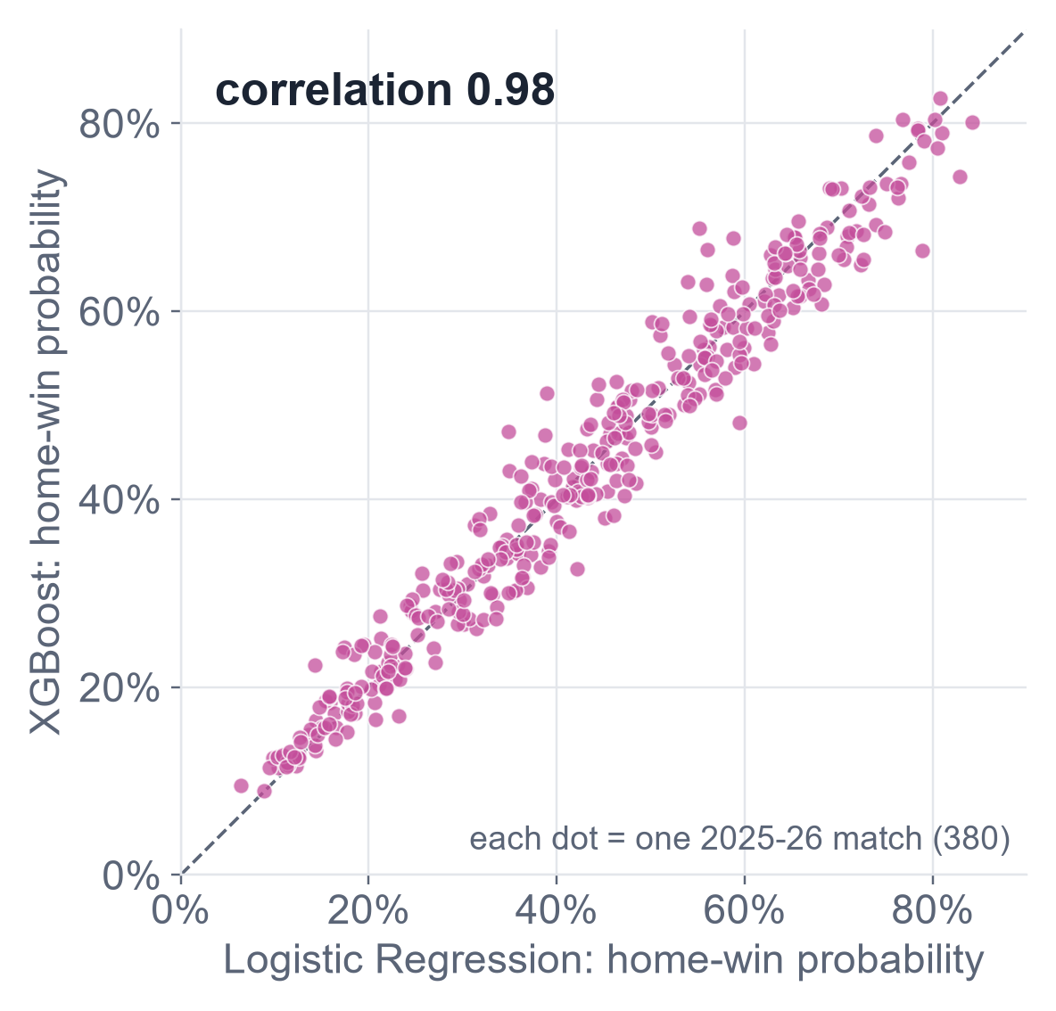
Three algorithms, almost the same answer
04 THREE MACHINE-LEARNING MODELS
Logistic Regression
Adds up the evidence for each outcome: a linear model
Random Forest
Hundreds of decision trees that vote
XGBoost
Trees built one after another, each correcting the last
0.97–0.98
88%
correlation between their home-win probabilities
of 2025-26 matches: all three pick the same outcome
Notes:
We trained three well-known classifiers on exactly the same features. Logistic Regression is a linear model: it adds up evidence for each outcome. Random Forest is hundreds of decision trees voting. XGBoost builds trees one after another, each fixing the last one's mistakes.
The chart is the surprise. Each dot is one match from 2025-26; across is Logistic Regression's home-win probability, up is XGBoost's. If they disagreed, this would be a wide cloud. Instead it hugs the diagonal: correlation 0.98, and 0.97 for Random Forest. All three pick the same outcome in 88% of matches.
A quick word on overfitting: a flexible model can memorise noise, like a student memorising last year's exam answers. With noisy football data, the settings that won were the simple ones: strong regularisation, and XGBoost trees only two levels deep.
One honesty note: 2025-26 is the season we used to choose each model's settings, so it's a selection season, not an independent test. The next slide fixes that.
Main point: the algorithm is not what limits us. Better predictions need better information, not a fancier model.
Transition: so how do we judge them fairly?

Slide 6
Testing like a forecaster, one season at a time
05 CHRONOLOGICAL WALK-FORWARD EVALUATION
1993-94
to 2015-16
16-17
17-18
18-19
19-20
20-21
21-22
22-23
23-24
24-25
25-26
26-27
How we score
Predict 2018-19
Predict 2019-20
Log loss: the probability you gave to what actually happened, as a penalty. Lower is better.
Predict 2020-21
Predict 2021-22
Predict 2022-23
Said 50%, it happened
0.69
Predict 2023-24
Predict 2024-25
Said 10%, it happened
2.30
Saved models
(used by the app)
1/3 on every outcome
1.10
Train
Choose settings
Predict and score
Hidden
First 100 matches of 2026-27: held out at first, examined since
Notes:
Two ideas on this slide.
First, walk-forward testing. Each row is one season we replayed, from 2018-19 to 2024-25. For each one, we hid everything after it, chose the model's settings using only earlier seasons, trained, and predicted. So every prediction used only what was known at the time: seven seasons, 2,657 matches, every forecast scored on the same matches.
The bottom row is the saved models in the app: settings chosen on 2025-26, then refitted. The first 100 matches of 2026-27 were held out at first, but we've looked at those results since, so they can't fairly judge a new model.
Second, scoring. Log loss looks at the probability you gave to what actually happened. Say 50% and it happens: 0.69. Say 10% and it happens anyway: 2.30, a big penalty for overconfidence. Lower is better. We also check calibration, the weather-forecaster test: when you say 40%, it should happen about 40% of the time.
Honesty note: these seven seasons were reused by every later experiment, so later gains on them are exploratory, not proof.
Transition: now the real test: the people who set the odds.

Slide 7
The bookmaker still beats the models
06 RESULTS VERSUS THE BOOKMAKER
Log-loss improvement over the baseline, 2018-19 to 2024-25 (higher is better)
6 of 7
seasons in which the bookmaker had the best log loss
0.021–0.023
bookmaker's lead over each model; 95% intervals exclude zero. It may reflect team news the models lack.
Baseline: the same historical outcome frequencies for every match (log loss 1.092); its single pick is always a home win. Scale starts at zero.
Notes:
Seven backtest seasons, pooled. The bars show how much each forecast improved on the baseline. Higher is better, and the scale starts at zero.
The baseline gives every match the same probabilities: how often home wins, draws and away wins happened in the training seasons. Its log loss is 1.092. Because home wins are the most common result, its single pick is always "home win", which was right 41% of the time in these seasons.
All three models improve on it by about 0.11, in every one of the seven seasons, and they're within 0.003 of each other.
The gold bar is the bookmaker: Bet365's odds turned into probabilities with the margin removed, used only for comparison. Its lead over the models is 0.021 to 0.023, about a fifth of the distance the models travelled from the baseline, and the 95% intervals exclude zero. It was best in 6 of 7 seasons.
Why? We can't prove it, but the likely reason is information the models don't have: injuries, line-ups, transfers.
Two things we don't claim. The models scored slightly better on the first 100 matches of 2026-27, 0.882 against 0.898, but 100 matches can't separate them. And draws: a draw is rarely anyone's single most likely outcome, the bookmaker's included. They're hard to pick out, not impossible to model.
Transition: could better team-strength measures close the gap?

Slide 8
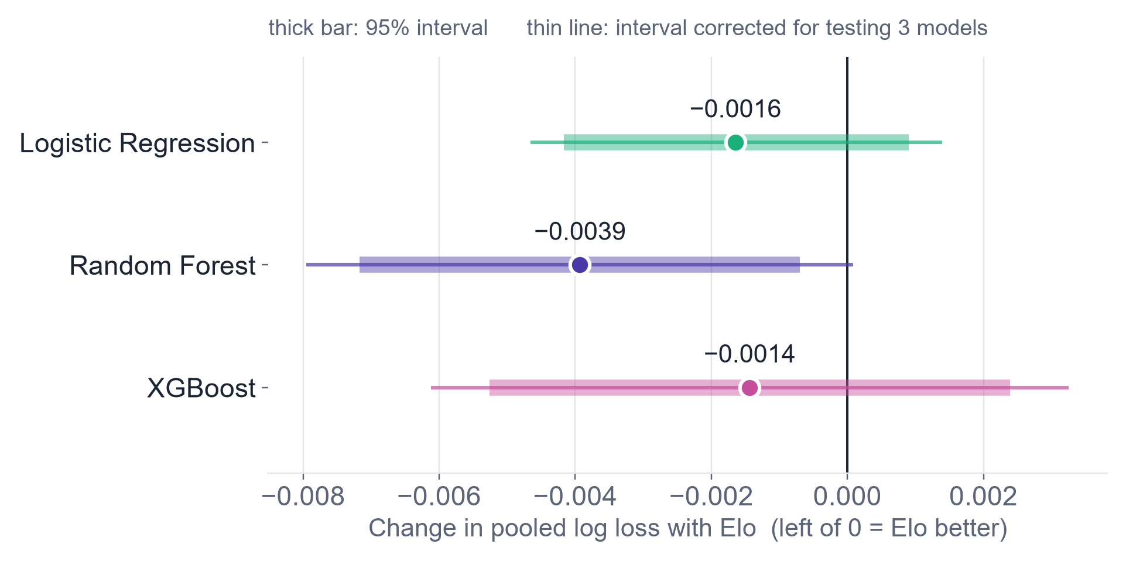
Two good ideas that didn't make the cut
07 ELO AND RECENCY EXPERIMENTS
Adding Elo ratings: change in pooled log loss over 7 seasons
Recency weighting
Six ways to make recent seasons count more
−0.0027
best strategy (5-year half-life), better in 6 of 7 seasons
But its intervals include zero, and it was the best of six tries on the same seasons.
Decision for both: not deployed
Every model improved slightly; after correcting for testing three models, no interval excludes zero.
Notes:
Two ideas that sounded promising.
Elo ratings come from chess: a club gains points by beating others, more for a surprise win. We added leakage-safe Elo ratings to the features and reran the seven-season backtest.
Left of zero means Elo helped, and every model moved slightly left, by 0.0014 to 0.0039. Sounds convincing. But the rule we wrote beforehand required the gain to stay clear of zero after correcting for testing three models: that's the thin line. Random Forest's ordinary 95% interval excludes zero, but its corrected interval ends at plus 0.0001. A miss by a hair, but a miss. The reason: Elo mostly repeats last season's points gap, which the models already have.
Recency: since the game changes, maybe recent seasons deserve more weight. Of six strategies, a 5-year half-life did best, better in 6 of 7 seasons by 0.0027. But its intervals include zero, and it was the best of six tries on the same seasons. That's exactly how luck can look like a discovery.
Neither gain is established, so neither is deployed. Both stay as candidates to test on seasons they haven't seen.
Transition: so 1X2 probabilities are close to what our data allows. What about goals?

Slide 9
We can estimate how many goals, not whether
08 EXPECTED GOALS VERSUS EVENT PROBABILITIES
Over 2.5 goals: log-loss gain over a 50/50 coin flip (higher is better)
Expected goals
10.3%
better than the league average (Poisson deviance), in all 7 seasons
Over/Under and both-teams-to-score probabilities: no demonstrated skill, and too extreme. None is shown as a forecast.
A coin flip scores 0.693. 2,660 matches, 2018-19 to 2024-25 (market odds: 2,658). Zero = no better than a coin flip.
Notes:
Many people care less about who wins than about goals: will there be more than 2.5 goals, will both teams score?
Goals in football follow a classic statistical pattern, the Poisson distribution, so you can estimate each side's expected goals and derive any goal probability from them. On expected goals, our Poisson regression is clearly good: 10.3% better than the league average, in all seven seasons.
But turn that into a yes-or-no probability and it falls apart. The chart shows how much each method beats a 50/50 coin flip on "over 2.5 goals". Zero means no better than a coin flip. Our best model gains 0.002. The league average is actually slightly worse than a coin flip. The market's Over/Under odds gain 0.015, about seven times our best.
The probabilities were also too extreme: when the model said 70%, it happened less often than that. And it under-predicted both-teams-to-score by about 4 percentage points.
So estimating the average number of goals is not the same as getting yes/no probabilities right. These models failed their readiness rule, and the app shows no goal forecasts. Its goals tab shows only history, labelled "not a forecast".
Transition: we went looking for why, and found it in the league itself.

Slide 10
Scoring drifts, and following it almost works
09 ADAPTIVE SCORING RATES
Goals per match by season, 1993-94 to 2024-25 (the seasons the experiments could use)
Following the last 200 matches
Over 2.5 goals, adaptive frequency vs the five rules set in advance
✓
Clear gain over the static frequency
✓
Not worse than the best model
✓
Better in 6 of 7 seasons
✓
Survives leaving out any season
✗
Calibration: adjusts too little
Promising, not validated: not deployed
Notes:
Home goals in blue, away goals in orange, season by season.
On the right, total goals went from 2.68 in 2018-19 to just over 3.0 in the next two seasons, then back to about 2.6. Away scoring has stayed well above its thirty-year average. A forecaster anchored to the long-run average is off in a consistent direction: that's drift.
So we followed the league: estimate the scoring level from the last 200 matches, pulled gently toward history, with settings fixed in advance.
It gave the best goal-event scores of any method. For over 2.5 goals it passed four of the five rules written in advance: a clear gain over the static frequency even after correcting for 8 comparisons, not worse than the best model, better in 6 of 7 seasons, and robust to leaving out any season. It failed calibration: right direction, but too timid.
We didn't tweak the settings afterwards, because that would be tuning on the test. And it's still behind the market: 0.6886 against 0.6786 on over 2.5.
So: our most promising goals idea, but exploratory. It needs seasons it has never seen.
Transition: all of this evidence ends up in the app.

Slide 11
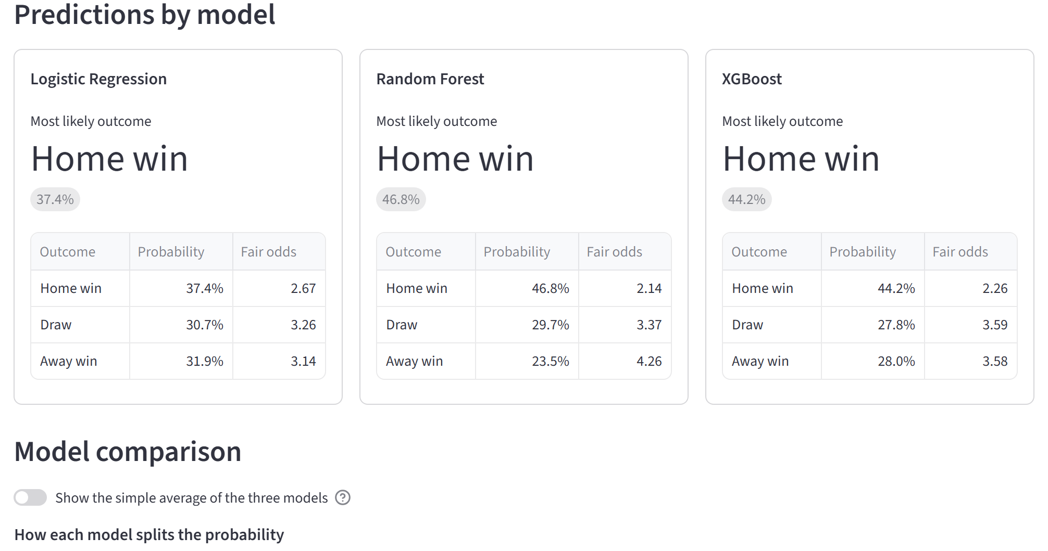
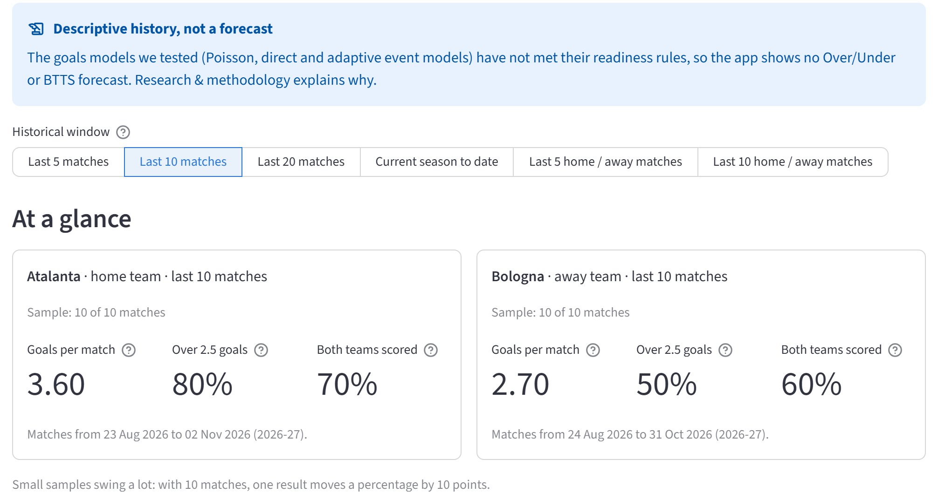
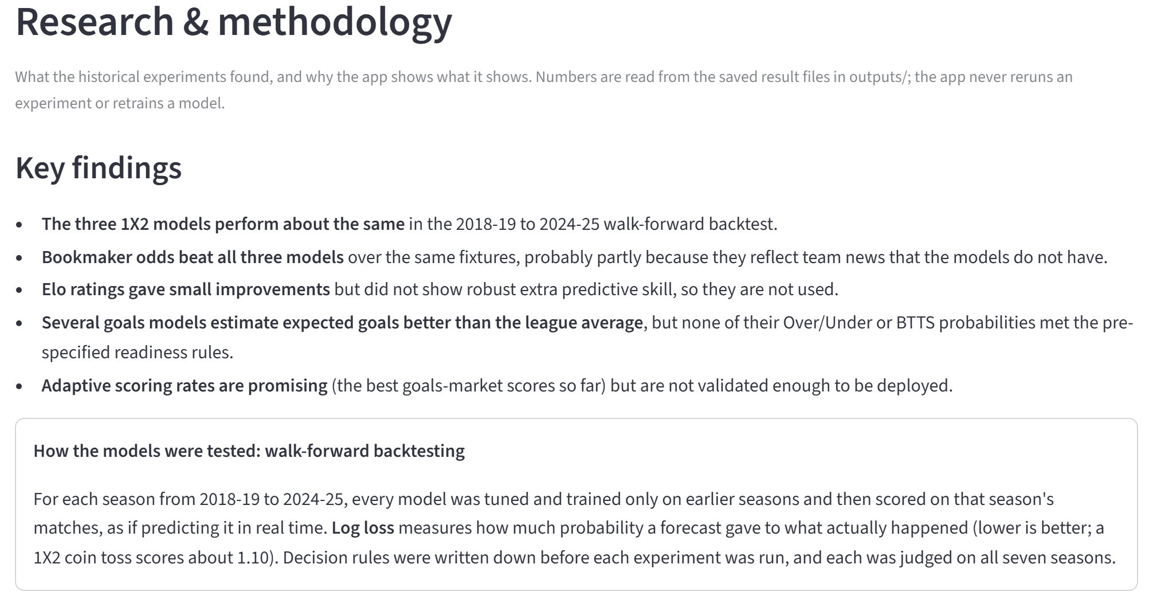
An app that is honest about what it knows
10 THE STREAMLIT APPLICATION
Match predictions
Goals & BTTS history
Research & methodology
model output
descriptive, not a forecast
the evidence, including what isn't used
Freshness
Honest demos
No hidden models
Shows the latest match date; warns when data is over 10 days old
Replays past matches as they looked that morning, and flags training seasons
No unvalidated forecasts; the app never retrains anything
Notes:
Everything we learned ends up in a Streamlit app with three tabs that keep three kinds of content apart.
Match predictions: pick two clubs and a date and see each model's probabilities, the fair odds they imply, and where the models disagree. The fixture's 50 features are rebuilt from matches before that date, using the same code as the training data.
Goals and BTTS history: each club's recent goal record. It's clearly labelled as history, not a forecast, because the goal models didn't pass their rules.
Research and methodology: the evidence from this talk, read straight from the saved result files, including why Elo and the goal models aren't used.
And some safeguards. The latest match date is always visible, and a warning appears when the data is more than 10 days old or the fixture is far beyond it. Historical demo mode replays any past match as it looked that morning, and warns when that season was used for training. The app never retrains anything.
Behind it: 436 automated tests, from leakage checks to the app's layout, and rebuilding everything from a fresh copy of the repository reproduced the published results.
Transition: so, what did thirty years of Serie A teach us?

Slide 12
What worked, what didn't, what we learned
CONCLUSIONS
What worked
What didn't
What we learned
Leakage-safe features, tested
Models beat the baseline in every season
A fair, reusable testing framework
Expected goals
Beating the bookmaker
Picking draws as the most likely outcome
Elo and recency: gains not confirmed
Over/Under and BTTS probabilities
The algorithm barely mattered
Seasons vary more than models
Accuracy can mislead; score probabilities
Write the rule before you look
Next: test the leading candidates on seasons they have never seen, and add new information such as line-ups.
Notes:
Three columns to finish.
What worked: a leakage-safe pipeline from thirty years of messy spreadsheets; models that beat the baseline by about 0.11 log loss in every season; a testing framework that makes the next idea cheap to test and hard to fool ourselves with; and good expected-goals estimates.
What didn't: we didn't beat the bookmaker, which stayed about 0.02 ahead. Draws are rarely anyone's most likely outcome. The Elo and recency gains weren't confirmed, and no Over/Under or both-teams-to-score model was good enough to ship.
What we learned: information most likely matters more than algorithms, because three very different models gave almost the same answer. Seasons vary more than models, so one season can flatter or sink any model. Accuracy can mislead, so score the probabilities. And write the rule before you look, so exploratory gains don't turn into false discoveries.
Next: test Random Forest with Elo and the adaptive goal frequency on seasons they've never seen, and add information such as line-ups.
Thank you. Happy to take questions.

