Slide 1
A fancy QCD thing
By cool people

Slide 2
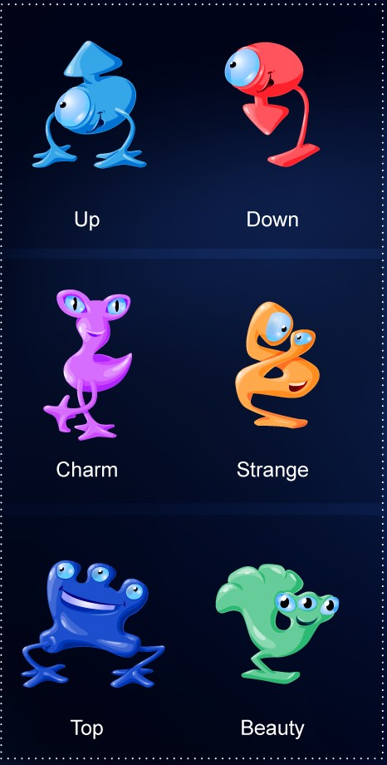
There are only 6 Quarks, but a huge „ZOO“ of hadrons.
pions
kaons
mesons
J/Ψ
many others...
protons,
neutrons
Baryons
many others...
Λ-resonances
tetraquarks, pentaquarks,
other hypotheticals

Slide 3
The PDG delivers the quark komposition, spin properties and much more for given hadrons.
Our program kan also work into the other way direction:
Input:
Output:
number of quarks
Flavours
Spins
Colours
Quark or antiquark
Possible QCD bound
states/hadrons with
their properties
Output:
Input:
Didactical tool
Use as a reference tool
Easy to handle, but physical: Not a toy, but can be used as one

Slide 4
Advantages:
Not just a listing, but works with physical values
The code can easily be extended
Possible extensions:
Not only QCD bound states by including leptons: Positronium, Atoms...
Particle decays

