Slide 1

Node Messenger
Shardool Patel | Tasin Ahmed | Omar Elemary

Slide 2
Problem Overview
Many invasive chat apps on the market.
Need for a simple and non-intrusive solution.
Need for a solution that can constantly evolve.
?

Slide 3

Solution
Node Messenger is very simple to use.
Node Messenger does not collect user data.
Node Messenger is open source.

Slide 4
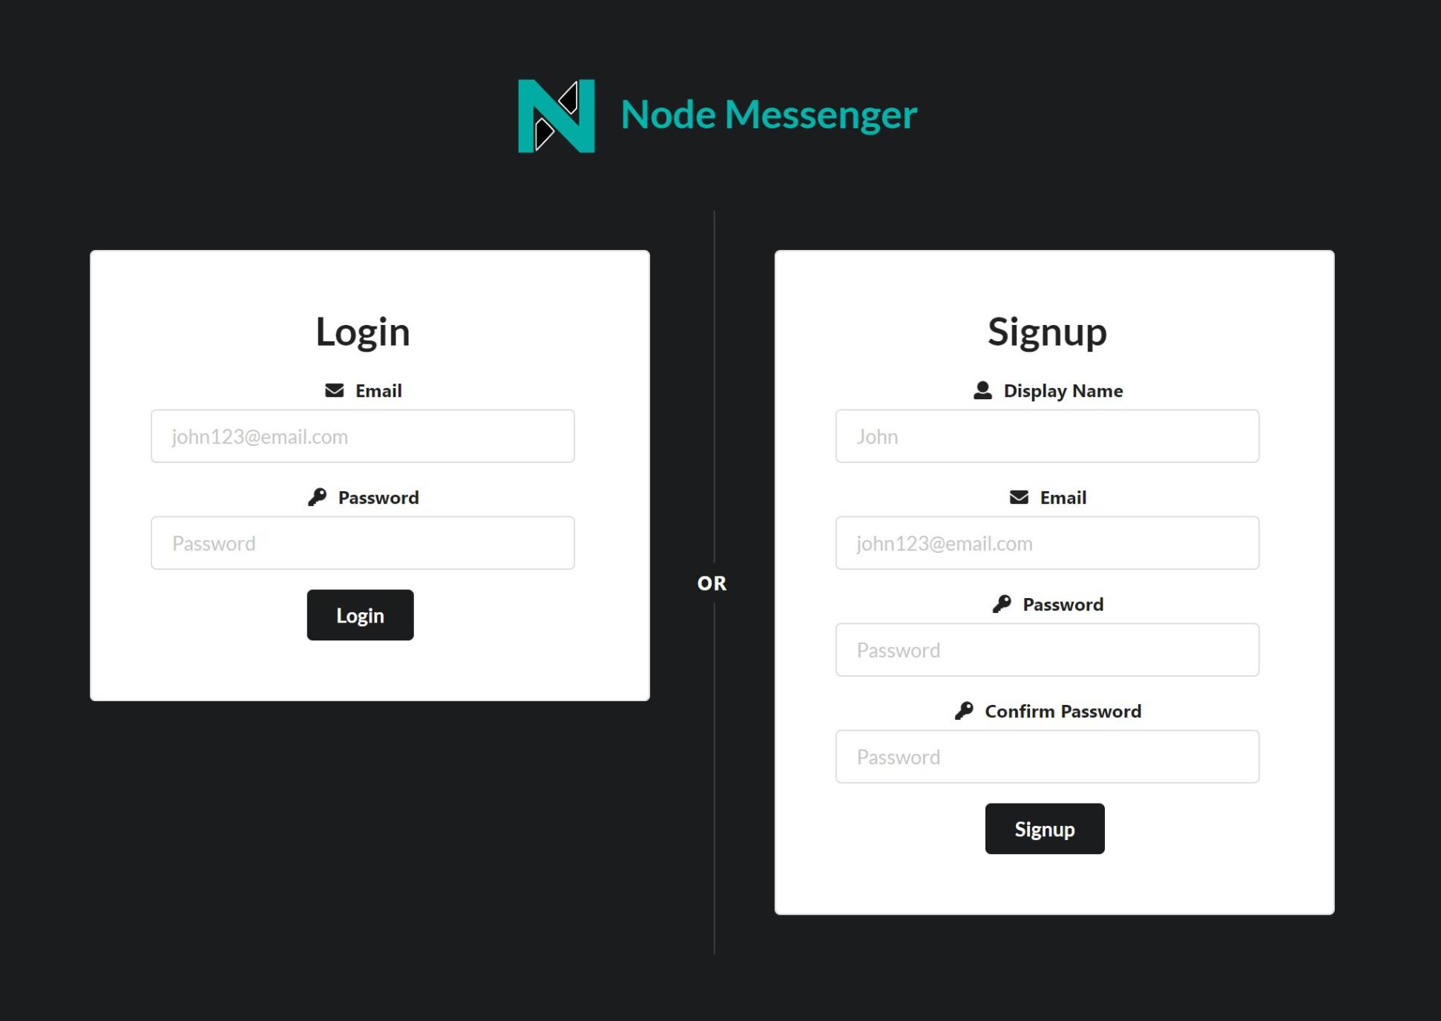
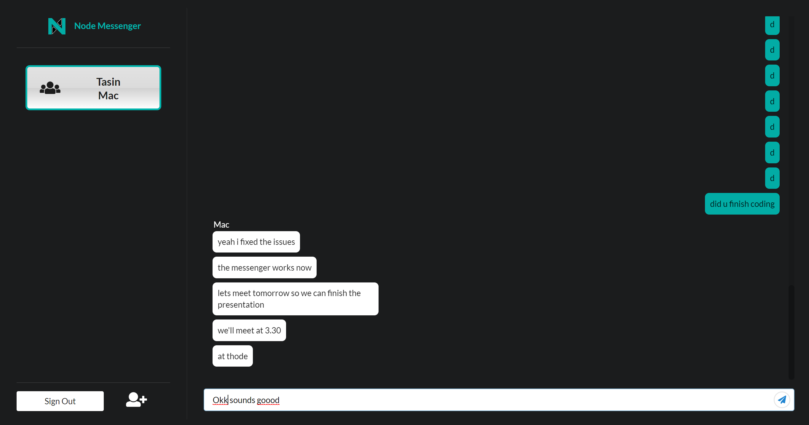
Node Messenger Explained

Slide 5

Demonstration!
Signup feature
Login feature
Create conversation
Messaging

Slide 6

Conclusion
Node Messenger has a clean interface.
Node Messenger does not store unnecessary user info.
Node Messenger is responsive and easy to use.
Node Messenger supports instant messaging & group chats.
Node Messenger supports a large number of users.

Slide 7

Questions?

