Slide 1
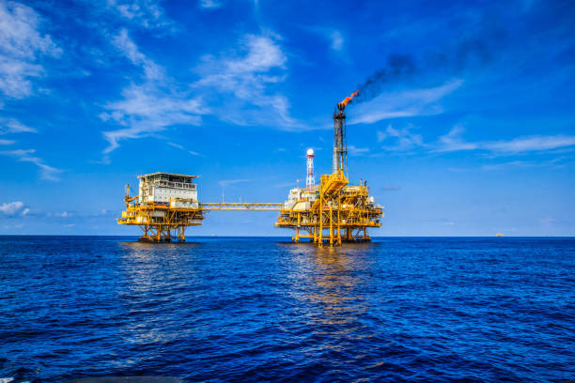

Prediction of Oil, Gas & Water Production in the DSEATS Field Using Machine Learning
Samuel Elema
SPE number: 5742059
July 2024
SPE Section: Port Harcourt, Nigeria
Category: Student
Course of Study: Electronic/Computer Engineering
School: University of Port Harcourt

Slide 2


Data
Exploration
2

Slide 3

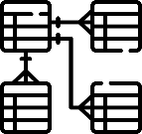

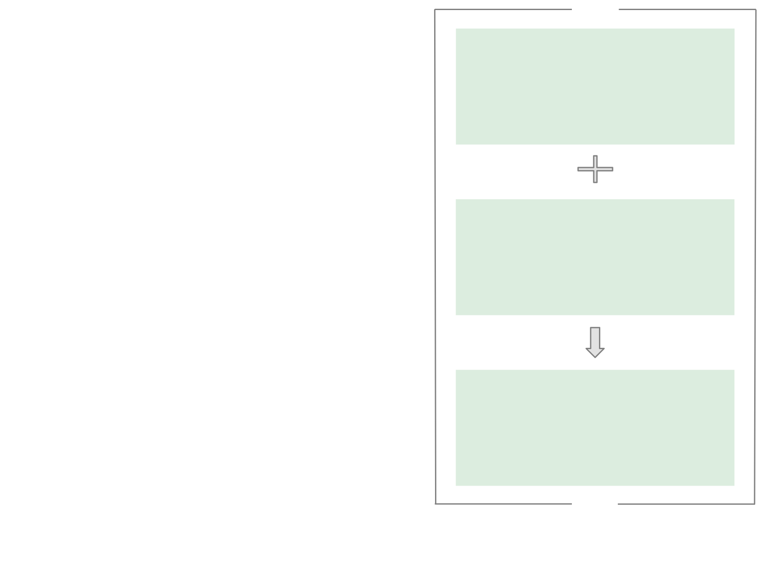




The Objective is to Predict Oil, Gas and Water Production with RMSE, R², MAE and MSE
Over 10 Columns:
Information about Wells
Random Forest
Regressor
Well Bore Code
Well Bore Name
Output Variable: Oil, Gas and Water
Production
Flow Kind
. . .
Random Forest Regressor
Downhole Pressure in PSI
Downhole Temperature in Kelvin
Choke Size
3
4

Slide 4



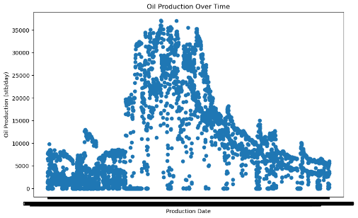
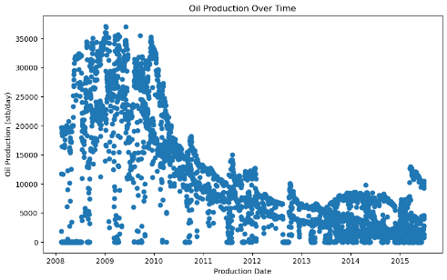
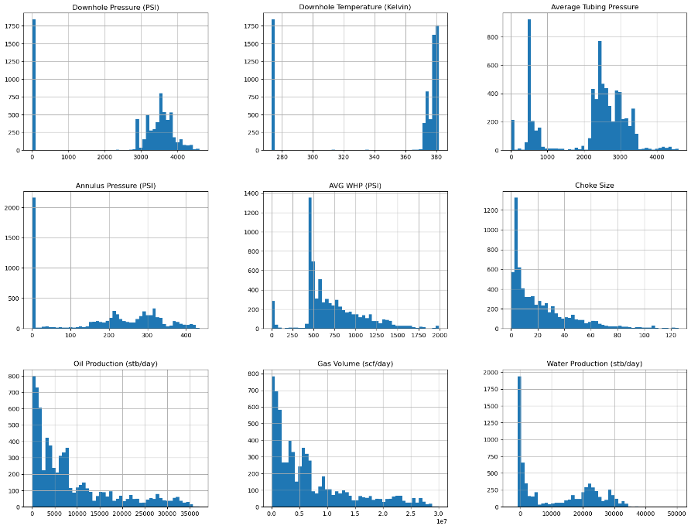




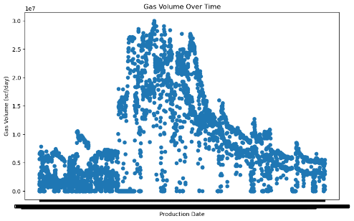
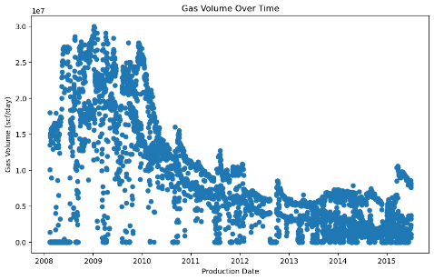
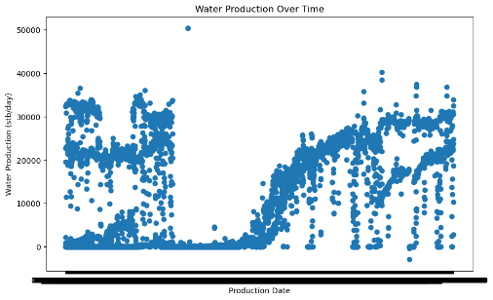
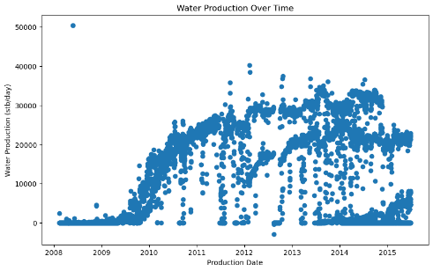
Data Exploration
Exploration of dataset is the foundation of the following pre-processing and modeling
Distributions of variables
Before Parsing Dates
After Parsing Dates
Parsing of dates to enrich the time and date component
4

Slide 5




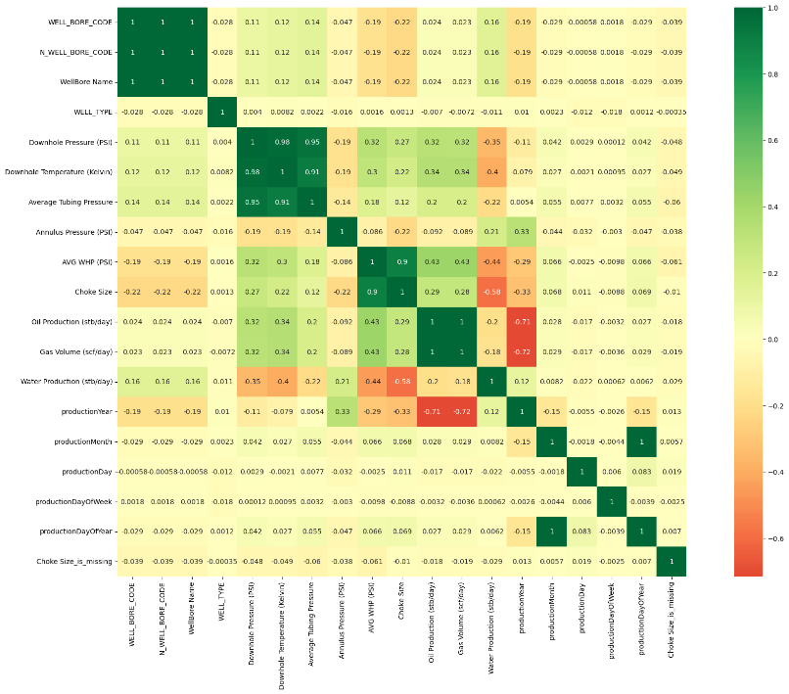

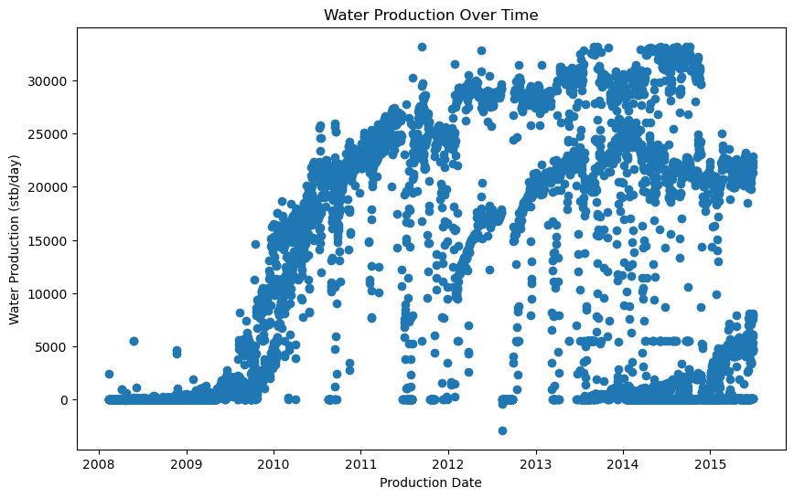
Dealing with Outliers
Filter out outliers in Water Production and replace them with the median.
Correlation Check
Check important features with high correlation with our target
5

Slide 6
Feature
Engineering
6

Slide 7
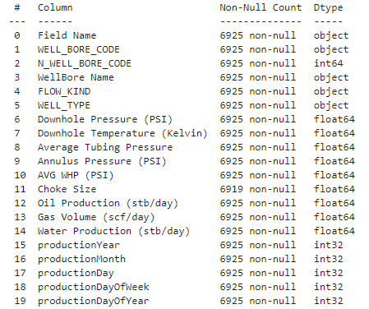
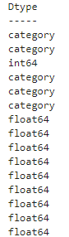
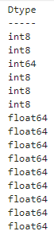






Converting Strings to Categories and then to Numbers
Pseudo Missing Values
Features
Group
Imputation
If data type is string
Convert to categories
If data type is not numeric
Turn categories into numbers
7

Slide 8
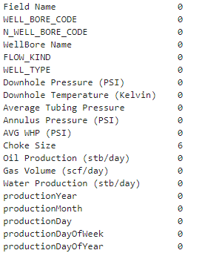
Dealing with Missing Values
Column:
Choke Size
Indexes:
[452, 454, 465, 468, 469, 472]
Fill missing numeric values with median
+
Add a binary column which tells us if the data is missing or not
No Garage
8

Slide 9
Model
Evaluation
9

Slide 10
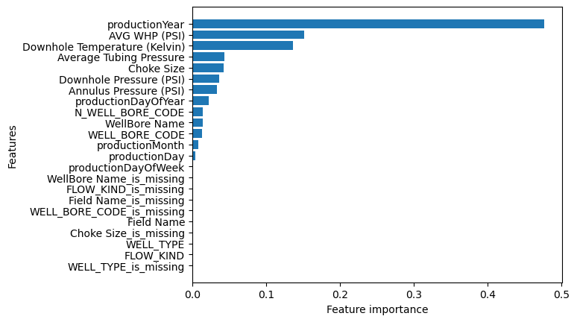



Prediction by Random Forest Regressor
Hyperparameter tuning with RandomizedSearchCV
Random Forest Regressor
MAE before hyperparameter tuning is 179663.418
RMSE before hyperparameter tuning is 502616.45
MSE before hyperparameter tuning is 753348032589.6094
R^2 before hyperparameter tuning is 0.95199
-------------------------------------------------------------------------
MAE after hyperparameter tuning is 180145.861
RMSE after hyperparameter tuning is 494302.55
MSE after hyperparameter tuning is 728676035585.3427
R^2 after hyperparameter tuning is 0.954168
Feature Importance Score:
Most important attributes
10

