Slide 1


Prediction of Oil, Gas &
Water Production in the DSEATS Field Using Machine Learning
Elema Samuel Obinna
SPE number: 5742059
July 2024
SPE Section: Port Harcourt, Nigeria
Category: Student
Course of Study: Electronic/Computer Engineering
School: University of Port Harcourt

Slide 2


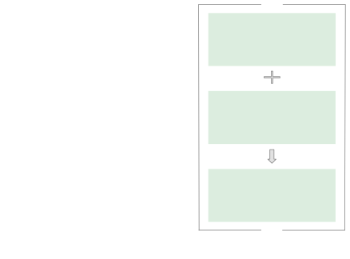


The Purpose is to Predict Oil, Gas and Water Production with RMSE, R², MAE and MSE
Over 10 Columns:
Information about Wells
Random Forest
Regressor
Well Bore Code
Well Bore Name
Flow Kind
Output Variable: Oil, Gas and Water
. . .
Random Forest Regressor
Production
Downhole Pressure in PSI
Downhole Temperature in Kelvin
Choke Size
4

Slide 3


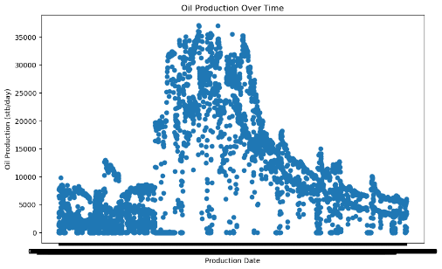
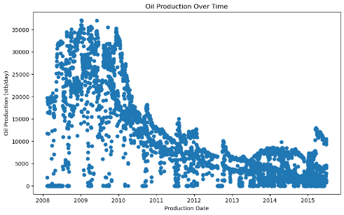



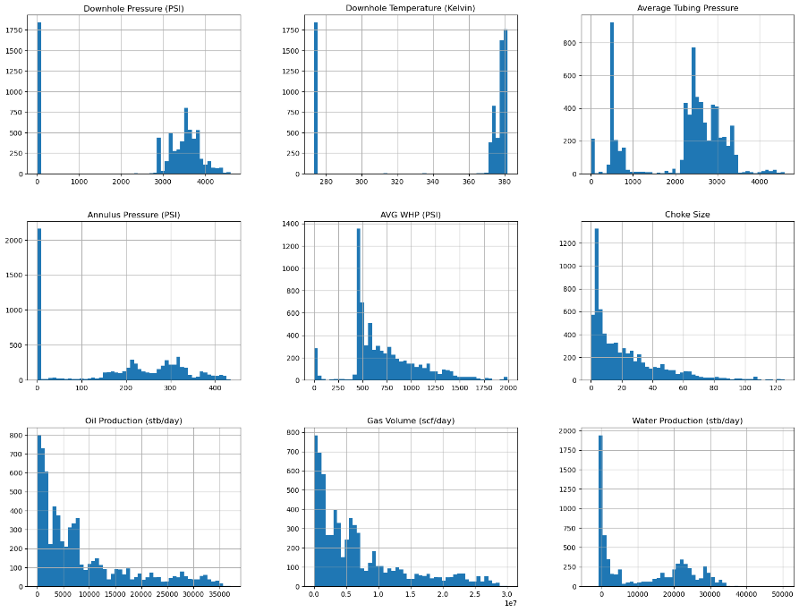
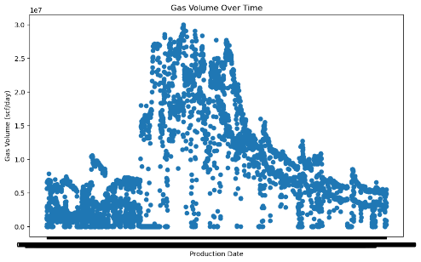
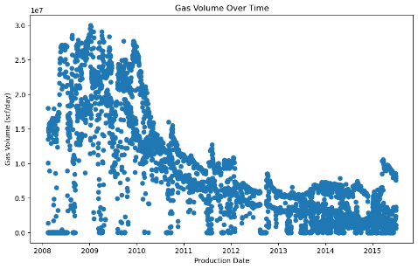
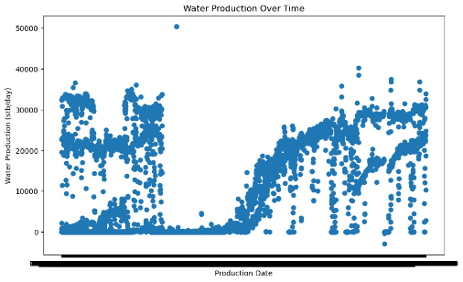
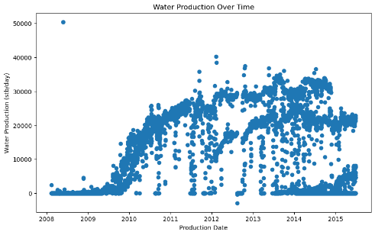

Data Exploration
Exploration of dataset is the foundation of the following pre-processing and modeling
Before Parsing Dates
After Parsing Dates
Distributions of variables
Parsing of dates to enrich the time and date component
7

Slide 4

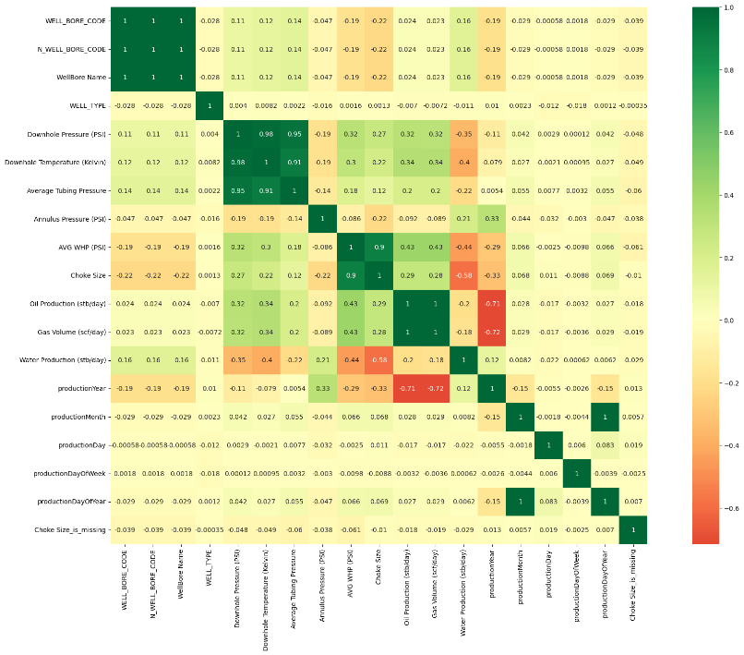

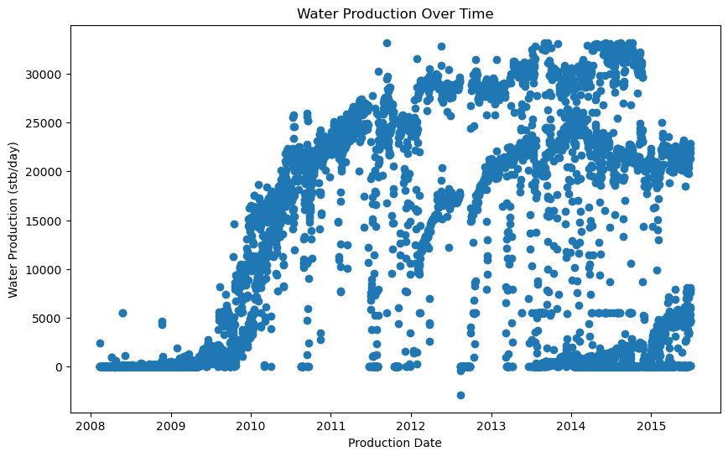
Dealing with Outliers
Filter out outliers in Water Production and replace them with the median.
Correlation Check
Check important features with high correlation with our target
7

Slide 5

Feature Engineering
12

Slide 6
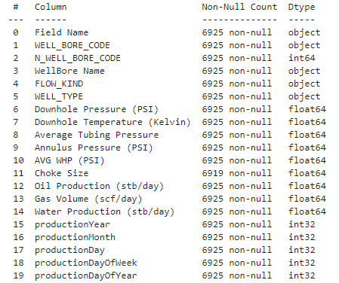
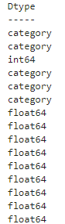
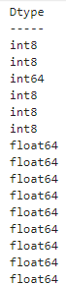




Converting Strings to Categories and then to Numbers
Pseudo Missing Values
Features
Group
Imputation
If data type is string
Convert to categories
If data type is not numeric
Turn categories into numbers

Slide 7
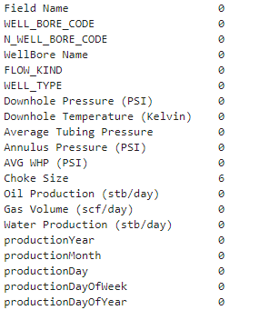


Dealing with Missing Values
Fill missing numeric values with median
+
Add a binary column which tells us if the data is missing or not
Column:
Choke Size
Indexes:
[452, 454, 465, 468, 469, 472]
No Garage
11

Slide 8

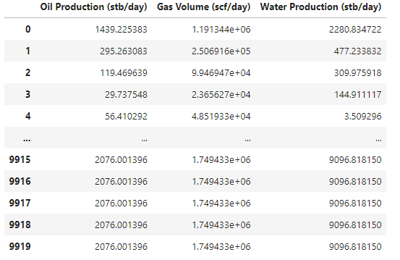



Prediction by Random Forest Regressor
Hyperparameter tuning with RandomizedSearchCV
Random Forest Regressor
MAE before hyperparameter tuning is 179663.418
RMSE before hyperparameter tuning is 502616.45
MSE before hyperparameter tuning is 753348032589.6094
R^2 before hyperparameter tuning is 0.95199
-------------------------------------------------------------------------
MAE after hyperparameter tuning is 180145.861
RMSE after hyperparameter tuning is 494302.55
MSE after hyperparameter tuning is 728676035585.3427
R^2 after hyperparameter tuning is 0.954168
22

Slide 9
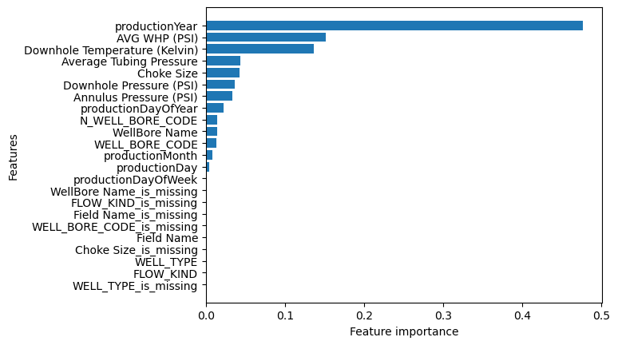


Feature Importance Score
Most important attributes of the data
23

Slide 10

Thank you!
25

