Slide 1

PPTX test file
Purpose: Provide example of this file type
Document file type: PPTX
Version: 1.0
Remark: Including some simple transitions
File created by https://www.online-convert.com
More example files: https://www.online-convert.com/file-type
Text of “Example content”: Wikipedia (https://en.wikipedia.org/wiki/John_Doe)
License: Attribution-ShareAlike 3.0 Unported
(https://creativecommons.org/licenses/by-sa/3.0/)
Feel free to use and share the file according to the license above.
Notes:
1

Slide 2
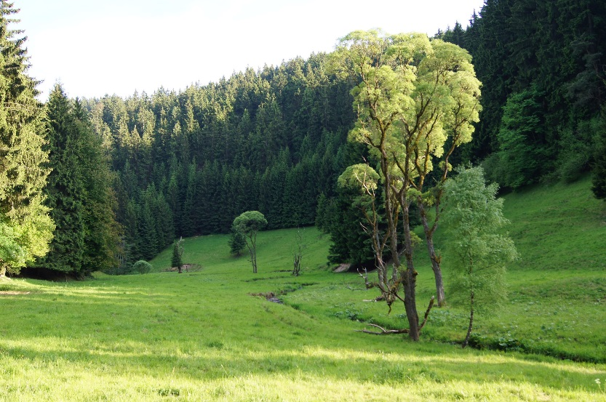
Example content:
The names "John Doe" for males, "Jane Doe" or "Jane Roe" for females, or "Jonnie Doe" and "Janie Doe" for children, or just "Doe" non-gender-specifically are used as placeholder names for a party whose true identity is unknown or must be withheld in a legal action, case, or discussion. The names are also used to refer to a corpse or hospital patient whose identity is unknown. This practice is widely used in the United States and Canada, but is rarely used in other English-speaking countries including the United Kingdom itself, from where the use of "John Doe" in a legal context originates.
Notes:
1

